Slide 1
Produced Water: From Feedstock to Infrastructure
Dr. Chad Unrau
Vice President, Beneficial Reuse & Industrial Water
The Energy Council
The Produced Water/Energy-Water Nexus
September 25, 2026

Slide 2
WES manages water at midstream scale
Produced water is not a theoretical issue for Western Midstream (WES). As a three-stream midstream operator, we manage it every day - at significant scale.
>3 million barrels/day
produced water managed
Gas | Oil | Water
true three-stream midstream operator
Integrated Delaware Basin Network
produced water operations across Texas & New Mexico
2

Slide 3
Declining pore space is tightening disposal capacity, while drought and growing demand are putting pressure on traditional water supplies.
From produced water to water feedstock
Produced Water
Treatment
Reclaimed Freshwater
Fit-For-Purpose Use
  A consistent, large-volume resource
  Using both proven and advancing technologies
  Treated to meet specific quality requirements
  Oil and gas reuse, power generation, data centers, industrial applications, surface discharge, land application
The opportunity: turn an existing water stream into a potential new supply.
3

Slide 4
Real-world applications. Growing demand. Increasing momentum.
Where reclaimed freshwater can create value
ESTABLISHED
EMERGING
ADVANCING
Oil and Gas Reuse
Existing demand and infrastructure
Power Generation
Growing need for reliable, low-stress water supplies
Data Centers/High-Performance Cooling
Large-volume cooling water demand in the region
Surface Discharge
Regulatory pathways and applications advancing
Land Application
Growing interest and continued research
Different uses require different water quality, infrastructure and economics.
4

Slide 5
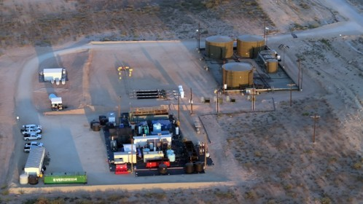
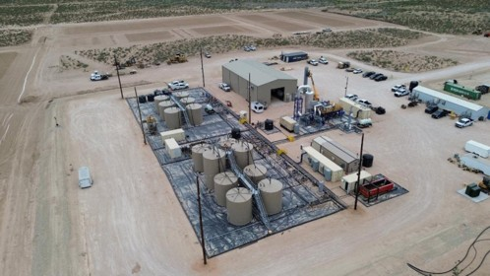
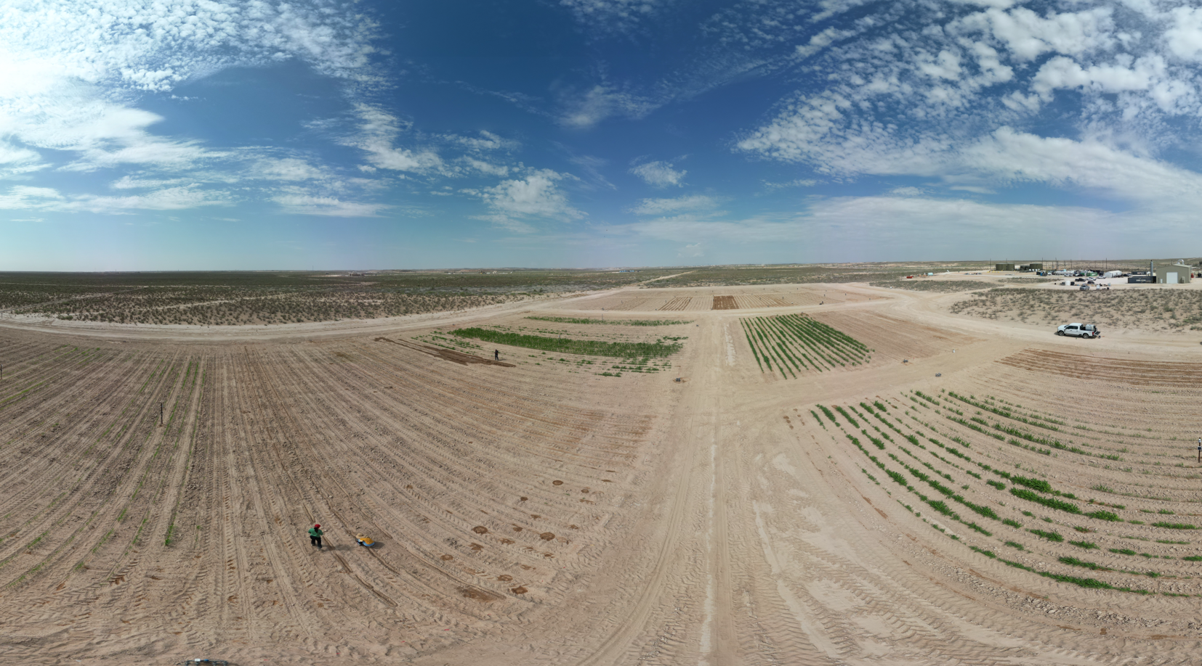
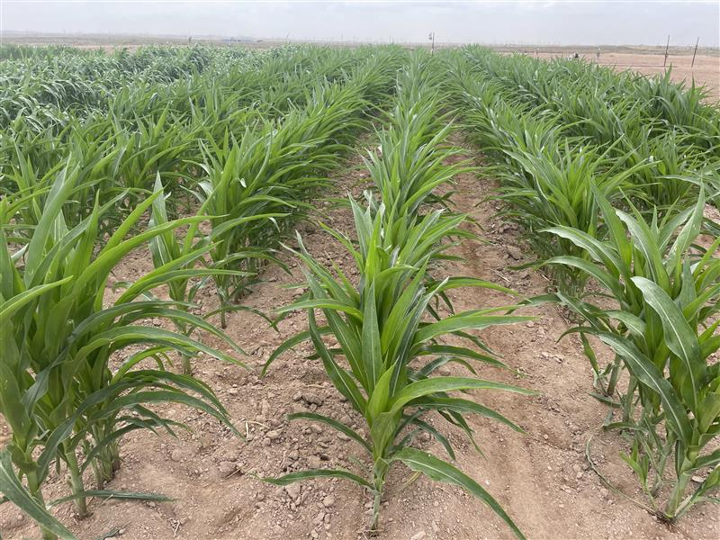
Building on proven performance to learn what it takes to operate at scale
From demonstration to commercial scale
10X Scale Up
JIP 1: PROVE
JIP 2: SCALE
APPLY
10X scale-up; 2,000 BPD feed
~1,000 BPD reclaimed freshwater
7-acre agricultural research site
The question is no longer whether produced water can be treated – it is whether treatment can be delivered reliably and economically at commercial scale.
~100 BPD pilot
~7-acre agricultural research study
Evaluating reclaimed freshwater in a defined, non-consumptive research setting with Texas Tech and Texas A&M partners.
5

Slide 6
Scaling treatment means closing the gap
We know we can treat the water – this opportunity is treating it competitively at scale.
TODAY
WHAT IS CHANGING
PATH TO SCALE
  Established infrastructure
  Lower-cost option in some areas
  Tighter capacity
  More restrictions
  in some areas
  Greater scrutiny
  Larger facilities
  Economies of scale
  Technology optimization
As disposal becomes more constrained, scale can make beneficial reuse increasingly competitive.
Footnotes Section
~7-acre agricultural research study
Evaluating reclaimed freshwater in a defined, non-consumptive research setting with Texas Tech and Texas A&M partners.
6

Slide 7
Creating a viable path to scale
States do not need to pick the technology - but they can help create the conditions for commercialization.
CLEAR PATHWAYS
FIT-FOR-PURPOSE STANDARDS
FIRST-OF-KIND DEPLOYMENT
ECONOMIC SIGNALS
  Regulatory certainty for new uses
  Requirements tied to intended use
  Room to demonstrate, learn, and de-risk
  Consider where incentives can help close the gap
~7-acre agricultural research study
Evaluating reclaimed freshwater in a defined, non-consumptive research setting with Texas Tech and Texas A&M partners.
7

Slide 8
A rare opportunity – if we do it right
The opportunity is to create value across all three.
COMMUNITY
  New water options and reduced pressure on traditional supplies
ENVIRONMENT
  Potential to reduce disposal dependence and create beneficial uses
INDUSTRY
  A more resilient, diversified water-management system
~7-acre agricultural research study
Evaluating reclaimed freshwater in a defined, non-consumptive research setting with Texas Tech and Texas A&M partners.
8

Slide 9
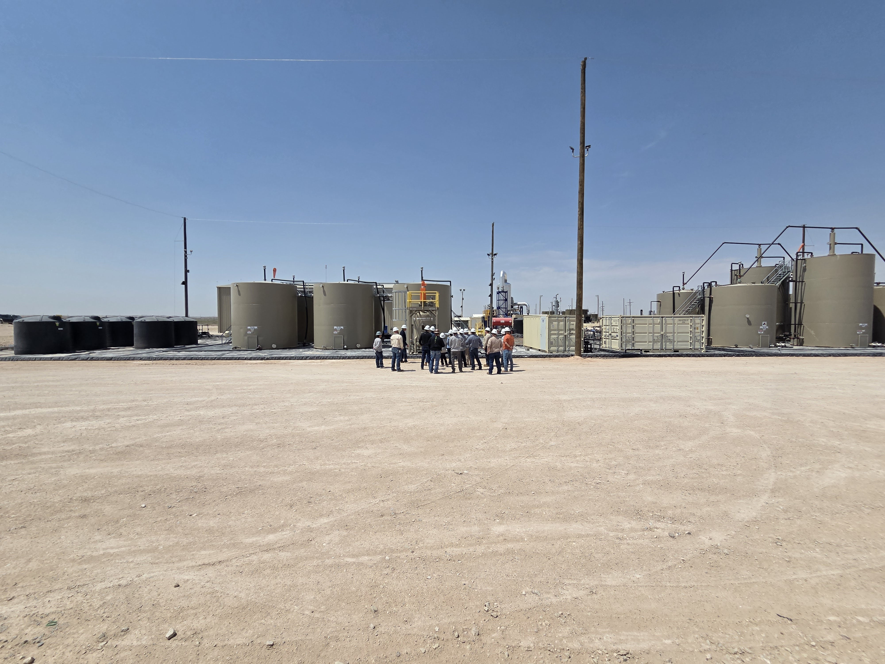
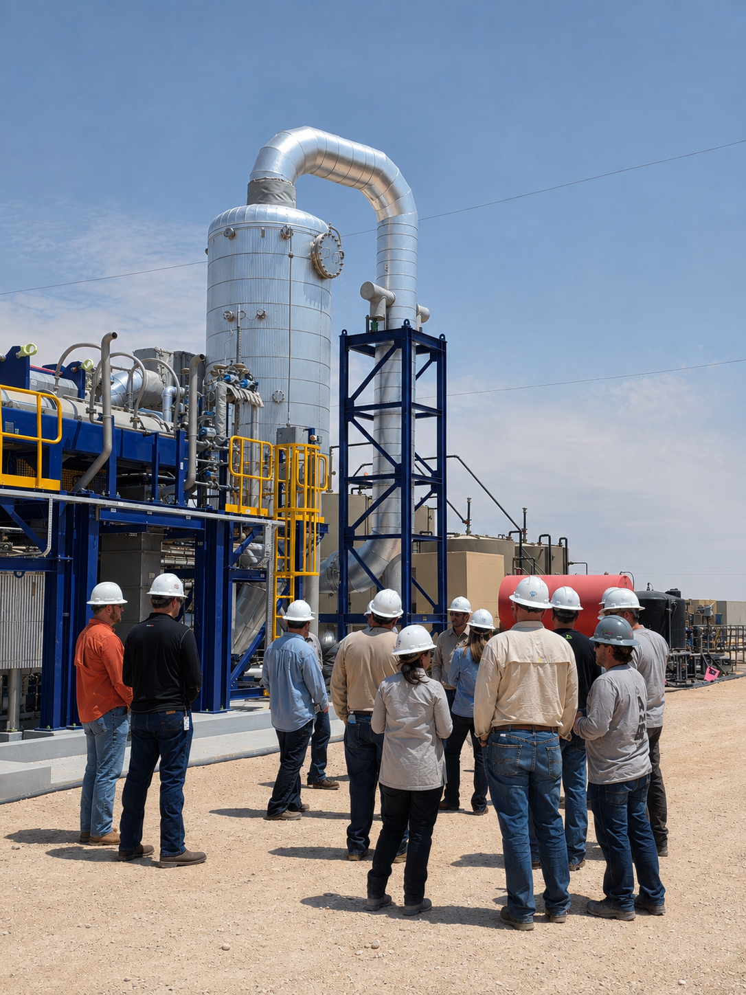
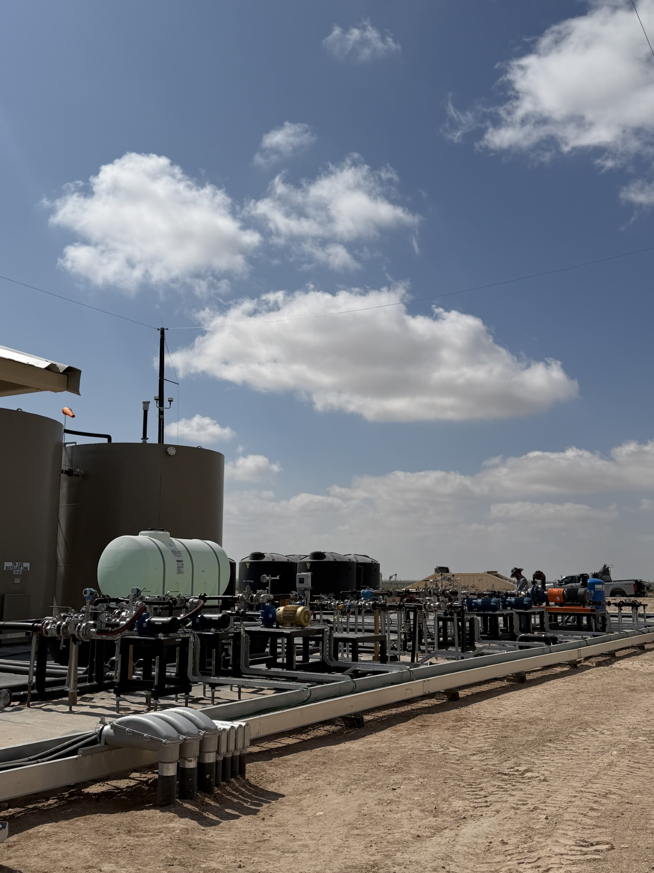
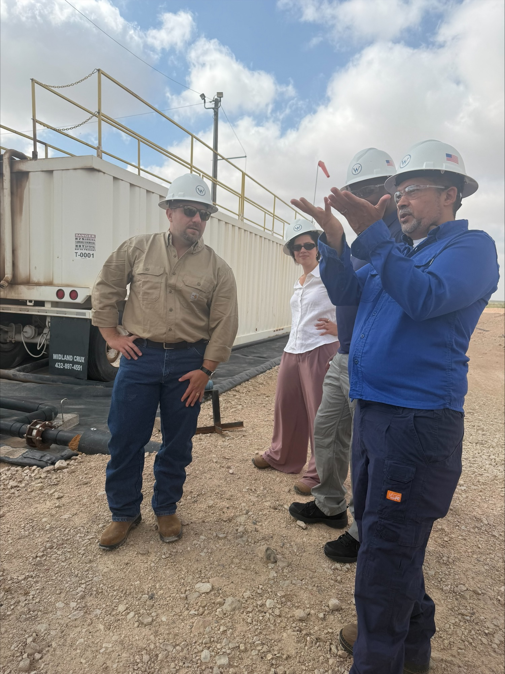
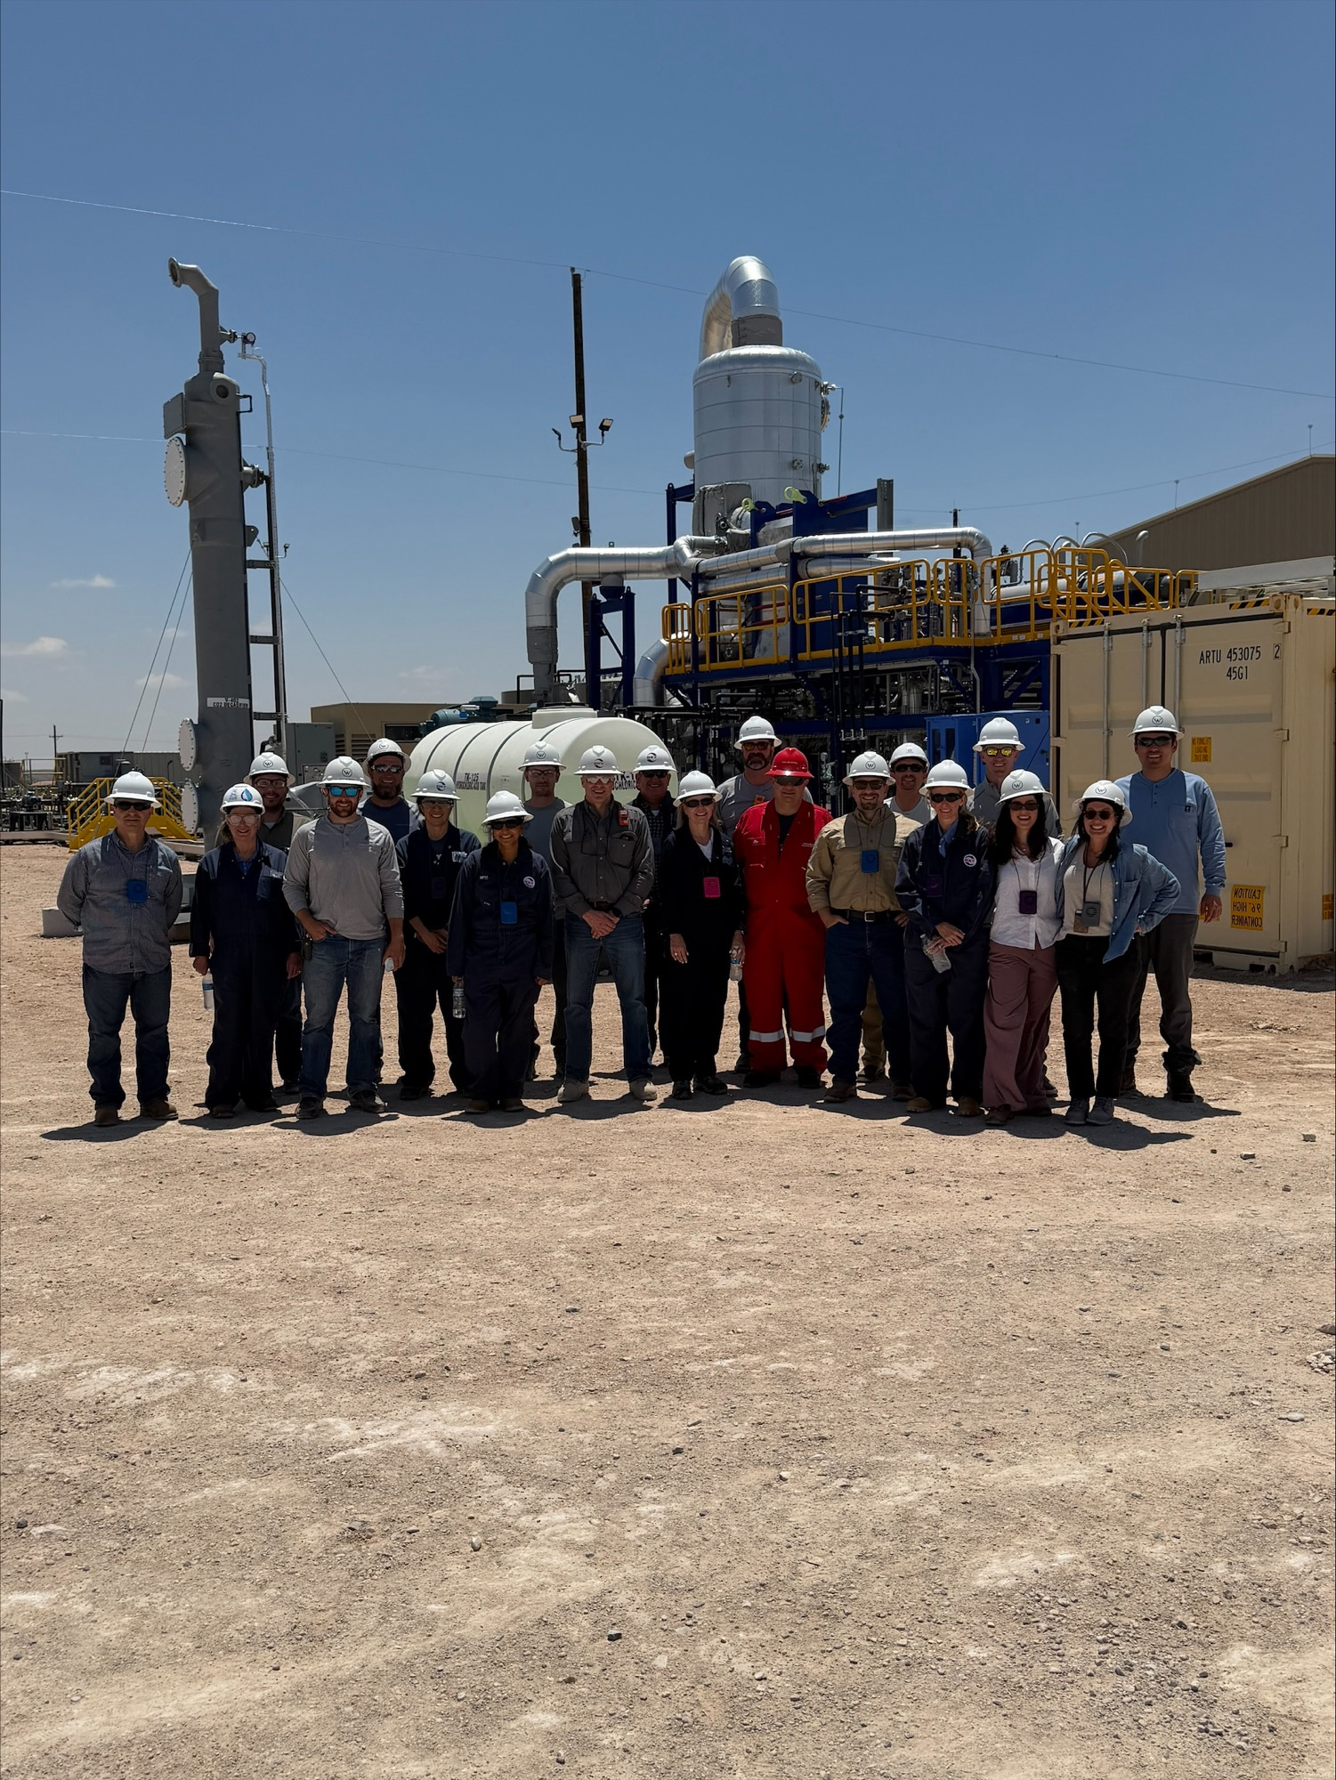
Water is about trust – data and transparency is how we earn it.
Questions?
~7-acre agricultural research study
Evaluating reclaimed freshwater in a defined, non-consumptive research setting with Texas Tech and Texas A&M partners.
9

