Slide 2
Produced Water in New Mexico: An Overview of the State of the Science
2026 Energy Council Meeting – Albuquerque, NM
Zachary Stoll, Ph.D.
Assistant Director
New Mexico Produced Water Research Consortium
at New Mexico State University
Friday September 25th, 2026
Disclaimer: The New Mexico Produced Water Research Consortium at New Mexico State University is conducting independent, science-based research to evaluate potential environmental and health effects related to the reuse of treated produced water for fit-for-purpose applications. This work is designed to generate objective data under controlled conditions, without promoting or opposing any specific reuse practices. Our goal is to provide clear, reliable information that supports informed decision-making around the safe and responsible use of produced water in New Mexico and beyond.
This presentation includes preliminary research data from the New Mexico Produced Water Research Consortium at New Mexico State University. The information presented is subject to change and has not yet undergone formal quality assurance or quality control (QA/QC) review. Distribution or sharing of this material without prior authorization from New Mexico State University is not permitted.
Notes:
Good morning, and thank you for the opportunity to be here.
I’m Zach Stoll, Assistant Director of the New Mexico Produced Water Research Consortium at New Mexico State University.
I recognize there are very different perspectives on produced water and its potential reuse.
Our role at the Consortium is not to advocate for or against reuse. Our job is to conduct independent research and put the best available science in front of decision-makers.
Today I want to give you a high-level picture of what produced water is, why we’re studying it, what the research actually tells, and—equally importantly—what we still don’t know.

Slide 3
Outline
Why are we talking about produced water (PW)?
Can PW be treated a level that is protective of human health and the environment?
What have we learned?
What current gaps and outstanding research questions still remain?
Notes:
I’m going to answer four basic questions.
Why are we talking about produced water in the first place?
Can we treat it to a level that is protective of human health and the environment?
What have we learned from all of this?
And what are the major questions that still need to be answered?
Transition: Before talking about produced water, I want to start with the larger reason this conversation is happening: water.

Slide 4
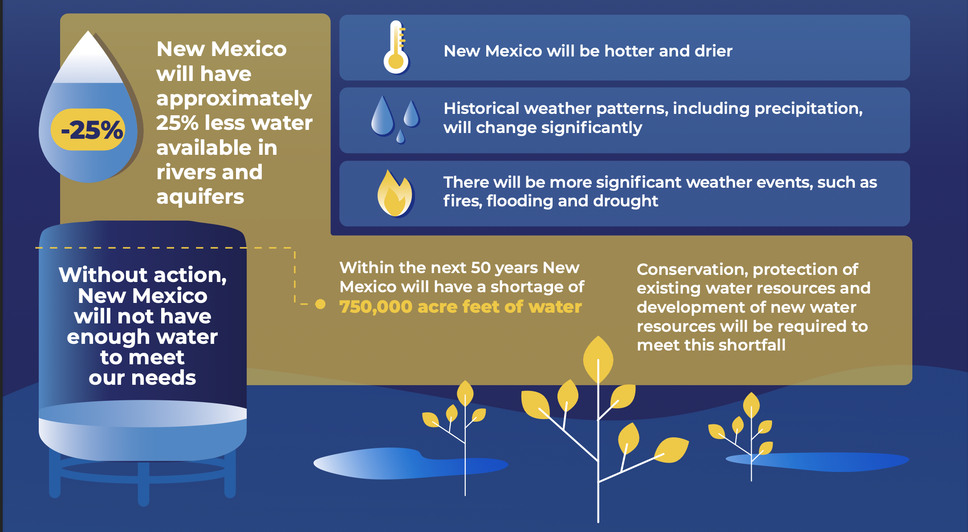
Over the Next 50 Years, Scientists Say…
Source: https://www.nm.gov/wp-content/uploads/2024/01/New-Mexico-50-Year-WaterAction-Plan.pdf
Notes:
New Mexico’s 50-Year Water Action Plan projects substantially less available water over the coming decades.
Regardless of the exact number, the broader message is straightforward: New Mexico is a water-limited state, and that constraint is expected to become more significant.
That means conservation remains important, but it also creates a reason to investigate alternative water supplies that could offset freshwater demand.
Produced water is one of those potential alternative waters, along with brackish groundwater and recycled municipal water.
Transition: To understand where alternative water might fit, it helps to understand where we’re currently using water.

Slide 5
Surface and Groundwater Use by Sector (2020 NM OSE)
Source: https://mainstreamnm.org/wp-content/uploads/2025/01/2020-Water-Use-By-Categories-2020_final_printable.pdf
Notes:
Surface and GW use by sector.
The point is that the projected water challenge is larger than something we can address through municipal conservation or recycling alone.
We should therefore be thinking broadly about where alternative water sources might appropriately offset freshwater.

Slide 6
Produced Water 101
Pump Jack
Oil and Gas sent to Processing
Produced water is primarily naturally occurring formation water that has been trapped underground alongside oil and gas (O&G) for millions of years, taking on the chemical characteristics of the surrounding geology.
It also includes flowback water and other fluids associated with O&G production.
Currently, PW is either reused inside the O&G field or injected deep underground.
Separator
Tank
Gas
PW is sent to Disposal Well or reused within O&G field
Disposal Well
Oil
PW
Well with Casing
Freshwater Aquifer
Oil, Gas, and PW flow out
Confining Rock Layers
Oil and Gas rich layer
Fractures
PW is reinjected deep into the subsurface
in porous, non-oil and gas producing zones
Notes:
Before getting too far into the presentation, I wanted to level set and define PW.
Oil and gas aren’t sitting underground in a giant pool. They’re contained within geologic formations along with naturally occurring formation water.
In unconventional production, the formation is hydraulically fractured, and oil, gas and water subsequently come back to the surface.
At the surface, those streams are separated.
The oil and gas become products. The water becomes something that has to be managed.
Produced water therefore includes naturally occurring formation water as well as water associated with the production process.
In the Permian Basin it can be several times saltier than seawater and contain hydrocarbons, metals, naturally occurring radioactive materials, ammonia and other constituents.
So when we talk about beneficial reuse, we are absolutely not talking about taking raw produced water and applying it somewhere.

Slide 7
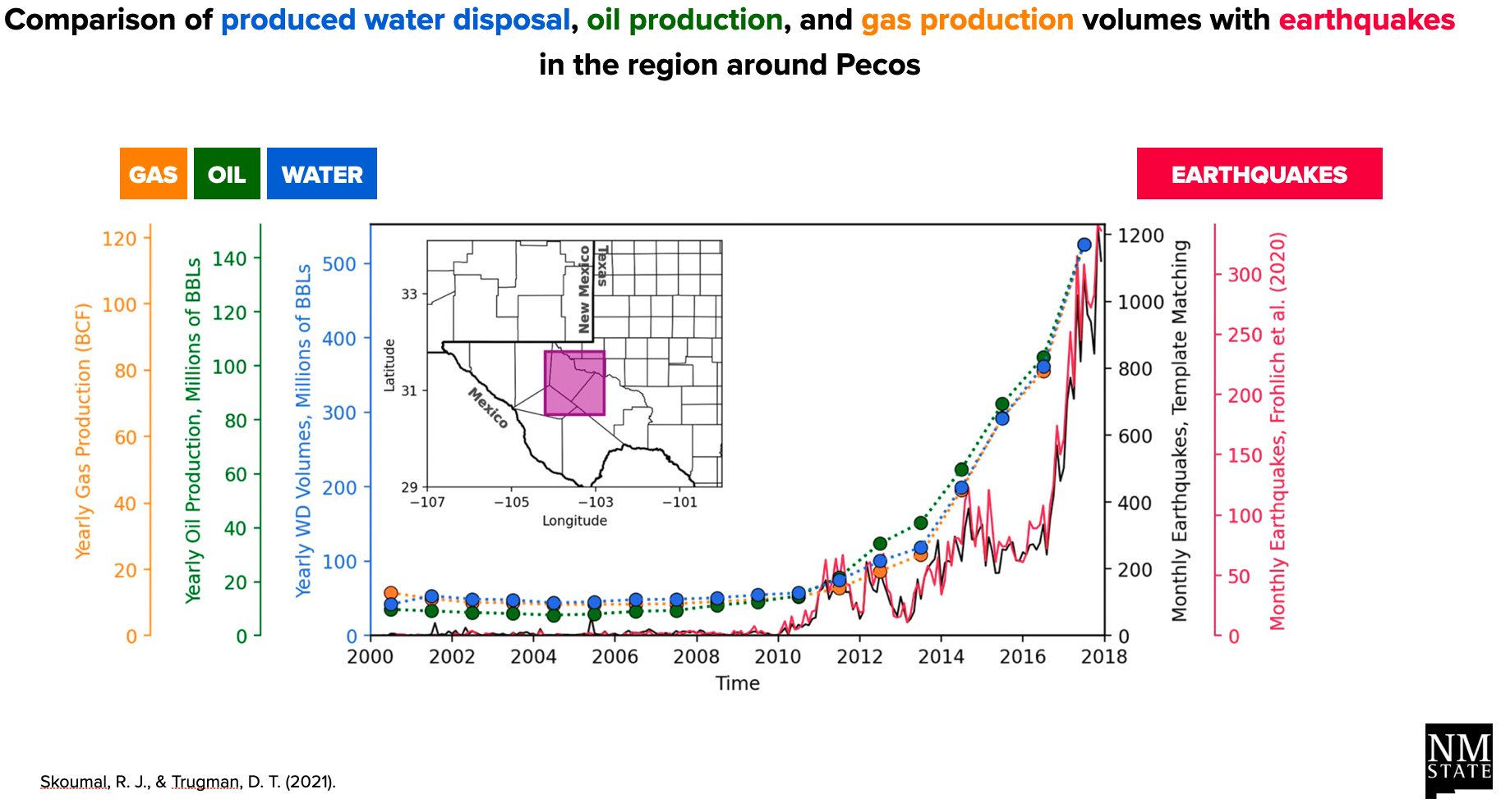
Why Can’t We Just Keep Injecting?
Notes:
Historically, the primary management option has been deep-well injection.
Injection remains an important management tool, but there are reasons to investigate additional options.
Those include disposal capacity, transportation requirements, costs, and induced-seismicity concerns in some areas.
So the question isn’t whether injection disappears. The question is whether treatment can create additional responsible management options.

Slide 8
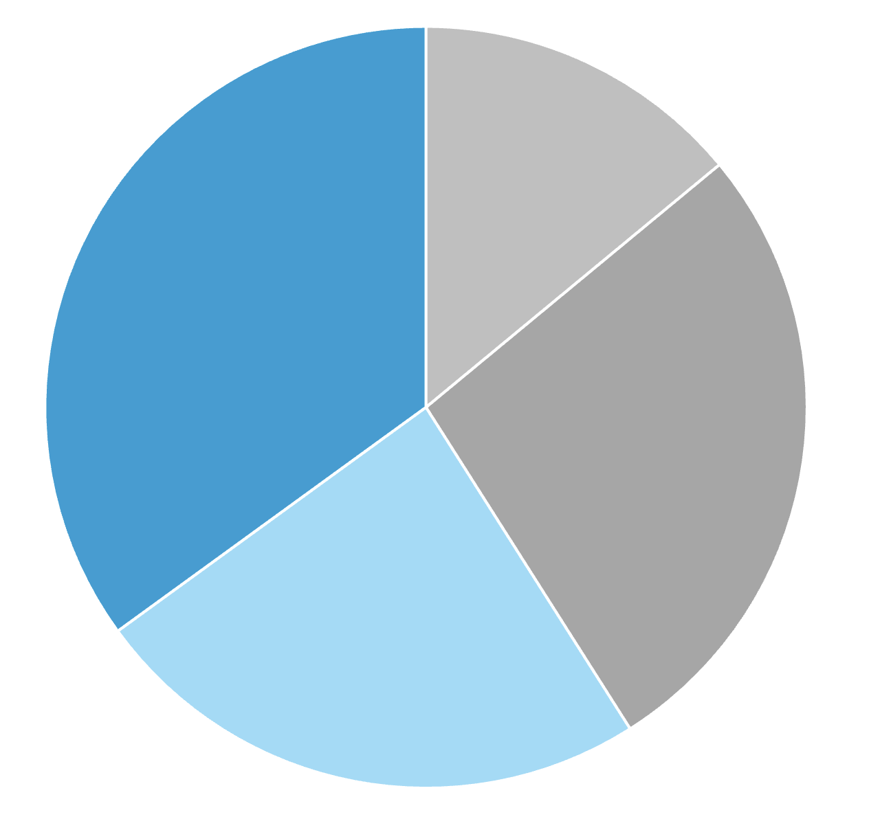
Current Produced Water Management Strategies in NM
Enhanced
Oil Recovery
(14%)
~40% of PW in NM is being reused inside the oil and gas field, already.
Reduces demand on already limited freshwater.
~60% of PW currently being disposed of (injected).
This fraction is available for treatment and beneficial use outside the oil and gas field.
Sent to TX for disposal
(35%)
Hydraulic
Fracturing
(Fracking, 27%)
Deep Well Injection in NM (24%)
Notes:
How is PW being managed currently?
Importantly, produced water reuse is not a completely new concept.
A significant portion is already recycled within oil and gas operations, primarily for hydraulic fracturing.
That recycling has already reduced the industry’s demand for freshwater.
The remaining fraction is largely disposed of through injection, including water transported for disposal.
The research question we’re discussing today is whether advanced treatment could eventually allow some portion of that water to serve applications outside the oilfield.
Your current slide estimates roughly 40% reuse within oil and gas and roughly 60% disposal.
09-25-26 NMPWRC PPT to Energy Council.pptx

Slide 9
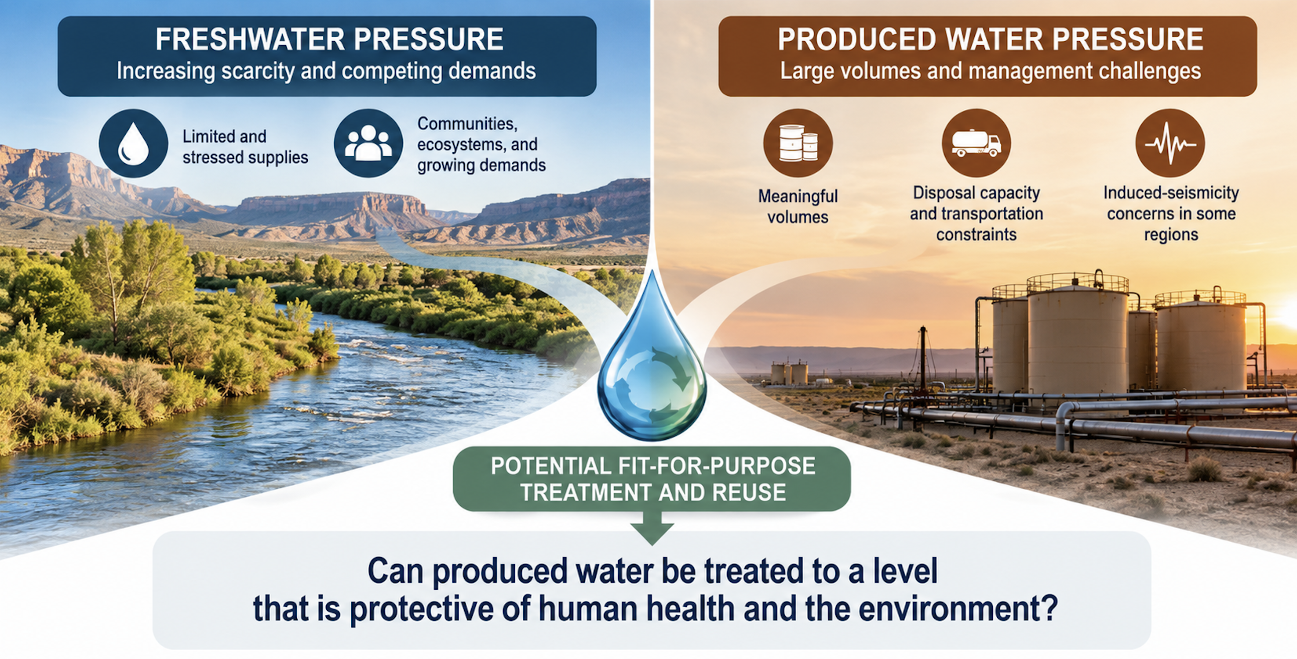
Why is Beneficial Use of PW Being Considered?
Source: ChatGPT generated
Notes:
So, to tie the first part of the story together.
On one hand, we have a large water stream that must be managed.
and the other, we have freshwater constraints in the same region.
But having a need and an opportunity alone does not mean produced water is automatically a water resource.
To use it outside the oilfield requires substantial treatment, along with the necessary evidence that the resulting, treated water is protective for its intended use.
And so this question of, can PW be treated to a level that is protective of HH and the env, is a much harder scientific question to answer.
And no single company, university or agency can answer it alone.
That’s really why the Consortium exists.

Slide 10
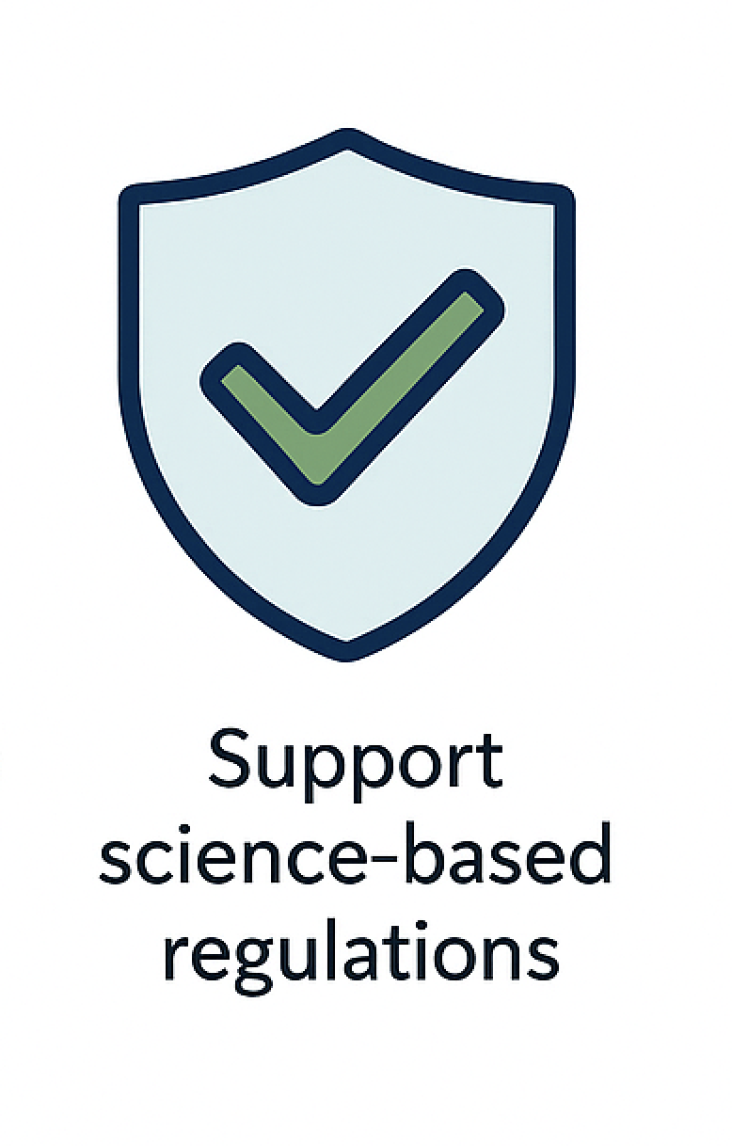
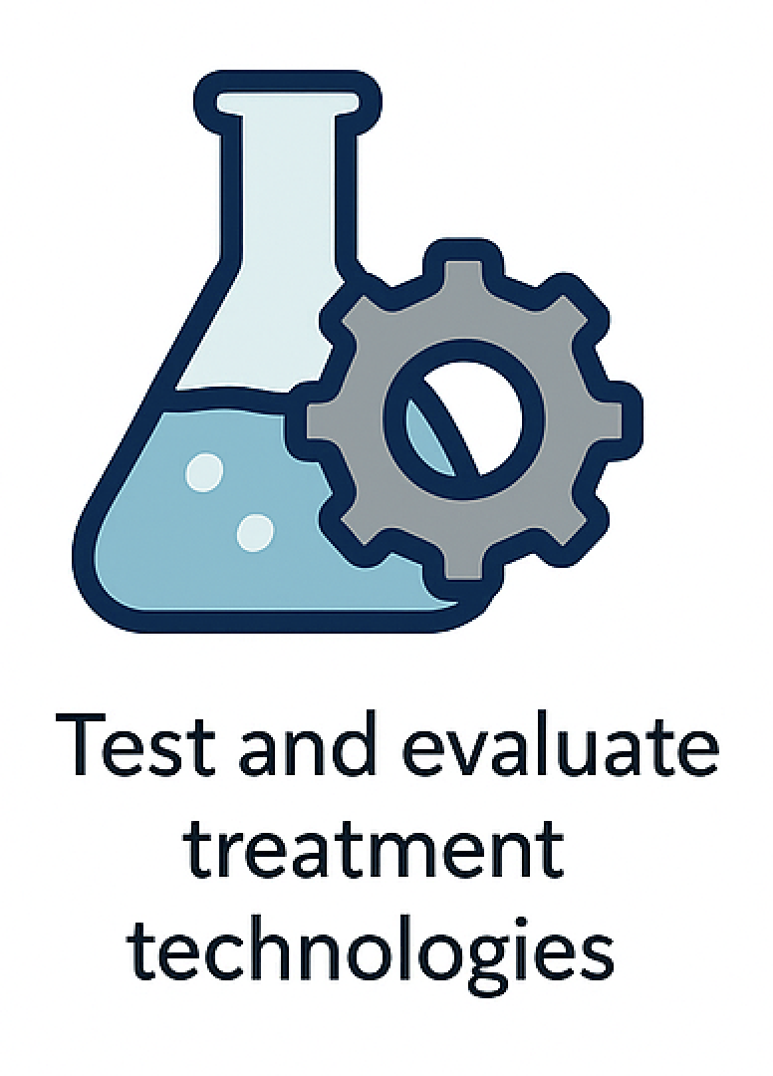

About the New Mexico Produced Water Research Consortium
Conducting science-
based research
Notes:
Our mission is to conduct the research needed to fill the scientific and technical gaps needed to inform science-based regulation.
We’re not one research group. The Consortium brings together universities, national laboratories, government agencies, industry, NGOs and other stakeholders.
Again, our job is not to determine whether New Mexico should reuse produced water.
Our job is to generate the science necessary for others to make informed decisions.
------
What We Do
Characterize produced water — understand what’s in it and how it behaves
Evaluate treatment technologies — from basic filtration to advanced desalination
Pilot real-world treatment systems — at well pads, in field labs, and controlled facilities
Assess risks & safety — to protect human health and the environment
Provide science for regulators — not advocating for or against reuse, but supplying data
Educate & engage communities — workshops, outreach, public info, and K-12 materials

Slide 11
Timeline of Major Events that Advanced the Field
NMPWRC Created - MOU between NMSU and NMED
2019
2021
2023
2025
2020
2022
2024
2026
NM HB 546
Produced Water Act
Phase 1: Development of NPDES+ List
NMPWRC Mission: To fill in science and research gaps that will enable NMED and the Water Quality Control Commission (WQCC) to make science-based regulations on safe reuse of PW.
* Timeline not to scale
Notes:
The research program has evolved systematically rather than starting with reuse and working backward.
Following the Produced Water Act and creation of the Consortium, the first major question was very basic: what should we even be looking for?
Produced water contains a much broader suite of constituents than conventional wastewater.
So the first phase of the research was developing a comprehensive analytical framework.

Slide 12
The “NPDES+” List and Analytical Framework
Major product generated in ~2022 by NMPWRC, stakeholders, and members.
This list of > 430 analytes serves as the basis for analyses of all raw PWs and treated waters generated from pilot systems.
Testing framework includes toxicity testing.
Has been adopted as a starting point by different agencies, industry, and the TxPWC.
Analytical Categories (17)
Metals/Elements - speciated
Anions
Wet Chemistry, Other
Radionuclides
Organic - VOC
Organic - VOC - TPH
Organic - SVOC - General
Organic - SVOC - TPH
Organic - SVOC - Explosives
Organic - SVOC - Agent Breakdown Products
Organic - SVOC - Pesticides/Herbicides
Organic - SVOC - PCBs
Organic - SVOC - PAHs
Organic - SVOC - Organic Acids
Organic - SVOC – Dioxins Organics - PFAS
Toxicity Testing
https://nmpwrc.nmsu.edu/reference-documents.html
Notes:
That became what we call the NPDES+ list.
You don’t need to read this list.
The important point is that we’re not just measuring salinity or a handful of conventional pollutants.
The framework contains more than 430 analytes drawn from existing standards, regulatory programs and compounds relevant to produced water.
It includes metals, radionuclides, hydrocarbons, VOCs, PFAS and many other constituent classes.
And importantly, we complement chemical analysis with toxicity testing.
This gave us a consistent framework for evaluating raw and treated water from different technologies.

Slide 13
Timeline of Major Events that Advanced the Field
NMPWRC Created - MOU between NMSU and NMED
Phase 2:
Pilot Projects Testing
2019
2021
2023
2025
2020
2022
2024
2026
NM HB 546
Produced Water Act
Phase 1: Development of NPDES+ List
NMPWRC Mission: To fill in science and research gaps that will enable NMED and the Water Quality Control Commission (WQCC) to make science-based regulations on safe reuse of PW.
* Timeline not to scale
Notes:
Once we had agreement around what to measure, the next step was generating treated water and testing actual technologies.
That moved the research from characterization into pilot-scale treatment.
And this is a spot where industry really stood up.

Slide 14
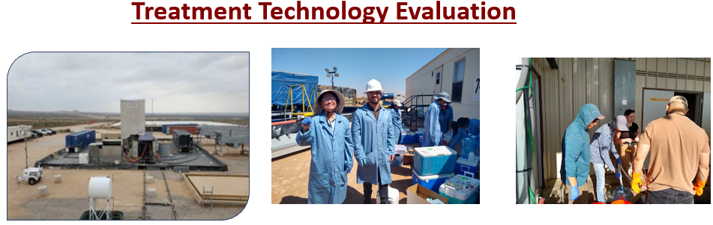
Example of Pilot System and Sampling Event in Permian Basin
Photos by Dr. Zhang and Dr. Xu
Notes:
Image on left is of a real pilot out in the Permin Basin
In the middle is Dr. Xu and a former PhD student, and next to them is a whole set of coolers with sample vials and bottles.
When we go out and sample the NPDES+ list, we're filling up around 1500 individual containers to send off for testing. This is a very comprehensive event.
We’ve now evaluated water from numerous pilot systems operating under real-world conditions.
That’s important because bench-scale experiments can tell us whether a process works conceptually.
Pilots begin telling us whether it works on actual produced water, under realistic operating conditions, and generate enough water for much more extensive chemical and biological testing.

Slide 15
Example of a Produced Water Treatment Train (Permian Basin)
Raw Water
Conveyance
Pretreatment
Desalination
Post-Treatment
Disposal
Purified PW for Fit-for-Purpose
Reuse
Oil Froth
Ultrafiltration
Zeolite
Or
IX
Dissolved Air
Flotation
GAC
Injection Well
Oil-Water
Separator
Floc and
Drop
Raw
PB PW
Mechanical Vapor
Recompression
Brine to Injection
Coagulant
pH Adjust
Solids to
Dewatering
Solids to
Waste
To Landfill
Notes:
This looks complicated, but there is one concept I want you to take away from it.
Produced-water treatment isn’t one process. It’s a multi-barrier treatment train.
First, pretreatment removes oil, suspended solids and constituents that would interfere with later treatment.
Then desalination removes the bulk of the dissolved salts.
But desalination isn’t necessarily the finish line.
Volatile organics, ammonia or other constituents can carry through or behave differently during treatment.
So we add post-treatment or polishing processes targeted at those remaining constituents.
That distinction—desalinated water versus fully polished water—turned out to be extremely important in the toxicity research.
Transition: The way that these waters are being evaluated is through a biological lens, and also through a chemical analysis lens.
Wanted to just show an example of what a TT looks like, and where sampling typically occurs.
Produced water salinity is ~ 125,000 mg/L TDS and there is elevated oil, hydrocarbons, suspended solids, and ammonia that are removed in the “Pretreatment” processes.
Advanced Desalination consists of mechanical vapor recompression (falling film evaporator) that evaporates ~ 50% of the produced water.
Some ammonia carries over off here, with organics, so water is post treated by carbon (GAC).
Treated water will have an elevated salinity still (some salts carry over into distillate – about 250 – 500 mg/L TDS in distillate), so RO polishing + EDI is required.

Slide 16
Timeline of Major Events that Advanced the Field
NMPWRC Created - MOU between NMSU and NMED
Phase 2:
Pilot Projects Testing
2019
2021
2023
2025
2020
2022
2024
2026
NM HB 546
Produced Water Act
Phase 1: Development of NPDES+ List
Phase 3:
Analysis of Treated PW and Investigating Toxicity
NMPWRC Mission: To fill in science and research gaps that will enable NMED and the Water Quality Control Commission (WQCC) to make science-based regulations on safe reuse of PW.
* Timeline not to scale
Notes:
Pilots generated water that allows us to send off for analysis to a certified, commercial lab and also we bring water back to campus for different types of analysis like toxicity analysis.
Purpose of the pilots were to show feasibility that a “safe” water could be generated.
Pilot systems gave us enough water to move beyond simply measuring treatment efficiency.
We could send samples to certified laboratories for detailed chemistry and bring samples back to NMSU for biological testing.
And this allowed us to ask the more important question: not simply “how much did we remove?” but “does the resulting water still produce biological effects?”

Slide 17

What is the State of the Science on PW Toxicity?
Test
(End-Use)
Raw PW
Pretreated
Desalinated
Post-Treated
[Ref.]
Signif. Reduced
Toxicity
WET
(Surface
Discharge)
Toxic
Toxic
No Toxicity
[3, 4,
5, 6 ]
Signif. Reduced
Cyotoxicity
Bioassays
(Human
Exposure)
Cytotoxic
Cytotoxic
No Cytotoxicity
[6, 7, 8]
Minimal Impacts*
No Adverse Impacts
Greenhouse
(Ag/Irrigation)
[Did not test]
[Did not test]
[9]
Notes:
Raw produced water is toxic in these test systems.
Pretreatment helps, but isn’t sufficient.
Desalination dramatically improves the water, but residual biological effects can remain.
When appropriate post-treatment is added, the waters we’ve tested have shown no toxicity, no cytotoxicity, or no adverse impacts in the endpoints evaluated.
That progression is extremely important.
The research isn’t telling us that “produced water is safe.”
It’s telling us something much more useful:
Treatment can fundamentally change the chemical and biological characteristics of produced water, and we can experimentally evaluate whether a particular treatment train produces water that is protective for a particular application.
Through collaborative research and independent evaluation, the science of produced water treatment and reuse has advanced significantly in recent years.
Peer-reviewed studies and pilot-scale evaluations provide growing evidence that advanced multi-barrier treatment systems have demonstrated high contaminant removal efficiencies and supports protective use of treated produced water.
Refs
3. USGS 2025
4. 2024 Tarazona a
5. 2024 Tarazona b
6. 2026 Tarazona
7. 2026 Edirisooriya
8. 2025 Wijekoon
9. 2026 Senanayake

Slide 18
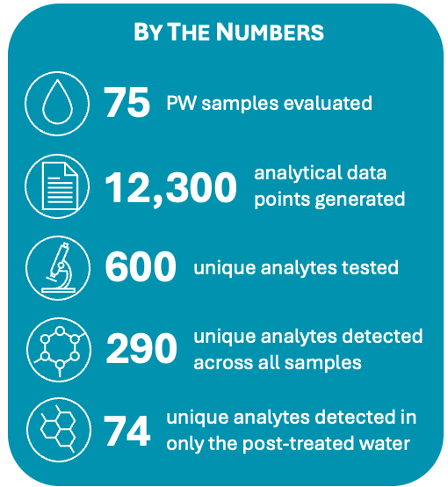
Analytes Detected in Produced Water
596 total
detected at
least once
285 total
post-treated
74 total
from membrane-based
not
detected
raw,
pre-treated,
desalinated
from thermal-based
below RSL*
*preliminary and unpublished data
Notes:
We can look at the PW characterization through an analytical lense, and it tells a similar story.
We have analyzed hundreds of constituents across raw, pretreated, desalinated and post-treated waters.
Treatment substantially reduces both concentrations and the number of detected constituents.
But some constituents remain detectable after treatment.
That is exactly why the next phase of research focuses on identifying those residuals, understanding their concentrations, and determining whether they matter biologically or environmentally.
Again, don’t focus on the individual numbers.
The pattern is what matters: many compounds in raw produced water; progressively fewer through treatment; relatively few remaining after polishing.
But “few” does not automatically mean “no risk.”
We still need to understand what those residual compounds are and what happens to them.

Slide 19
Timeline of Major Events that Advanced the Field
Phase 4:
Demonstration Scale Systems (in TX only)
NMPWRC Created - MOU between NMSU and NMED
Phase 2:
Pilot Projects Testing
2019
2021
2023
2025
2020
2022
2024
2026
NM HB 546
Produced Water Act
Phase 1: Development of NPDES+ List
Phase 3:
Analysis of Treated PW and Investigating Toxicity
NMPWRC Mission: To fill in science and research gaps that will enable NMED and the Water Quality Control Commission (WQCC) to make science-based regulations on safe reuse of PW.
* Timeline not to scale
Notes:
The research is now entering another stage.
Pilot studies demonstrated that very high-quality water can be produced.
Larger demonstration-scale systems are beginning to evaluate treatment at much greater volumes.
But scaling treatment also creates new questions around long-term reliability, monitoring, cost, residuals and environmental behavior.
So the science doesn’t stop when we demonstrate treatment feasibility.

Slide 20
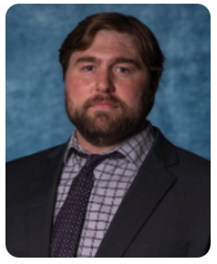


Current Research Focus
Question
Research Approach
Lead Researchers
Are there compounds outside the targeted NPDES+ List that we are not analyzing for?
In conjunction with targeted analysis, conduct Non-Targeted Analysis to screen for transformation by-products and TICs.
Notes:
One of the biggest questions is whether our targeted analytical list captures everything that matters.
Targeted analysis asks: “Are the compounds we know to look for present?”
Non-targeted analysis asks a different question: “What else is there?”
We’re using high-resolution analytical methods to look for compounds and transformation products that conventional targeted testing might miss.
This is particularly important when dealing with chemically complex waters.

Slide 21
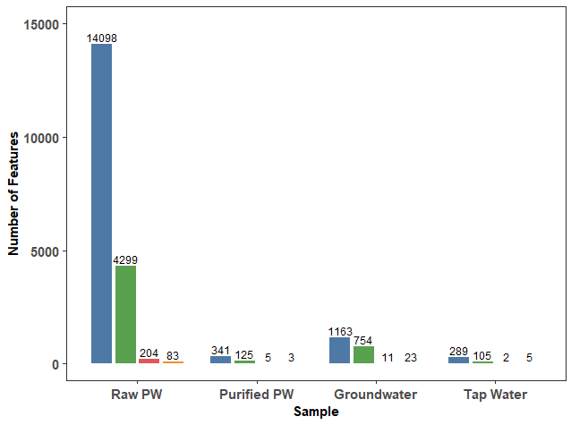
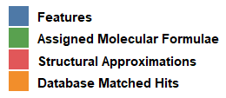
Example: NTA of PW, Groundwater, and Tap Water from Midland, TX
169.9
Raw PW showed the highest number of detected features
A substantial reduction in the number of features can be seen after the purification
Groundwater also showed a relatively higher number of features
The number of detected features was consistent with the TOC values of each sample
*TOC values in red (mg/L)
16.9
0.37
1.07
Notes:
Here’s an example comparing raw produced water, purified produced water, groundwater and tap water.
You don’t need to interpret the individual features.
The takeaway is that raw produced water has a much more complex organic chemical signature.
Treatment substantially reduces that complexity.
Non-targeted analysis gives us another tool for determining what remains after treatment rather than assuming we’ve captured everything with a predefined list.

Slide 22

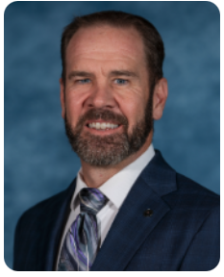











Current Research Focus
Question
Research Approach
Lead Researchers
Are there compounds outside the targeted NPDES+ List that we are not analyzing for?
In conjunction with targeted analysis, conduct Non-Targeted Analysis to screen for transformation by-products and TICs.
What about potential chronic impacts to organisms exposed to tPW over long durations?
Conduct long-term zebrafish toxicity testing (98 day), mouse toxicity (100 days) and reproduction studies, and mosquito studies to probe health and ecological impacts of long-term exposure.
Do chemical additives in fracking fluids have an impact on the treated PW?
Use FracFocus data to compare fracking chemical footprints and assess how these additives may influence produced water chemistry, toxicity, and treatment complexity.
What is the fate and transport of the (organic) compounds that make it through treatment?
Build off existing F&T models to model and predict if compounds pose a risk to human health & environment.
What are the economics of Permian Basin PW treatment?
Conduct a technoeconomic analysis and calculate levelized cost of water of a conventional treatment train, w/ focus on understanding where R&D is needed to reduce costs.
Notes:
Other major questions we’re focused on now.
First, unknowns: Are there residual compounds or transformation products we’re not routinely measuring?
Second, long-term biological effects: Most studies to date are relatively short compared with the exposure periods that might occur in real-world reuse.
Third, oilfield chemistry: How do chemical additives influence treatment requirements and treated-water quality?
Fourth, fate and transport: If trace compounds remain, where do they go in soils, plants, groundwater or surface water?
Fifth, economics: I’ll emphasize that our main focus is not to generate a single number on cost and say, “It costs this”. Its to focus on understanding where R&D is needed to reduce costs.

Slide 23
Key Takeaways
Produced water is both a management challenge and a potential water resource, creating a reason to evaluate additional management options.
Advanced, multi-barrier treatment can substantially improve produced-water quality, but treatment must be designed and validated for the intended use.
Important scientific questions and uncertainties remain, particularly around long-term effects, presence of compounds outside the targeted NPDES+ list, and long-term treatment performance and reliability at scale.
Not every scientific uncertainty must be resolved before a regulatory framework can be considered. The existing body of research can inform a structured evaluation of what is known, what remains uncertain.

Slide 24

Contact Information
New Mexico State University
New Mexico Produced Water Research Consortium (NMPWRC)
College of Engineering Outreach | (575) 646-2913 | nmpwrc@nmsu.edu
Dr. Craig Newtson
Interim Associate Dean
Office of Engineering Extension and Outreach
Patsulli@nmsu.edu
Dr. Pei Xu
Research Director
Professor, Civil and Environmental Engineering
pxu@nmsu.edu
Dr. Zach Stoll
Assistant Director
zstoll@nmsu.edu

Slide 25
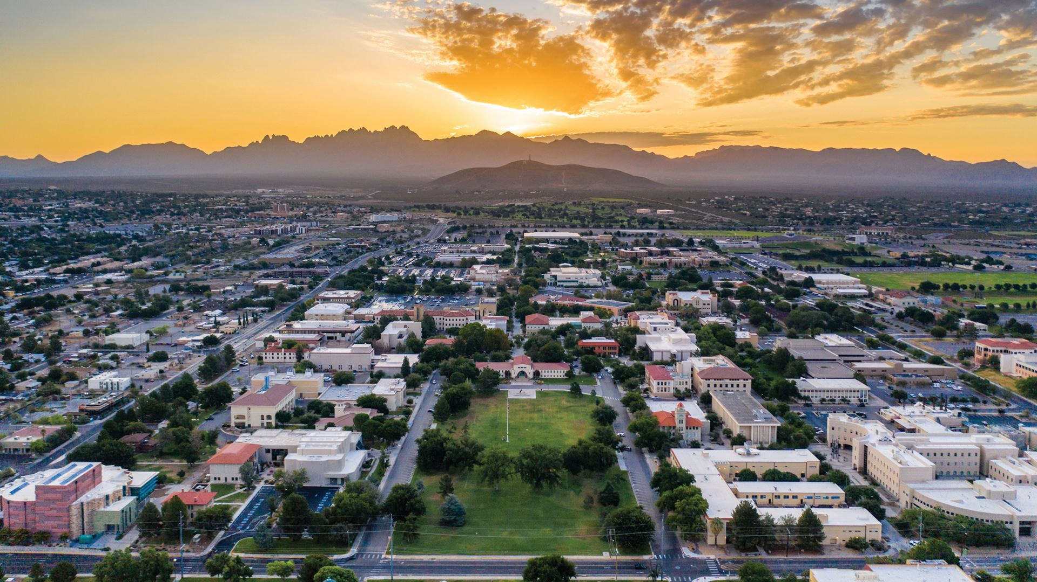
Thank You!
Notes:
What questions do you still have?
What makes you feel uncomfortable?

Slide 26
Extra Slides

Slide 27
NM Produced Water Volumes by Year (2026 OCD Data)
Source: https://www.emnrd.nm.gov/ocd/ocd-data/statistics/
Notes:
Produced water is generated at a very meaningful scale.
New Mexico is currently generating on the order of hundreds of millions of gallons per day.
The significance of this graph is simply scale. We are generating a very large water stream in the same region where freshwater is constrained.
That makes it worth asking whether some fraction of that water could eventually be treated for appropriate uses.
The deck currently frames New Mexico PW production at roughly 250–300 MGD and discusses the potential for increasing water-to-oil ratios over time

Slide 28
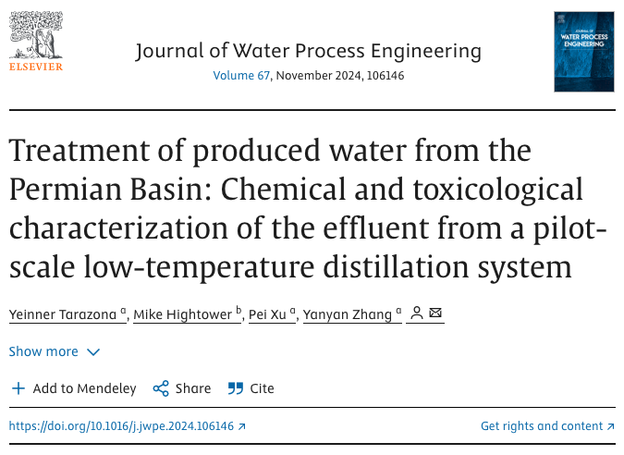
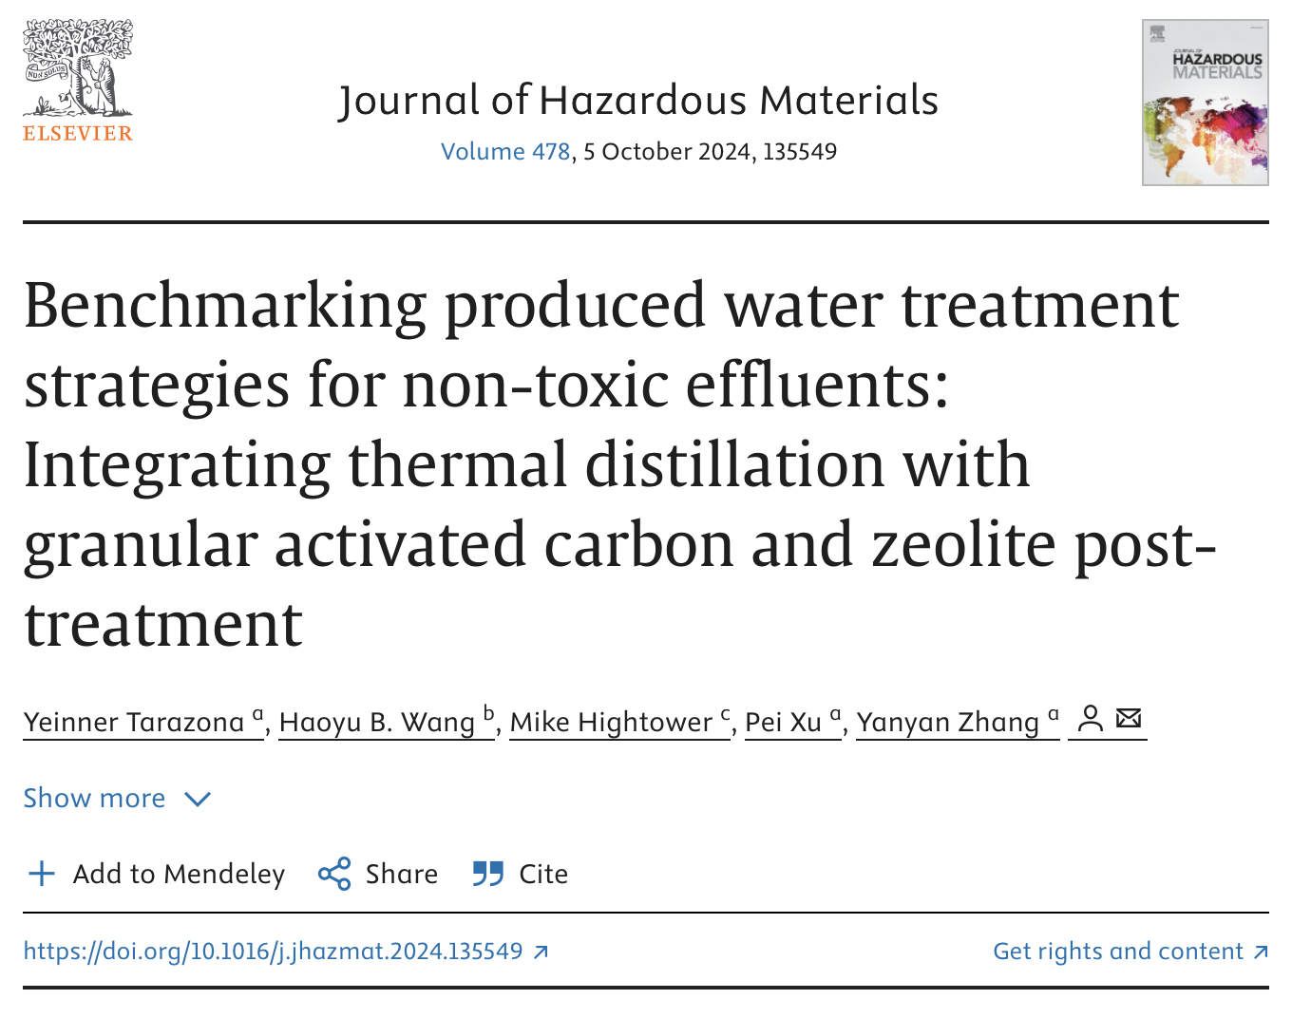
Progress in R&T Space – 2024 Tarazona et al (a, b)
Evaluated toxicity of model organisms across 4 trophic levels (algae, bacteria, invertebrates, fish embryos).
System removed >99% salts, 60–100% metals, ~93% ammonia and, 43–60% organics.
Distillate still toxic and led to failed WET tests.
Same experimental set up but added post-treatment as GAC + zeolite.
Re-evaluated toxicity of the same model organisms across 4 trophic levels (algae, bacteria, invertebrates, fish embryos).
Polished distillate was non-toxic across the board and led to passing WET tests.
Notes:
This was one of the pivotal findings from the research.
Thermal desalination performed extremely well if you only looked at conventional removal percentages: more than 99% of salts, substantial metals removal, and major reductions in ammonia and organics.
You could look at those numbers and conclude, “This treatment worked.”
But when researchers exposed aquatic model organisms to that distillate, the water still exhibited toxicity and failed Whole Effluent Toxicity testing.
Researchers then added polishing using activated carbon and zeolite.
When the water was tested again, the polished distillate passed the WET tests and no toxicity was observed across those model organisms.
That’s why one of our central messages is: removal efficiency alone is not enough.
What ultimately matters is what’s left in the water and whether it causes a biological response.
These experiments evaluated organisms across four trophic levels and showed the distinction between desalination alone and subsequent polishing.
So while its great to look at the % and nominal removal rates, what really matters is whether or not there is toxicity or if the tPW poses and risks to human health and the environment.
With that, I want to start out by giving some background on the previous R&T work done at the NM PW RC and highlight major efforts that got us to where we are today. These R&T efforts being led by Dr. Yanyan Zhang.
If we go back in time to before the Consortium, there wasn’t a complete understanding of how treated PW impacted human health and the environment. Additionally, I think a lot of focus was on salinity as the main metric for treated water quality: if the salinity or conductivity was low, it must be safe. But what Mauricio and Yanyan did was look at the toxicitiy impacts of the thermally treated PW on 4 aquaitic model organisms across the food chain. In the first paper, found that thermal distillation was insufficient to pass a WET test because of the ammonia and VOC carry over, despite having high removal of salts, metals, ammonia, and organics.
The follow up paper “benchmarking…” then looked at what post-treatment requirements were needed to pass a WET test – landing on GAC for organics removal and zeolite for ammonia + metals removal, as two model post-treatment processes. The paper also began to provide rough technical targets for effluent limits, of ~ 5 mg/L TOC, < 1 mg/L NH3, and ~ BDL for Cd and Cu.
However, even though the treatment train led to passing of WET tests, one of the big questions remaining was, was there any acute or chronic toxicity that organisms were experiencing?
This leads us into the Wijekoon paper that was recently published on July 19th of this year in the journal of Ecotoxicology and Environmental Safety, which provides strong data that addresses this exact question.
2025 Wijekoon et al looked at 3 different human cell lines to see the impact on multiple biomarkers using the same PW from Tarazona et al papers, meaning the untreated PW, distillate from the LTD, and post-treated GAC + zeolite water. Addition here was of a conventional pilot MVR.
Six in vitro toxicity assays were conducted to assess cell viability, necrosis, apoptosis, oxidative stress, estrogenicity, and aryl hydrocarbon receptor (AhR) activation after PW exposure.
Results found no impact of post-treated PW on any of the cell lines for any biomarker vs control.
Caco-2 (Human Intestinal Epithelial Cells)
Rationale: Represents the intestinal lining, which would be a key route of exposure if treated PW were to enter drinking water or food chains (e.g., through irrigation).
Relevance: Useful for assessing cytotoxicity, oxidative stress, and barrier integrity effects from chemical contaminants.
MCF-7 (Human Breast Cancer Cells, Estrogen Receptor-Positive)
Rationale: These cells express estrogen receptors and are widely used to test for endocrine-disrupting activity of environmental chemicals.
Relevance: Critical for evaluating estrogenicity (via the E-Screen assay) and activation of hormone-mediated pathways that may be triggered by organic compounds (e.g., BTEX, PAHs) in PW.
HEK293 (Human Embryonic Kidney Cells)
Rationale: Represents kidney tissue, which is a primary site for detoxification and excretion of xenobiotics in the human body.
Relevance: Effective for detecting general cytotoxicity, apoptosis, and oxidative stress, reflecting potential renal risks from PW exposure.

Slide 29
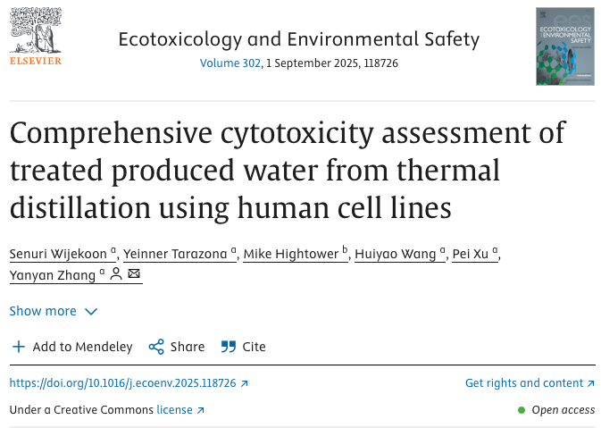
Progress in R&T Space – 2025 Wijekoon et al
Does polished PW have an impact on the genetic level?
Evaluated same LTD water + MVR
  clean brine,
  distillate, and
  purified PW
3 human cell lines (kidney, intestinal, breast cancer)
Looked at 7 biomarkers/genes (cell viability, mitochondrial, ATP, LDH, nitrite, AhR, estradiol)
Notes:
That raised another question. Passing an aquatic toxicity test is encouraging, but what about biological responses relevant to human exposure?
Researchers evaluated three human cell lines representing different biological systems and examined multiple endpoints.
Raw produced water produced substantial biological responses.
Desalination dramatically reduced those responses, although some remained.
After polishing, the endpoints tested were generally indistinguishable from the controls.
Again, I’m deliberately not saying this proves that all treated produced water is “safe.”
What it tells us is that under these experimental conditions, the treatment train eliminated the biological responses we were measuring.

Slide 30
Progress in R&T Space – 2025 Wijekoon et al
PW Test | Feed LTD | LTD Distillate | LTD GAC + Zeolite | Feed MVR | MVR Distillate | MVR GAC + Zeolite
WET Test | Fail | Fail but not as bad | Pass | Fail* | Fail but not as bad* | Pass*
MCF-7, HEK93, Caco-2 (% Cell Viability, MTT) | Low viability above 6.25% PW | High viability at or near control levels. MCF-7 some variation | Did not test | Low viability above 6.25% PW | High viability at or near control levels for all | Did not test
MCF-7, HEK93, Caco-2 (% Cell Viability, Luciferase) | Low viability above 6.25% PW | High viability at or near control levels. MCF-7 and HEK293 some variation | Did not test | Low viability above 6.25% PW | High viability at or near control levels | Did not test
MCF-7, HEK93, Caco-2 (LDH) | Increasing/dose-dependent cytotoxicity for all | No difference vs control | Did not test | Elevated cytotoxicity for all, relationship not as clear | No difference vs control | Did not test
MCF-7, HEK93, Caco-2 (Nitrite) | Elevated nitrite and increased oxidative stress except Caco-2 | No difference vs control | No difference vs control | Elevated nitrite and increased oxidative stress | No difference vs control | No difference vs control
MCF-7 (AhR) | Suppressed 1A, highly upregulated 1B | Highly upregulated 1A and 1B | No difference vs control | Suppressed 1A, moderately upregulated 1B | Highly upregulated 1A, no difference vs control for 1B | No difference vs control
MCF-7 (17B-estradiol) | ~ 2x higher proliferation effect | ~ 1.5x higher proliferation effect | No difference vs control | Higher proliferation effect | ~ 1.5x higher proliferation effect | No difference vs control
*unpublished data
Notes:
I’m not going to walk through this table.
I’m showing it simply so you can see the breadth of biological endpoints that were evaluated.
Across the different tests, the overall pattern is consistent: treatment progressively reduces biological effects, with the polished water performing most similarly to controls.
Takeaway is that the distillate can still exhibit effects on WET testing and some of the biomarkers, but the polished distillate not only passes the WET test but also does not elicit biochemical responses vs the controls for the biomarkers tested. It would have been great to test the GAC+zeolite on the cell viability and LDH tests, but the distillate alone didn’t show any impacts so would guess that no impact vs controls for these either.
Currently Dr. Zhang is doing 96 day acute toxicity experiments.
Also experiments on

Slide 31
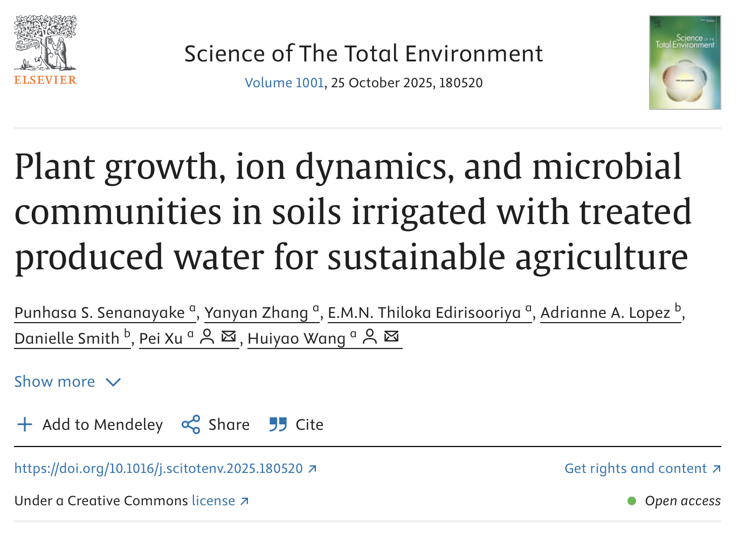
Progress in R&T Space – 2025 Wijekoon et al, 2025 Senanayake et al.
Does polished PW have an impact on the genetic level?
Evaluated same LTD water + MVR
  clean brine,
  distillate, and
  purified PW
3 human cell lines (kidney, intestinal, breast cancer)
Looked at 7 biomarkers/genes (cell viability, mitochondrial, ATP, LDH, nitrite, AhR, estradiol)
Produced water from TPWR
Treatment = conventional pretreatment, freeze desal, post-treatment (See 2026 Edirisooriya et al paper)
Looked at impact on plants, soil, and soil microbiome
Results showed…
Notes:
We then expanded beyond aquatic organisms and human cell assays into potential environmental applications.
That includes plants, soils and soil microbial communities.

Slide 32
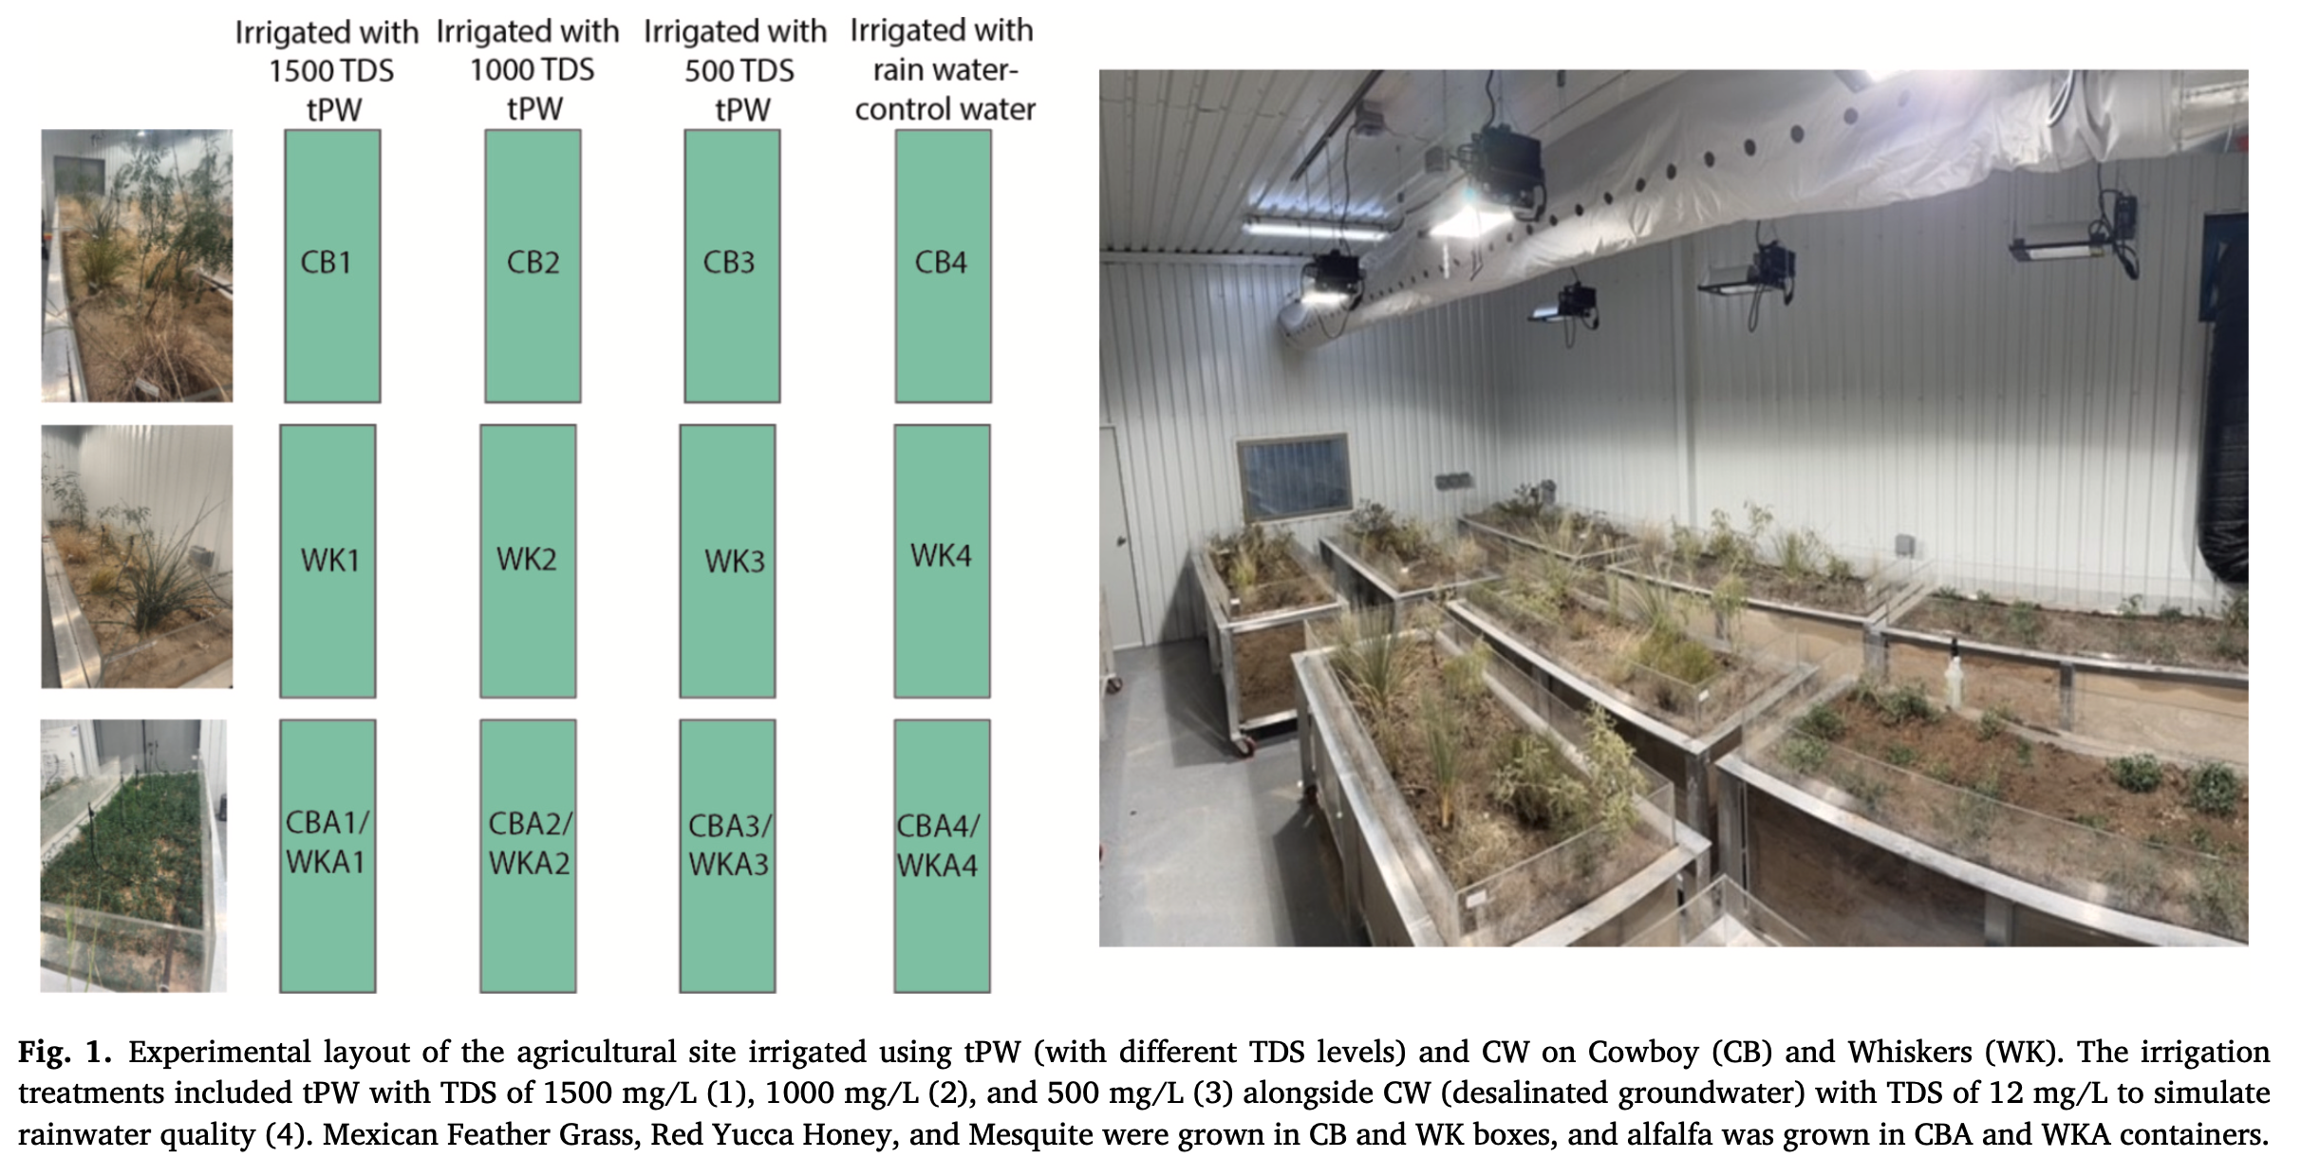
Progress in R&T Space – 2025 Senanayake et al.
Notes:
This was a nine-month greenhouse study evaluating treated produced water at different salinity levels.
Researchers measured much more than whether the plant survived. They looked at plant growth, forage quality, soil chemistry, ion transport and microbial communities.
At 500 and 1,000 milligrams per liter TDS, the treated waters generally maintained or improved measured soil-health and forage-quality outcomes relative to the study control.
At higher salinity, performance began to deteriorate.
That’s important because it reinforces the concept of fit-for-purpose water quality.
The appropriate water quality depends not only on treatment technology but also on soil, crop, salinity and intended use.
The underlying study evaluated 500, 1,000 and 1,500 mg/L TDS waters and found outcomes depended on water quality, soil and plant type

Slide 33
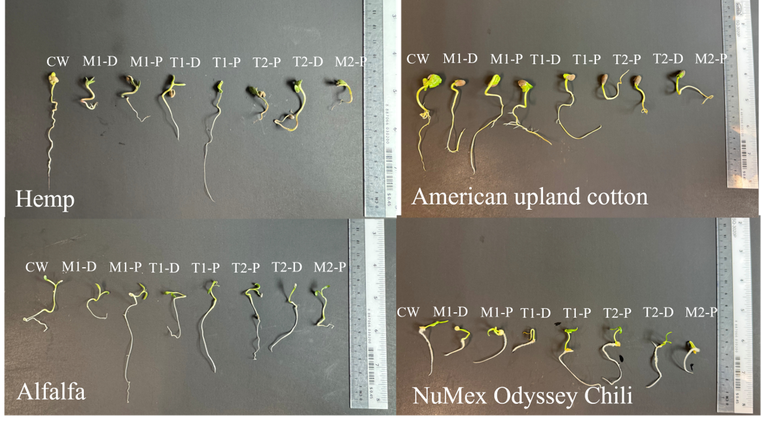
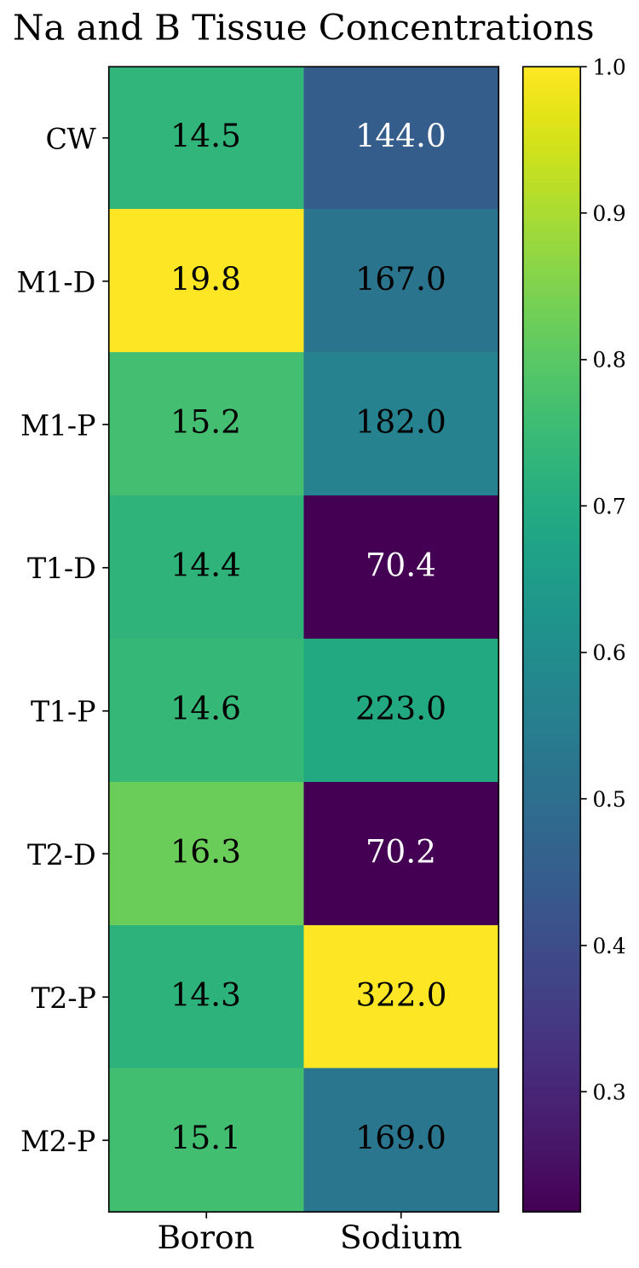
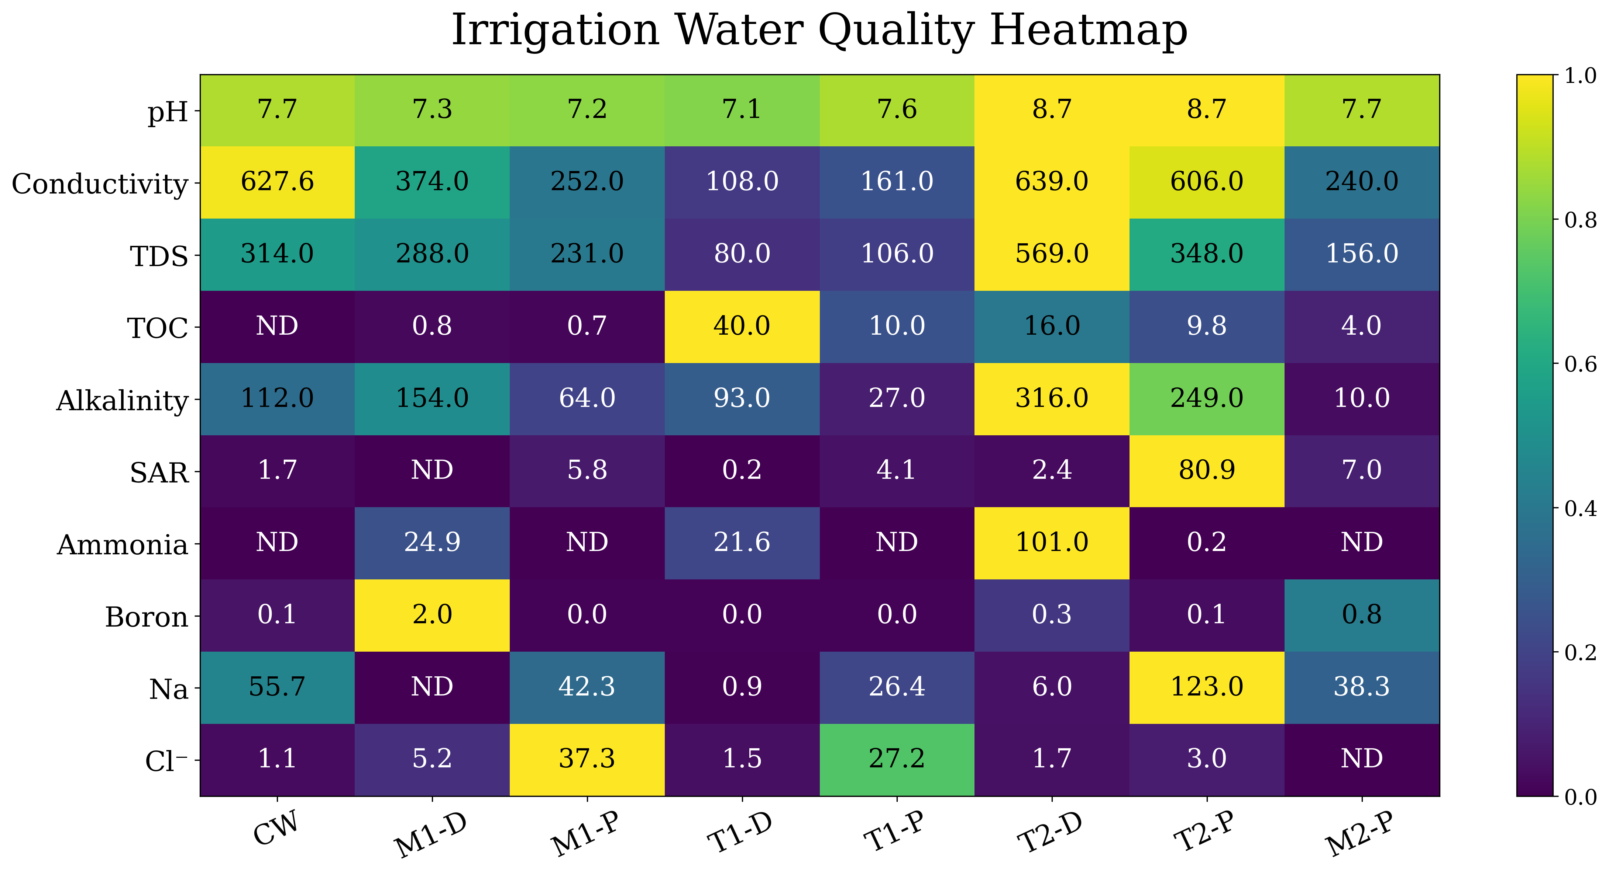
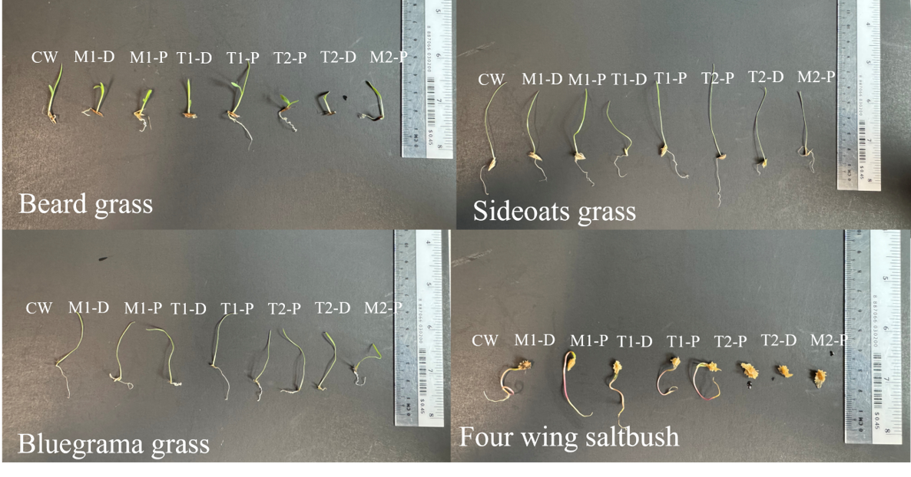
Seed Germination
Post-treated desalinated PW (M1-P, T1-P) generally performed best for root and shoot growth.
Desalting alone was not sufficient; residual constituents (B, NH₃-N) affected plant responses – root growth.
No single water type was best for all species; responses were species-dependent.
8 native plants and crops were irrigated
7 desalted and post-treated PW with different levels of salts, SAR, ammonia, TOC, and B were tested against tap water (CW)
Notes:
Influence of Treated Produced Water Chemistry on Seed Germination (Germination test - Petri dish) and Seedling emergence under native soil condition (Artesia soil)
Other studies have looked across multiple crops and native plants.
Again, post-treated waters generally performed better than desalinated-only waters.
But responses varied by species.
That’s another reason we avoid saying there is one universal definition of “treated produced water.”
Treatment requirements ultimately have to connect to the intended application.

Slide 34
Water Quality-Driven Technoeconomic Analysis (TEA) validated by experimental data
Produced Water Treatment
Desalination
Fit-for-Purpose Water Reuse
Pretreatment
Polishing/Posttreatment
Water quality requirements:
Drinking water
Ag Irrigation
Land application
Pure water for industry
Resource Recovery (NH₃, critical minerals, H₂, acids, bases…)
Levelized Cost of Water:
Costs: CaPX, OPEX (energy, chemicals, labors, replacement, maintenance)
Energy sources
Waste management and disposal (liquid, solids)
Sensitivity analysis (cost of materials, life cycle time)
Benefits: water uses, resources recovery and valorization
https://nmpwrc.nmsu.edu/

Slide 35
Research Priorities - strong consensus
  Provide science to enable policy/standards for regulations:
    Need a clearer PW reuse policy/regulatory framework
    Provide protective water quality standards/limits that regulators and industry can reference
  Build credibility through risk assessment + fate/transport:
    Risk assessment on human health and environment is central for public acceptance
    Fate & transport study is important for regulators and permitting: needs credible fate/transport evidence for residual compounds in receiving environments (soil, surface water, crops, etc.)
  Support implementation with monitoring and transparent data:
    Open access to data (e.g., on the website)
    Real-time/near-real-time monitoring systems that can support discharge and reuse without requiring impractical sampling burdens.
  Use TEA strategically (comparative + sensitivity) while acknowledging private cost data limitations
  Evaluate long-term field testing and impacts on fit-for-purpose reuse not just near-term lab results.
https://nmpwrc.nmsu.edu/

Slide 36
Summary of Consortium Research to Date
Industry, NGOs, academia, and regulators have coalesced on using the “NPDES+ List” to determine what constituents should be analyzed for in the raw and treated PW.
Water samples were taken from > 10 different pilots operating in the Permian Basin and analyzed using the NPDES+ list to understand treatment performance.
Exposing model organisms to PW treated by thermal distillation alone was not sufficient to remove toxicity impacts.
Robust post-treatment processes are required to polish or purify the water to “safe levels” that do not lead to acute or chronic toxic effects.
Treated and purified PW was shown to be non-toxic to model aquatic species, with no adverse impacts on human cell lines, plants, soils, and soil microbiomes.
Currently looking into what specific compounds are present in polished water, at what concentration, and their toxicity.

Slide 37
Back up slide

