Slide 1
Brief Overview of Nuclear Energy Research at
Los Alamos National Laboratory
Chris Stanek
stanek@lanl.gov
Los Alamos National Laboratory
September 26, 2026
The Energy Council Annual Meeting
Albuquerque, NM
LA-UR-26-27522

Slide 2
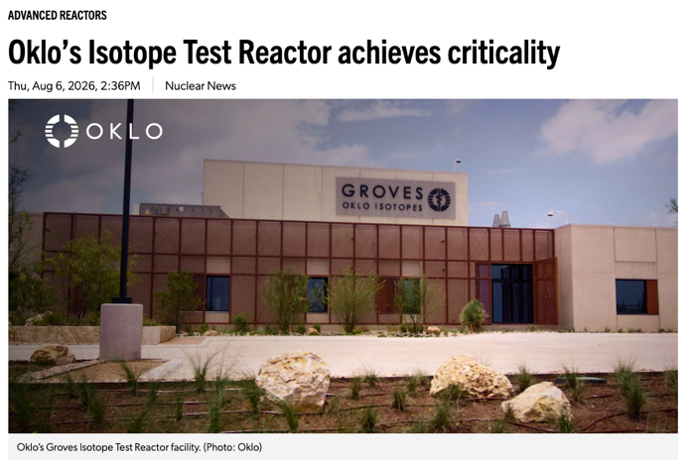
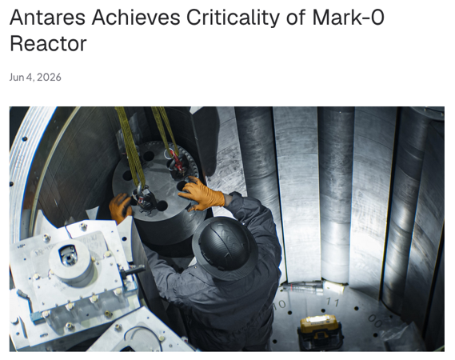
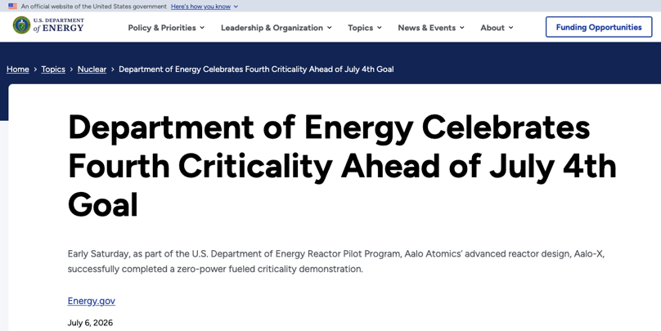
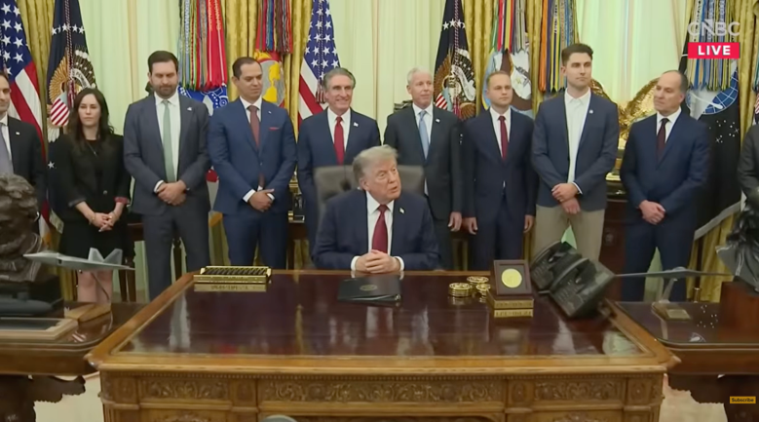
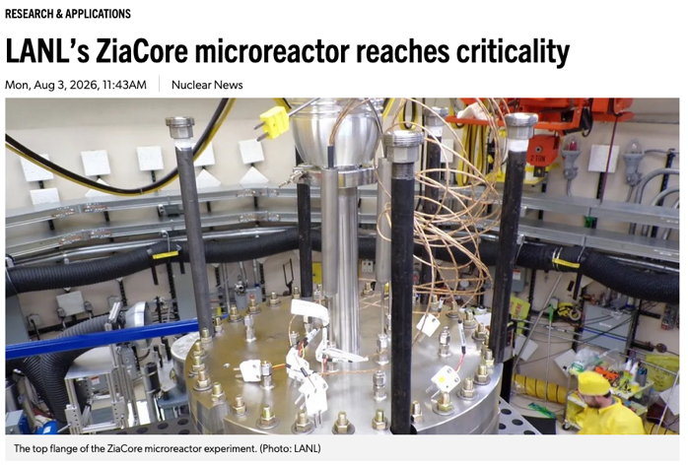
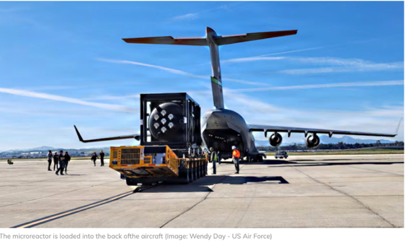
Most exciting time for nuclear energy since advent of nuclear power

Slide 3
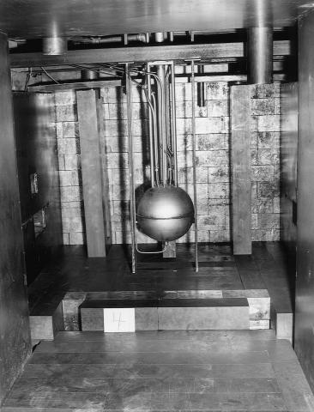
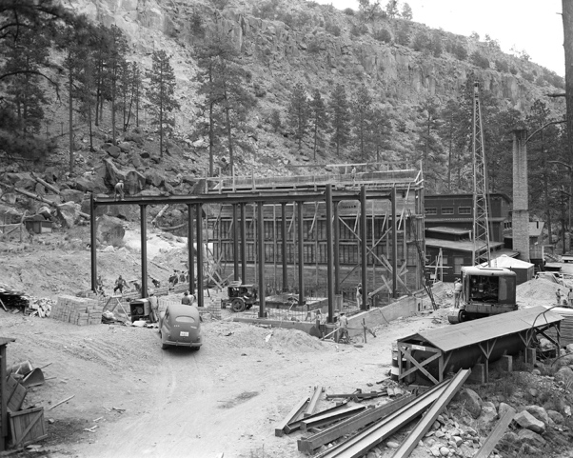
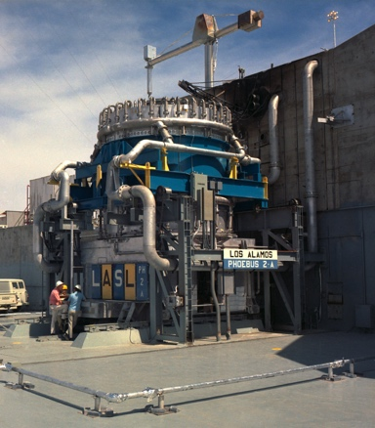
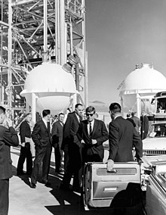
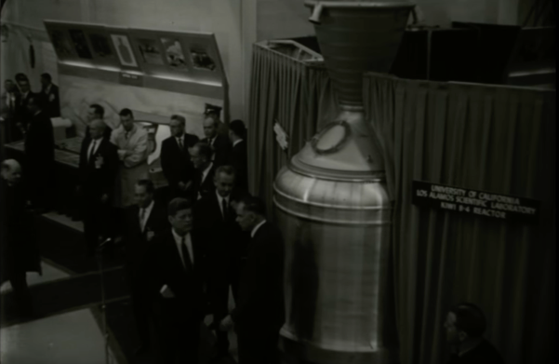
LANL R&D for nuclear energy is connected to and inspired by our history
  Manhattan Project:
  LOPO: world’s 3rd nuclear reactor and first liquid fuel reactor. Critical in 1944 using valuable U-235 with Enrico Fermi “at the controls”
  Clementine: First fast reactor 1949, fueled by plutonium and cooled by liquid mercury
  Space Nuclear Propulsion – Rover/NERVA Programs
  (1955-1973):
  JFK visit to LANL in 1962 (Rover)
  10s of reactors/critical assemblies – including highest power reactor ever
  tested (>4,000MW)
LOPO, 1944
Clementine Reactor, 1945-50
JFK at Nevada and LANL, 1962
Phoebus 2A, 1968

Slide 4
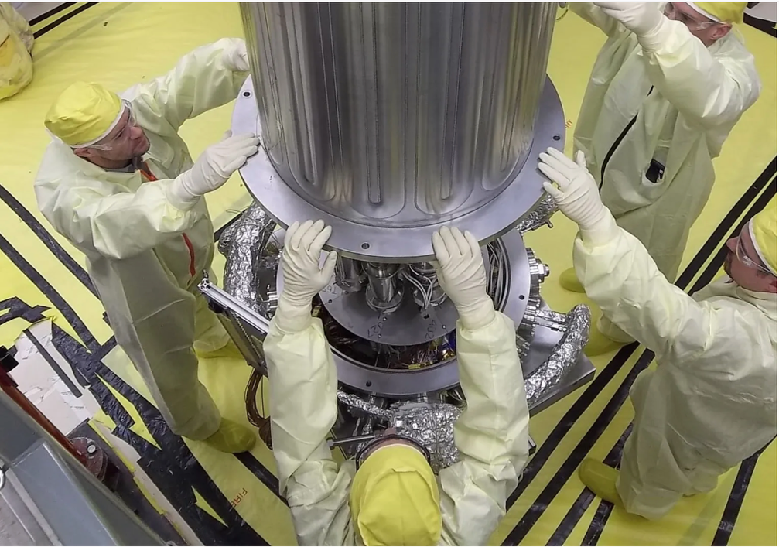
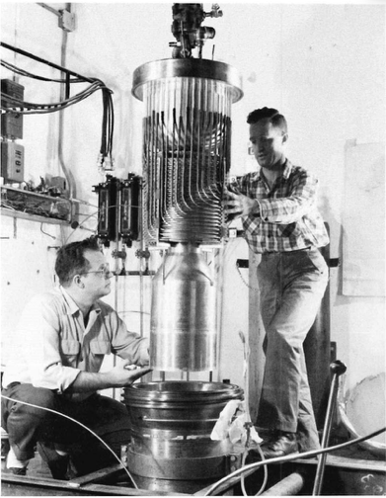
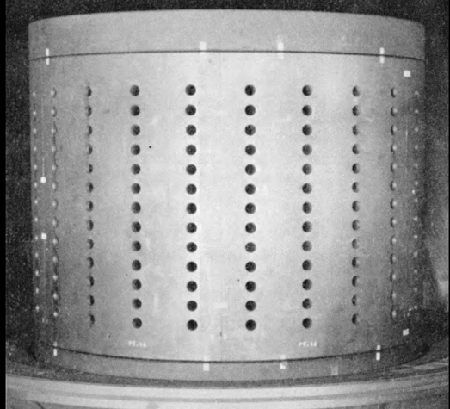
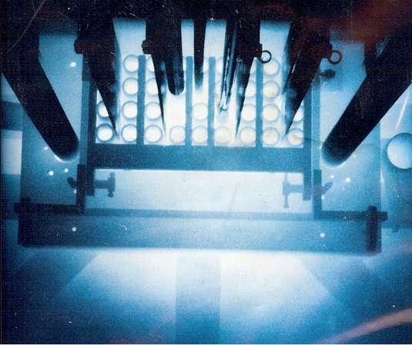
Other Los Alamos Reactors
UHTREX, 1959-1971
LAPRE series, 1959-1963
KRUSTY (Kilopower Reactor Using Stirling Technology), 2017-2018
Very important modern reactor test, demonstrating self regulation of heat pipe-cooled reactors, currently pursued by Space Nukes.
Omega West, 1956-1994

Slide 5
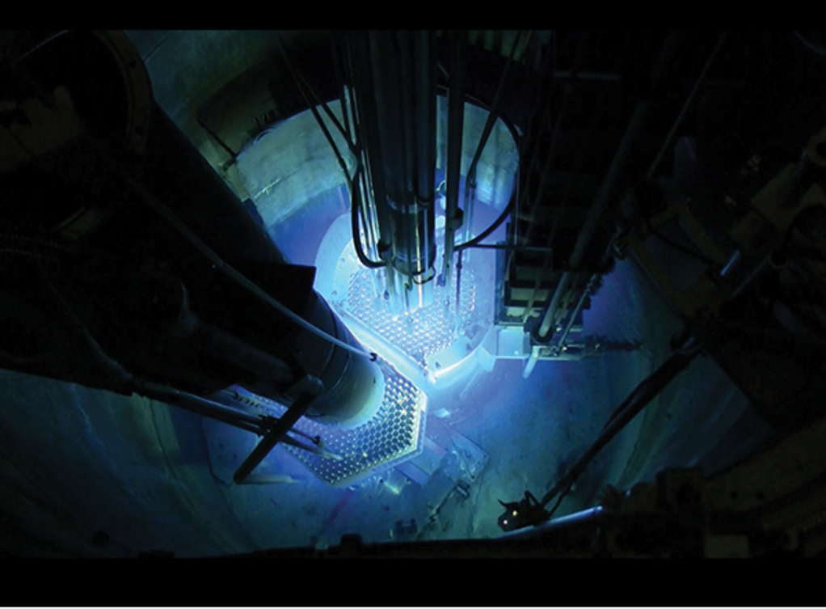
Annular Core Research Reactor (ACRR)
Sandia has operated ACRR since 1978. Features of ACRR (open water pool research reactor) influenced the technology behind Eden Radioisotopes, which will produce at a commercial scale important medical isotopes.

Slide 6
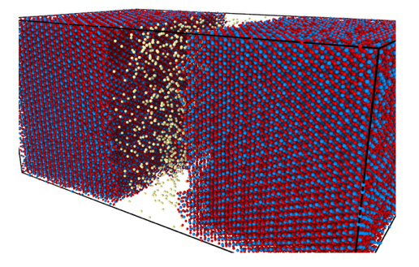
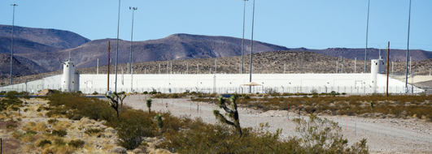
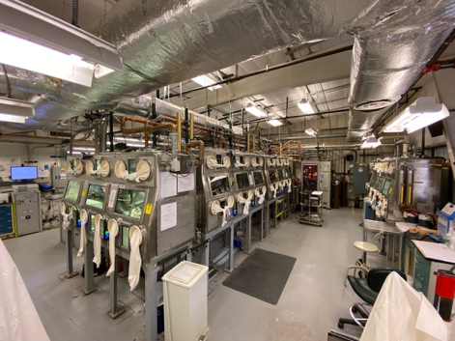
LANL nuclear energy strategy is focused on core capabilities connected to laboratory mission
Nuclear weapons, therefore nuclear energy: Key for mission-relevant capability development (e.g., actinide science, nuclear experiments, materials in radiation environments) and staffing/recruitment. Dovetails with reliable energy for global security.
Core capabilities:
Critical experiments and nuclear data,
Design and testing of special purpose reactors
Advanced fuel development
Materials (structural, moderators)
Nonproliferation and safeguards science
Used fuel and repository R&D
Our core capabilities are being meaningfully utilized to accelerate the deployment of advanced reactors

Slide 7
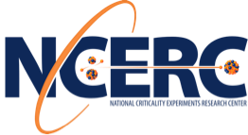
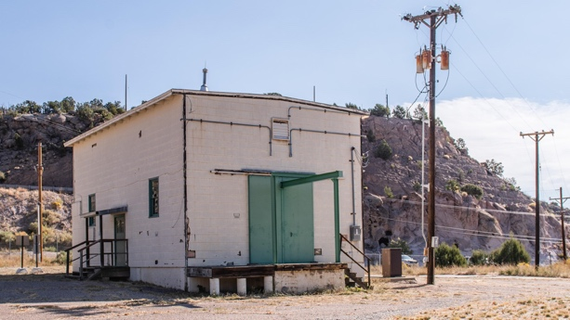
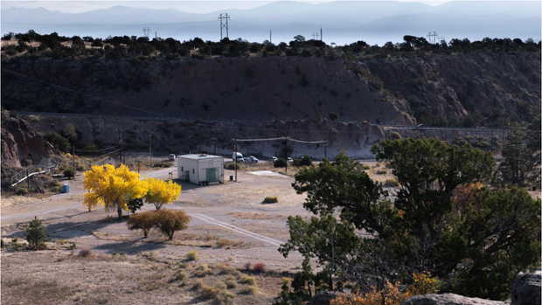
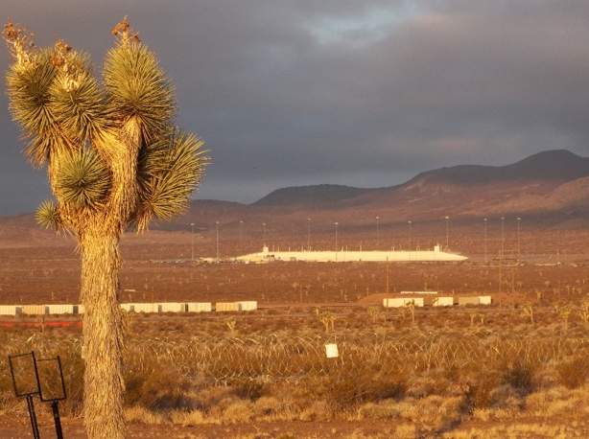
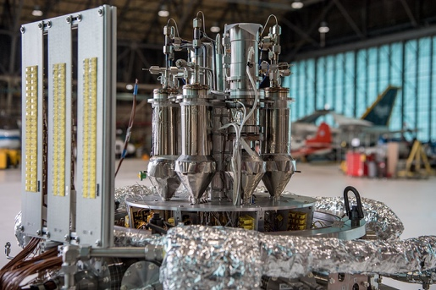
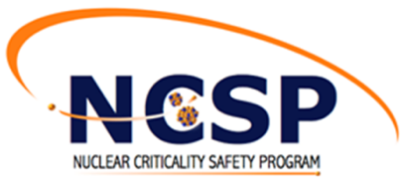
LANL continues to perform critical experiments –
but not in Los Alamos
National Criticality Experiments Research Center (NCERC) at Nevada Nuclear Security Site - Device Assembly Facility (DAF), 2011-present: Critical >1000 times for >25 unique experiments.
Advanced microreactor development: First use of a heat pipe to transport heat from fission (DUFF), and demonstration of reactor self-regulation (KRUSTY).

Slide 8
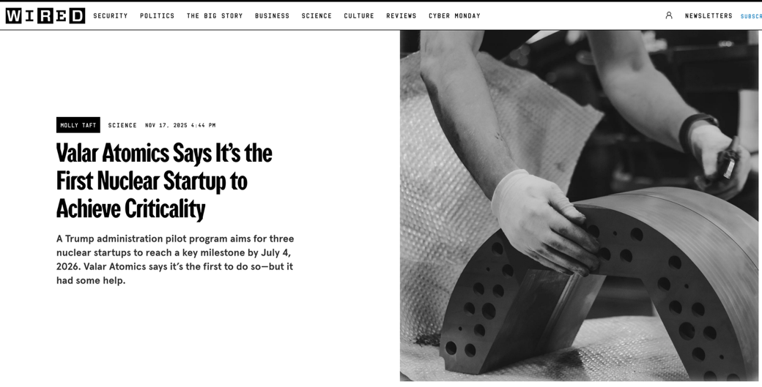
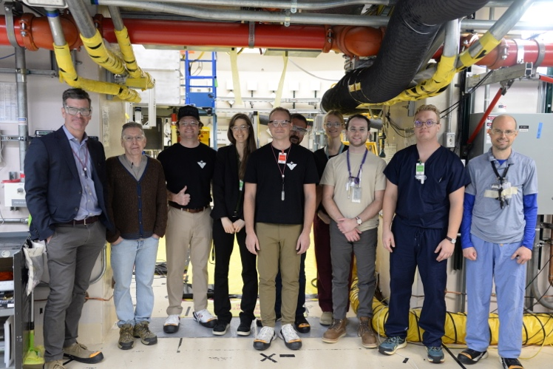
Recent NCERC Highlight
Reactor experiment for Valar Atomics
Reactor experiment for Valar Atomics

Slide 9
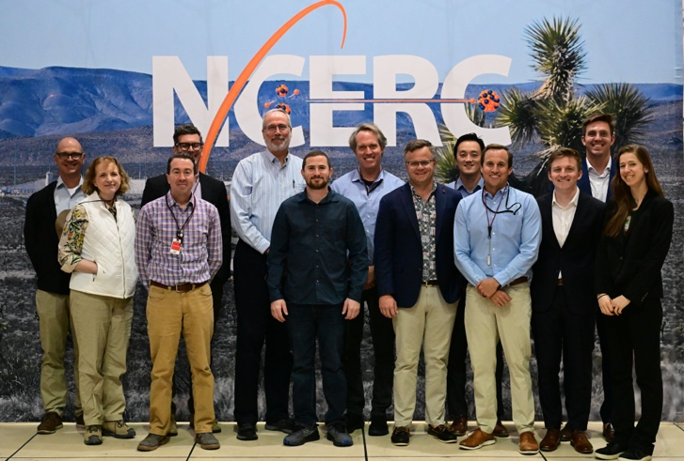
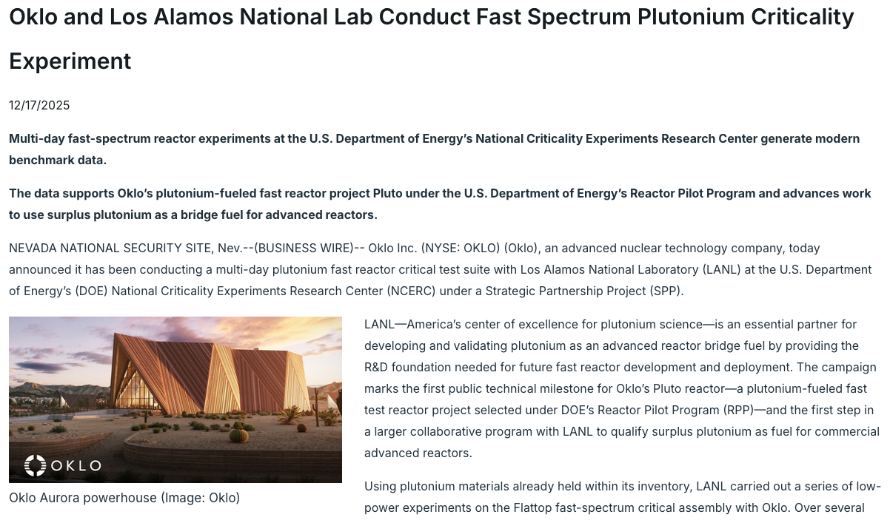
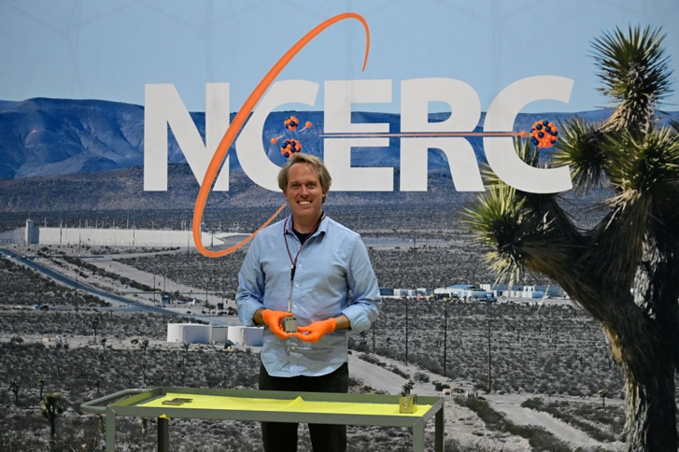
Recent NCERC Highlight (continued)
Pu critical experiment for Oklo

Slide 10
Special Purpose Reactor Design and Testing

Slide 11
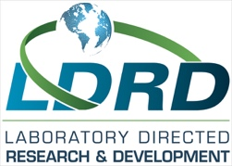
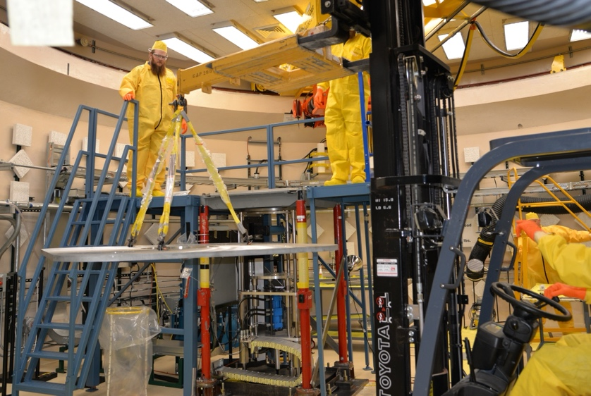
ZiaCore is using materials science to drive special purpose reactor design
LDRD project (using internal Los Alamos funds, began in 2024) is based on currently available fuel (i.e. LEU UO₂) to drive reactor design
Overarching goal is to demonstrate a transportable microreactor that is conceivably deployable in the very near term
Transportability and scalability of ZiaCore results in a range of potential use cases including for national security (expeditionary power, space, etc.)
The performance of enabling components were evaluated during the project, and it culminated with a critical experiment at NCERC

Slide 12
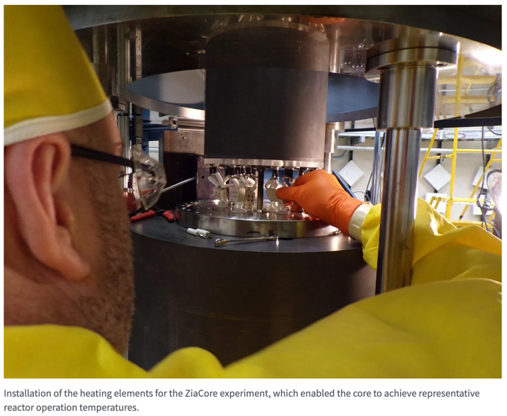
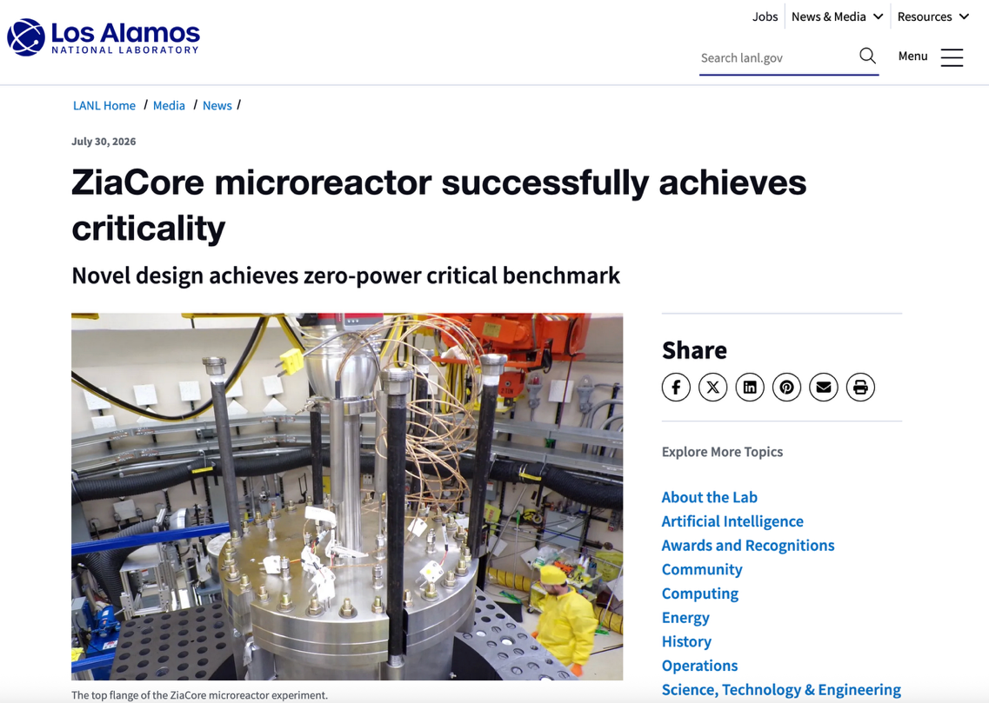
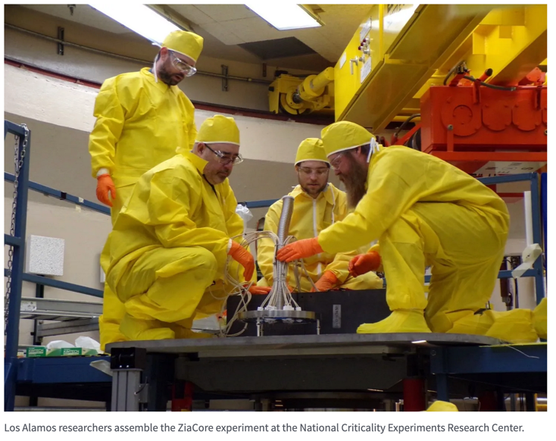
ZiaCore critical experiment was successful in May

Slide 13
Nuclear Fuels and Materials R&D

Slide 14
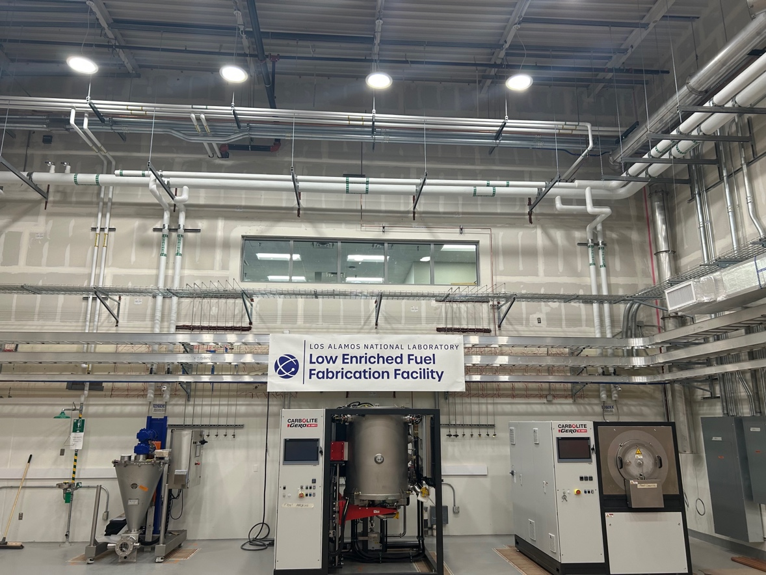
Prototype HALEU Fuel Fabrication:
Low Enriched Fuel Fabrication Facility (LEFFF)
Prototype-to-manufacturing: LEFFF is a less than hazard category 3 radiological shell and authorization basis to allow fabrication of intermediate scale quantities of specialized HALEU-bearing nuclear fuel.
Original vision for LEFFF conceived nearly a decade ago, foreseeing a need to expand fuels R&D to include fabrication for HALEU-demonstrations.
First occupant is Kairos Power, where fuel for Hermes will be produced.

Slide 15
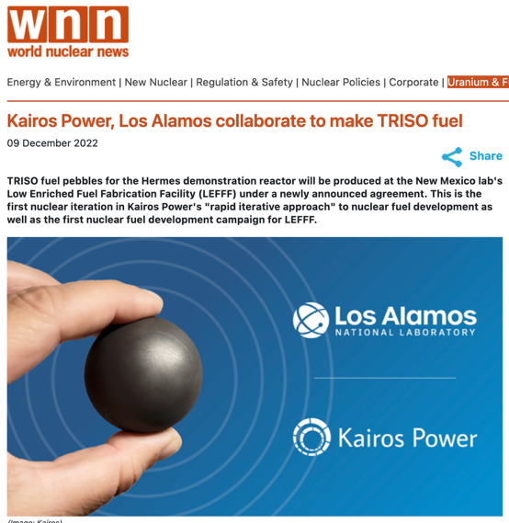
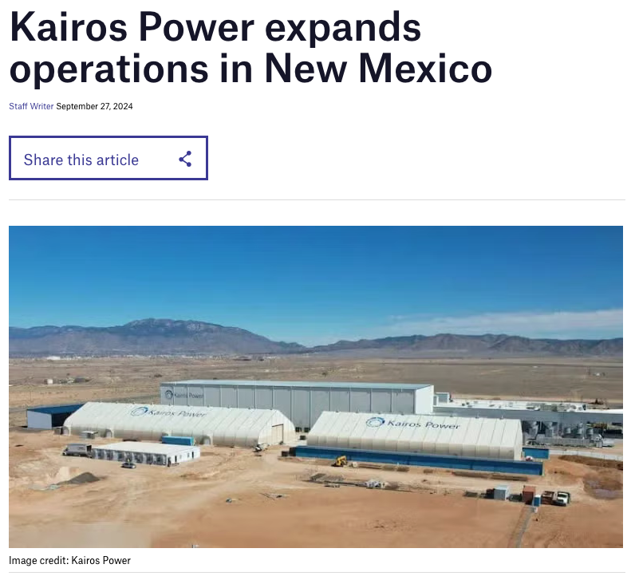
Kairos Power has a Significant Presence in NM
Kairos Power established an engineering center in Albuquerque (Mesa del Sol) in 2019 to support the development of its advanced reactor technology.
Focus is non-nuclear research and development including fuel fabrication and engineering test unit of demonstration reactor Hermes.

Slide 16
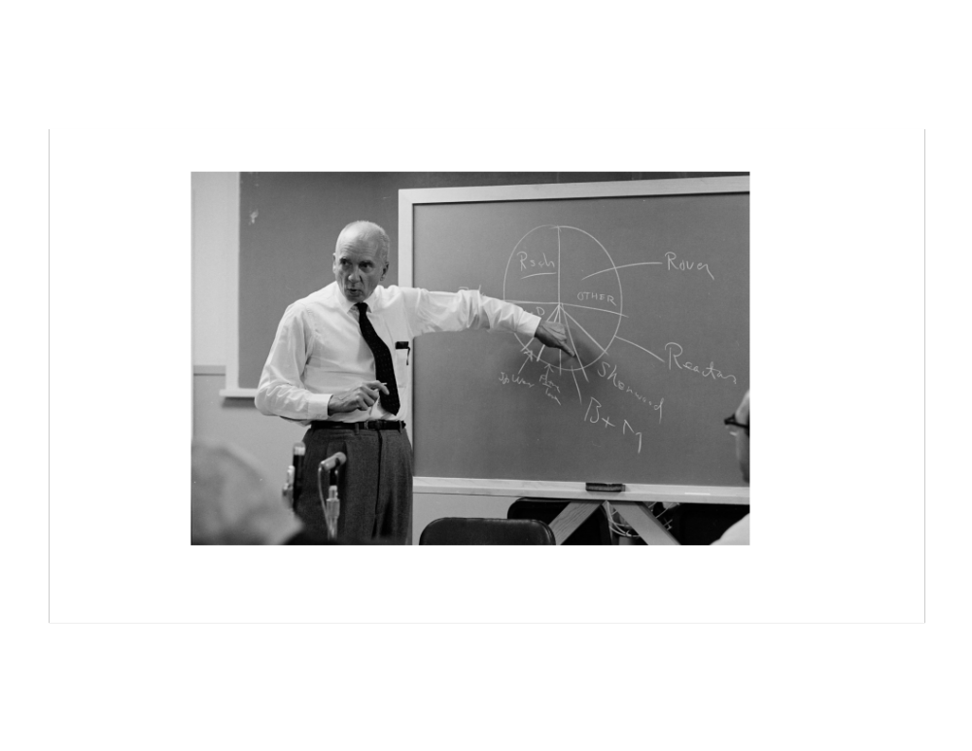
Summary
It’s an extremely exciting time for nuclear energy – and there’s plenty that national labs can and should be doing to accelerate the deployment of advanced nuclear energy technologies.
LANL is striving to make pivotal contributions to advanced nuclear, which are tightly connected to energy security, global security and weapons missions.
Current focus: demonstration reactor fuel R&D and fabrication, safeguards-by-design, HALEU critical experiments, design and testing of special purpose reactors and spent fuel management.

