Slide 1
New Mexico’s
Energy Conservation and Management Division
Geothermal Development and Deployment
Rebecca Puck Stair
Director, ECAM
September 2026

Slide 2
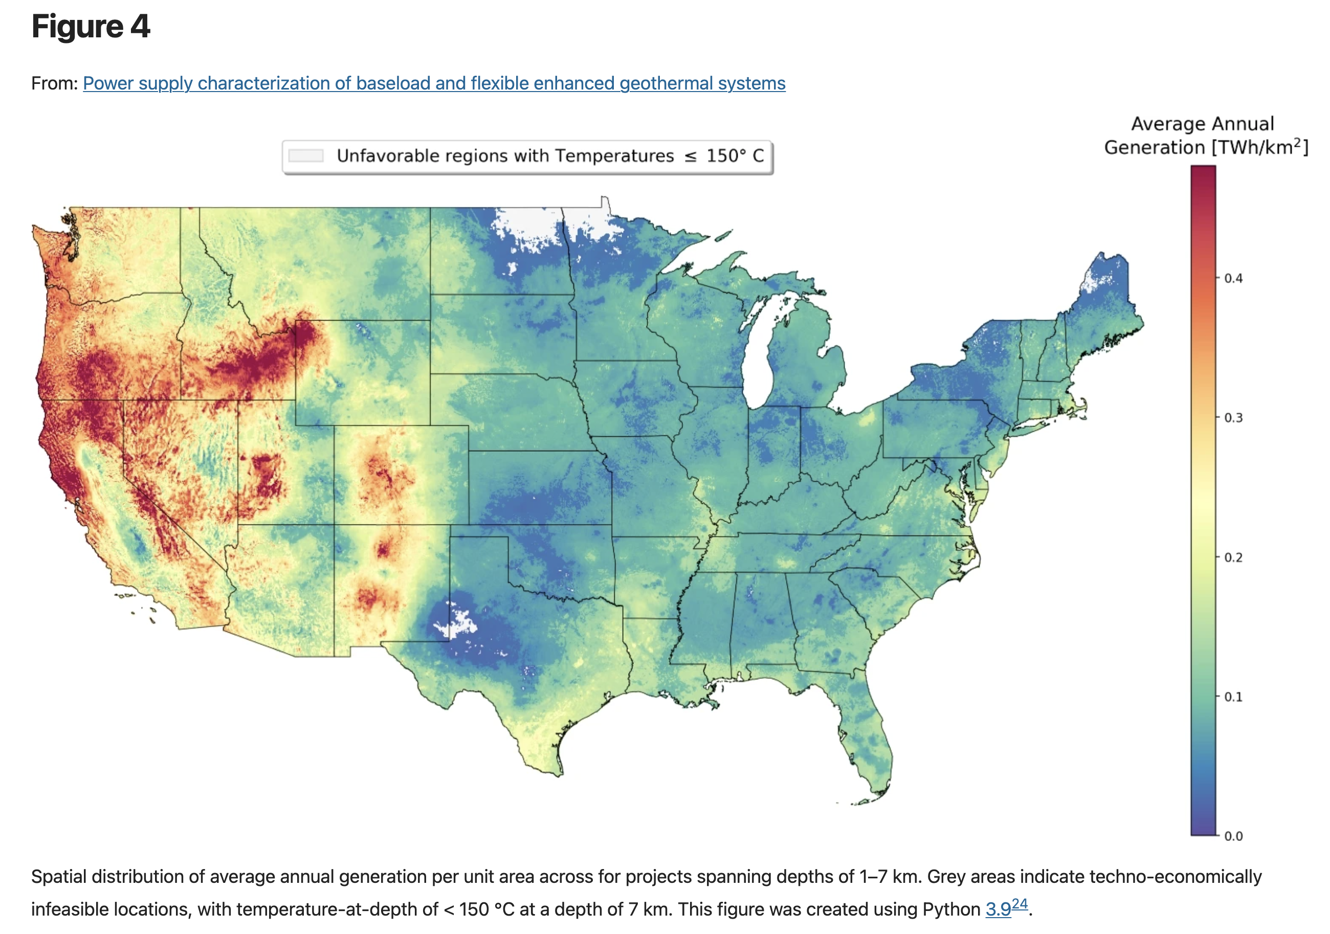
United States Geothermal Potential
90 gigawatts by 2050
Possibly up to 300 gigawatts
1 gigawatt = 1 nuclear plant
Current US grid peak = 759 gigawatts
https://docs.nlr.gov/docs/fy23osti/84822.pdf
Source: Nature.org

Slide 3
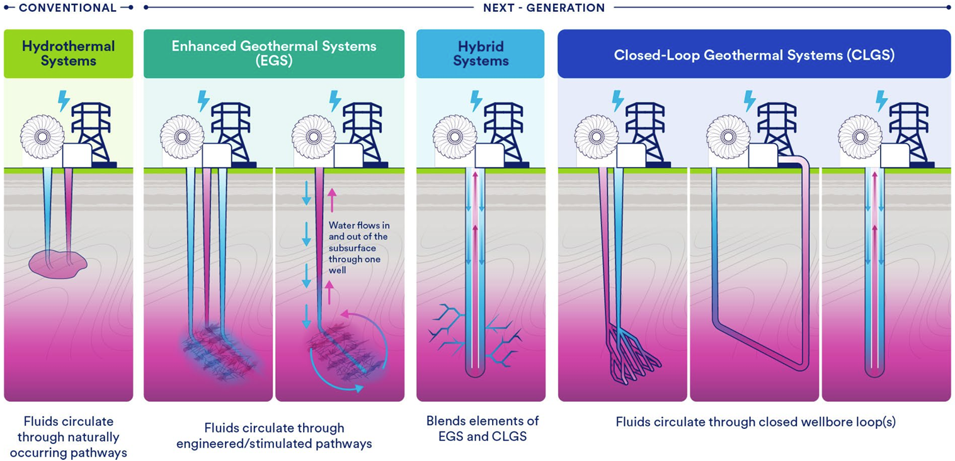
Types of Geothermal Electricity – it’s both an old and new tech
Source: Clean Air Task Force https://cdn.catf.us/wp-content/uploads/2026/08/17201451/NextGenGeothermal_State.pdf
Notes:
Mention water usage for each.

Slide 4
Benefits of Geothermal Electricity
Versatile – electricity, heating/cooling (which can smooth grid curve), storage. Diverse revenue streams
Clean firm, also dispatchable – pairs well with intermittents like solar and wind
Small physical footprint per kilowatt hour (only nuclear is denser)
Renewable – heat can recharge over time
Domestic resource – no supply chain or fuel shipping
Zero emission electricity generation
Stable cost to produce – no variable fuel costs
Critical minerals mining – from the brine. In some locations. Extra revenue.
Blackstart – in blackouts it can start up independent of any other power source (currently only nuclear and hydro can blackstart. Batteries emerging.)
Spinning inertia – helps stabilize the grid
Homegrown – advanced geothermal made possible by American fracking and directional drilling

Slide 5
Drilling for heat is different than oil & gas
Unknown subsurface – heat is typically in different geologic locations than oil & gas
You always find heat. But… how deep? How hot? How long will it last? Does it pencil?
Heat can recharge over time
Drilling is the easy part – then you’re building a power plant, transmission lines
Connecting the “product” to market – power purchase agreements, interconnection queues.
Different type of customer – you’re connected to them 24/7.
More complex to shut down pumping and also to resume
Fixed price for your “product”
Duration of asset – 20, 30, 50, 80 years

Slide 6
If it’s so great, why isn’t geothermal ubiquitous right now?
High upfront risk
Unknown subsurface
High upfront capital
Exploration and drilling now expensive
Transmission uncertainty
Timelines,
permits &
queue
Regulatory uncertainty Heat ownership
Unclear permits
New tech
Digitize existing data.
Incentivize exploration.
Loans, grants,
tax credits and more.
Aim to iterate.
Build more.
Plan it, together.
Help finance it.
Definitions.
Update statute.
Staff agencies.
So it may be more common soon – and is getting cheaper.
Notes:
And then conclude with conversation about affordability and cost.

Slide 7

CleanEnergy.nm.gov
Rebecca Puck Stair
Director, ECAM
Rebecca.stair@emnrd.nm.gov

Slide 8
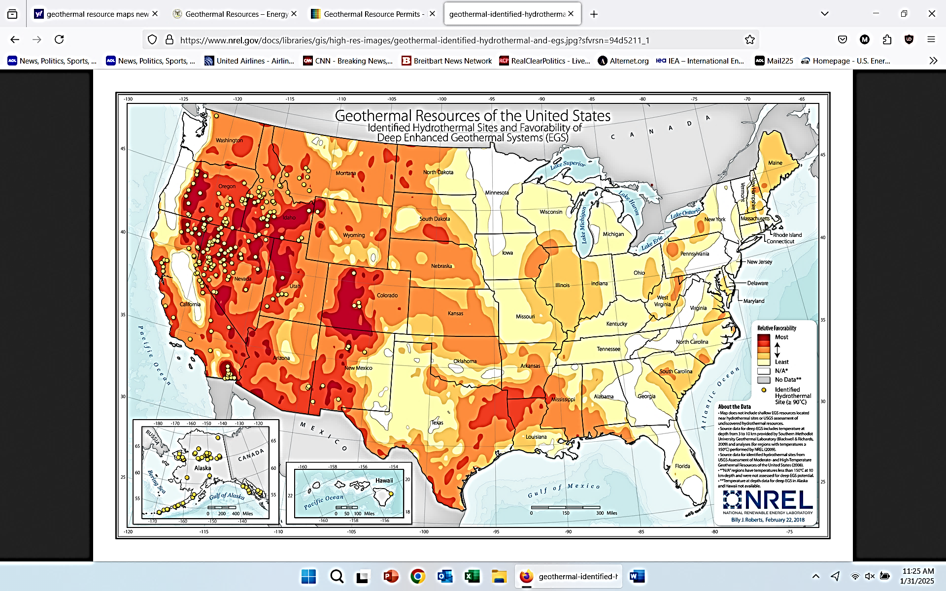
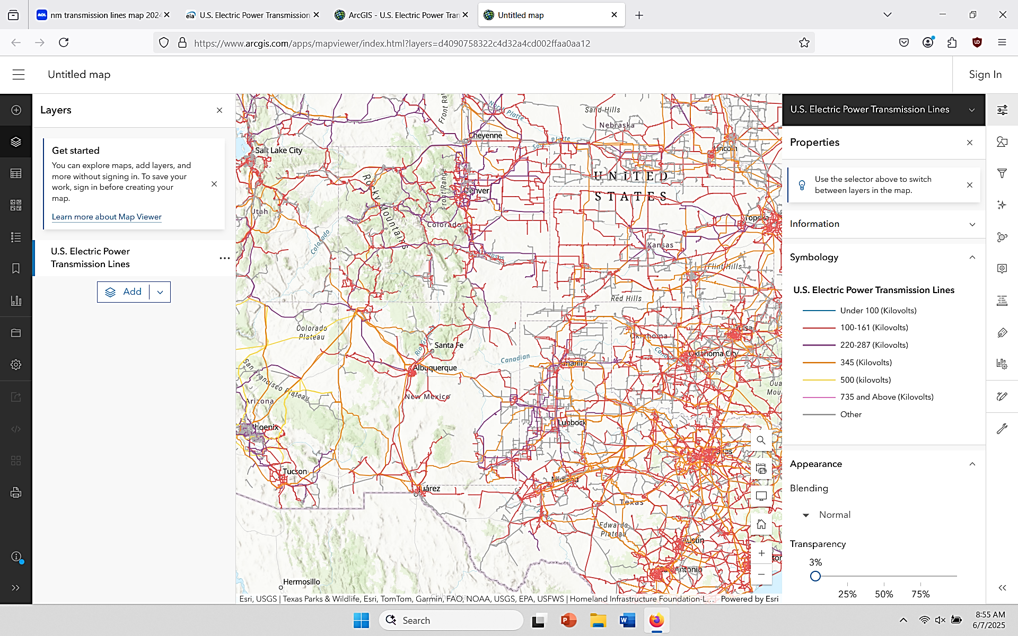

Overlay: NM’s Geothermal Resources/Transmission Lines
Most
Least
N/A
No data
Transmission Lines
100-161 Kv
220-287 Kv
345 Kv
Hydrothermal
Site (≥ 90º C)
https://www.arcgis.com/apps/mapviewer/index.html?layers=d4090758322c4d32a4cd002ffaa0aa12

Slide 9
1 Grants
2 Loans
3 Outreach and education
4 Workforce
5 Permitting
6 Policy & Next Steps
ECAM Geothermal Programs

Slide 10
Geothermal Grants
Funds “to advance geothermal projects.”
~ $20m
Four initial awards, to focus on different regions of the state:
UNM – Albuquerque metro
NMSU – Las Cruces region
Jicarilla – Jicarilla Apache Reservation
NM Tech – Socorro region
Phases of study and go/no-go steps:
Tabletop data analysis (subsurface, grid, surface permissions, etc)
Noninvasive field tests (magnetotelluric studies; gravity studies)
Invasive field tests (skinny wells to check temperature gradient and subsurface, etc)
Production well

Slide 11
Geothermal Loans
Geothermal Projects Development Fund – Loans
  Loans to advance geothermal projects (current focus is exploration backstop)
  $2.5m in state seed money, and can receive outside dollars too
  Who is eligible to receive funding from EMNRD: entities, tribes, universities, political subdivisions
  Target availability: winter 2026

Slide 12
Geothermal Outreach and Education
“Geothermal 101” road show
  Educational workshop presented to local officials, county commissioners, environmental groups, neighbors, unions, etc
  Goals:
    Present neutral fact-based information
    Lay out pros, cons and lessons learned elsewhere
    Before a geothermal project arrives in the area
    Open a line of communication between ECAM regulators and local officials, environmental groups, Office of State Engineer, etc
  Starting with 3 – 5 locations around the state; hope to expand to all 33 counties
  Tribal content too

Slide 13
Geothermal Workforce
Workforce
  ECAM’s geothermal staff and ECAM’s workforce staff are collaborating with DWS and JTIP
  Presented at monthly Workforce Alliance For Green Energy (WAGE) working group
  NM Tech geothermal certificate

Slide 14
Geothermal Permitting
  Goal: Fast, fair, safe permitting
  Updating ECAM permitting rules.
  Estimated completion late fall 2026
  New features balance new technologies with state reliability, and safety:
    Multiple different well categories; ability to roll over to a different category
    ECAM has power over pooling, protect developer’s sunk costs and the state’s heat resource
  Smooth coordination across agencies like the State Land Office, Office of the State Engineer and EMNRD.
  Building a permitting website with digital forms and process
  Dedicated geothermal staff (but they are terms not perms)

Slide 15
Geothermal Challenges, Solutions & Next Steps
Upfront risk and upfront capital remains very high for developers (“valley of death”).
  One solution: continue state investment in subsurface data (a la FORGE in Utah)
There’s a need to coordinate timing with the grid, especially on transmission buildout
  One solution: update utility integrated resource plans annually, not every 3 years
Rapidly changing technology can outpace regulatory capacity
  One solution: adequately staff ECAM’s geothermal office, including sufficient in-field inspectors
  4. National and international supply chains, as well as competition with oilfield private market, are slowing deployment of ECAM dollars and raising prices.
  One solution: extend ECAM’s authority to spend the $22.5m through FY28.

Slide 16
New Mexico support for geothermal – Strong Customer Base
  Potential customers include:
  Data centers, which are attracted to New Mexico’s geographically central location, with little to no incidence of natural disasters like hurricanes or earthquakes.
  Four major military installations evaluating geothermal for energy security.
  Intel, Boeing and Raytheon, which run major manufacturing facilities in geothermal basins.
  The state’s IOUs, which are under a renewable portfolio standard to produce 100% of the state’s electricity carbon-free by 2045.

Slide 17
New Mexico support for geothermal – World-Class Research
  New Mexico hosts major research institutions which have been exploring and experimenting with geothermal energy for decades:
  University of New Mexico
  New Mexico State University
  New Mexico Tech – now offering a geothermal engineering certificate
  Los Alamos National Laboratory (Los Alamos, NM)
  Sandia National Laboratory (Albuquerque, NM)

Slide 18
Geothermal – Financial support
Geothermal Electricity Tax Credit
  Credit for geothermal electricity generation of $0.015 per KwH generated.
  Program runs from January 1, 2025 to December 31, 2031.
  Annual aggregate amount available is $5 million per year.
Tax Deduction
  Gross Receipts Tax deduction for selling goods or services that are associated with geothermal power plants.
IRBs
  Industrial Revenue Bonds (IRBs) for private developers in county partnerships

Slide 19
Geothermal – Financial support
Geothermal Ground-coupled Heat Pump Tax Credit
  Provides a credit for 30% of the purchase and installation costs of a geothermal heat pump system, capped at $9000 per taxpayer per year.
  Program runs from January 1, 2024 to December 31, 2033.
  Annual aggregate amount available is $4 million per year.

