Slide 1
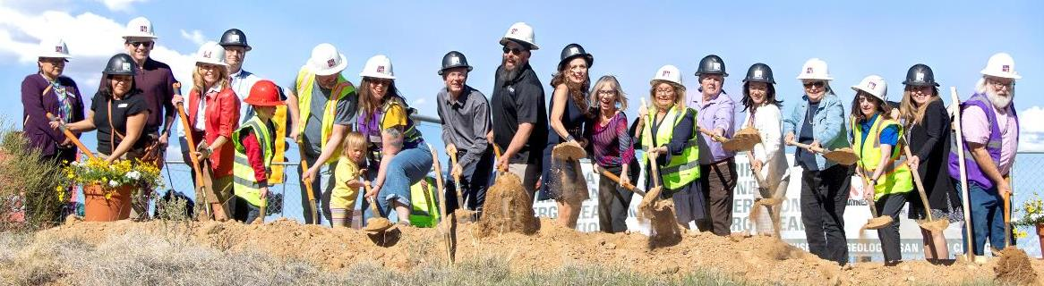

Higher Education Partnerships
Supporting Energy Development

Slide 2
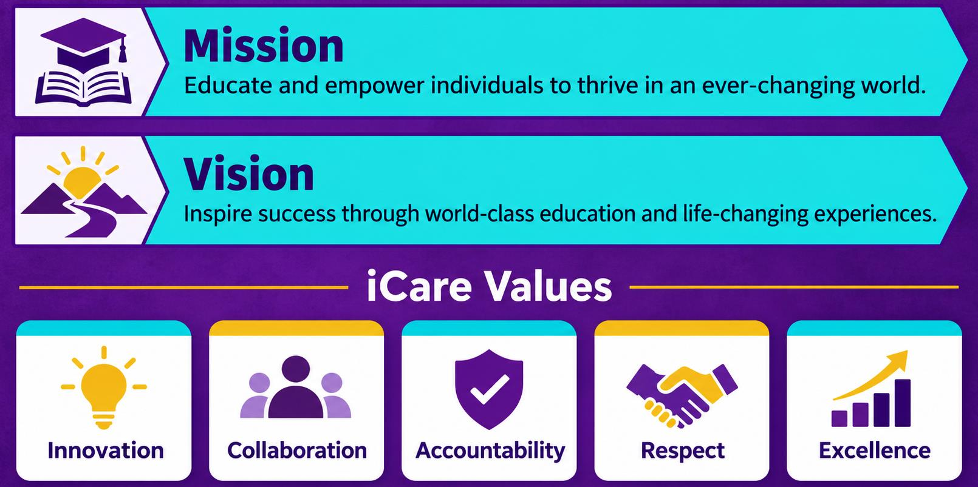
Mission, Vision & Values

Slide 3
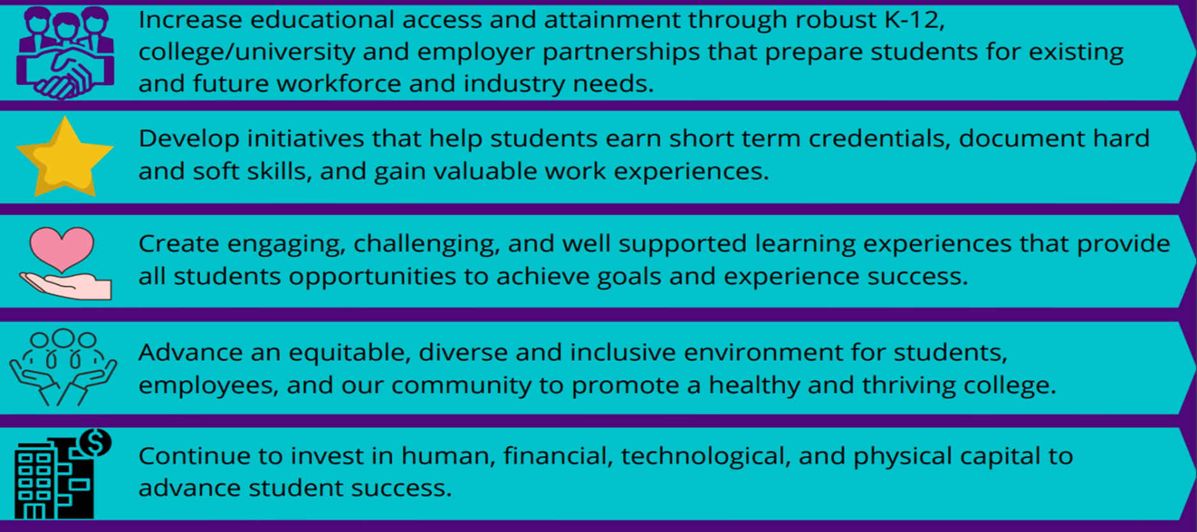
Five Strategic Directions 2022-2027

Slide 4
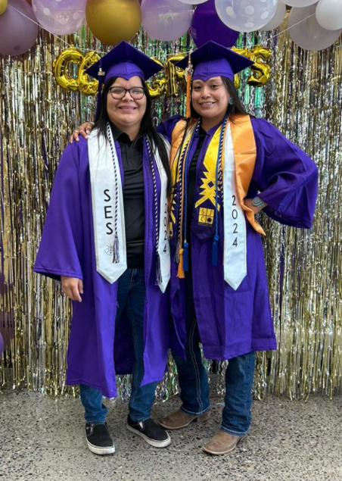
SJC Facts
Credit enrollment: 9,262 students
Non-credit enrollment: 2,925 students
32% Native American
23% Hispanic
66% female, 34% male
Tuition: $61 per credit hour
140+ degree and certificate programs
1st in nation for Native American/ Alaskan Native graduates
96% of students would recommend SJC to their friends and family

Slide 5
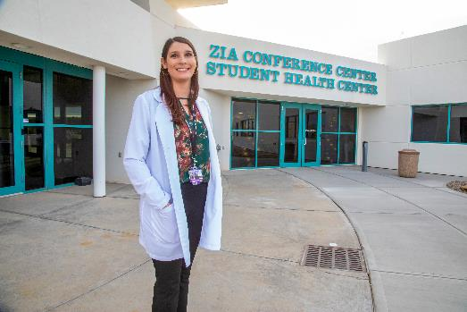
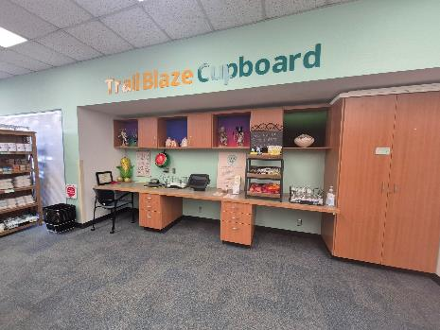
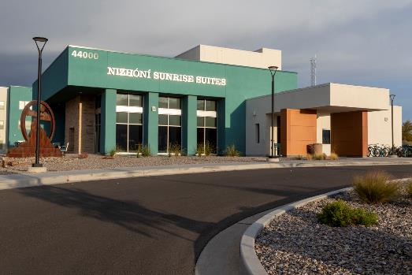
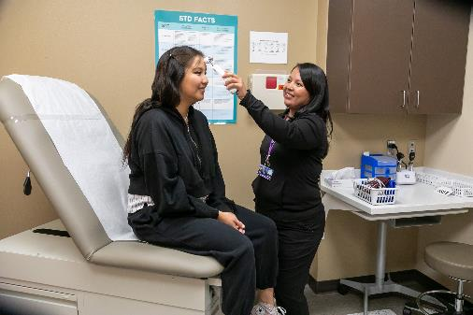
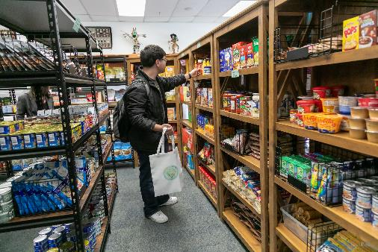
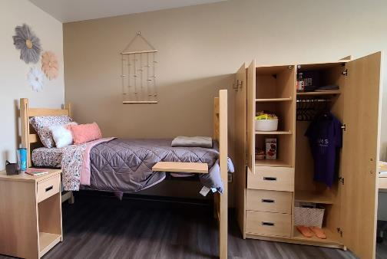
Supporting Student Success
Student Health Center
Trail Blaze Cupboard
Nizhóní Sunrise Suites

Slide 6
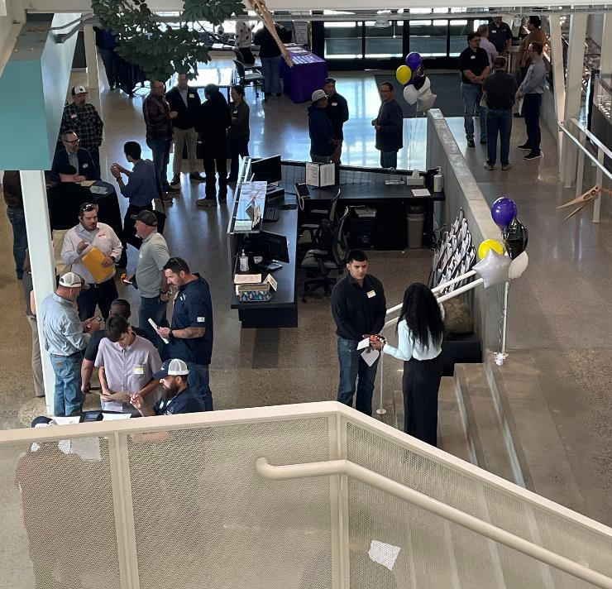
Partnership in Action: Classroom to Career
130
Employers
737
Experiential learning students
89%
Graduate employment, continuing education or entered military

Slide 7

























































100 +
EXPERIENTIAL
LEARNING SITES
Edwards Automation and DESIGN, LLC

Slide 8
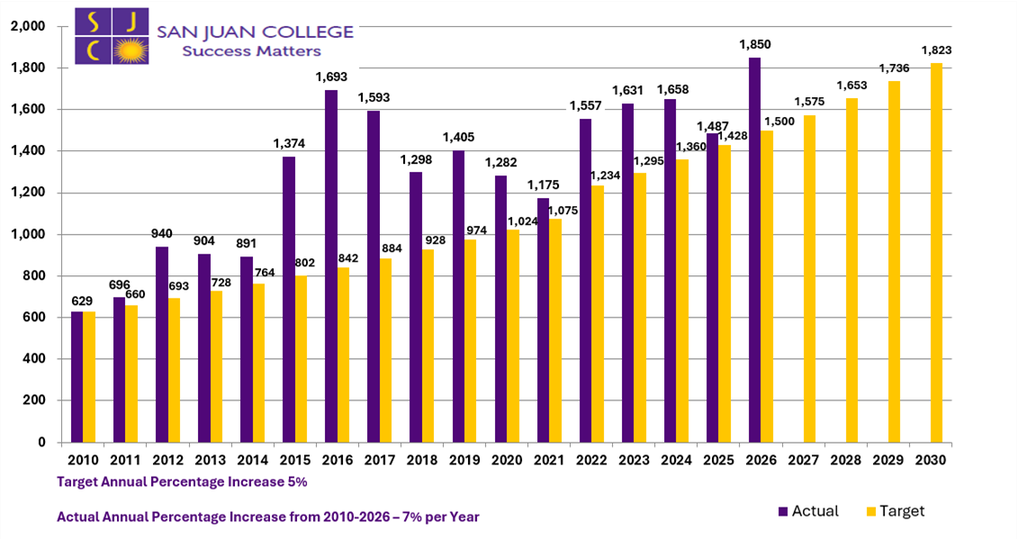
Graduate Challenge
629
2010 graduates
1850
2026 graduates
~3x
as many graduates
7% annual increase
2010–2026

Slide 9

School of Energy Programs:
Academic Certificates and Degrees
Advanced Petroleum Production Operations
Commercial Driver’s License
Instrumentation, Controls, and Electrical Technology
Industrial Maintenance Mechanic
Industrial Process Operations
Natural Gas Compression
Occupational & Commercial Construction Safety
Water Operator Certificate

Slide 10
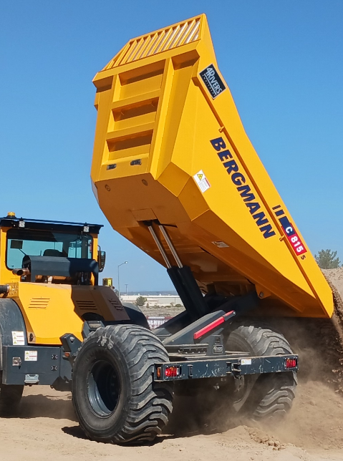
School of Energy Programs:
Non-Credit Offerings
IADC Well Control
  Onsite and Client Site
Industrial Safety Training
Heavy Equipment Operator
Process Safety
New Mexico & Texas State Inspector Training
Specialized Corporate Training
Emissions Technician, OGI Certification Credential

Slide 11


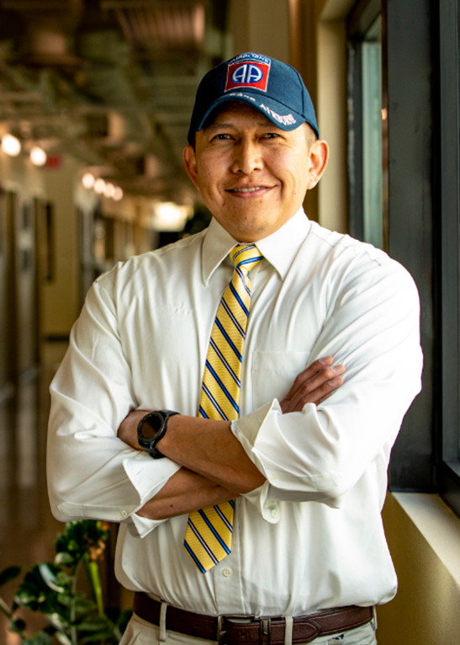

















Partner Sampling

Slide 12
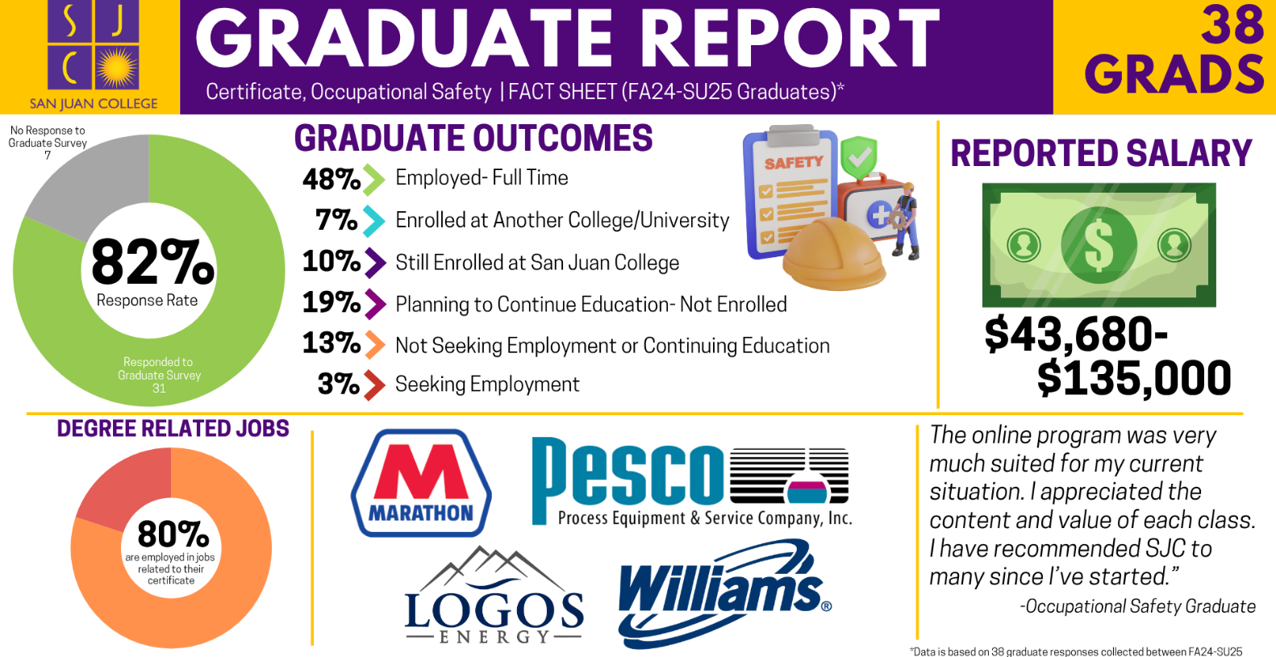
Occupational Safety Graduate Outcomes

Slide 13
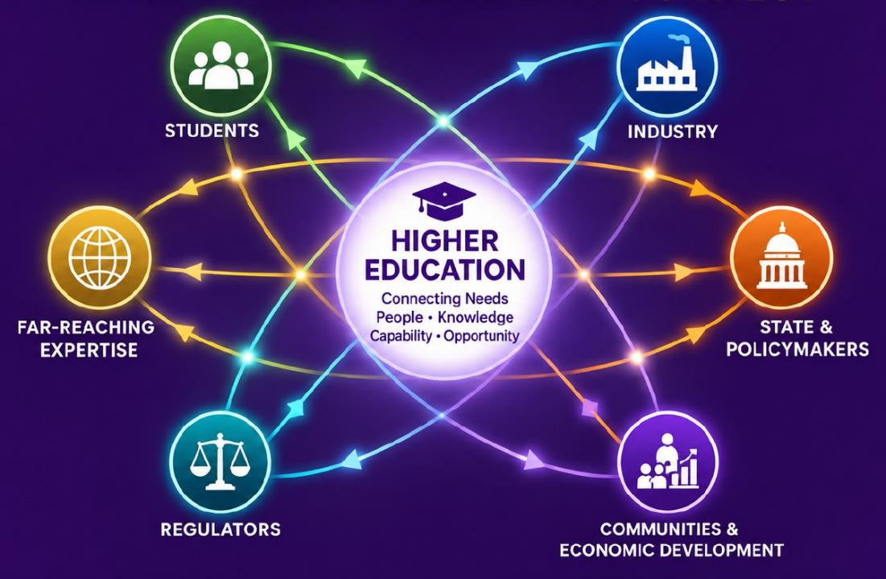
Energy Development Happens When…
…The Right Elements Connect

Slide 14
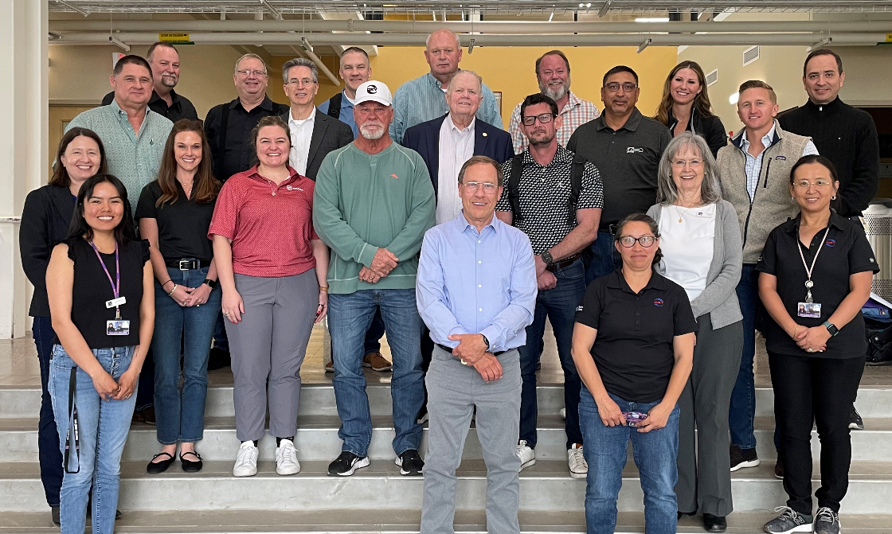
Partnerships Expand What a College Can Accomplish
STUDENTS
Access • Experience
GRADUATES
Careers • Mobility
COMMUNITY
Workforce • Opportunity
GOVERNMENT
Capacity • Development

Slide 15
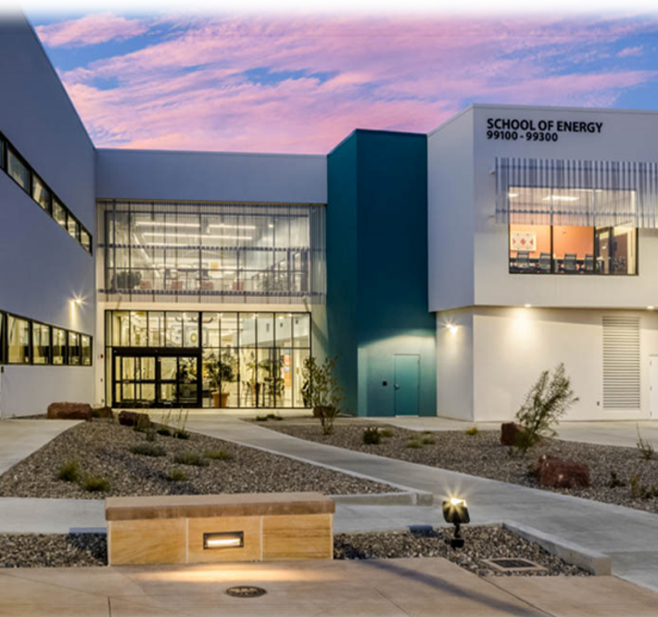
New Mexico Center of Excellence
for Renewable Energy & Sustainability
2019
BUILD
LAUNCH
EVOLVE
→
→
→
State Designation
Advance successful work
Address emerging needs
Develop & Deliver
Anticipating, building, and implementing
Current examples:
Certified Natural Gas • Emissions / LDAR •
Carbon Capture • Class VI • Water •
Fusion Workforce Assessment • Deep Geothermal

Slide 16
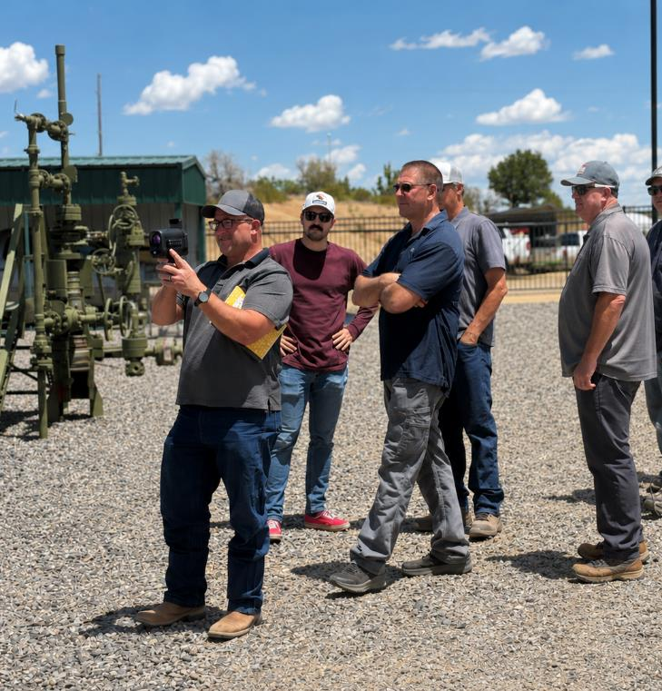
When a Need Leads to Something Much Bigger
EMPLOYER NEED
Emissions/ OGI Skills
CAPABILITY GROWS
Training • Equipment • Relationships
GOVERNOR REQUEST
SJC develops the Certified Natural Gas Initiative
TODAY
SJC maintains and expands the statewide registry

Slide 17
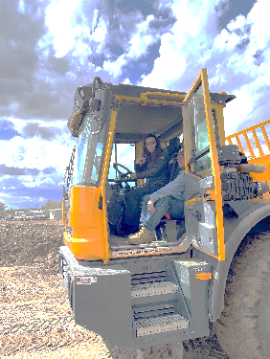
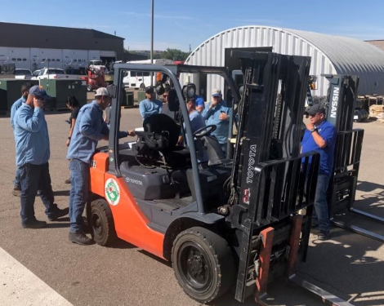
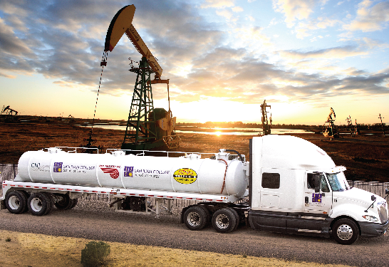
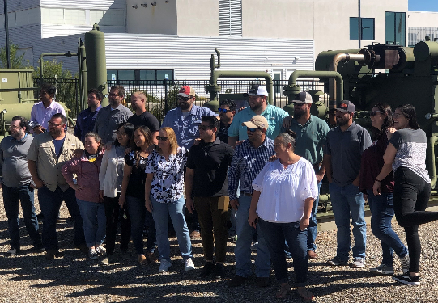
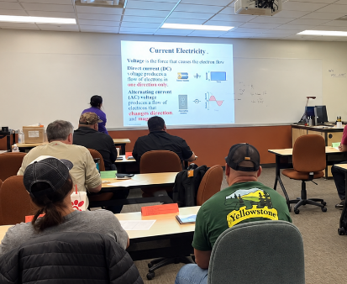
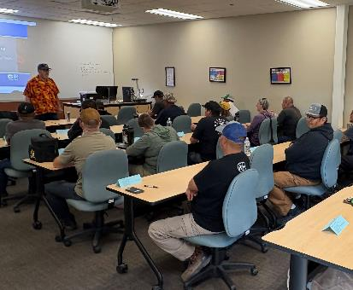
Build for Employer Needs
MODULAR
BUILDS
PACE
EXPERIENCE
→
Leverage Expertise
Speed of Industry
Selection

Slide 18
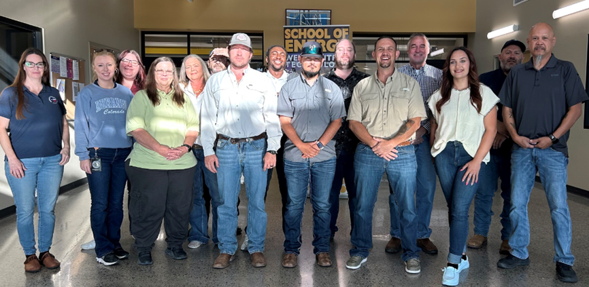
Partnerships Can Build State Capacity
STATE NEED
New inspector training
SCHOOL OF ENERGY
Develop customized training
REGULATORS
Collaborate on development
EXPERTISE
Bring together industry, research, and resources
PILOT
Listen and refine

Slide 19
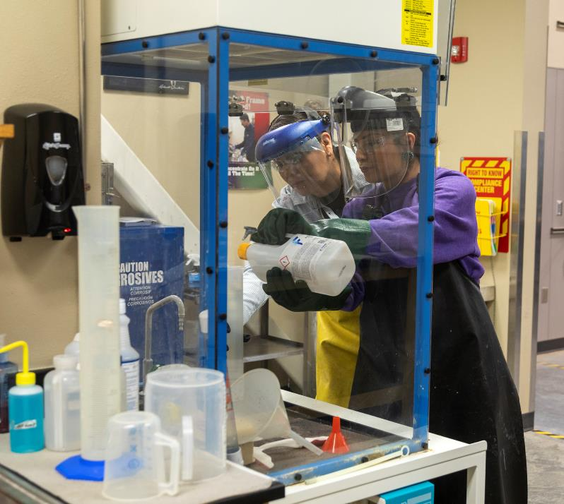
Prepare Before the Jobs Arrive
CONVENE
Industry • SMEs • Economic Development
IDENTIFY
Centers of expertise
INVENTORY
Existing skills and outcomes
ALIGN
Transferrable skills for emerging roles
GAP
Build only for identified gaps

Slide 20
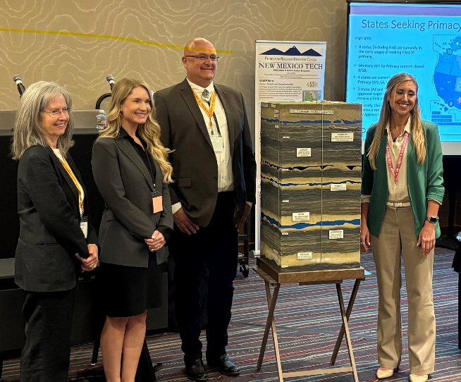
Partnerships Extend Our Reach
Class VI Inspector Training
Carbon Capture Technician Training
Hydrogen Technician Training
EXISTING FOUNDATION
OUTSIDE EXPERTISE
NEW TRAINING CAPABILITY
Foundational knowledge
+ skills
Specialized knowledge + application
Built faster and with
stronger context

Slide 21
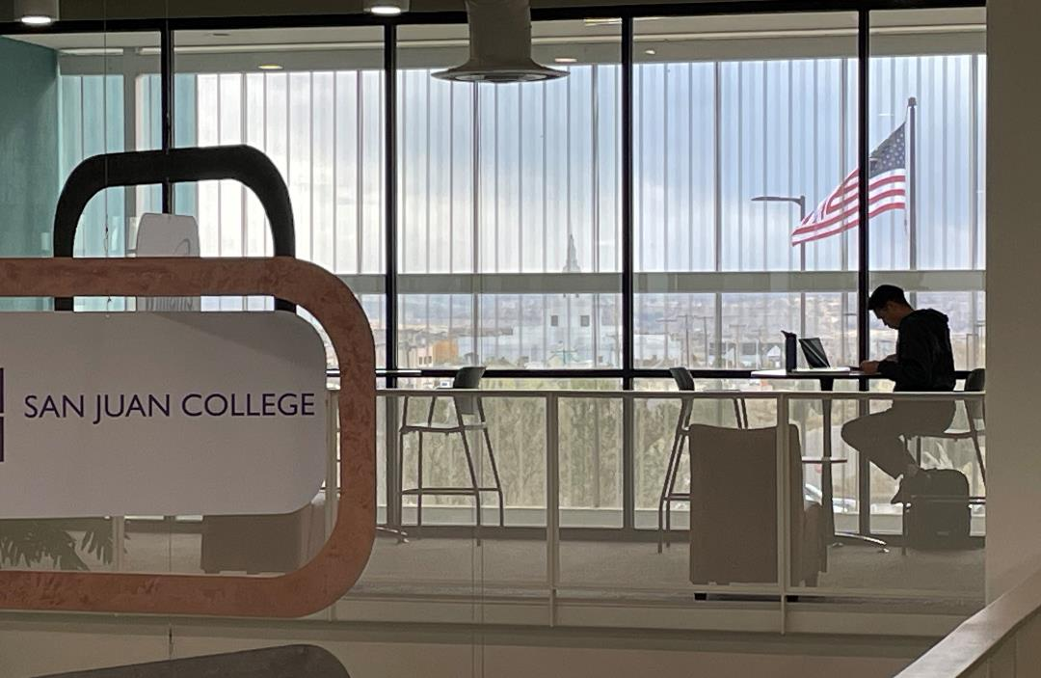
Workforce is an Economic Development Asset
Workforce Implements Rollout
95.5%
Workforce depth
listed as important
or very important
2026 Area Development
Corporate & Consultant Site Selection Survey

Slide 22
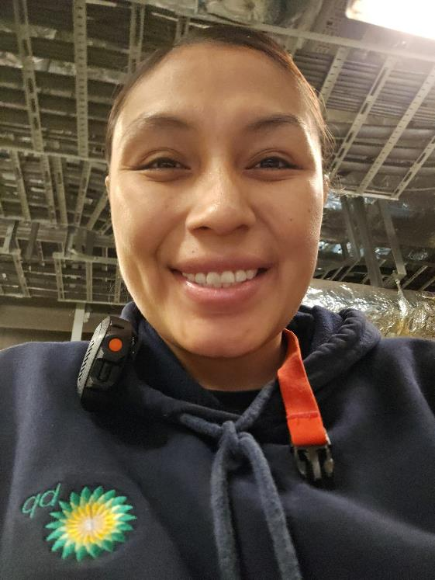
Partnerships Have to Reach the Individual
ACCESS
Pell Grant Support • 94% Receive Grants/Scholarships
PATHWAY
Discover → Access → Skills → Employer → Career
OUTCOME
average salary range SOE programs
six months after graduation
$62.5K-$90.2K
Opportunity matters when it changes a trajectory

Slide 23
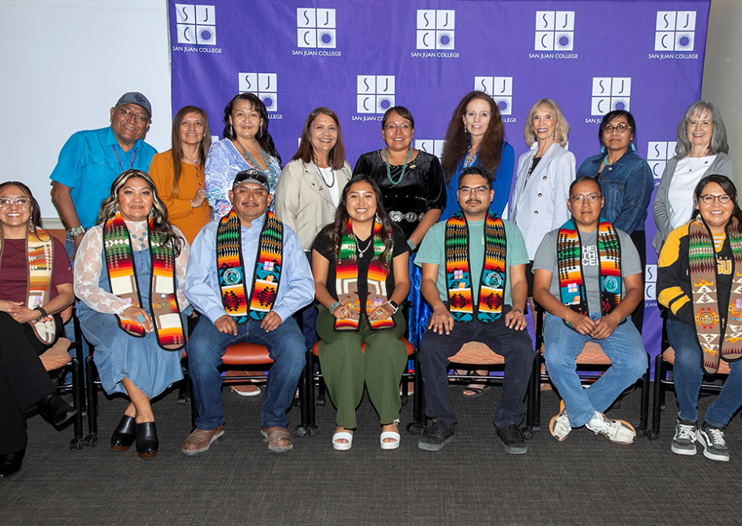

Foundation Giving
PROGRAM
CONTRIBUTIONS
SCHOLARSHIP
CONTRIBUTIONS
SoE: $182,397
SJC: $1,258,284
SoE: $338,394
SJC: 1,093,530

Slide 24
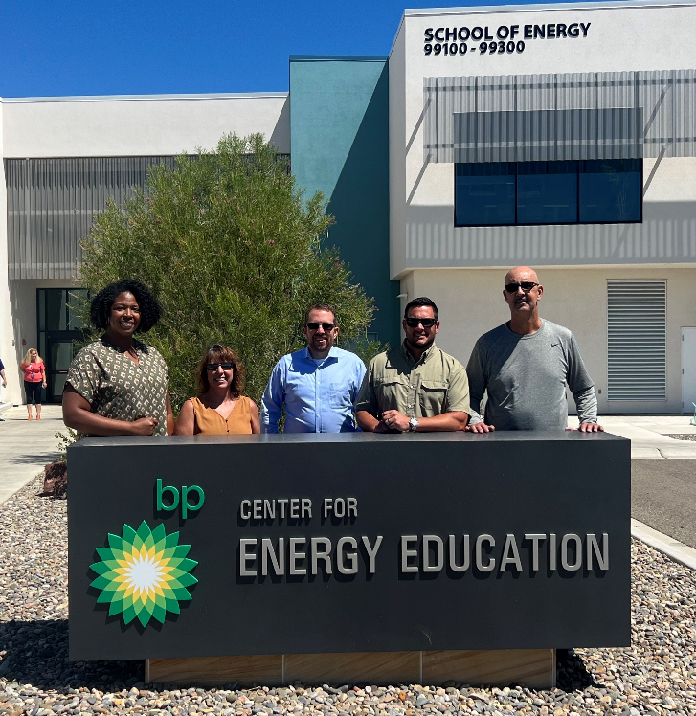
What Has Helped Our Partnerships Work
RESPOND
-Early involvement
-Flexibility
CONNECT
-Right-sized response
-The right people
BUILD
-Existing capability
-Capacity that compounds

Slide 25
