Slide 1
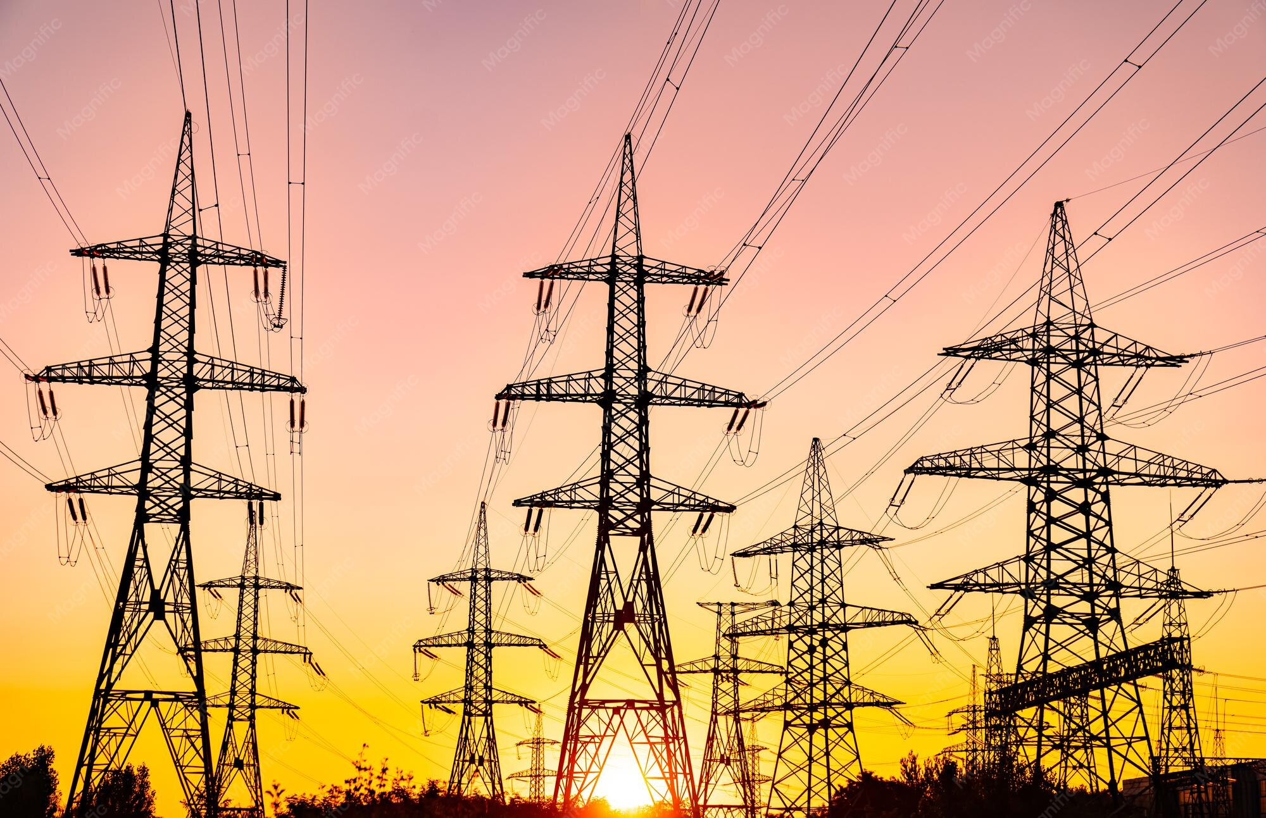

New Mexico Transmission Update
Commissioner Greg Nibert
The Energy Council
2026 Annual Meeting

Slide 2
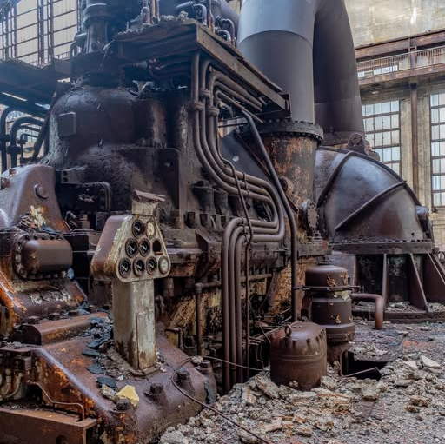
1930s Westinghouse Electric Generator

Slide 3
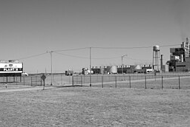
Coal Fired Electrical Generation Facility

Slide 4
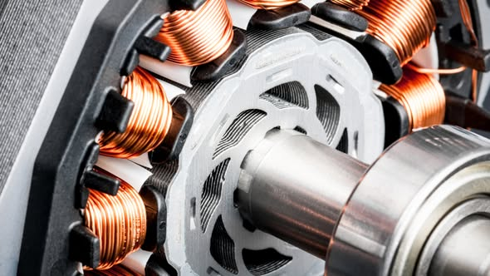
Copper coils spin around a rotor or stator

Slide 5
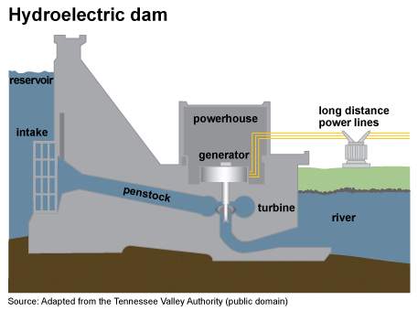

Slide 6
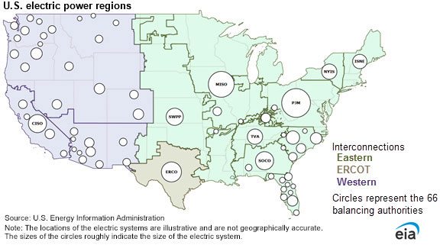
Eastern, Western and ERCOT

Slide 7
Megawatthours Sold in US
(In Thousand Megawatthours) US Energy Information Administration
Year | Residential | Commercial | Industrial | Transportation | Other | Total
2014 | 1,407,208 | 1,352,158 | 997,576 | 7,758 | N/A | 3,764,700
2015 | 1,404,096 | 1,360,752 | 986,508 | 7,637 | N/A | 3,758,992
2016 | 1,411,058 | 1,367,191 | 976,715 | 7,497 | N/A | 3,762,462
2017 | 1,378,648 | 1,352,888 | 984,298 | 7,523 | N/A | 3,723,356
2018 | 1,469,093 | 1,381,755 | 1,000,673 | 7,665 | N/A | 3,859,185
2019 | 1,440,289 | 1,360,877 | 1,002,353 | 7,632 | N/A | 3,811,150
2020 | 1,464,605 | 1,287,440 | 959,082 | 6,548 | N/A | 3,717,674
2021 | 1,470,487 | 1,328,439 | 1,000,613 | 6,334 | N/A | 3,805,874
2022 | 1,509,233 | 1,390,873 | 1,020,464 | 6,599 | N/A | 3,927,169
2023 | 1,450,025 | 1,408,109 | 1,009,256 | 6,864 | N/A | 3,874,253
2024 | 1,482,874 | 1,450,941 | 1,034,584 | 6,983 | N/A | 3,975,382

Slide 8
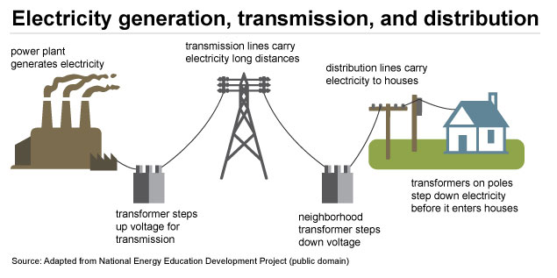
Source: Image taken from the U.S. Energy Information Administration

Slide 9


Slide 10
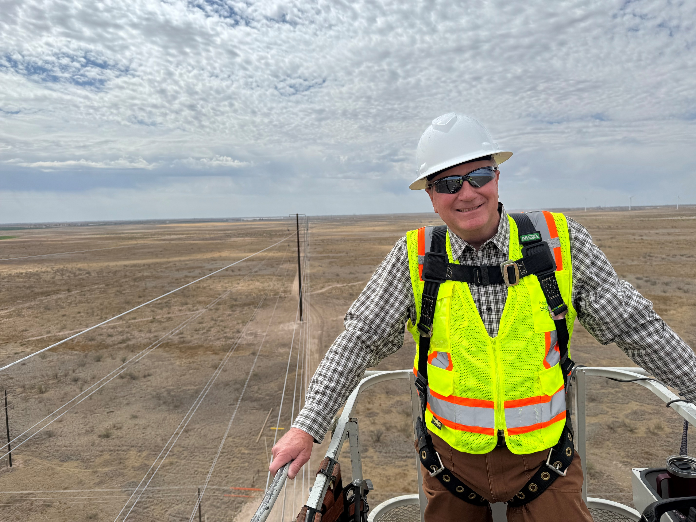
View from the Top of a New
345 kV Line Lea County, NM

Slide 11
What is driving transmission needs?
Rapid load growth
  Data centers
  Artificial intelligence
  Expansion of domestic manufacturing
  Electrification of sectors that traditionally used fossil fuels
Reliability needs and resource adequacy
Aging infrastructure that needs replacement
Generation interconnections
Grid hardening and security

Slide 12
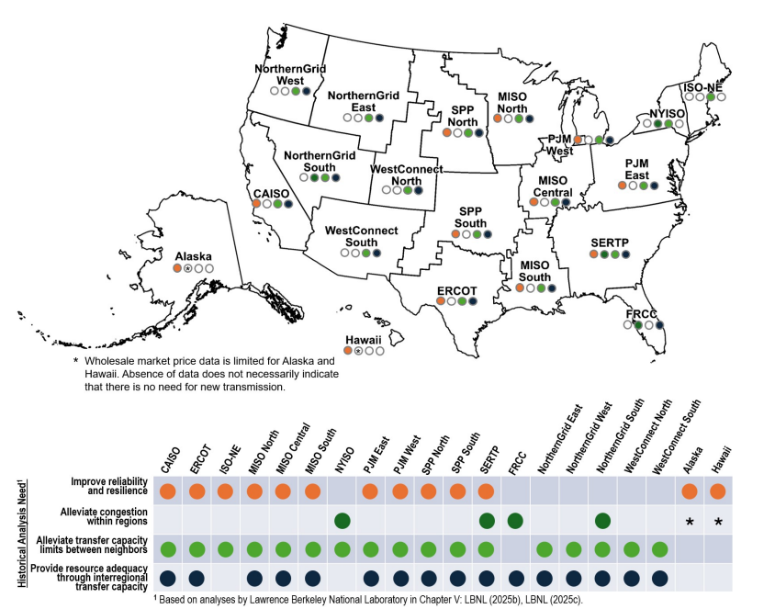
Current
Landscape
Source: Image taken from the Department of Energy’s National Transmission Needs Study Draft (July 2026)

Slide 13
What are states in the Energy Council doing?
Member State/Province | Project Name | Anticipated In-Service Date | Length (mi) | Kilovolt (kV) | Cost (USD)
North Dakota | Tande-to-Boundary Dam | 2027 | 60 | 230 | $ 68,500,000.00
North Dakota | Wheelock-to-Boundary Dam | 2027 | 70 | 230 | $ 79,500,000.00
New Mexico | Potter-Crossroads-Phantom 765-kV Transmission Line Project | 2031 | Potter-Crossroads: 180 Crossroads-Phantom: 150 Potter-Tecovas: 22 Phantom-Bandit: 9 | Potter-Crossroads: 765 Crossroads-Phantom: 765 Potter-Tecovas: 345 (3 lines) Phantom-Bandit: 345 (3 lines) | $ 3,600,000,000.00
Texas | Potter-Beckham 345-kV Transmission Line | 2029 | 125 | 345 | $ 222,000,000.00
Montana & North Dakota | North Plains Connector | 2032 | 420 | 525 | $ 6,000,000,000.00
Kansas & Oklahoma | Buffalo Flats - Delaware 345 kV New Line | 2029 | 155 | 345 | $ 484,090,326.00
West Virginia | MidAtlantic Resiliency Link | 2031 | 58.9 | 500 | $ 482,706,000.00
Note: Table is not comprehensive and only highlights some projects happening in Energy Council states.

Slide 14
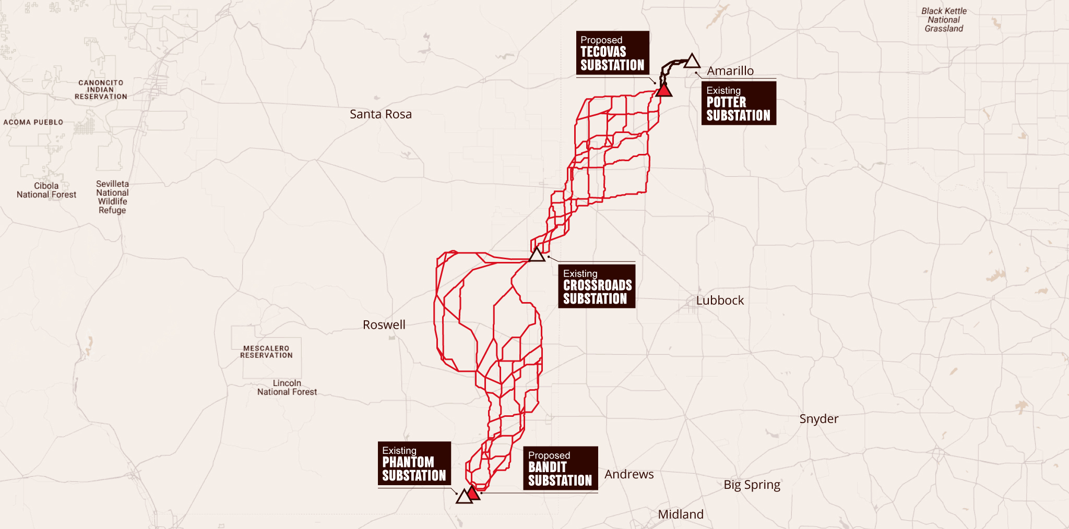
In-depth look: New Mexico
In Southeastern New Mexico there is a significant amount of load growth due electrification oil and gas production in the Permian Basin.
Southwest Power Pool selected a large-scale transmission corridor (the Potter-Crossroads-Phantom 765-kV Transmission Line Project) to provide more energy to the area.
This line will extend from Amarillo, Texas to Portales, New Mexico and continue to the Southern part of Lea County near the Texas border.

Slide 15
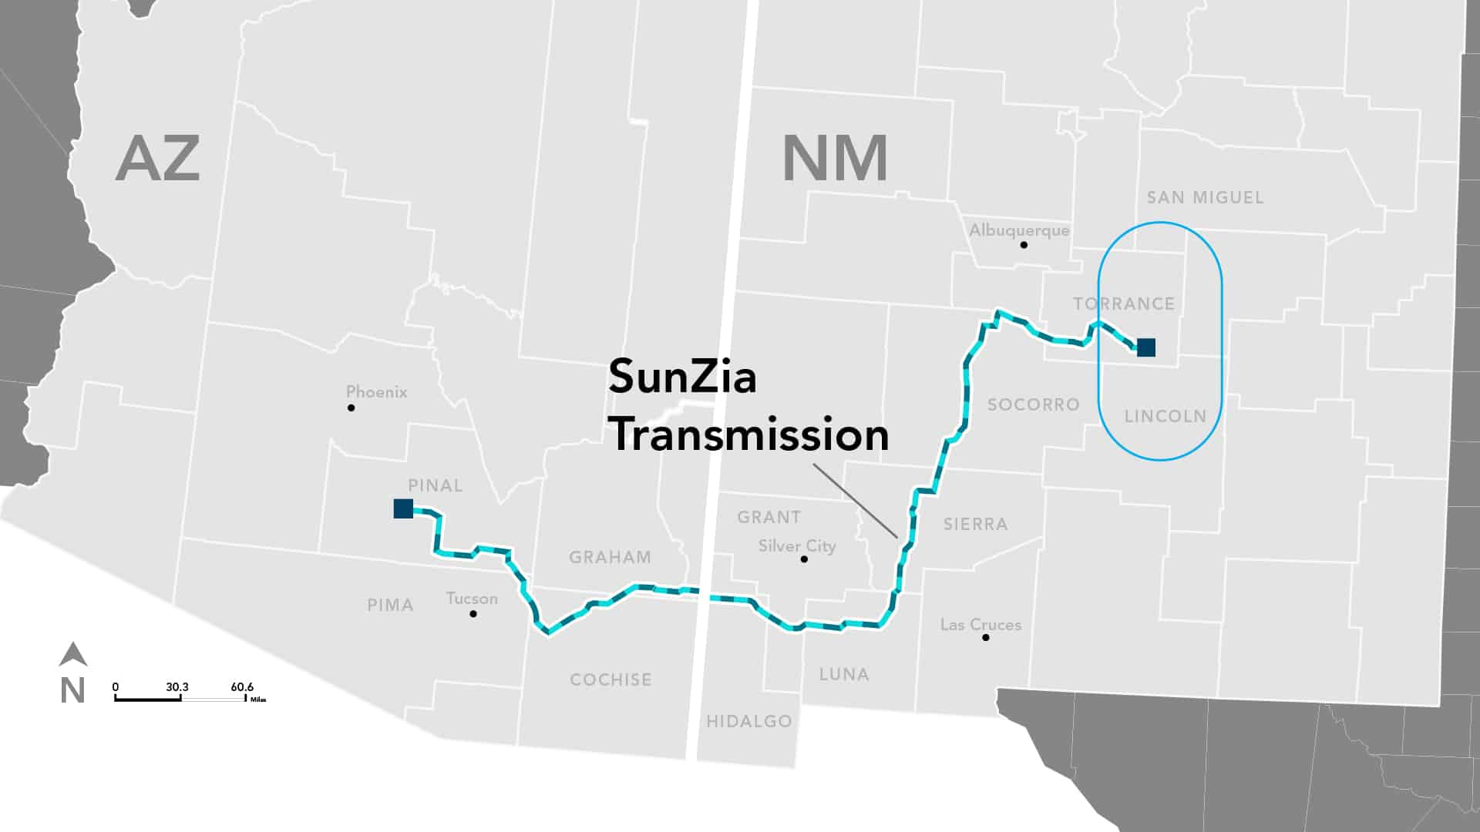
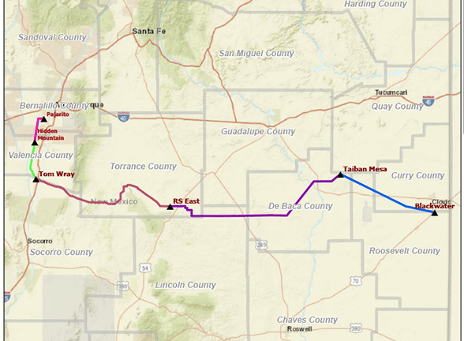
Other Transmission Projects in New Mexico
Eastern New Mexico Connector Transmission Line Project
SunZia Transmission Line
Operation Date: May 2026
Operation Date: 2032

Slide 16
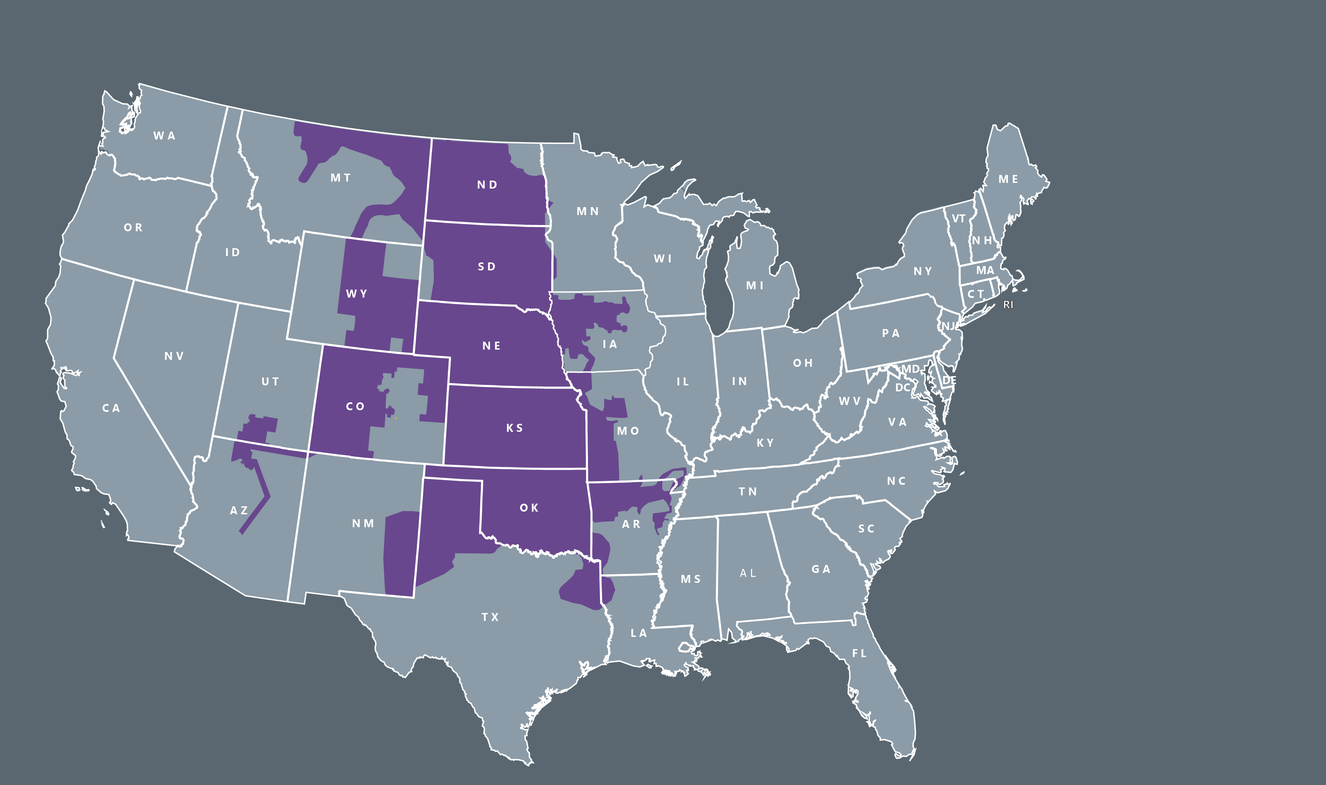
RTO OPERATING REGION
732,086 square mile service territory
~20 million population served
East Balancing Authority
  72,979 miles of transmission
  1,013 generating plants
  5,205 substations
West Balancing Authority
  12,552 miles of transmission
  166 generating plants
  507 substations
In-depth look: Southwest Power Pool (SPP)
Note: Thank you to SPP for providing the following slides discussing the regional transmission organization.

Slide 17
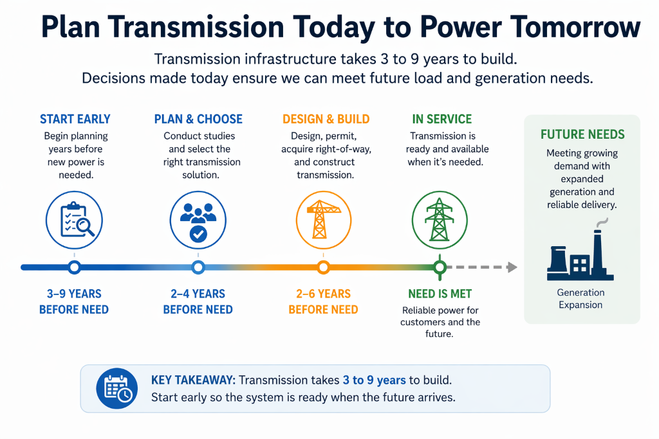

Slide 18
SPP’s PEAK Load may double in 5-10 years
The GW peak we saw in
2025 ITP F2 Y10
is now less than
2026 ITP F1 Y5
and almost
equivalent to
2027 ITP BR Y10
Notes:
Notes: F1 and F2 mean Future 1 and Future 2; BR means Base Reliability

Slide 19
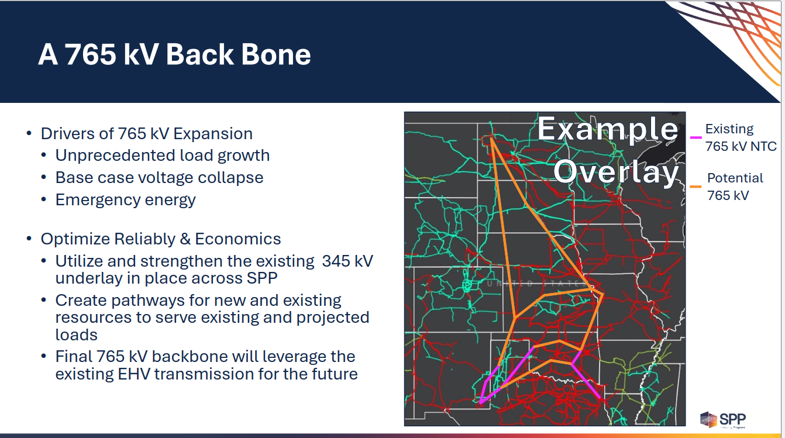
2024 ITP 765 kV (Approved)
2025 ITP 765 kV (Approved)

Slide 20
