Slide 1
Integration & Consolidation of the Nuclear Lifecycle
Integrated Nuclear Ecosystems Leading to Economic Opportunities for States
Tom Mason | September 25, 2026
Notes:
Intros – I’m the other Tom Mason
Thank Wyoming Senator Ed Cooper
really important topic
honor to be asked to share my observations
Hello Kansas
Hello WV
Hello NM
Topic is central to my day to day – vitally important to USA and huge opportunity for states
Envisioned Three Hours with breaks and snacks / settle for 30 minutes – consolidated for the benefit of all
The economic value of NLIC comes from integration. By collocating key fuel-cycle functions, NLIC creates efficiencies and investment opportunities that are greater than the sum of the individual facilities.

Slide 2
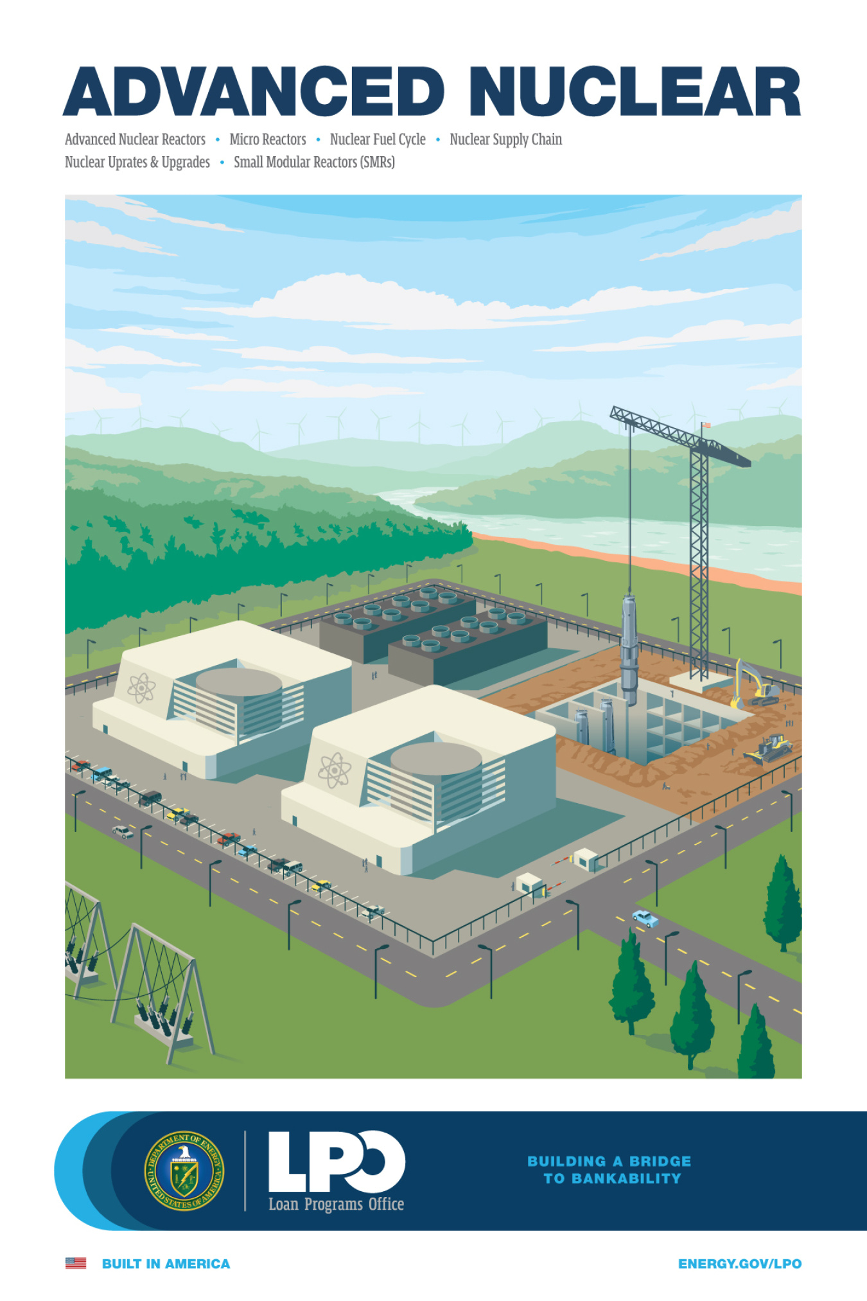
Discussion Topics
Industry Vantage Point - Amentum
The Nuclear Ecosystem
The Stars Have Aligned
DOE Office of Nuclear Energy (NE)
Final Disposition is Key
How States Win

Slide 3
Industry Vantage Point – Amentum
Amentum - $15B rev /44 countries / 55,000 employees
Amentum in the U.S. Nuclear Industry
  Nuclear Projects Organization
    design and construction of nuclear facilities
    Nuclear Center of Excellence – Oak Ridge, TN (500 engineers)
    DOE /NNSA – special nuclear facilities, legacy facility decommissioning
    commercial nuclear – design facilities in every phase of the nuclear fuel cycle
  DOE Tier 1 – Operating 20 Sites for DOE NNSA, EM, and NE
    Operate DOE sites
    Oak Ridge / UCOR – Facility decommissioning, land cleanup and land transfer to industry
    MSTS – mission support / NNSA infrastructure / capital projects
    Idaho National Lab – mission support, environmental restoration, NR spent fuel mission

Slide 4
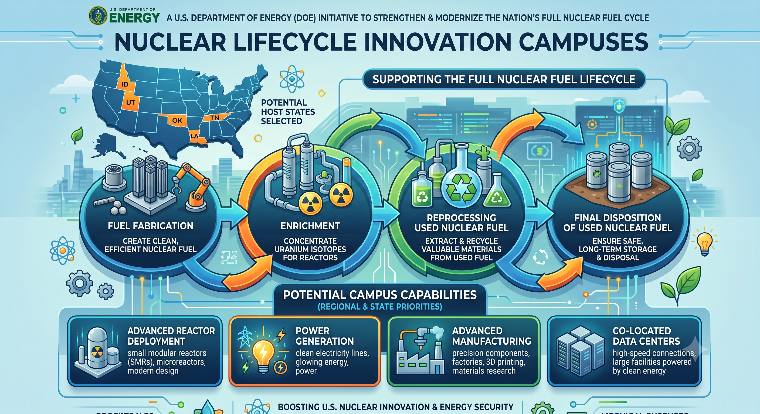
The Nuclear Ecosystem

Slide 5
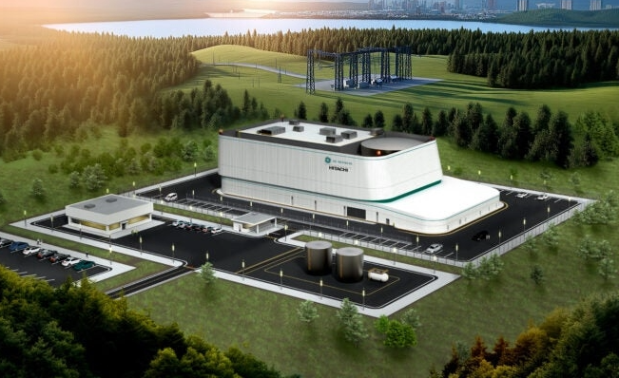
The Stars are Aligned like Never Before
All Key Elements Are In Place
Power Demand Curve – Ideal for nuclear
  AI data centers driving steady demand for electric power
Investment Capital is Abundant and Flowing
  private investments /
  IPO / public investment
Federal “Tailwinds”
  Executive orders nuclear energy
  Federal agencies / legislation
  Federal commercial partnerships – rapidly advancing nuclear technology
  Federal land leases
State “Tailwinds”
  Financial incentives / tax incentives / relocation incentives
  Favorable regulatory environment
Community Reuse / Economic Development Organizations

Slide 6

U.S. DOE Office of Nuclear Energy
Federal Partner Driving the Industry
Senate Confirmed Leadership
  NE1: The Honorable Theadore (Ted) Garrish
Defense Production Act Consortium (DPA)
Nuclear Lifecycle Innovation Campus (NLIC)
Driving Legislative Framework for Final Disposition

Slide 7
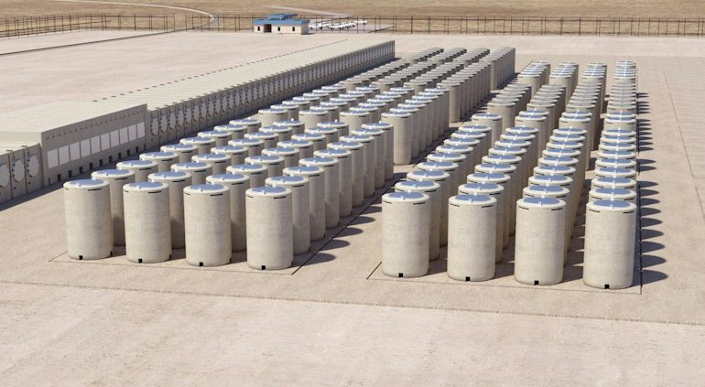
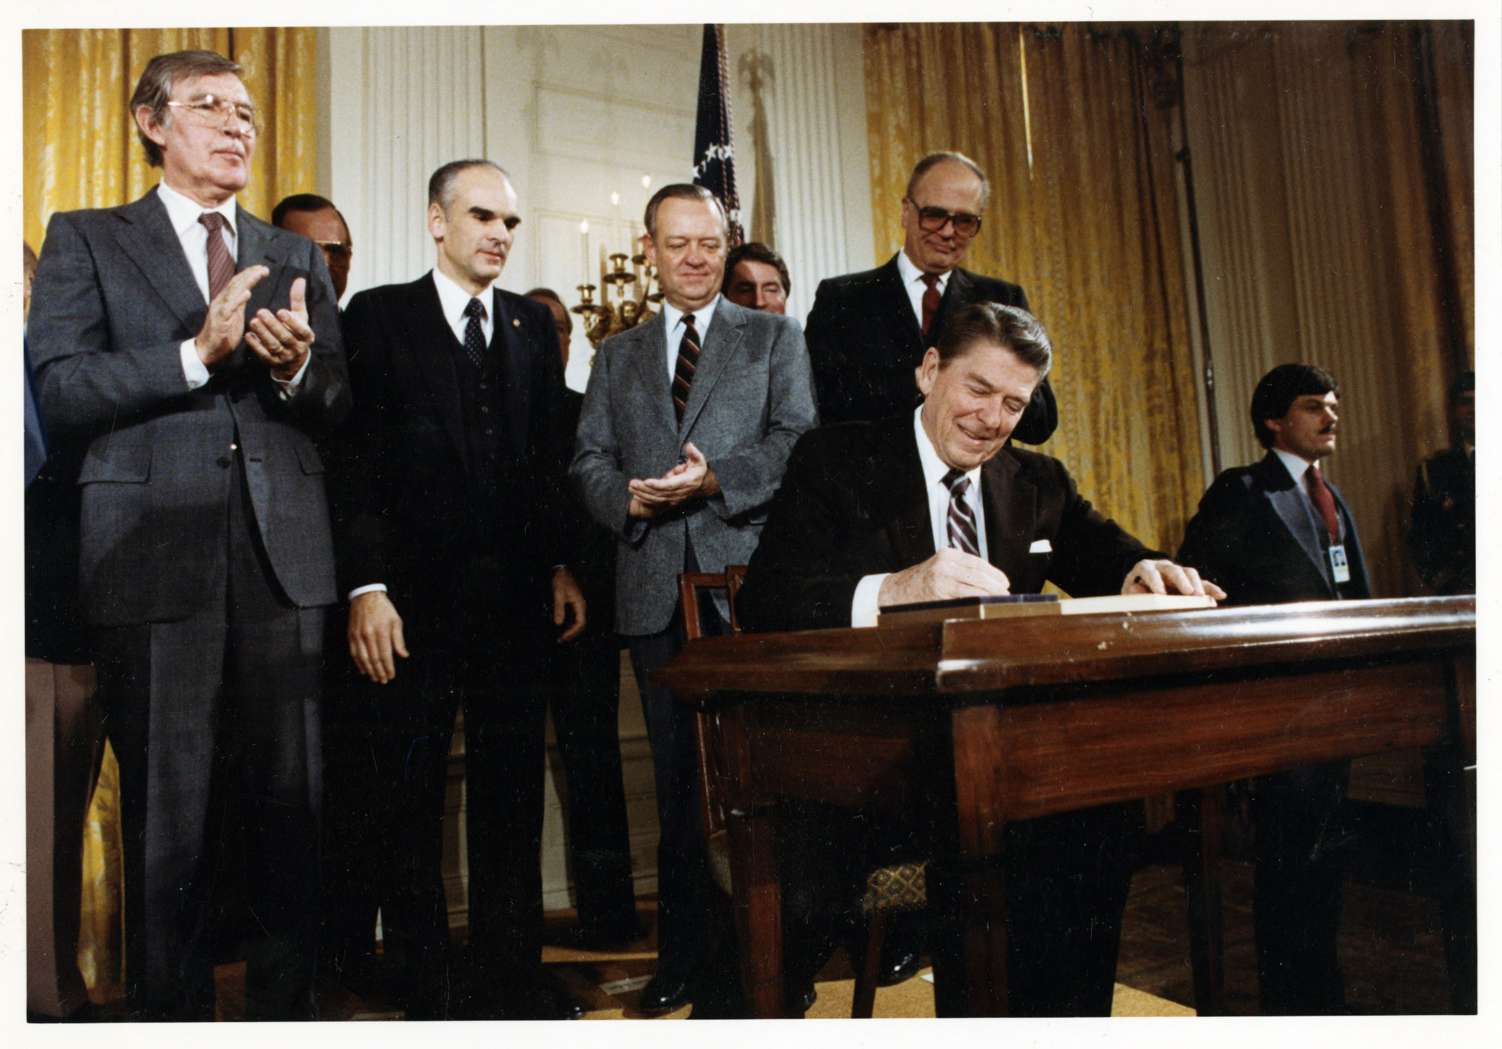
Completing the Nuclear Lifecycle
Final Disposition is Essential
  closes the nuclear fuel cycle
  provides a permanent solution
  reduces risk passed to future generations
Current Status of Spent Fuel in U.S.
  95,00 metric tons staged at generating sites
  no permanent U.S. repository exists
  solution is fully funded - nuclear waste fund = $52B
  legislation required to utilize fund
Yucca Mountain Policy Failure and Lesson Learned
  safety case and technology success, political failure
  lesson = repository cannot be imposed on unwilling host
  resulted in consent-based siting used globally
Nuclear Waste Policy Act (NWPA) of 1982

Slide 8
How States Win
Volunteer for a Permanent Repository
  See NWMO case study for scale
  Full nuclear enterprise follows repository siting and acceptance
  Massive economic benefit to host state
Capital Follows Certainty
  land availability and workforce development
  environment regulatory framework
  state transportation corridors, highway and rail, highspeed internet
  safety and security
Leverage Existing Infrastructure, University Partners, and Regional Solutions
  multiple levels of nuclear / nuclear adjacent opportunities exist
  every state won’t be a repository – geology, public acceptance, location
  regional solutions are valuable – Idaho / Utah / Wyoming /tri-state compact example
Copy Highest Performing State Incentive Packages
  corporate relocation incentives
  state nuclear fund
  tax incentives

