Slide 1

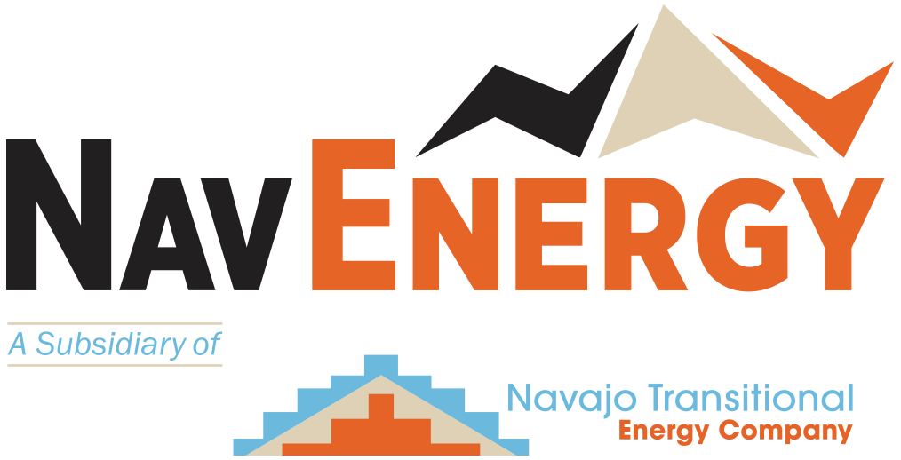
Energy
Sovereignty
For the Navajo Nation
The Energy Council
September 24-26, 2026

Slide 2
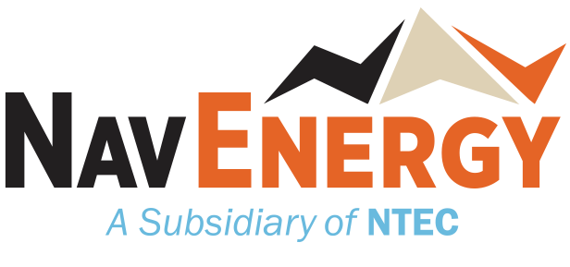
Who is NTEC?
September 24-26 · 2026
navenergy.com

Slide 3

Who We Are
Owned by the Navajo Nation | Third Largest Coal Producer in the U.S. | Winner of National Safety and Reclamation Awards
Navajo Transitional Energy Company (NTEC) was created to fulfill the 2013 Navajo Nation Energy Policy:
    To protect and promote the economic and financial best interest of the Navajo Nation
    To achieve greater sovereignty over Navajo resources
    To develop and hold a portfolio of energy assets that benefits future generations of Navajo citizens, while protecting the land
Established the Navajo Nation as the first tribal owner of an operating mine and power plant
NTEC provides more than one-third of the Navajo Nation’s General Fund annually to our sole shareholder, the Navajo Nation
^{~32%}
^{23%}
^{NAVAJO MINE}
OF THE NAVAJO NATION GENERAL FUND COMES FROM THE COMBINED CONTRIBUTIONS OF THE NAVAJO MINE AND FOUR CORNERS POWER PLANT (FCPP) ON AVERAGE
^{9%}
^{FOUR CORNERS}
^{POWER PLANT}

Slide 4
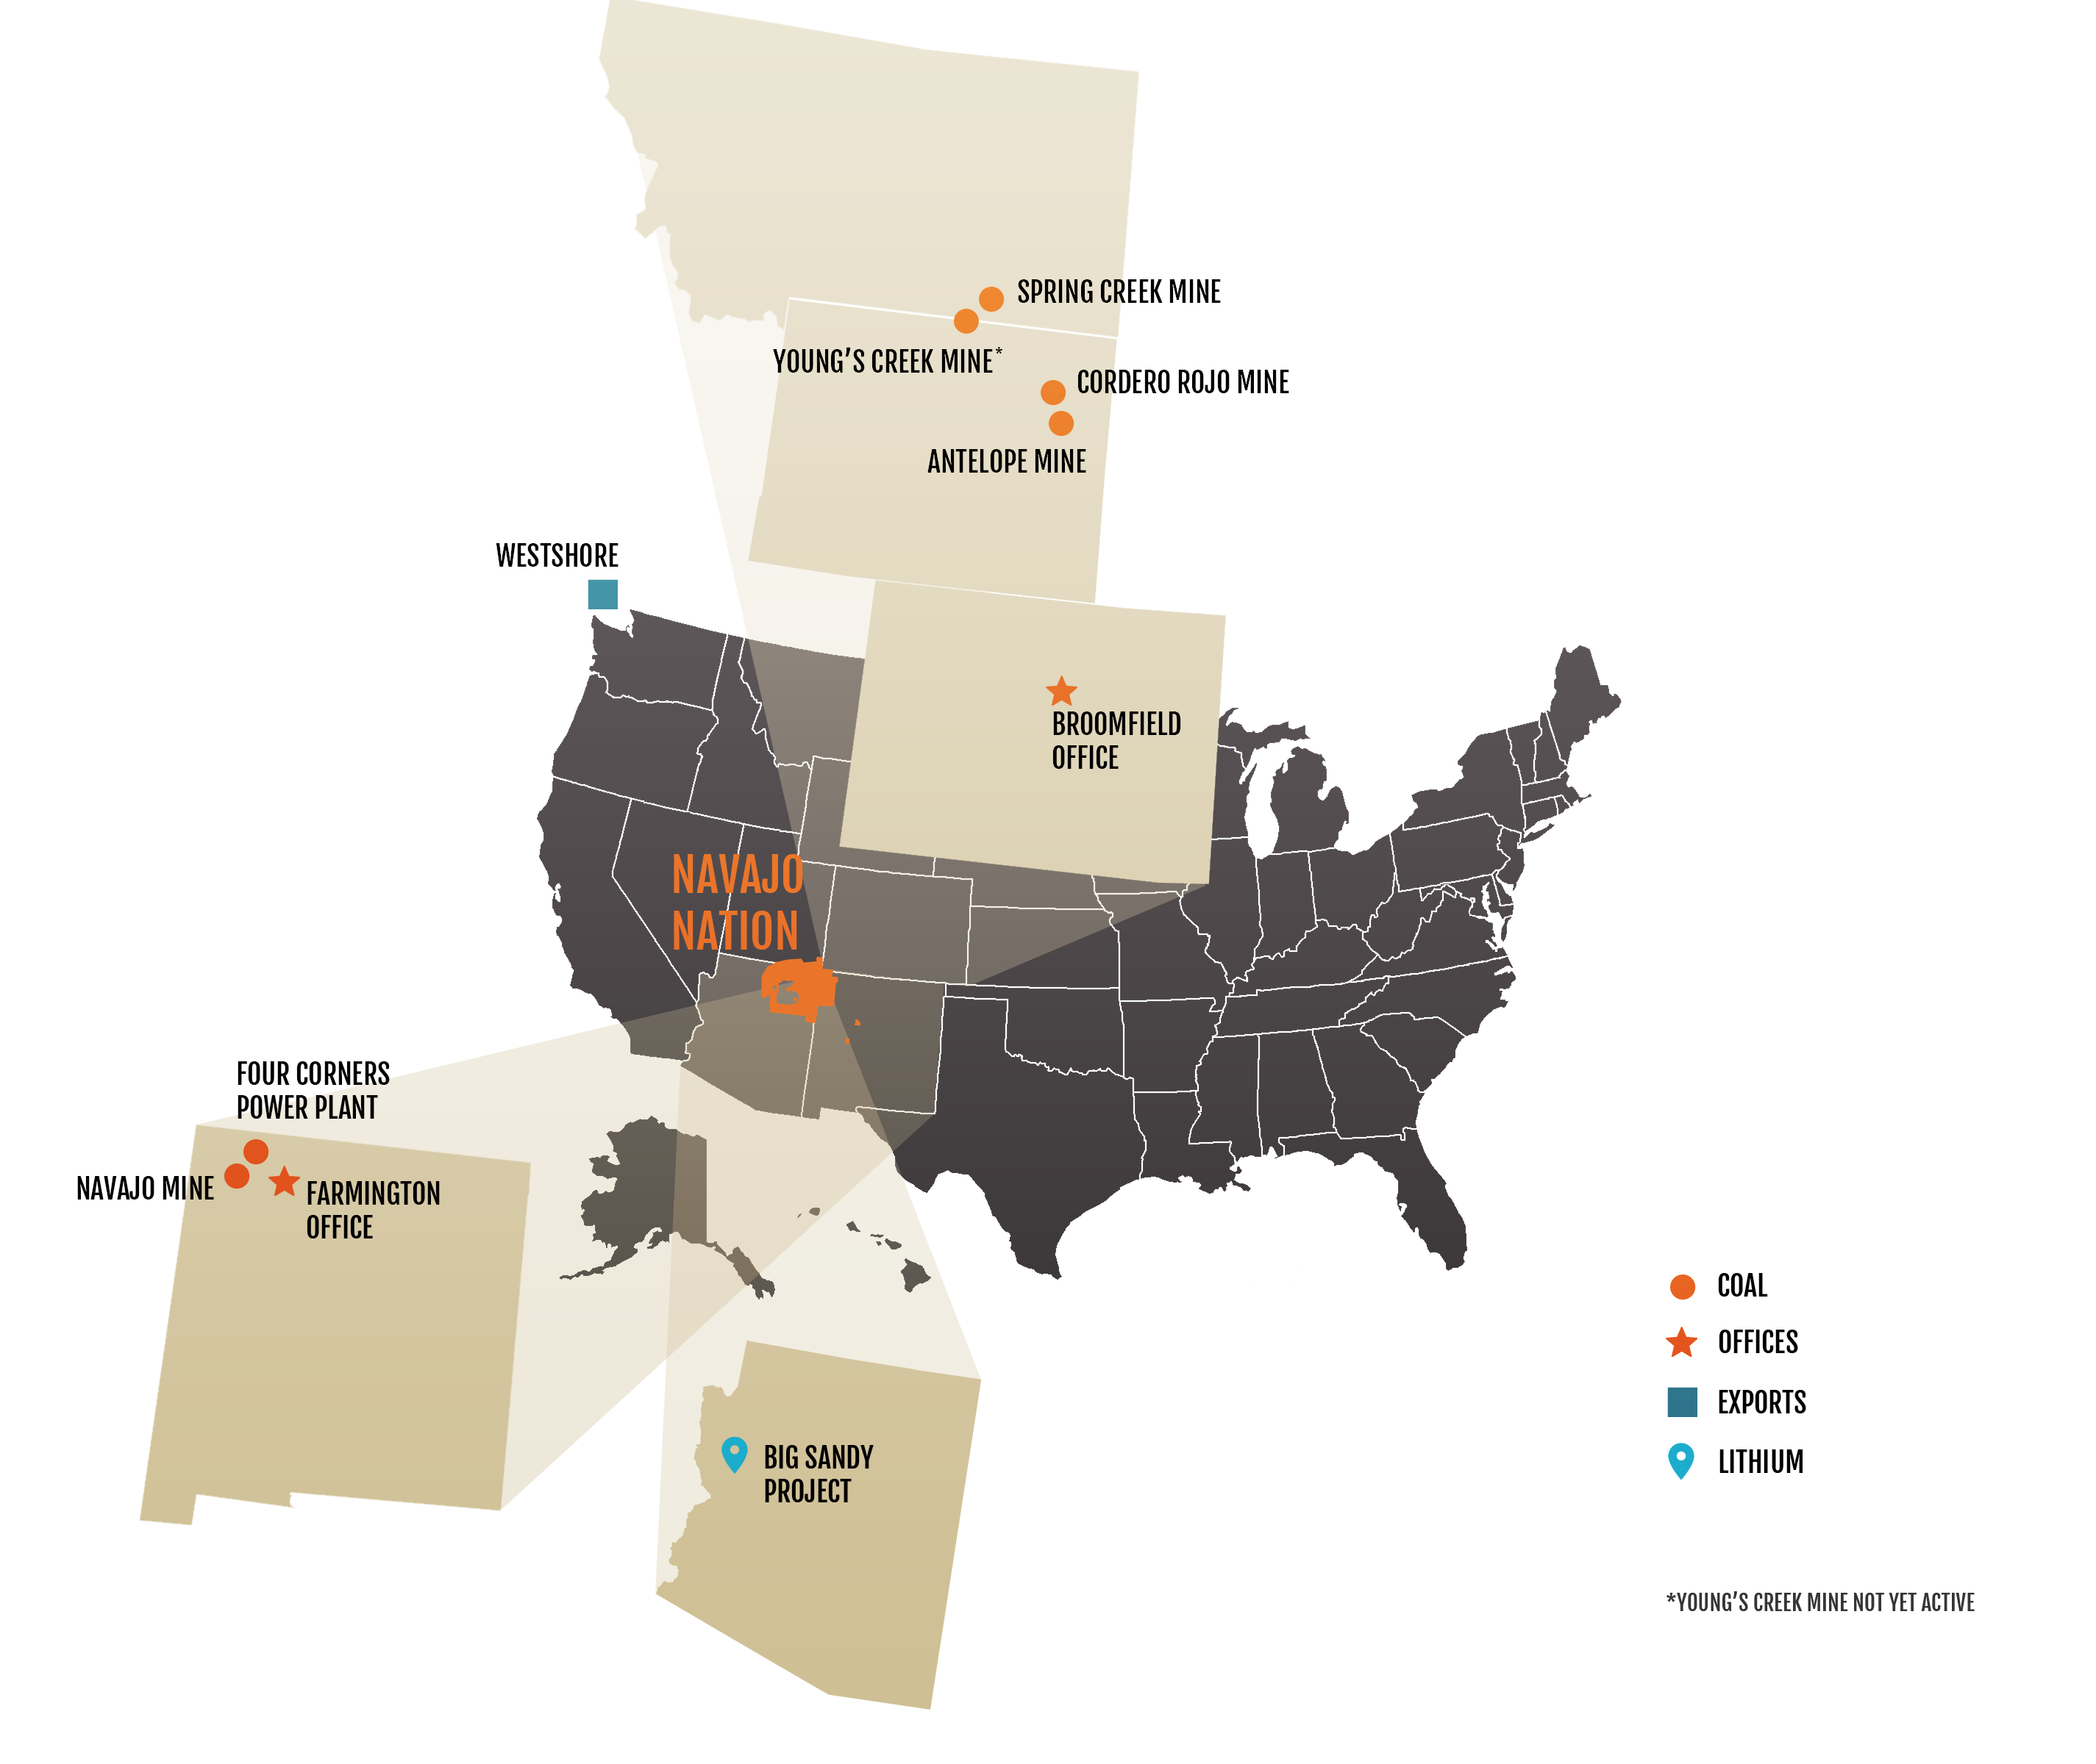
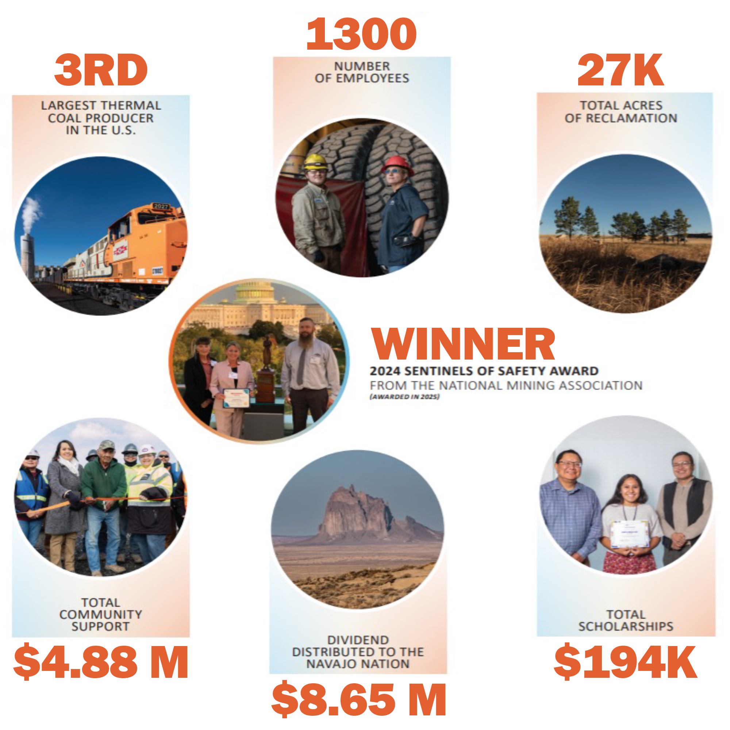
Our Core Business
COAL
OFFICES
EXPORTS
LITHIUM
Real progress | Real returns | Real impact for the Navajo Nation
*YOUNG’S CREEK NOT YET ACTIVE
3RD
LARGEST THERMAL COAL
PRODUCER IN THE U.S.
$4.88M
TOTAL COMMUNITY
SUPPORT
1300
NUMBER OF
EMPLOYEES
$8.65M
DIVIDENDS DISTRIBUTED
TO THE NAVAJO NATION
27K
TOTAL ACRES OF
RECLAMATION
$194K
TOTAL
SCHOLARSHIPS
WINNER
2024 SENTINELS OF SAFETY AWARD
From the National Mining Association (Awarded in 2025)
2025 EXCELLENCE IN SURFACE COAL MINING RECLAMATION
From the Office of Surface Mining and Reclamation Enforcement
2025 EXCELLENCE IN SURFACE COAL MINING RECLAMATION
From the Office of Surface Mining and Reclamation Enforcement

Slide 5
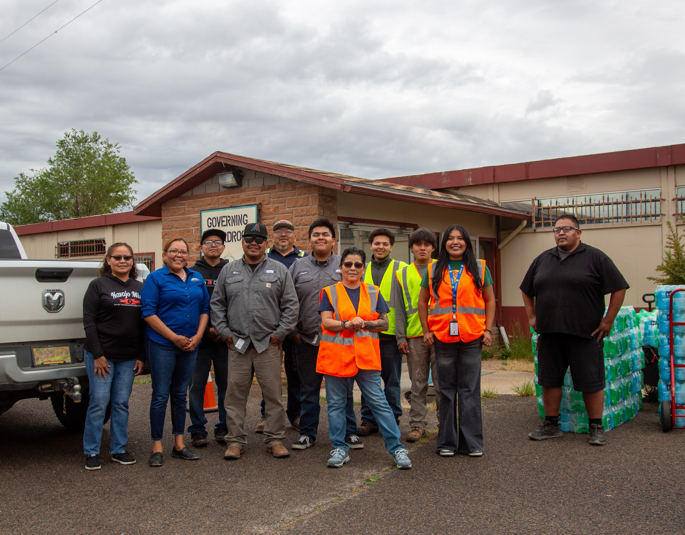
Community Comes First
Working Together to Strengthen the Communities We Serve
$2,100,000
NTEC’S 2025 TOTAL CONTRIBUTION TO NAVAJO COMMUNITIES
DONATIONS
$1.64M
EDUCATION
$160K
NTEC CBF
$300K
$100,000
DONATIONS TO COMMUNITIES IN THE POWDER RIVER BASIN

Slide 6
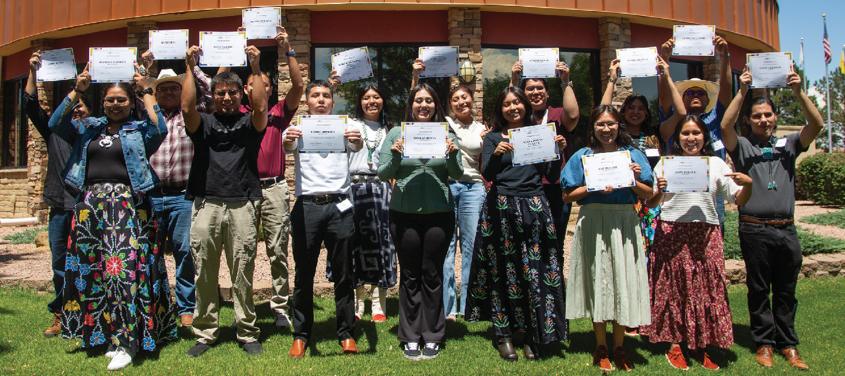
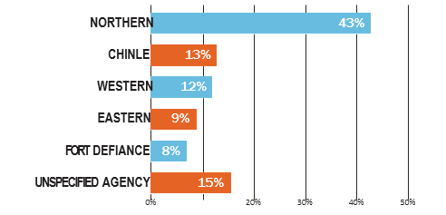
Powering Student Potential
Scholarships Help Students Shape the Nation’s Future
$34,500
AWARDED IN SCHOLARSHIPS IN 2025
TO COMMUINITIES IN THE PRB
2025 NTEC SCHOLARSHIPS BY AGENCY
$160,000
AWARDED IN SCHOLARSHIPS TO NAVAJO STUDENTS
& NTEC EMPLOYEES IN 2025

Slide 7
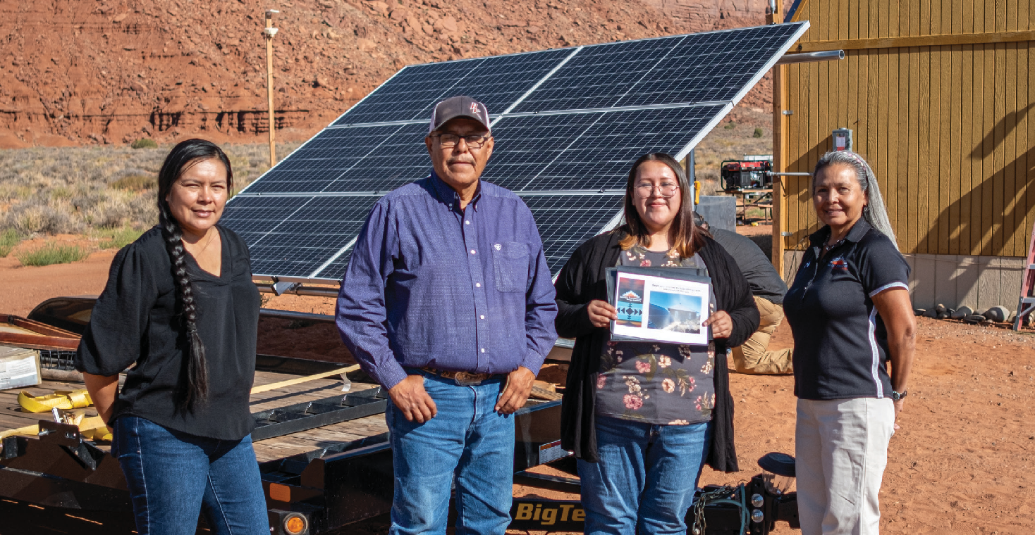
Harnessing the Sun
Prioritizing Energy Access for Navajo Homes
NAVAJO SUN POWER!
PROGRAM $2.6M DOE 50+ SYSTEMS LAUNCH GRANT AWARDED INSTALLED
2020
2024
2025
2026-2029
A BRIGHT FUTURE
125
TOTAL SOLAR UNITS TO BE INSTALLED
75 DOE-FUNDED
50 NTEC-FUNDED
$1,275,000
INVESTED IN POWERING HOMES ON NAVAJO
THROUGH 2025

Slide 8
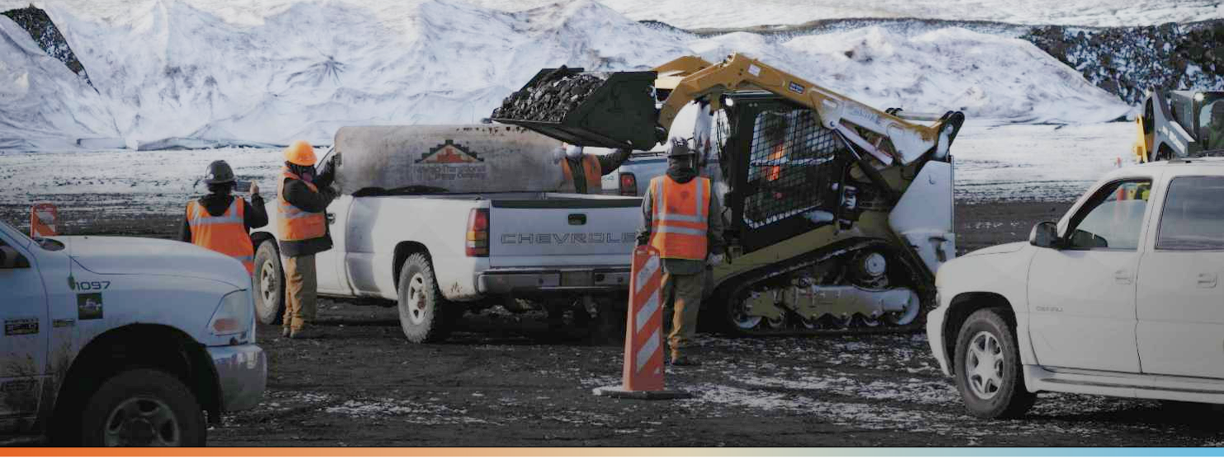
Community Heating Resource Program
Heating the Hogan
⁵ ¹⁵¹
^{2,600}
^{8,289}
^{$2.68M}
^{VISITORS TO NAVAJO MINE}
^{TONS VIA BULK DELIVERIES}
^{TONS OF COAL DISTRIBUTED}
^{ECONOMIC VALUE}

Slide 9
What is NavEnergy?
navenergy.com

Slide 10
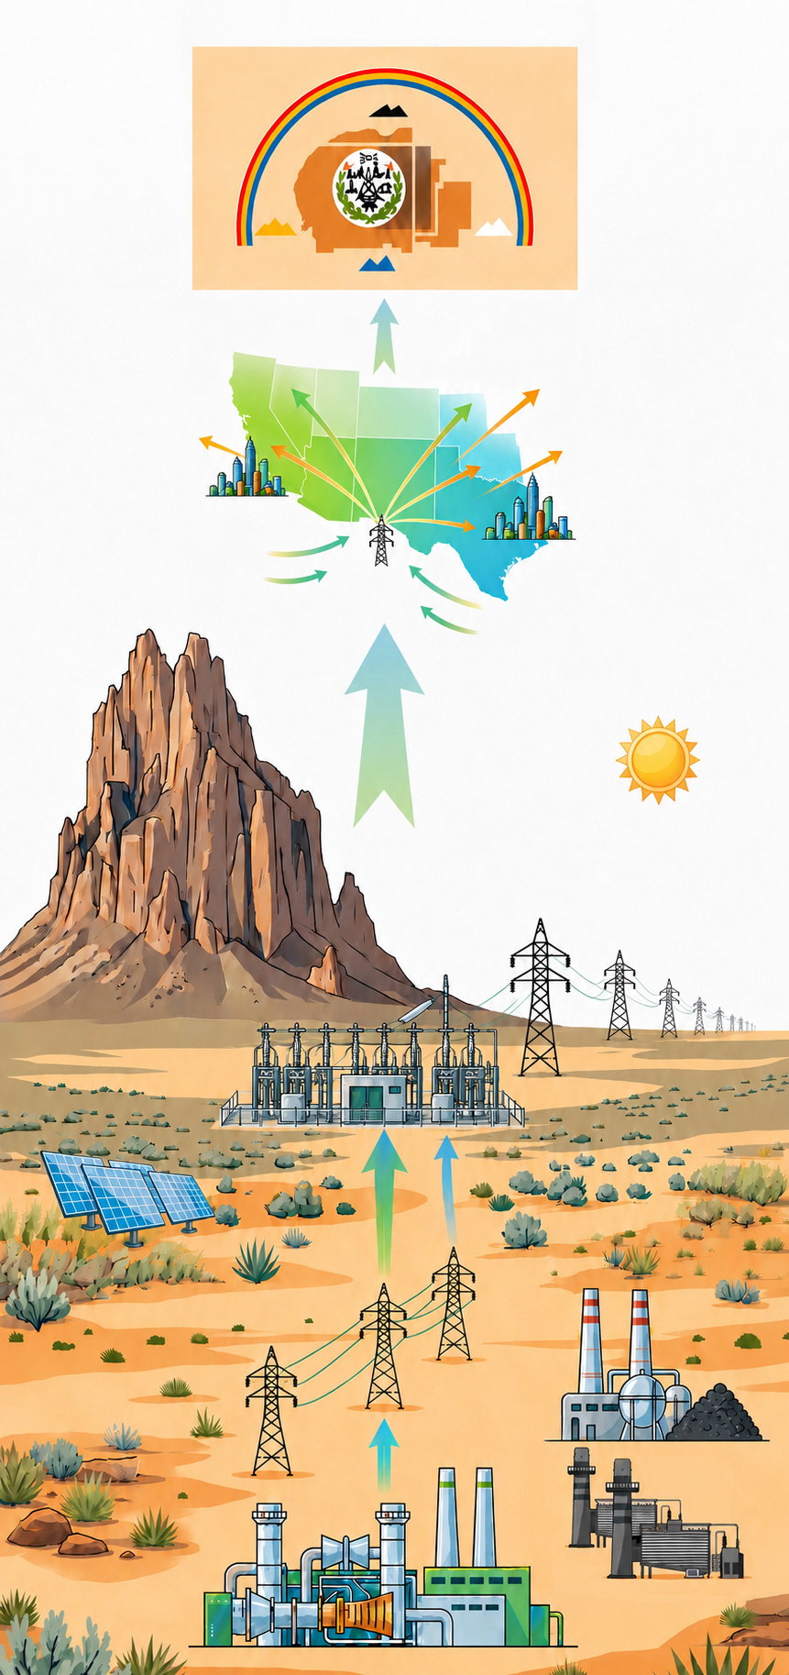
The Transition to Sovereignty
NTEC’s new subsidiary, NavEnergy, was charged to fulfill the Transition to Sovereignty by owning, developing, and advancing the Nation’s Energy Resources.
Drives the long-term economic stability of the Navajo Nation through a balanced portfolio of reliable & dispatchable energy generation built with the highest standards of environmental responsibility
The Navajo Nation through NavEnergy controls its own energy future in a way that reflects Diné values
  Diné values teaches balance (Hózhó) – Development must move forward in balance, protecting the people, the land, the air, and future generations
  K’é (kinship) requires responsibility to one another – Transparency, public review, and enforceable standards ensure the Navajo Nation and its people are respected throughout development
Builds on NTEC’s success as a leading mining company with the highest environmental standards
NavEnergy Hub™ is the first project of the new subsidiary
near Four Corners Power Plant

Slide 11
Driving Growth for the Navajo Nation
Real progress | Real returns | Real impact for the Navajo Nation
VALUE FOR THE NATION
BUILT ON CORE BUSINESS PRINCIPLES
Do The Right Thing
Diversify & Maximize Revenue Streams
Sustain Employment & Maximize Job Creation
Create Foundation for Economic Development
Ensure All Environmental Protections are Met and / or Exceeded
Value Land Use and long -term view of all natural resources
Empower People and Communities
Create Multi-Generational Solutions
Operate a World Class Energy Company

Slide 12
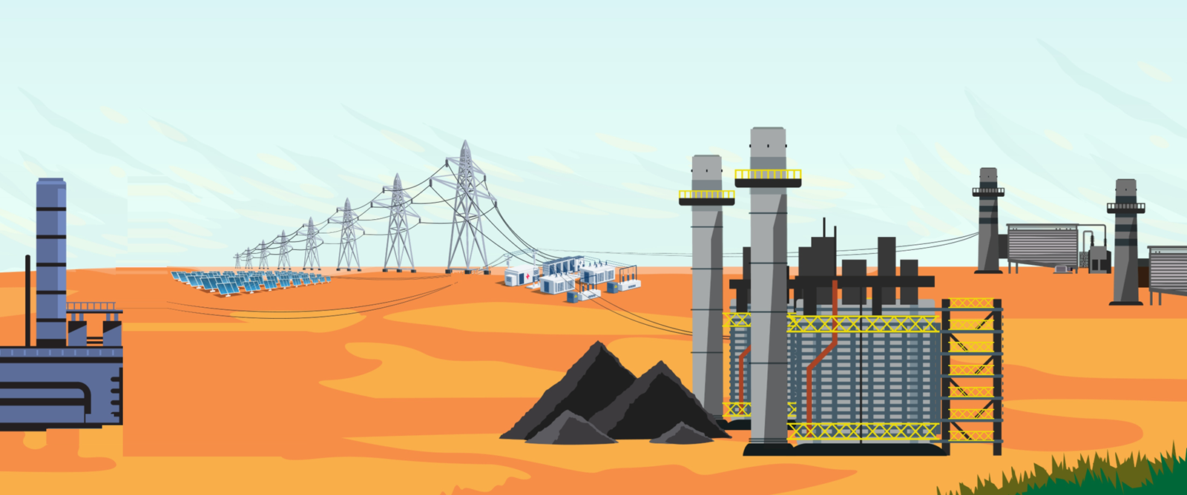
What is the NavEnergy Hub?
FOUR CORNERS POWER PLANT
CLEAN COAL TECHNOLOGY
GAS
TRANSMISSION
SOLAR

Slide 13
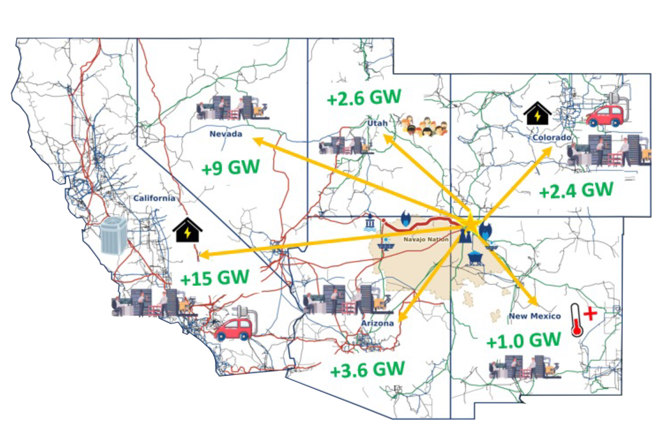

NavEnergy Generation and Market Access
+2.6GW
500 kV+ (existing)
345 kV (existing)
230 kV (existing)
100-161 kV (existing)
<100 kV / unknown (existing)
NTEC 500 kV (planned)
Navajo Nation
Nevada
Utah
Colorado
+9GW
+2.4GW
California
+15GW
New Mexico
Arizona
+1.0GW
+3.6GW

Slide 14




The Vision
Clean. Diverse. Dispatchable.
CLEAN COAL
The long-view on coal is to leverage the abundant coal reserves
on the Nation, approx. 38.5 B tons, to advance a NEW Coal Plant eventually replacing FCPP; future proofed with the most advanced environmental controls and GHG Solutions.
GAS
To support fuel and revenue diversity, enhance grid reliability, and support for intermittency of renewables, develop dispatchable peaking and combined cycle gas energy generation.
TRANSMISSION
Leveraging existing transmission infrastructure, build the NTEC
Energy Park Switching Station to allow for expedient interconnection
of new generation resources. Enhance energy transport capacity by developing NEW High Voltage lines.
SOLAR
Navajo land and solar resources are prime for solar generation;
driven by overall value proposition to the Nation, i.e. balancing
economics and other solar commitments; potentially develop 200 MWs of solar on reclaimed mine land.
$6B
Value to the Nation
600
Full Time Jobs
7,000
Construction Jobs
3,155 MW
New Energy Available

Slide 15











NavEnergy Generation and Market Access
Peaking Gas
720 MW
CAISO
WAPA/TSGT
New Large Load
Load 3 GW
Solar
200 MW
NEPSS 345 kV
1800 MW
APS FCSWYD FCSS 345 kV
PNM Pintado FCSS 345 kV
New Coal
1 GW
Wind
3500 MW
CAISO/EDAM
Existing FCPP 7%
NTEC 108 MW Coal
500 kV NEPSS
Transmission Expansion 3 GW
600 MW x 2
Combined
Cycle Gas
NTEC OWNERSHIP

Slide 16
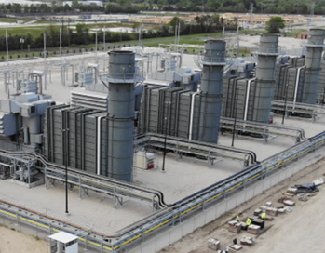
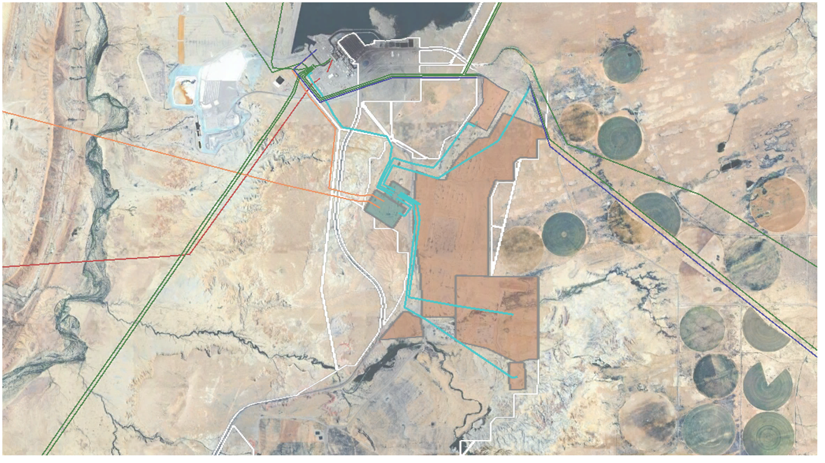
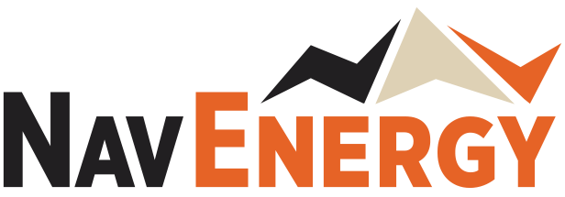
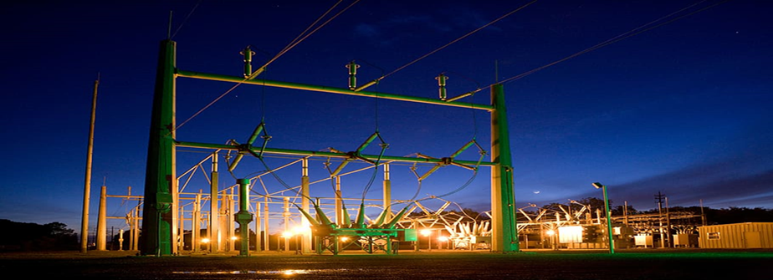
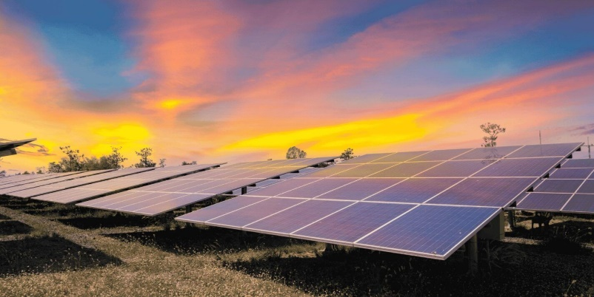
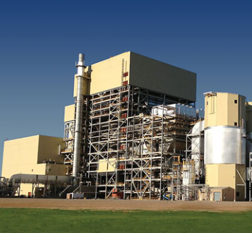
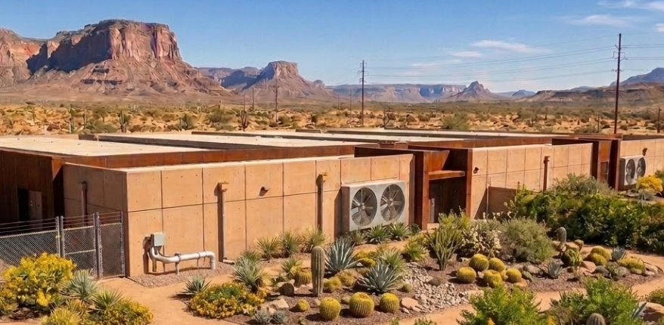
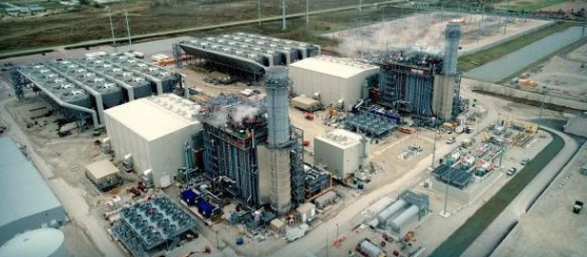
NavEnergy Hub Layout
HUB
NEGP Peaking Gas
EXISTING PINFRASTRUCTURE
AND PROPOSED ENERGY ROJECTS
Proposed Generation Projects
Proposed Transmission Projects
Proposed 345kV
Proposed 500kV
Existing 230kV
Existing 345kV
Existing 500kV
White lines denote NTEC controlled
mine and plant lease areas
345 & 500kV Switchyards
Shandiin Solar
New Coal Plant Locations
Adjacent Land Available for
Scalable Data Center Construction
Company Proprietary and Confidential Information
Combined Cycle Gas

Slide 17
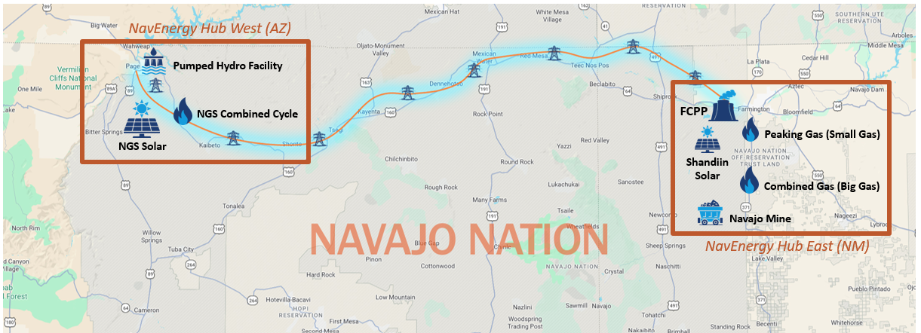
Transmission Expansion Vision
WHY IT MATTERS
Delivers NavEnergy’s Four Corners power to NGS/Navajo Substation near Page, AZ
Provides electric service opportunities to homes, businesses & utilities along route through stepdown power transformation
Unlocks new energy development through expanded interconnection access across the Navajo Nation
Utilization of Navajo Nation Transmission Service Rights
at NGS through incremental customer purchases of delivered generation
CONNECTING NAVENERGY TO THE GRID
A Navajo-owned backbone transmission line that carries Navajo-generated power to regional markets – and brings reliable electricity home to the Western Navajo Nation.
PROJECT DETAILS
200 miles of 500 kV
TARGET IN-SERVICE
2032
CONNECTS
Four Corners to NGS Area
NAVAJO OPPORTUNITY
Brings power to the Western Navajo Nation to support economic development opportunities.

Slide 18
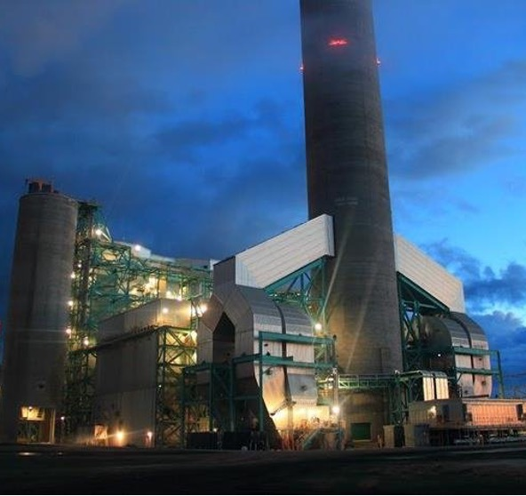
Exploring New Clean Coal
WHY IT MATTERS
Keeps Navajo Mine operational while meeting environmental goals
Continues the long-term economic benefits to the Navajo Nation
Deploys new coal technologies to leverage Navajo Nation’s abundant coal resources
Goal is to capture ~ 95% of CO₂ from Power Plant
Supports American energy dominance and independence
Provides affordable energy to the region
CO₂ CAPTURED
~95%
TARGET IN-SERVICE
~2030
SUPPORTS
Continuing Operation of Navajo Mines
NAVAJO OPPORTUNITY
Construction & skilled-trade jobs | Long-term plant operations careers | Contracting & procurement for Navajo-owned businesses

Slide 19
What If We Could?
Guarantee long-term affordable energy that directly benefits our communities?
Support the economic sovereignty
and job creation on the Navajo Nation?
Say “YES” to Data Centers and development projects in our states?
Ensure American energy dominance
and independence?
Dramatically reduce emissions with proven technologies that make financial sense?
WE Believe New Coal Can Provide Reliable, Affordable, Abundant Energy with No Emissions!

Slide 20
Energy
Sovereignty
For the Navajo Nation
navenergy.com
September 24-26 · 2026

