Slide 1
Scaling Fusion from Research to Industry
The Energy Council
9.25.26 - Albuquerque, NM
Notes:
Say Hi,
Note that you have talked to energy experts all day, and as the first person without a PhD at the end of my name, I ask you to bear with me.

Slide 2
Agenda
01 | The promise of fusion energy
02 | Pacific fusion’s plans to scale
03 | Policy levers to encourage scaling the advanced energy industry

Slide 3
01
The promise of fusion energy

Slide 4

Fusion could provide the world’s most affordable clean, firm power
Safe | Cannot melt down. No long-lived radioactive waste.
Clean | No carbon emissions. Small footprint. Resource-light.
On-demand | Provides dispatchable firm power.
Nearly free fuel | Fuel is widely available, with energy density millions of times higher than chemical fuels.
‹#›
Notes:
Fusion is the holy grail of energy. Scientists have been seeking out fusion reactions for energy applications for 70 years, and that persistent pursuit is because of Fusion’s unique energy benefits.
Fusion is safe, carbon free energy, that provides on-demand, firm power, and the fuel source is limited and widely available. The key behind fusion’s benefits are how energy dense its reactions are. 1 pound of fusion fuel can power 1,000 homes for a year.

Slide 5
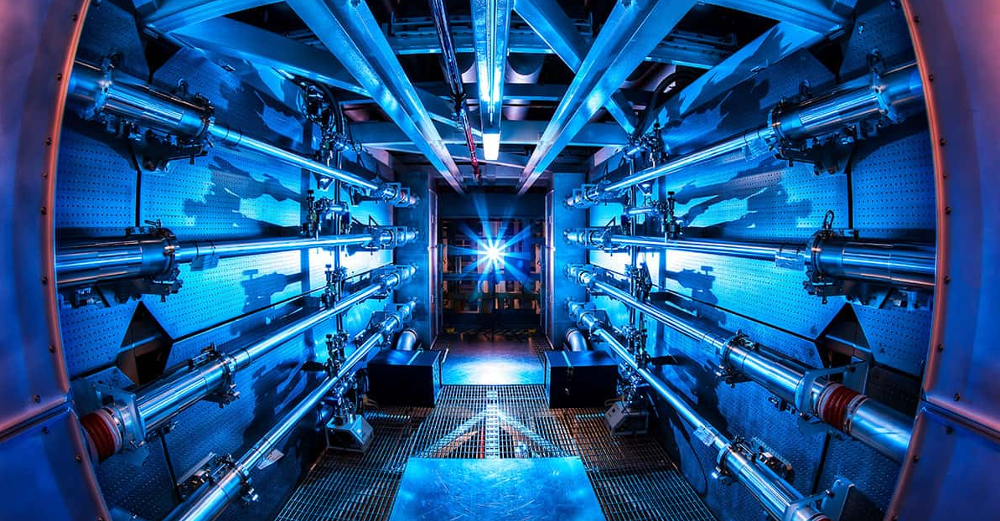
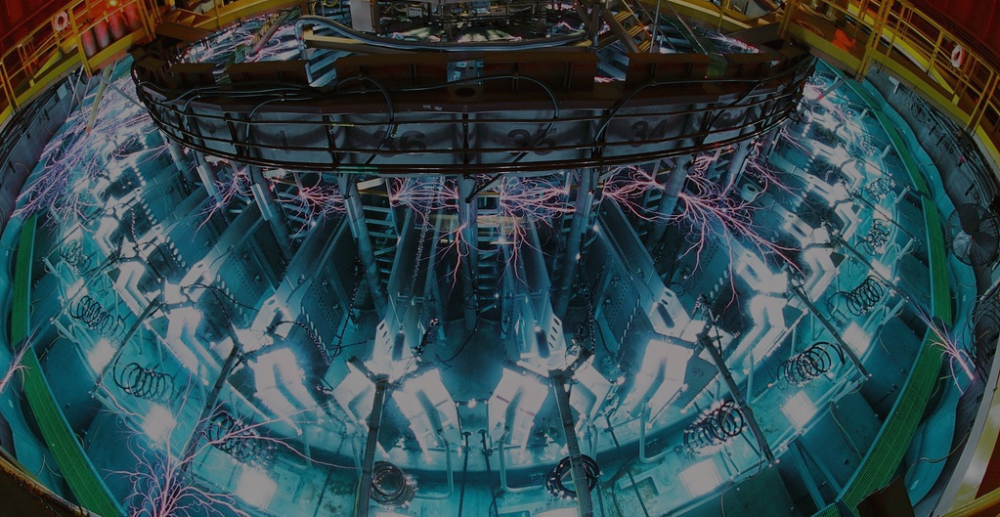
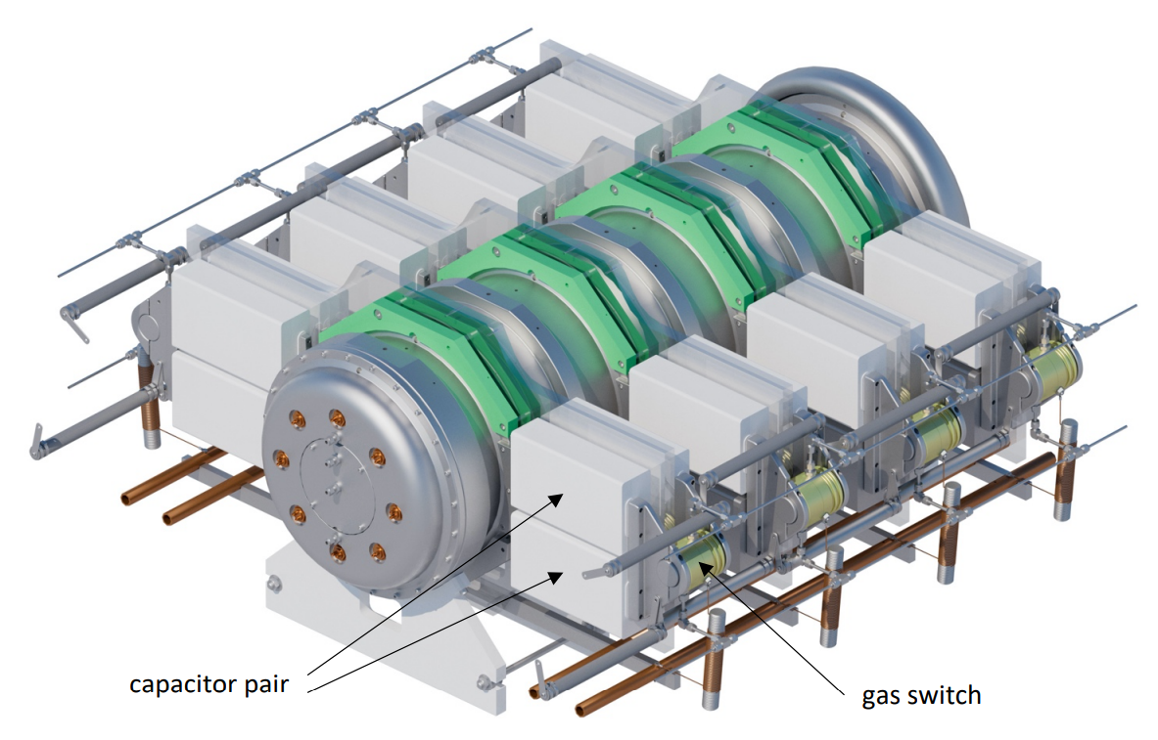
Three breakthroughs in 2022 created a new path to practical inertial fusion energy:
01
First-ever controlled
fusion ignition
02
Efficient path to ignition using electric pulsers
03
Mass-manufacturable, modular electric pulsers
Notes:
In 2022, after decades of pursuit the breakthrough scientists had been seeking out was achieved when scientists at lawrence livermore national laboratory achieved ignition: a fusion reaction that produced more energy than it took to create the reaction. That feat has been replicated several times at Livermore and is proven science. We know the temperature and pressure we need to obtain to get hydrogen atoms to fuse together.
That same year, scientists at Sandia National Labs at the Z-machine found a more efficient path to ignition using electric pulsers
And still in that same year, our chief Technology officer, Keith LeChien, produced the first mass manufacturable modular electric pulser. The facilities at livermore and sandia are very specialized bespoke machines that take years to build. This discovery means a pathway exists to mass manufacture machines capable of fusion reactions.
As a result of these breakthroughs, fusion energy truly on the brink of becoming a reality.

Slide 6
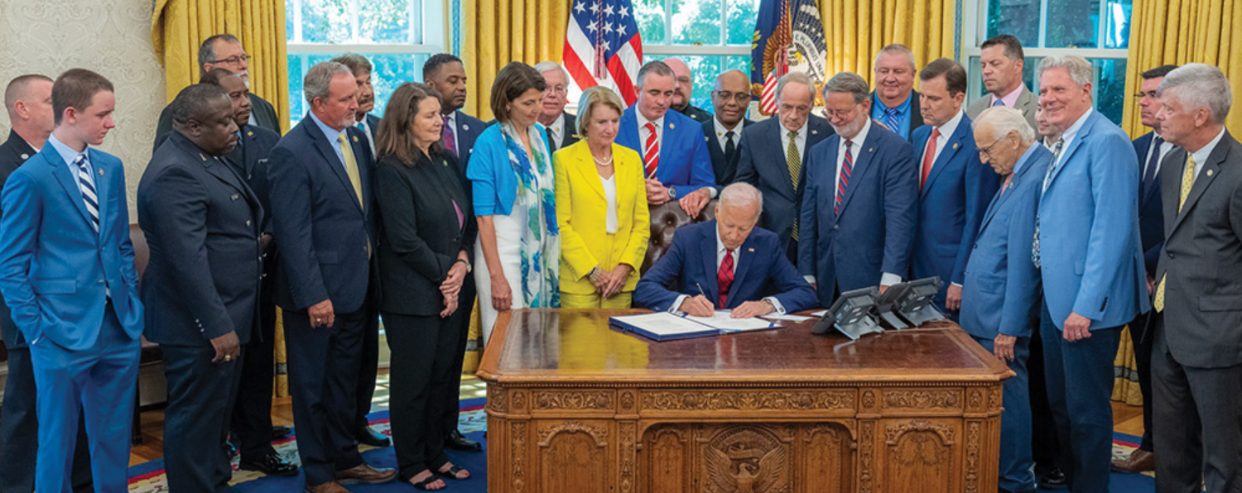
Fusion and fission are fundamentally different
Fission
Fusion
ADVANCE Act
(Accelerating Deployment of Versatile, Advanced Nuclear for Clean Energy Act of 2024)
Neutron
Deuterium
Helium
Neutron
Energy
Neutron
Uranium or Plutonium
Tritium
Neutron
As a result: Much simpler regulatory environment due to passing of the ADVANCE Act in 2024.
Neutron
No risk of meltdown.
No long-lived waste.
Does NOT use uranium or plutonium.
Notes:
And you, like many others, might be thinking about the National Labs and their history with Nuclear fission. Fusion is fundamentally different. Fission uses heavy atoms to crash them and break them apart for energy.
With fusion, hydrogen is used at such temperature and pressure that the atoms combine together or fuse to create even more energy. The difference means there is no risk of meltdown - its not a chain reaction and any stop to the inputs will stop the reaction. Fusion produces much less waste than nuclear fission and the waste it does produce is short-lived, with half lifes of ten years or less. And lastly, it does not use uranium or plutonium.
The differences are so significant that in 2024 Congress passed and the President signed the ADVANCE Act, which formally allowed for the states to manage oversight and regulation for fusion machines, while keeping nuclear fission under the oversight of the Federal Government.

Slide 7
Fusion power provides abundant energy with limited environmental impact
Limited water use | Fusion power is not water intensive. Our research and manufacturing campus will use the same amount of water as a white collar office facility of a similar size, and future power plants will operate in a closed loop system that uses dry cooling.
Low-impact fuel | Fusion fuel is energy dense. Just a pound of fusion fuel can power over 1,000 homes for a year. The primary source of fuel is refined from seawater: deuterium and tritium.
Limited, short-lived waste | Fusion power plants will produce orders of magnitude less waste than fission power, and fusion waste cools quickly, enabling safe disposal by existing routes used by hospitals and research facilities.
Notes:
Fusion’s advantages don’t stop there. Fusion power is not water intensive. It uses low-impact fuel from witch the primary sources are derived from seawater. And fusion has a limited waste profile that that mirrors the type of waste at a research facility or hospital.

Slide 8
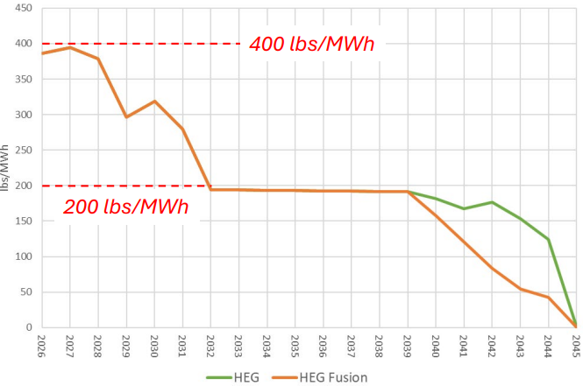
Fusion can provide the low-cost, firm, dispatchable energy which will decarbonize our grid faster and at a substantially lower cost
20-Year Net Present Value ($M)
$17,237
-$849M
$16,387
PNM’s recent IRP highlights fusion’s potential to be the most cost-competitive source of firm generation while achieving key objectives across affordability, decarbonization and grid resiliency.
An analysis of including fusion energy in PNM’s energy mix under a High Economic Growth Scenario showed that:
Fusion energy could reduce total system costs by nearly $850M, and
Fusion energy could reduce carbon emissions at a faster rate
HEG
HEG Fusion
Projected Annual Portfolio
CO2 Rate (lbs/MWh)
Source: PNM IRP Workshop #6, May 13, 2026, Slide 31. https://gridworks.org/wp-content/uploads/2026/05/PNM-IRP-2026-Workshop-6-2.pdf
From the IRP Report. “The introduction of firm, low-cost fusion completely displaced all SMR capacity previously selected in the HEG base case. Because of its high-capacity factor and firm zero-carbon profile, the 1,800 MW fusion addition reduced the need for several other buildouts across the system, [...] delivering $850 million in portfolio cost savings while driving a substantial acceleration in system-wide carbon emissions reductions.”
Notes:
A recent analysis by PNM confirmed fusion’s place as the holy grail of energy: an analysis as part of their integrated resource plan showed that not only did the incorporation of fusion power on the grid reduce carbon emissions faster than their current plans, but it also provided nearly $850M in savings to ratepayers.
So we not only get massive amounts of energy from limited fuel from a reaction that produces limited waste, but we do so affordably.
So until 2022, fusion energy was the theoretical holy grail. After those scientific breakthroughs, the industry has made great progress on next steps toward making fusion energy a re

Slide 9
02
Pacific Fusion’s plans to scale
Notes:
So that’s the promise of fusion energy. Let me take you inside Pacific Fusion and its plans to scale.

Slide 10
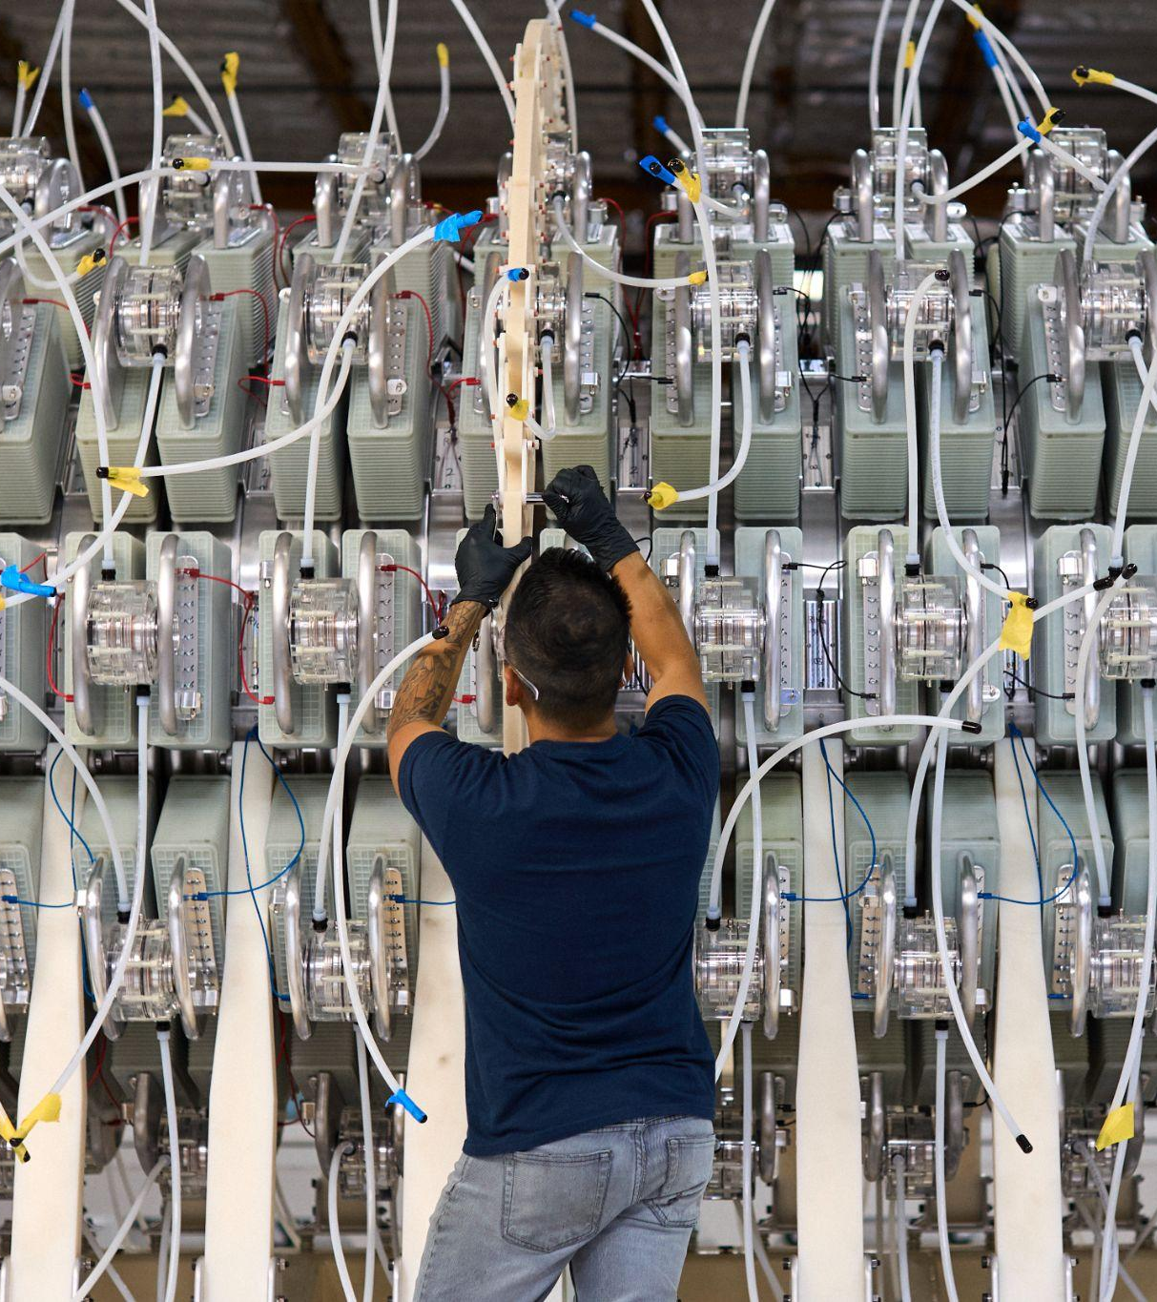
Pacific Fusion has a clear path to making fusion energy a reality
Built on established science
Right people
Mass manufacturable design that is:
  Practical
  Affordable
  Scalable
We’ve raised the capital to execute
Notes:
First, Pacific Fusion is a local partner with a clear path to meeting the ultimate goal of putting fusion electricity on the grid.
We’re built on established science - our founding team and senior staff were there for the three breakthroughs that make fusion energy possible.
Those people have designed a system that is practical, affordable and scalable. We’ve taken a page from the solar and wind industries in designing a system in which major components are modular and made at manufacturing hubs that can be deployed across the country and globe. Our manufacturing hub is in Los Lunas and can build future power systems there and ship them elsewhere. That means less bespoke construction on site and more scalability in one manufacturing hub. That makes it more affordable and more scalable.
Lastly, we’ve raised the capital to execute on this design. Because of the features of our business plan, we have raised the most of any fusion company’s series A fundraise, at just over a billion dollars.

Slide 11
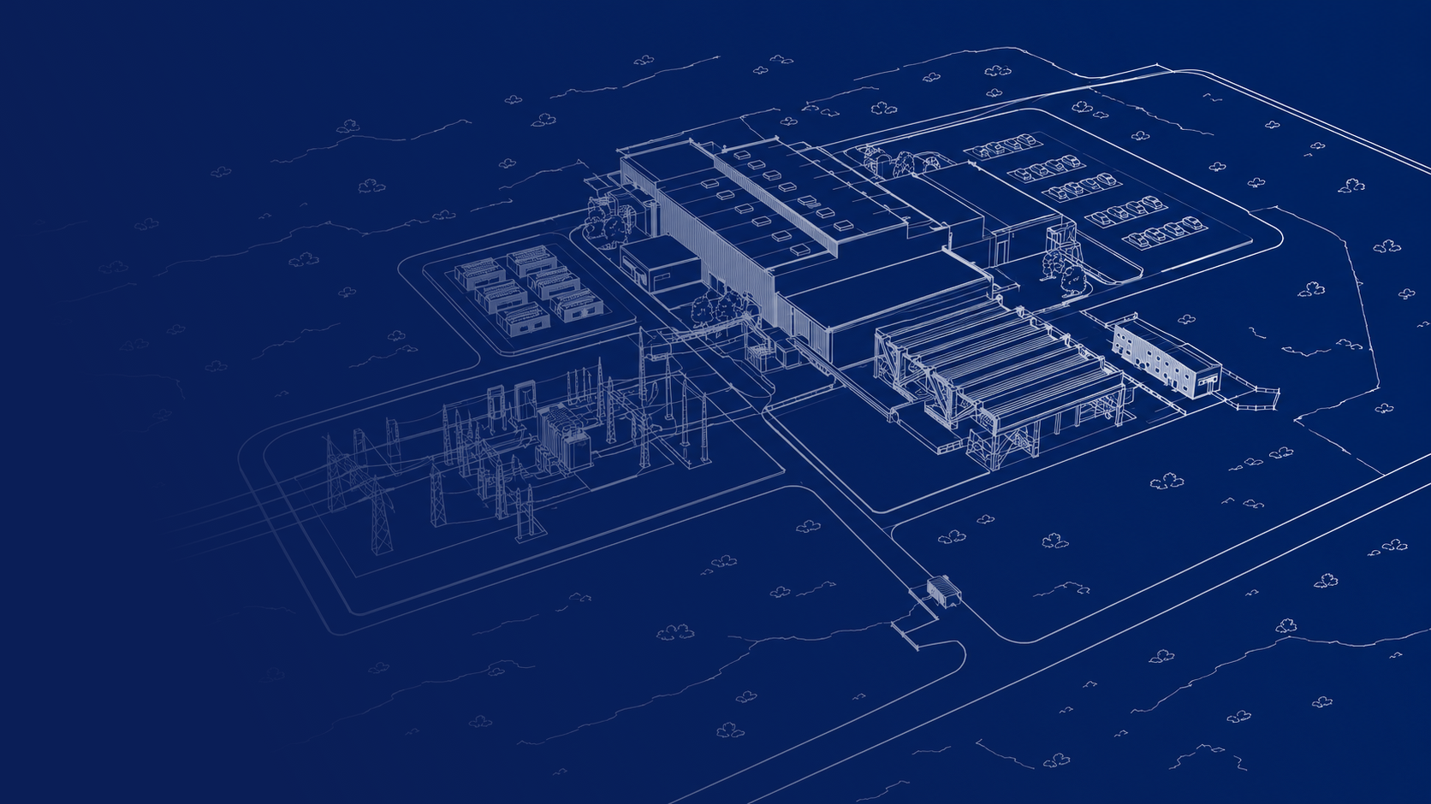
Our vision for a New Mexico fusion economy
Establish first-ever fusion factory
Build and operate a profitable Research and Manufacturing Campus
  200 permanent employees from PF
Build first power system in New Mexico
  100-200 operational jobs
Expand NM manufacturing to build power plants across the country
  Hundreds of thousands of sq. ft of manufacturing
  Thousands of jobs
Notes:
We have what it takes to make this a reality, and we have a vision for a fusion economy in NM.
It all starts with what we’re building now: a fusion factory in Los Lunas and a Research and Manufacturing campus in Mesa del Sol
This brings NM to 200 full-time employees.
After that we’ll be focused on building a first power plant. That power plant - if in New Mexico - will lock in the central region of our state as a manufacturing hub for our first and future power plants. The power plant itself would create between 100-200 jobs, and building the components for future power plants across the country would create thousands of jobs and create a need for hundreds of thousands of square feet of manufacturing space.

Slide 12
Our path toward fusion energy for the grid
WE ARE HERE
 | 2025 | 2030 | 2035
R&M Campus Objective: Demonstrate Net Facility Gain by 2030 Investment: $1 billion 200 full-time jobs
Fusion Energy Systems Objective: Carbon-free, on-demand power by mid-2030s Investment: $10s of billions 1,000s of full-time jobs
Sept. 2025
Announce project in NM
Dec. 2025
Open Build
Center in
Los Lunas
2030
Demonstrate Net Facility Gain
2030 Onward
R&M Campus center
for multiple R&M opportunities
2026-2027
Supply chain development, community engagement
Mid-2030s
First power system
After 2035
Scale production and deployment of power plants across the country
2027-2032
Permitting and other approvals,
community engagement
Notes:
We have two overlapping timelines at Pacific Fusion, with the top one focused on what we are building now. We’re building our research and manufacturing campus in Mesa del Sol which will be where we achieve net facility gain by 2030. That campus will continue on as an important center for our development and manufacturing as well as a hub for pulsed power research opportunities.
Below that you can see our developmental path toward future fusion energy systems - putting electrons on the grid. Right now we’re building out supply chains and will soon start community engagement in siting a power plant. We’ll look both in NM and neighboring states. We want to be in a community that welcomes us, and that starts with conversations. We’ll continue that engagement and obtain permits and approvals through 2032, where we’ll then break ground on our first of a kind power plant for the mid 2030s and scale up from there.

Slide 13
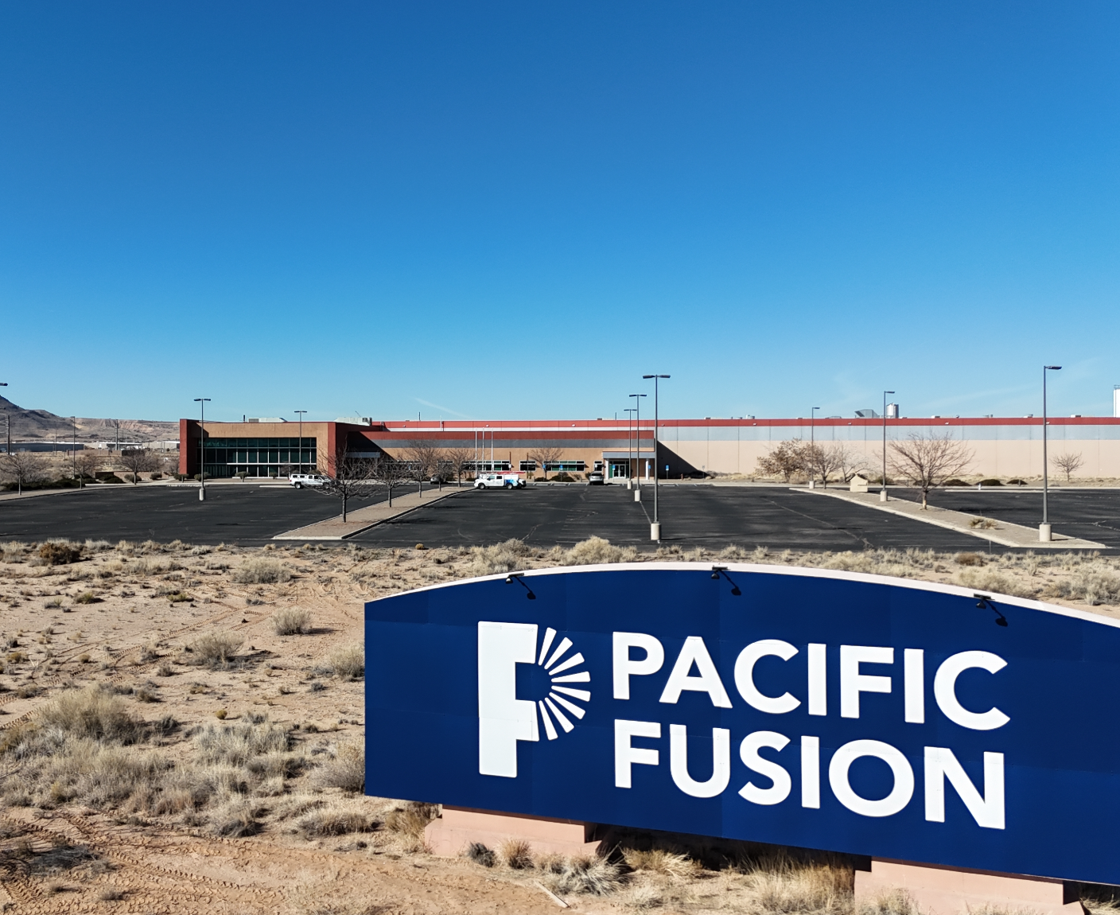
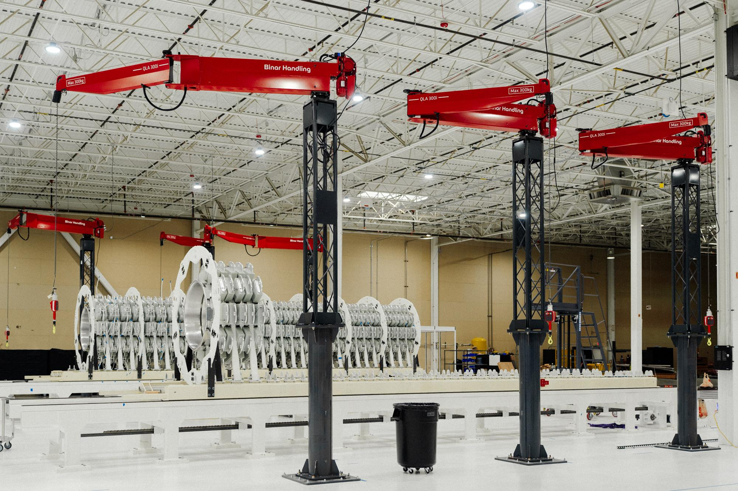
Los Lunas Build Center:
The world’s first fusion factory
CURRENT STATUS:
Invested in building for a production-ready manufacturing floor
Production of Demonstration System components began in May
80 employees and growing, with 95% from in-state
Notes:
share avg. salary

Slide 14
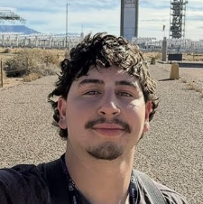

Creating meaningful jobs in
Los Lunas:
“The work is hands-on, fast-moving, and meaningful, which is exactly the type of environment I wanted to be in. Working at PF means a lot for my life and career.”
Ethan Alderete
Electro-Mechanical Technician
Los Lunas Build Center
“The work is challenging, the mission is exciting, and you're surrounded by people who are motivated to solve hard problems. For me, working at PF means being part of something with real purpose.”
Victoria Lujan
Electro-Mechanical Technician
Los Lunas Build Center
Notes:
And those jobs are good jobs. When I transitioned from education to pacific fusion, I came because of fusion’s transformative potential and for the opportunities the company would provide to New Mexicans.

Slide 15
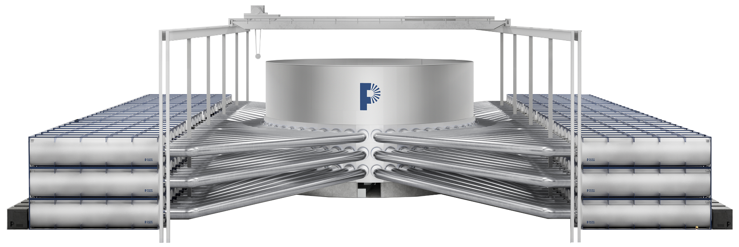

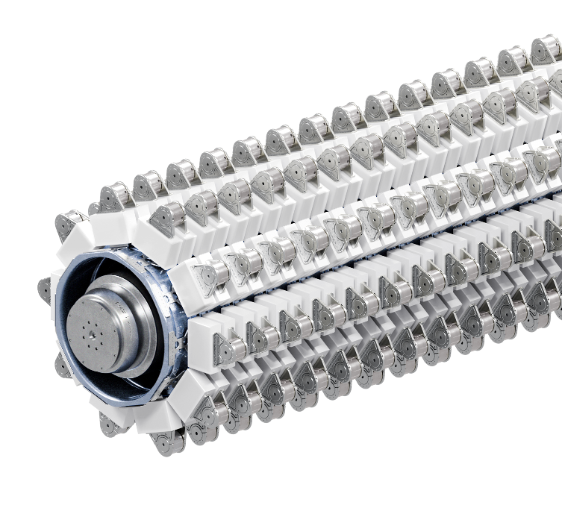
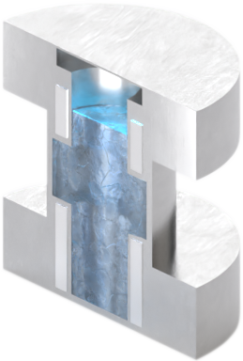
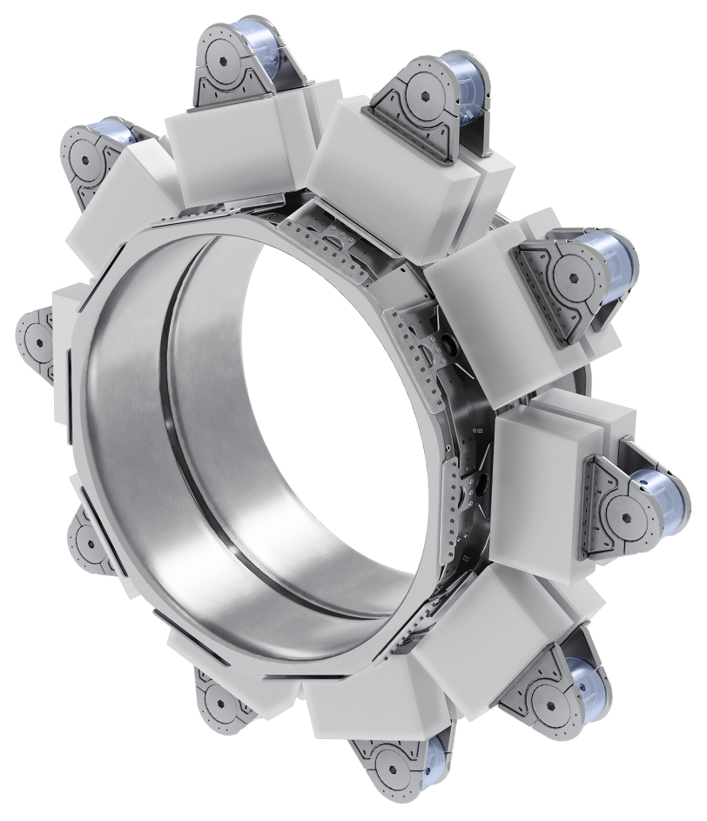
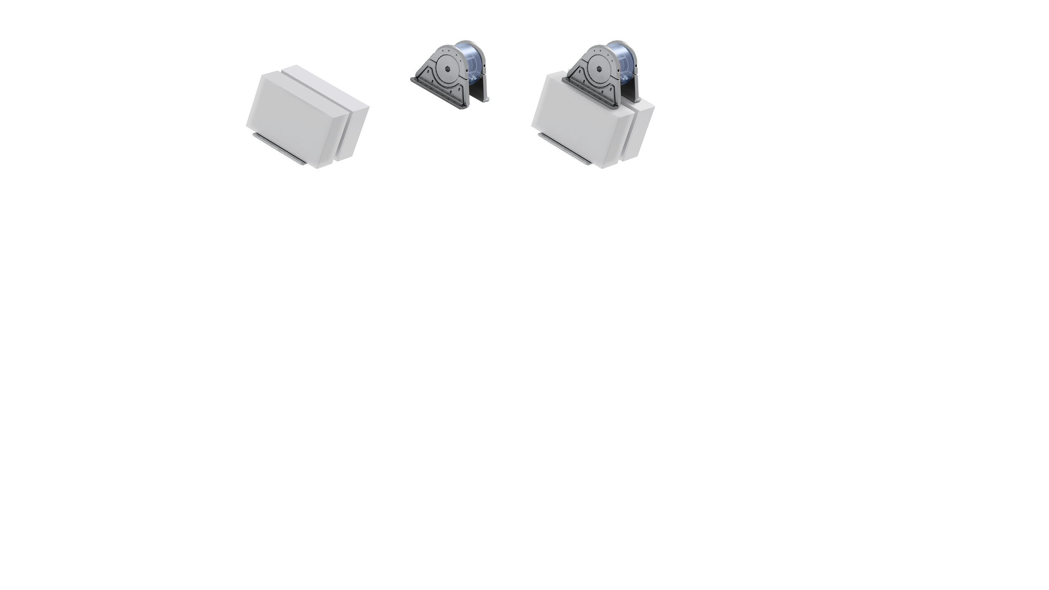
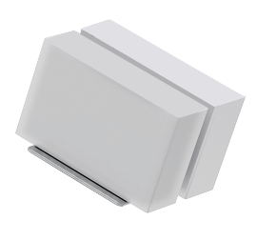
We are assembling the modular components of our system at the
Los Lunas Fusion Factory
PULSER
TARGET
Small size (<1 cm)
Low complexity design enables low manufacturing cost
Compatible with ~Hz rep rate
~50k
100,000 capacitors
+ 50,000 switches
10
Identical bricks/stage
32
Identical stages/module
156
Identical modules/pulser
Notes:
And this is what theta re building in Los Lunas - right now - for installation at our research and manufacturing campus upon completion of construction.

Slide 16
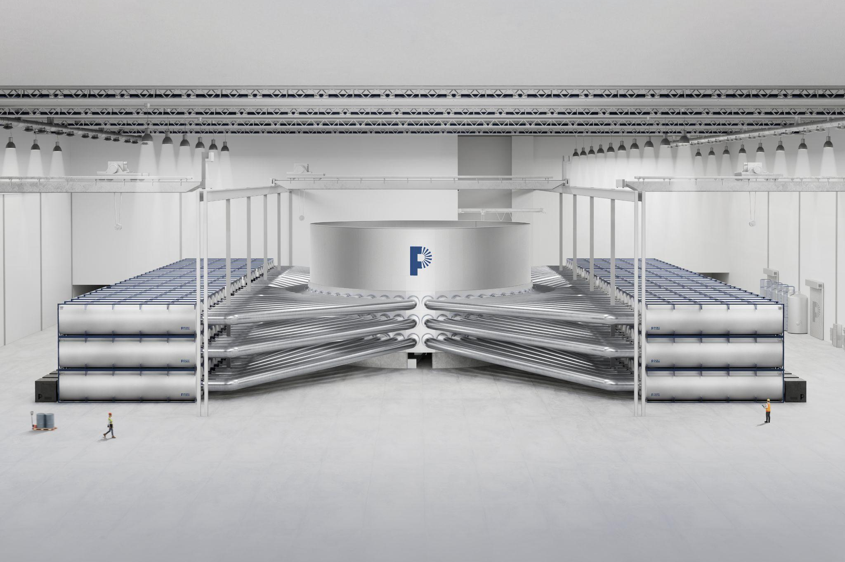
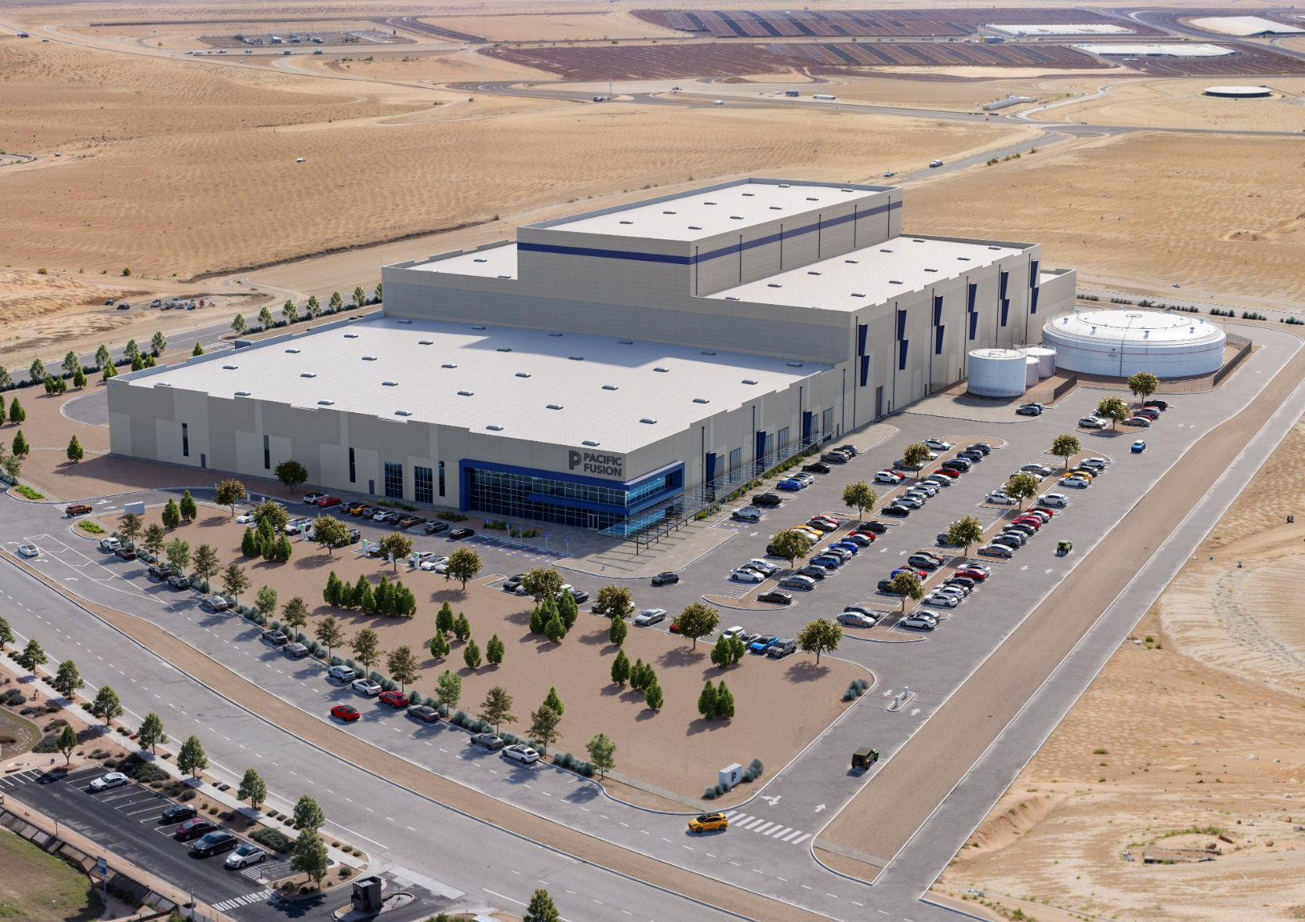
Research & Manufacturing Campus
The world’s most powerful pulsed power system
CURRENT STATUS:
Broke ground on August 25th
Demonstration System’s #1 priority is to achieve Net Facility Gain by 2030
Future of the Demonstration System: A hub for research and manufacturing for all pulsed power interests, including fusion energy, defense applications and materials testing
Notes:
share avg. salary

Slide 17
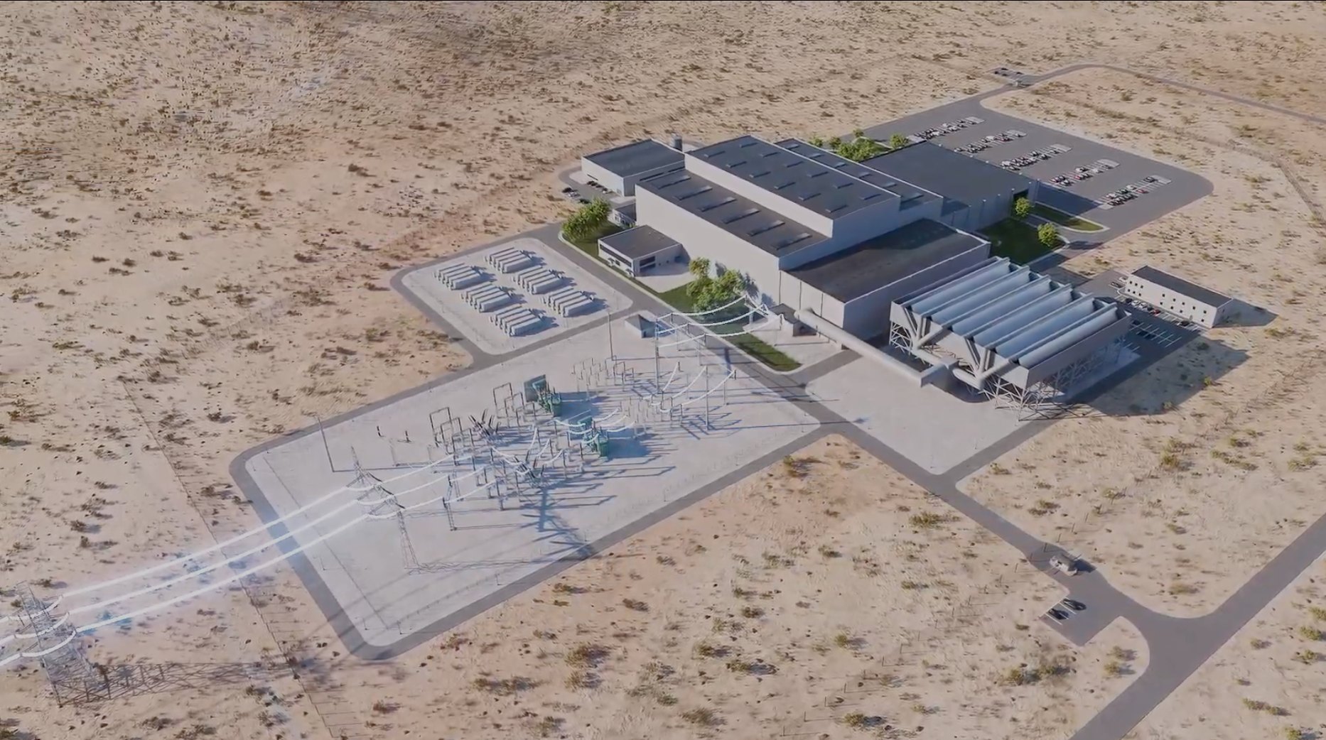
Our fusion power plant will look like a typical dry cooled power plant, minus the emissions
PACIFIC FUSION
PROPRIETARY AND CONFIDENTIAL
‹#›
Notes:
And here’s what it looks like for a future power plant. 40 acres, ~300MW
You’ll notice no tubes for exhaust in the sky, no cooling ponds, this is a closed loop system.
Point out the fusion machine, turbine hall, cooling area, switch yard and battery area.

Slide 18
03
Policy levers to encourage scaling the advanced energy industry
Notes:
So those are Pacific Fusion’s plan for scaling. Fusion energy for the grid is coming, and its coming fast.
In thinking about the audience for this presentation, though, I want to share how policy can shape where the future of fusion or any advanced energy industry can advance.

Slide 19
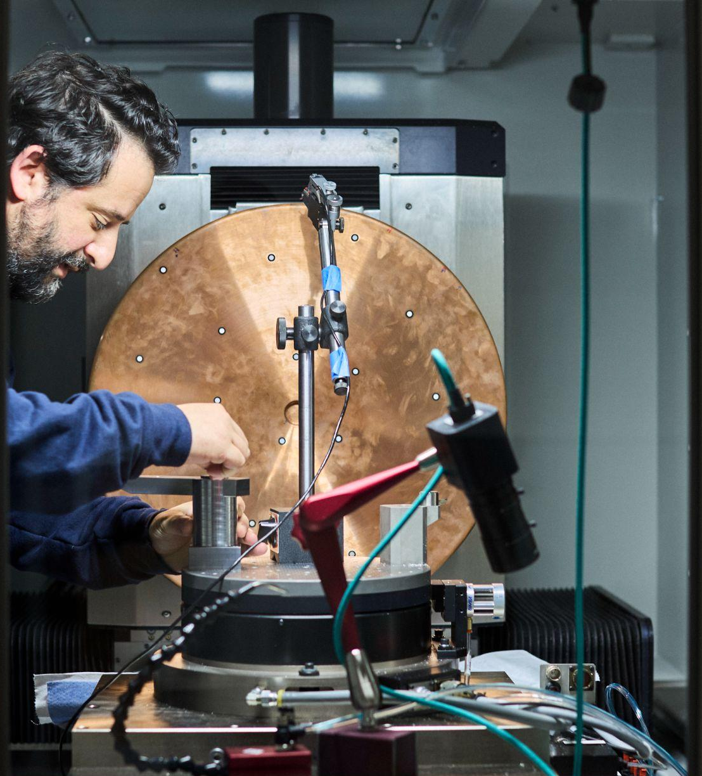
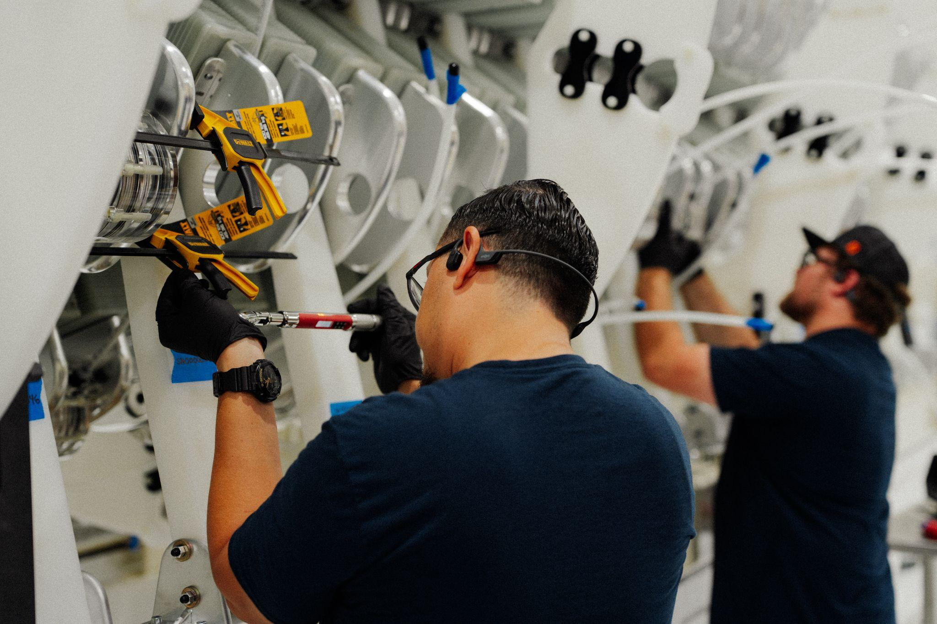
To be a true advanced energy hub, a state needs to provide the appropriate incentives and infrastructure to host:
01
Research and development
02
Advanced manufacturing
03
Advanced energy power on the grid
Notes:
In order for a state to win the fusion industry - and again I think this is parallel for most advanced energy - a state needs to provide incentives and infrastructure to host a company’s Research and Development, Advanced Manufacturing, and support putting new power sources on the grid. Strong incentives in these areas, paired with good talent and great partners mean states can win.

Slide 20
New Mexico can build the right incentives to support advanced energy companies to scale
The state currently offers effective incentives for advanced manufacturing, but needs to update research and development incentives and a cohesive development program
Research and development Research and development is already part of the state’s economic DNA.. Few states can credibly claim this depth of expertise, talent and infrastructure. The R&D Tax Credit acts as a formal incentive to further develop R&D, but changes to the tax credit are needed to maximize its impact..
Advanced manufacturing Investments from the State Investment Council, combined with Industrial Revenue Bonds, the Advanced Energy Manufacturing Tax Credit and the Investment Tax Credit are an attractive suite of incentives for manufacturers.
Development program for advanced energy power generation New Mexico lacks a development program to bridge advanced energy technologies to produce electricity like Tennessee, Virginia, Utah, Washington and Wyoming.
Notes:
In New Mexico, we have incredibly strong partnerships and the state has the appropriate talent base. And if we look at these three categories, we’ve clearly figured something out in the advanced manufacturing space. The Advanced Energy tax credit, Investment tax credit, industrial revenue bonds, and support from the state investment council is a strong set of incentives.
We don’t have that same portfolio for R&D and to support new power plant development. For Research and Development - New Mexico has a strong case for being an elite talent base, and we have incentives like the R&D Tax Credit ready to support. However, that tax credit has barriers to access and very limited refundability, meaning startups don’t get the benefit from the credit.
And the state lacks a development program aimed at incentivizing advanced energy projects for the grid. These programs are working in other states:
In Tennessee, they have a development program for nuclear power plants. They now have 3 separate projects in development.
In Texas, after years of grid reliability issues from inclement weather, the state provided significant incentives for new power generation projects. Grid reliability increased greatly.
Here in New Mexico, we have an energy transition act and we need new technology to meet the goals of that act. A development program aimed at getting us to zero carbon by 2045 would align incentives like these with already-established state priorities.

Slide 21
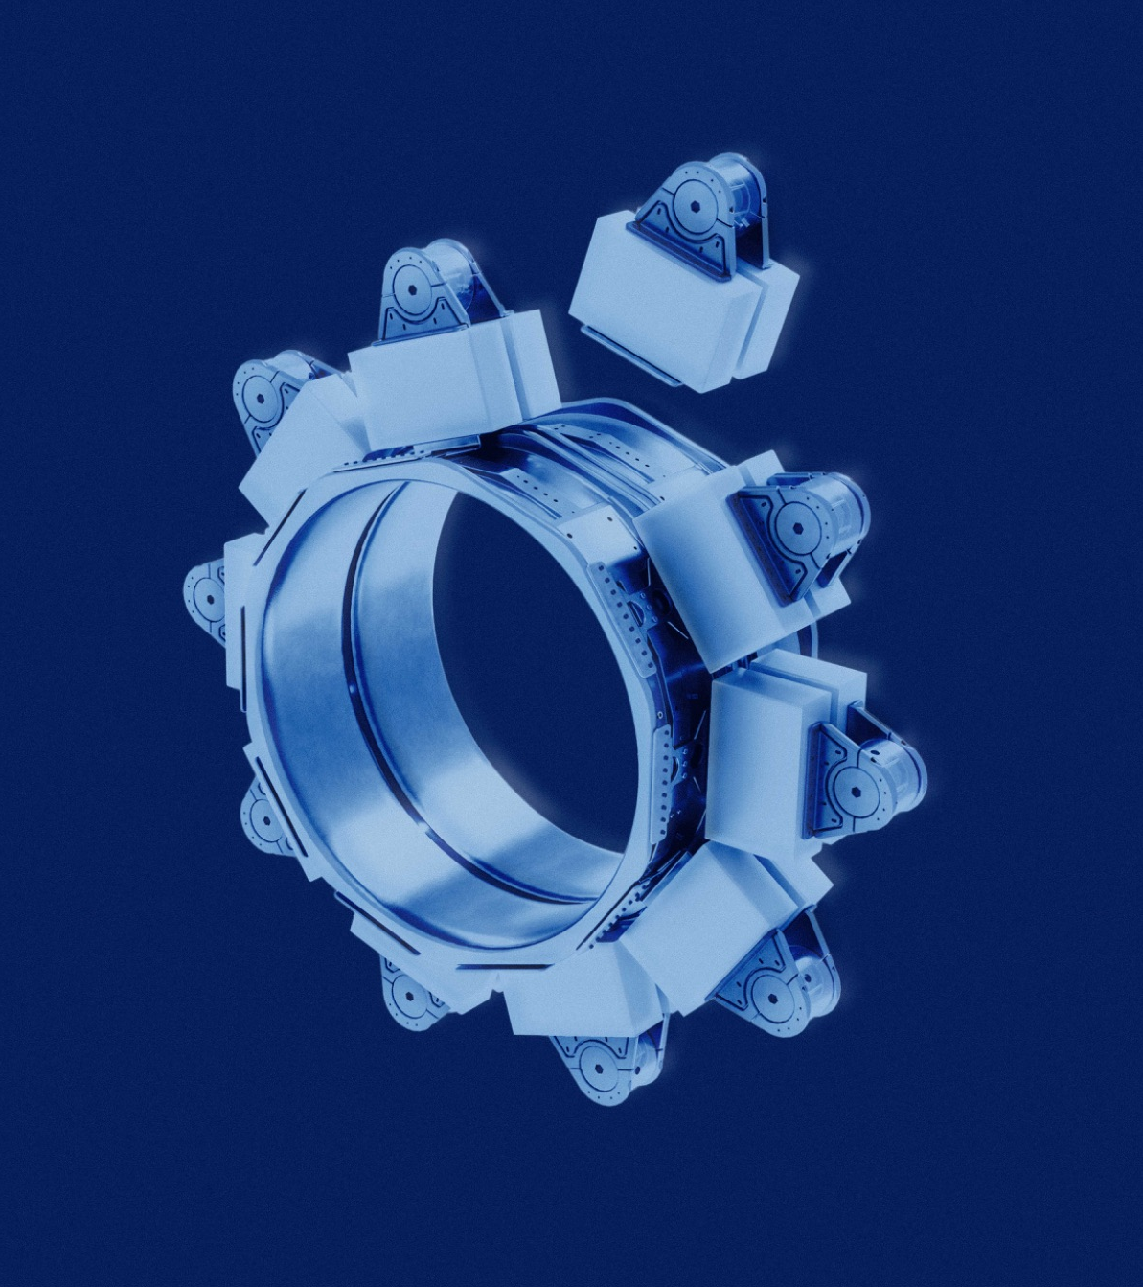

The New Mexico state legislature can support the advanced energy economy
01 | Make the R&D Tax Credit stackable with IRBs and refundable for the benefit of startups.
02 | Create a development program to lower the cost of bringing new technologies to the grid with project development funding, streamlined regulatory processes, and access to low-cost loans.
Notes:
So any state can take a run at being a national leader on research and development, advanced manufacturing and supporting new energy generation projects.
For New Mexico, changes to their R&D tax credit as well as the creation of a development program to get new technologies on the grid and meet state goals is critical to being a true national hub for advanced energy technologies.

Slide 22
Matt Pahl
External Relations Lead
matt.pahl@pacificfusion.com

