Slide 1
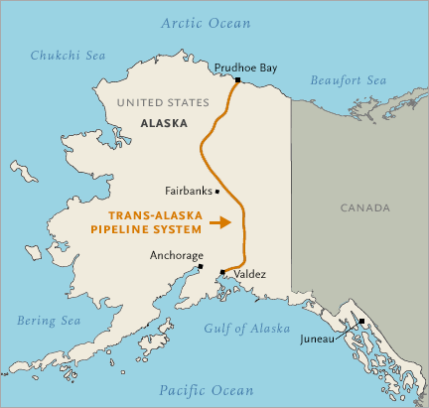
TRANS-ALASKA PIPELINE SYSTEM:
Past, Present and Future
Tom Marchesani, VP Engineering
Alyeska Pipeline Service Company.
September 20, 2025

Slide 2
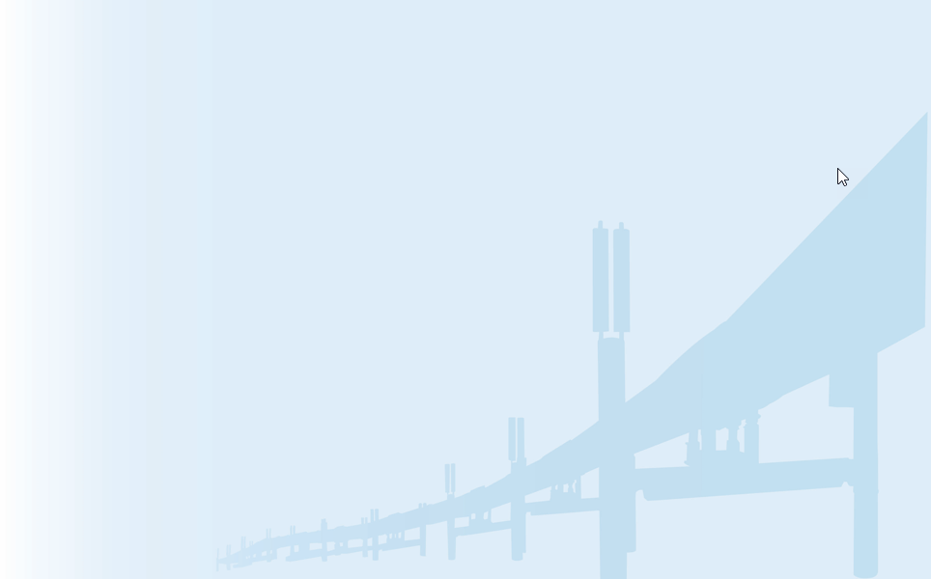
Outline
Trans Alaska Pipeline System (TAPS) Overview
Origin of TAPS
A Decade of Challenges
Reconfiguration and Renewal
The Low Flow Challenge
Forward to TAPS100

Slide 3
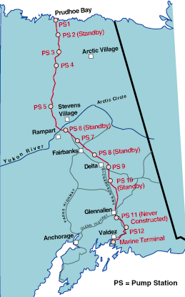
Trans Alaska Pipeline
System (TAPS) Overview
Built to bring Alaska North Slope crude oil to market 1975-1977
800 miles long, 48-inch diameter
  420 miles above ground
  380 miles below ground
Three mountain range crossings
34 major river crossings
Notes:
800 miles long, 48-inch diameter
34 major rivers, 800 river & stream crossings
Yukon River
Tanana River
Gulkana River
3 mountain ranges
Brooks Range - Atigun Pass - elevation 4,739 ft.
Alaska Range - Isabel Pass - elevation 3,420 ft.
Chugach Range - Thompson Pass - elevation 2,812 ft.

Slide 4
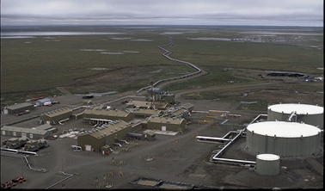
Pump Stations
Original design – 12 pump stations
  Eleven (11) were built
    Ten pumping stations
    One relief stations
Today – 5 operating stations (one relief only) + 2 spill response bases
Notes:
11 Pump Stations
To move oil from Prudhoe Bay to Valdez, we have 11 pump stations
Original design called for 12 pump stations, with 4 pumps each.
Technological advancements allowed us to build TAPS with 11 pump stations.
One is a relief station, so there are no mainline pumps there -- PS5.
Each station has 3 pumps -- 2 in operation and 1 in standby.
At peak throughout 2.1 mbpd - all 3 pumps operated..
In 1996, we began placing stations in standby. Throughput had reduced enough that we no longer needed as many stations. 1996 - two stations in standby -- PS8 & PS10. 1997 -- two more in standby -- PS2 & PS6. Currently operating the pipeline with 7 pump stations
Self-sufficient / 10-25 crew
PS are self-sufficient facilities with crews of 10-25 people, depending on the size of the station.
Crew includes those who run the pumps, maintain the equipment/facilities, catering staff, etc.
Crews typically work a -week on/-week off schedule, 12-hour shifts; two shifts for 24-hour coverage.
Boost Oil Flow
Purpose is to boost the pressure to move the oil. The line can’t operate without PS1,3 and 4.
APSC operates a fuel gas pipeline to PS 1,3 and 4. They are critical stations required to move the oil over Atigan Pass. Once over Atigan, there are several other configurations to get it to Valdez.
Meter Oil
Alyeska is a common carrier pipeline. We accept custody of oil from Producers at PS1 and are responsible for it until it is loaded on to tankers at the VMT.
We count the oil, analyze it and track it at various locations to ensure that what goes in is “accounted” for at the end of the line. There are two places along the route where crude is pulled off by refining facilities. Once pulled off, it is processed and the residual oil (which is still a product but not usable at these facilities) is put back into the line.

Slide 5
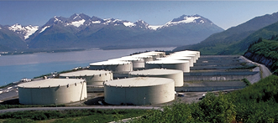
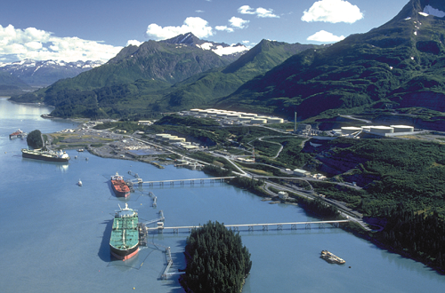
Valdez Marine Terminal (VMT)
1000 acres
Oil metered, stored & loaded on tankers
  Originally 18 crude storage tanks (9 million bbl capacity)
  Originally 4 berths - 380,000 bph loading capacity
  Original Operations Control Center
  Power generation
  Ballast water treatment and outfall
  Spill containment and response
Notes:
14 days of throughput
Tanks: 18 now 13
5 berths in original design, only four were built, 2 in use
Berth 1 is a floating platform berth due to depth of water, Berths 3,4 and 5 are fixed platform berths.
OCC was located at the VMT and controlled the entire pipeline system.
Alyeska generates its own power to run the terminal. Capable of producing 37.5 megawatts -- enough to power a city of 25,000.
Use 10.
Intertie with Copper Valley to reduce diesel burn and provide power to Valdez grid.

Slide 6
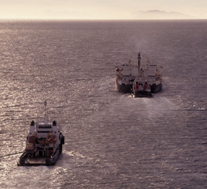
Ship Escort Response Vessel System (SERVS)
Created July 1989 after Exxon Valdez
All laden tankers escorted by 2 SERVS vessels
  Escort tankers 70 miles through Prince William Sound
  Assist tankers in emergencies
  Provide initial oil spill response
Notes:
Largest oil spill response organization in western hemisphere
and possibly the world.
Prevention is key; ready to respond
Primary function is to PREVENT an oil spill from a tanker that’s travelling through Prince William Sound
Secondary function is to respond if there is an oil spill.
SERVS created in July 1989
in response to EVOS.
All laden tankers escorted by 2 SERVS vessels
Primary prevention function is escort system.
All tankers that leave the VMT are escorted by 2 SERVS vessels through PWS.
It’s a 70-mile escort, so we often say the pipeline is actually 870 miles long.
Their job is to help keep tankers out of trouble

Slide 7
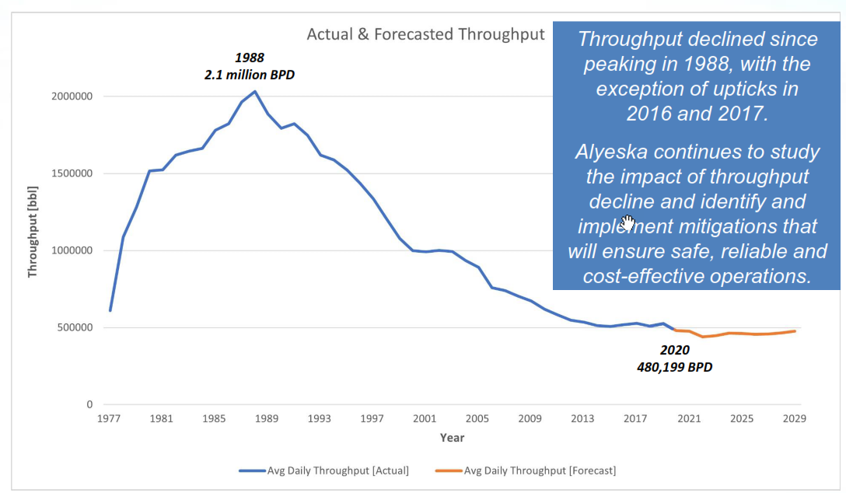
Throughput history (through 2020)
Peak throughput 2.1 million bpd - 1988
Current thru-put ≈ 460,000 bpd
19 billionth barrel left PS01 this past Monday
Notes:
2.1 mbpd peak throughput -- 1988
Oil volume traveling though the pipeline is called “throughput”. Thoughput volume peaked in 1988 at 2.1million barrels per day. Since then, throughput has been declining.
1.07 mbpd current
We are currently at 1.07 mbpd
The 13 billionth barrel of oil will go through pipeline in the next couple of months.
Oil travels approximately 3.6 miles per hour through the pipeline
Oil takes approximately 9 and a half days to get from Prudhoe to Valdez
We’ve had 16,000 tankers call at the terminal
We've safely escorted over 7,000 tankers
These are the kinds of “milestones” that we track and celebrate as a company
How many billion barrels
How many tankers
How many escorts carried out by Ship Escort Response Vessel System

Slide 8
TAPS Origins
Discovery, Design, Construction, and Early Operation

Slide 9
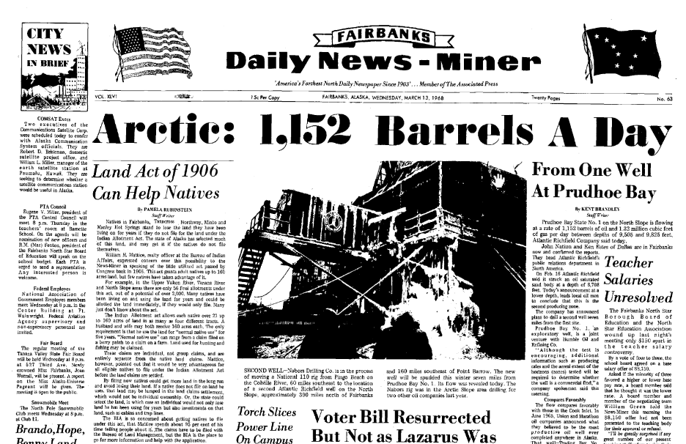
Discovery well announced
March 13, 1968

Slide 10
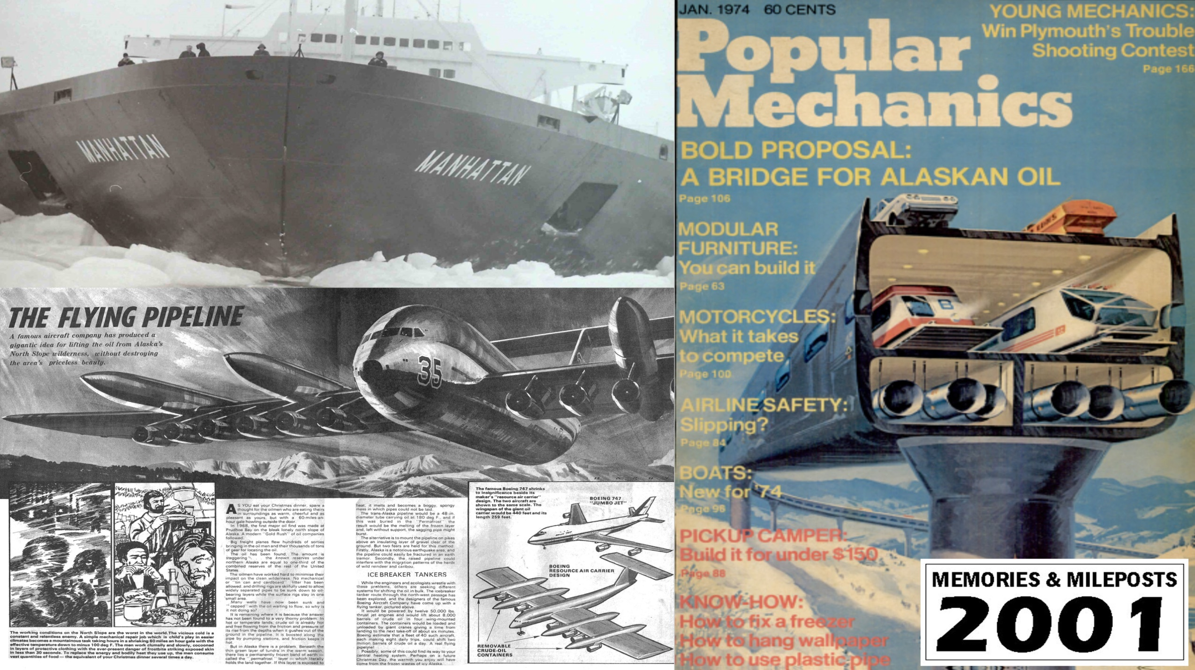
Early Ideas: Thinking “Outside the Pipe”

Slide 11
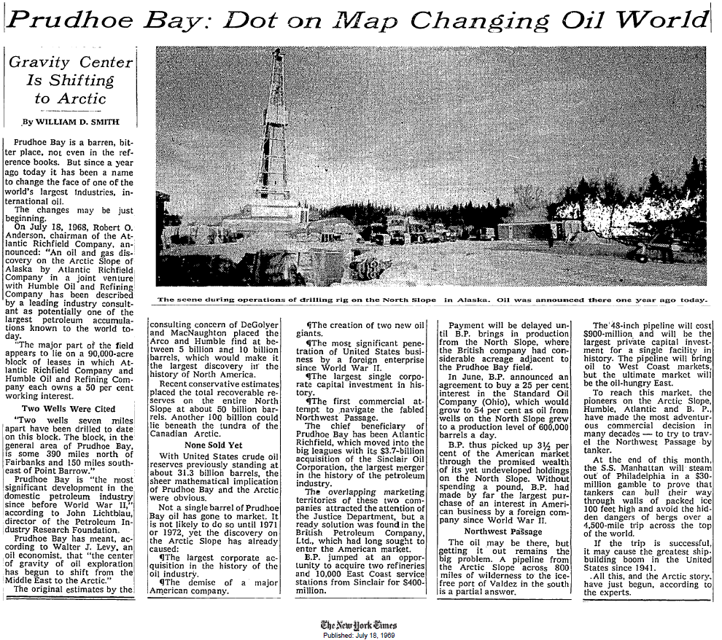
Oil industry excitement
July 1968 - Pipeline field studies start
October 1968 – Atlantic Pipeline, Humble Oil, BP Exploration enter into agreement for a pipeline planning study
February 1969 – Companies announce plans for 800 mile all Alaska pipeline to Valdez (northernmost ice-free port, land provided by City of Valdez)
  Pipe ordered
  Two alternative routes (Atigun selected)
July 1969 - $900 MM estimate to be the “largest private capital investment for a single facility inn history” (Final cost $8 billion (1977).

Slide 12
Lands Issues
Federal transfer of lands to the State of Alaska suspended in 1966 because of native land claims
This remained in effect thru discovery and delayed establishment of the right-of-way
In 1971 congress passed the Alaska Native Claims Settlement Act (ANCSA), which cleared the way for right-of-way acquisition

Slide 13
Legal contests
Santa Barbara spill in 1969 triggered the environmental movement
First lawsuits filed in 1970 and contested for years
TAPS was the first project for which an Environmental Impact Statement (EIS) was required, triggering a large amount of documentation and concessions.
Resolution of lawsuits required an act of Congress decided Spiro Agnew’s tie-breaking vote – 1973
Final clearance of all legal actions completed in early 1974, allowing haul road (Dalton Highway) and pipeline construction

Slide 14
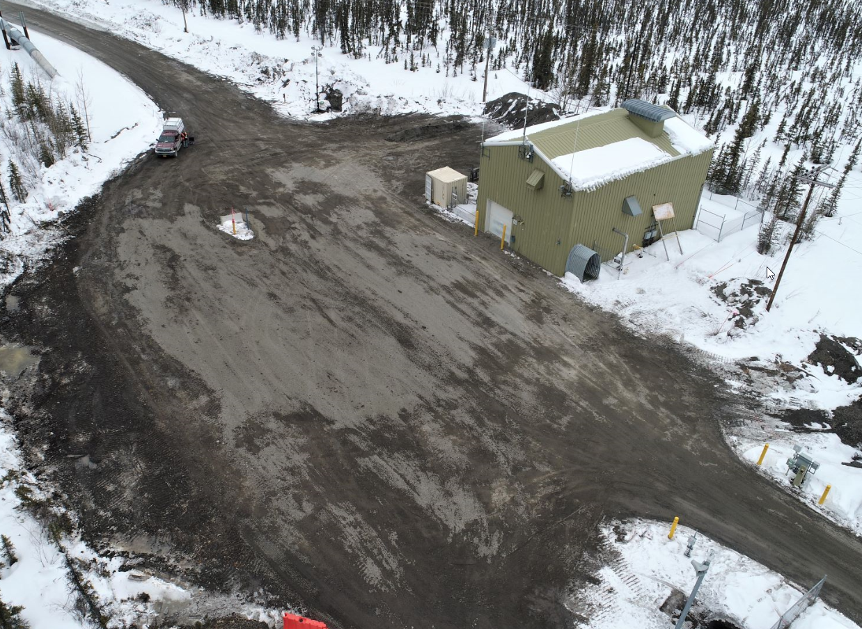
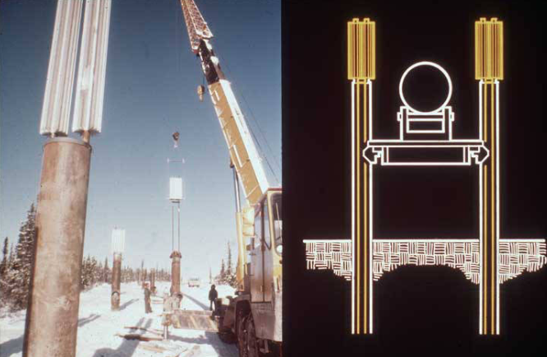
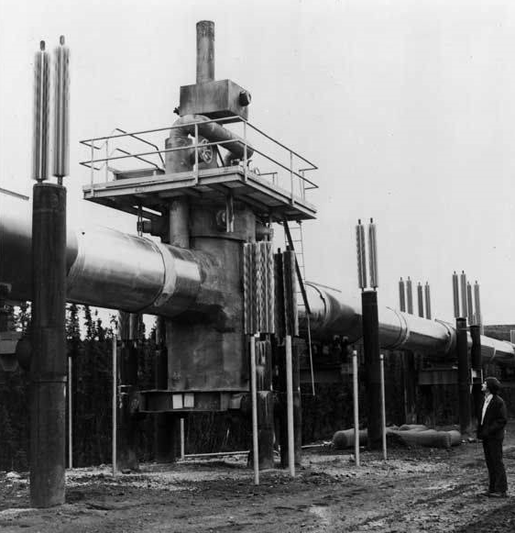
Unique aspects of TAPS design
Above ground design with heat pipes
Mainline soil refrigeration
Remote gate valves

Slide 15
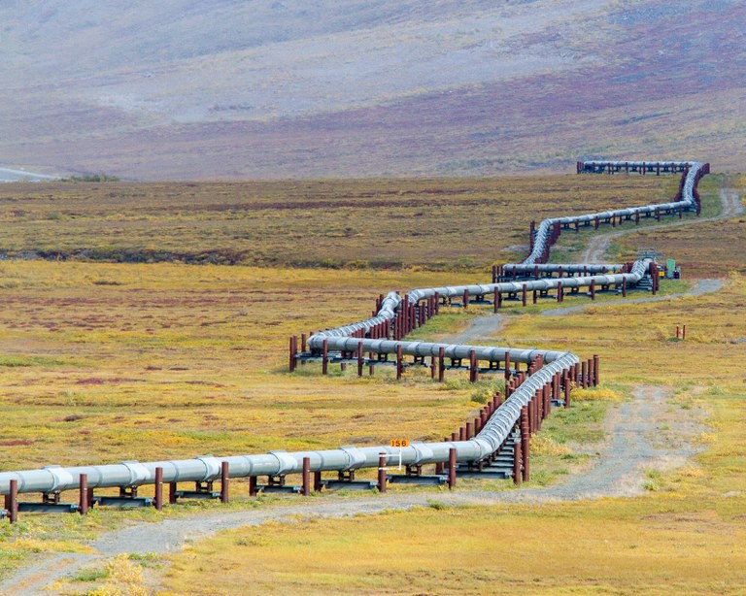
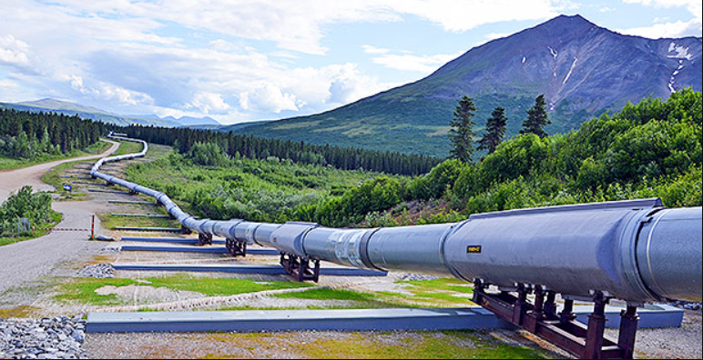
Unique aspects of TAPS design
Seismic design
Thermal expansion

Slide 16
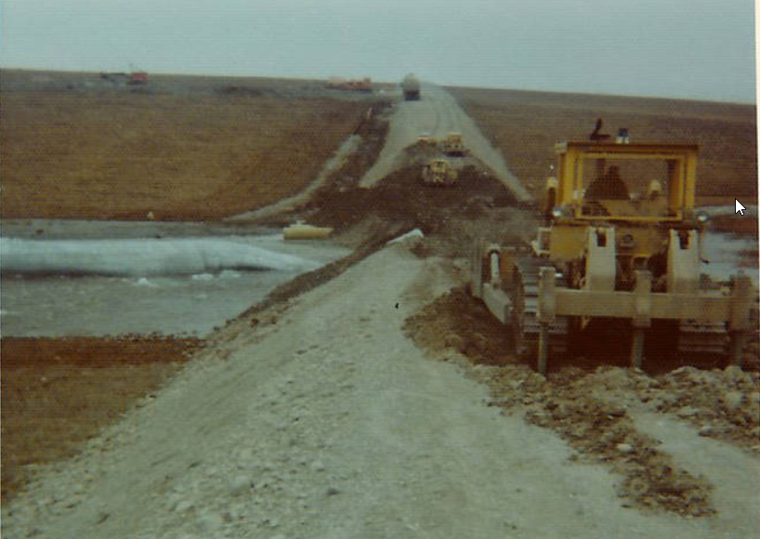
Haul Road Construction (start-to-finish in 1974)
Before the pipeline, there was the haul road. It was required in order to begin pipeline construction work north of the Yukon River
Alaska Highway experience informed pipeline design

Slide 17
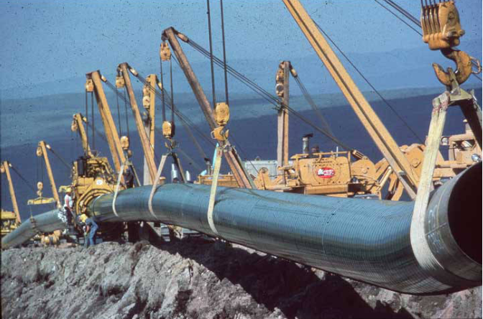
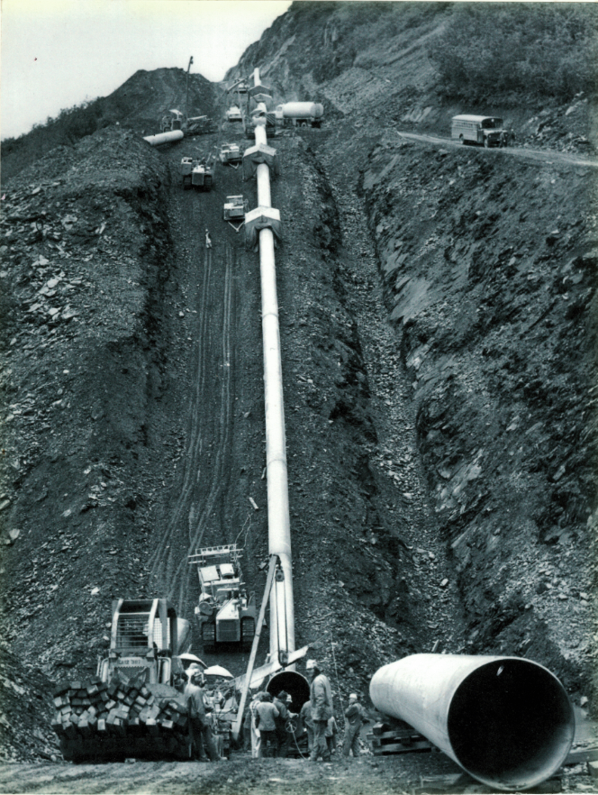
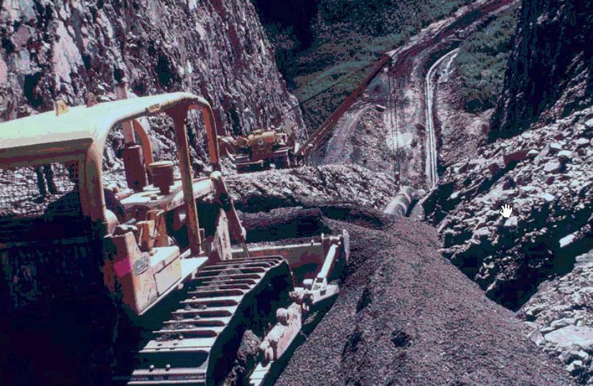
Below ground construction
1975-1977

Slide 18
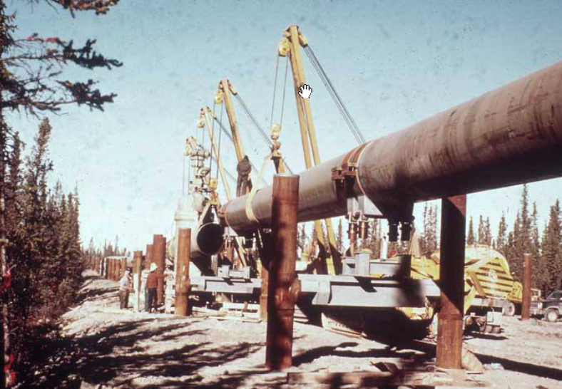
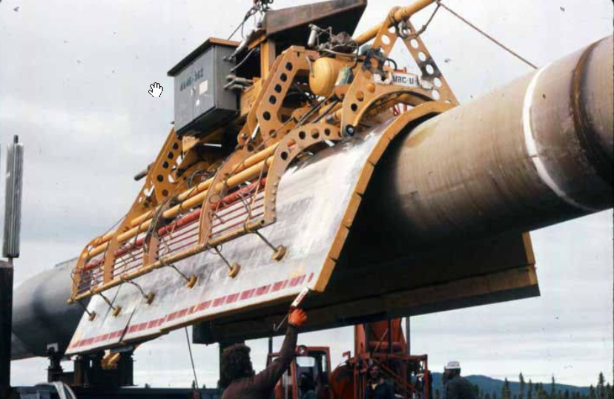
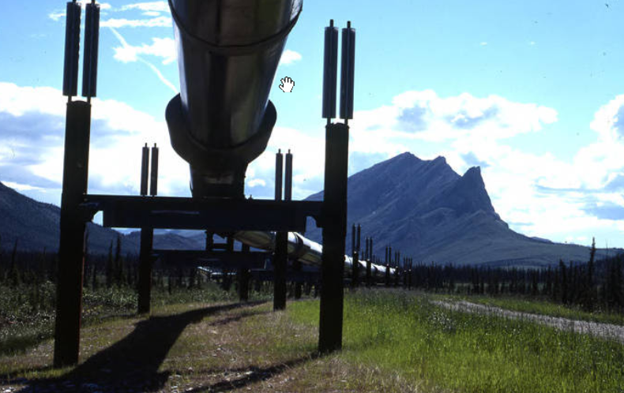
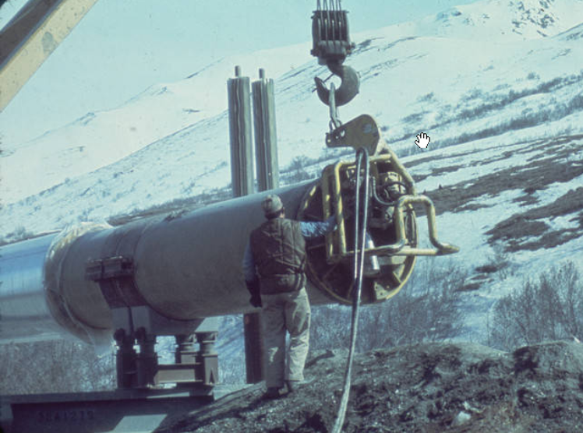
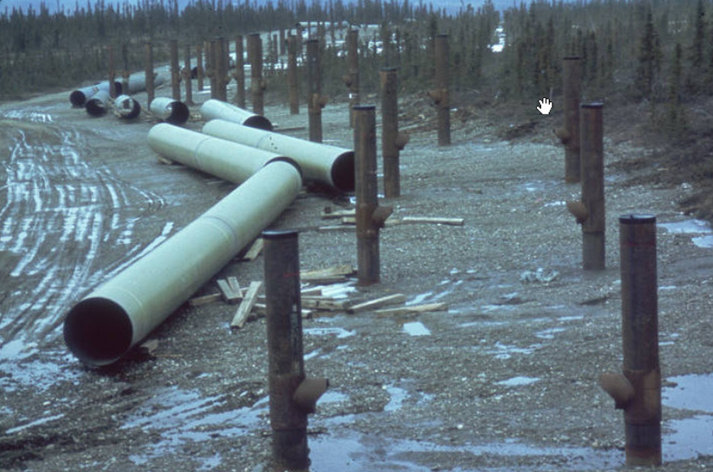
Above ground construction
1975-1977

Slide 19
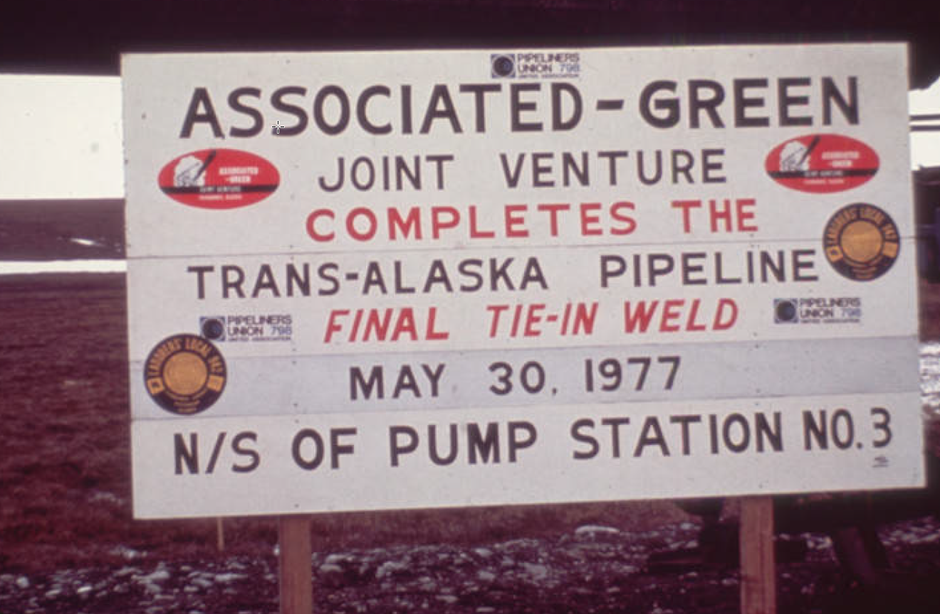
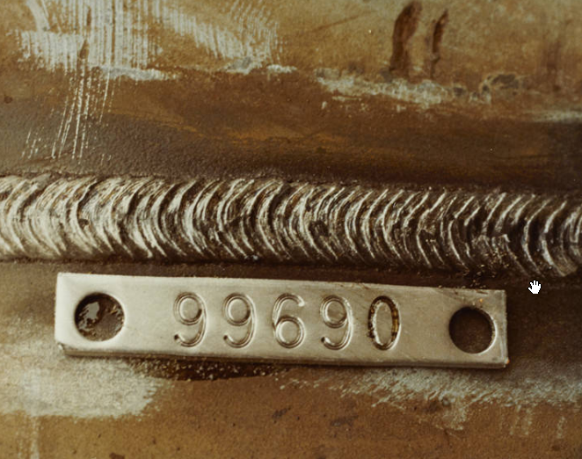
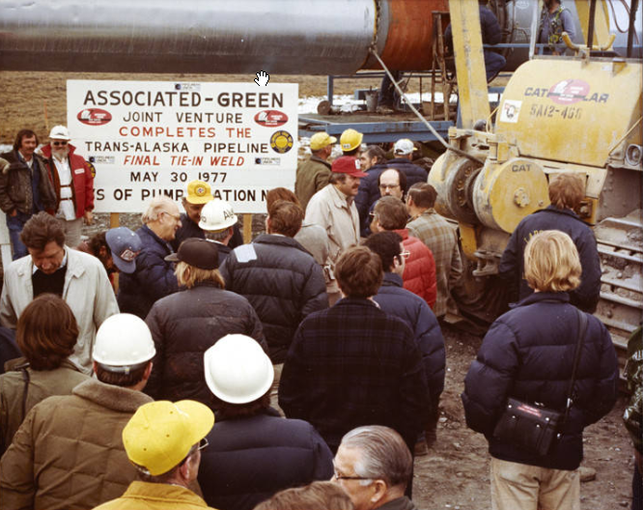
The final weld – 05-30-1977

Slide 20
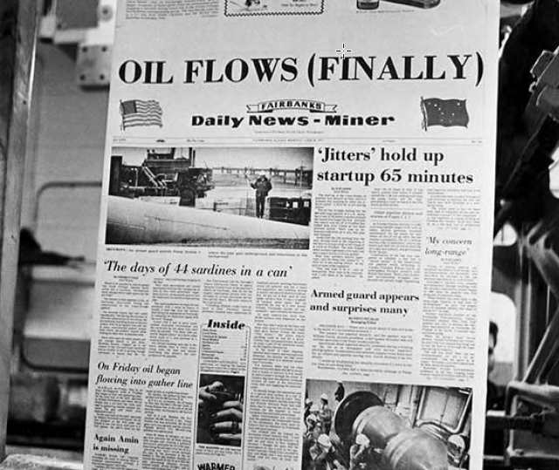
Oil in –
June 20, 1977
Nitrogen ahead of leading- edge pig

Slide 21
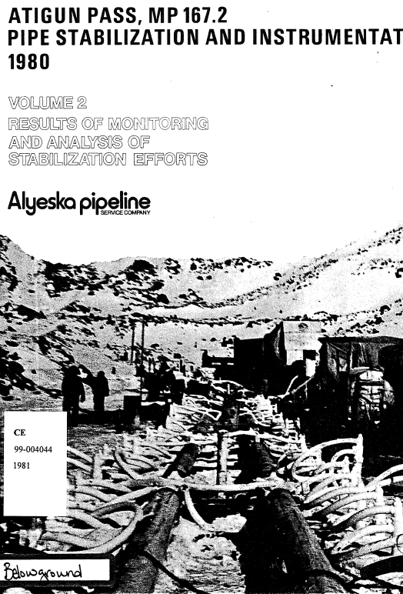
Settlement issues
Atigun Pass (north side) underpinning stabilization and leak repair – 1979 [buckled pipe replaced in 1987]
Upstream of Pump Station 12: sleeving of leak and stabilization – 1979
Atigun Pass south side MP 167.2 (left) – stabilization through ground freezing (no leak) - 1980
MP 200 – pipe replacement of deep settlement segment -
Facility piping settlement

Slide 22
Production ramp-up: “throughput is king”
Phase II stations – PS02 and PS07
DRA
Obviated need for pumps at 05 and 11
Added Ledeen actuators due to check valve shear
Pump modifications
Never had to add fourth MLU at stations
Half head pumps
Rim cooling
Full bore operation
Diversion to relief tanks to maintain throughput
RESULT
THROUGHPUT MAXIMIZED AT 2.1 MMBPD
Pump Station 2 (1979)
Pump Station 7 (1981)
Started 1979

Slide 23
A Decade of Challenges

Slide 24
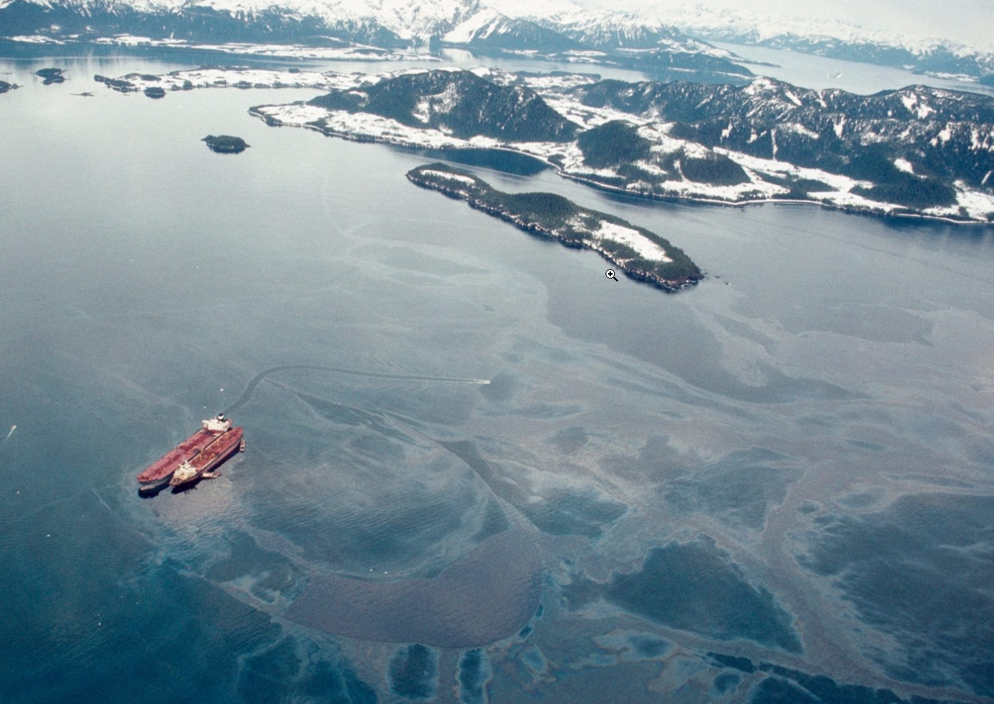
Exxon Valdez
March 1989
The spill occurred amid rising regulatory and public scrutiny of TAPS operations
Though Alyeska was a third party, the spill increased scrutiny related to spill potential, preparedness, and response
Many changes followed on the pipeline, including formation of SERVS and oil spill contingency plans.

Slide 25
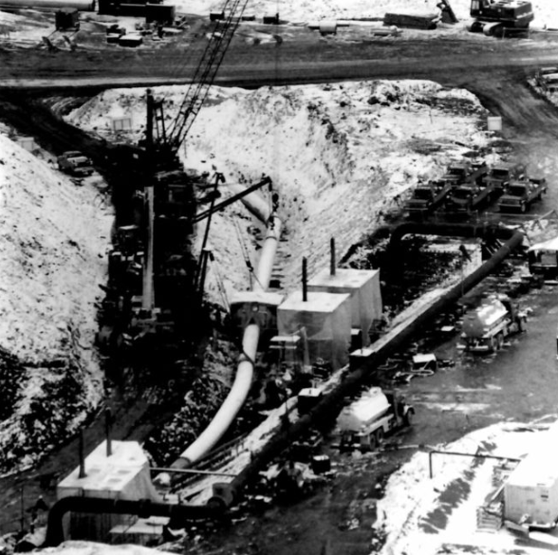
Atigun Reroute – 1990-1991
This was the largest of many corrosion projects on the pipeline
Replaced 8.5 miles of pipe using new fusion-bonded epoxy coating
Three new 48” valves
Drain, clean and abandon-in-place original pipe
Largest single post-construction project until the 2000s

Slide 26
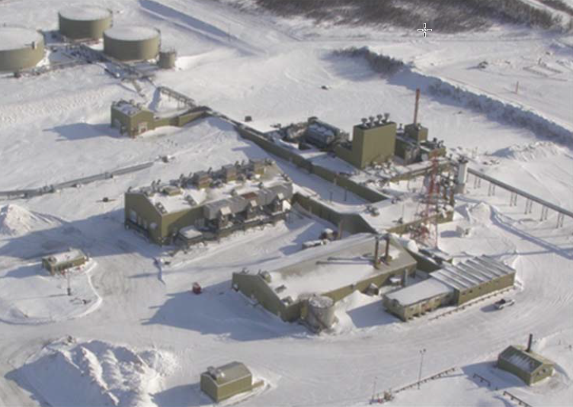
Facility Rampdown
By 1995, throughput had declined by over 1/3 from peak to 1.4 Mbpd
Some stations no longer needed hydraulically
Alyeska performed “ramp down” of excess stations starting in 1996
  Pump Stations 8 and 10 (1996)
  Pump Stations 2 & 6 (1997)
  Pump Station 12 (2005)
  Pump Station 7
Restart within 6 months
Topping units (that produced liquid fuel for operations) shuttered in 1995-96

Slide 27
Reconfiguration and Renewal

Slide 28

Right of Way Renewal
Original Federal Grant and State Lease of Right-of-Way executed in 1974
This was valid for 30 years, so had to be renewed for continued operation of TAPS
$60M in RoW maintenance and restoration
Renewal negotiations from 2000 to 2002
Renewal signed 11-26-2002

Slide 29
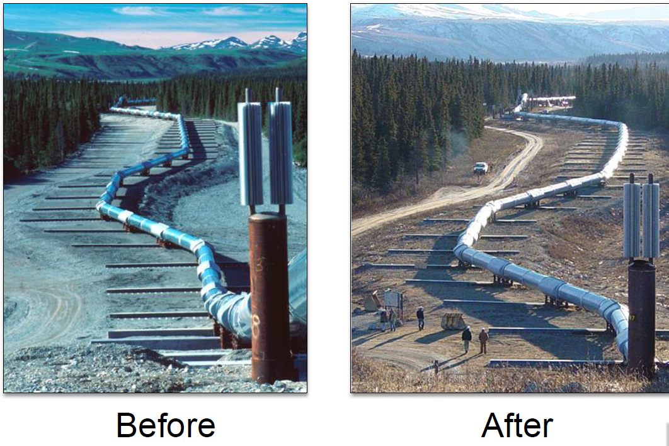
Denali Fault Earthquake – October 2002
Magnitude 7.9
Occurred in a zone designed for “high displacement”
  Crossbeams and shoes damaged
  No oil spilled
“Final exam” before Right- of-way renewal

Slide 30
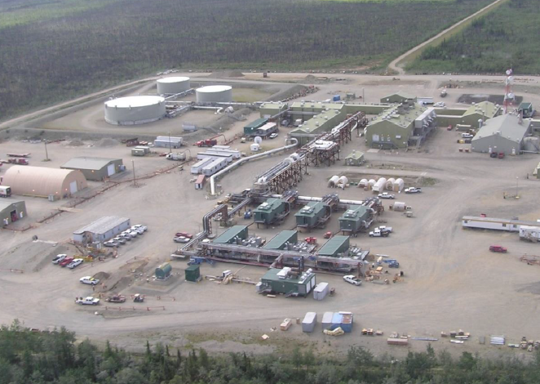
Strategic Reconfiguration
Electrification and automation of remaining pump stations
Replaced mainline pumps and turbines
  Commercial power to variable frequency drives at Pump Station 9
  Turbogenerators at Pump Stations 1, 3, and 4
New control architecture and “smart” power distribution
Elevated arctic modules on piles
Pump Stations 3, 4 and 9 completed between 2007 and 2009
Pump Station 1 completed 2017

Slide 31
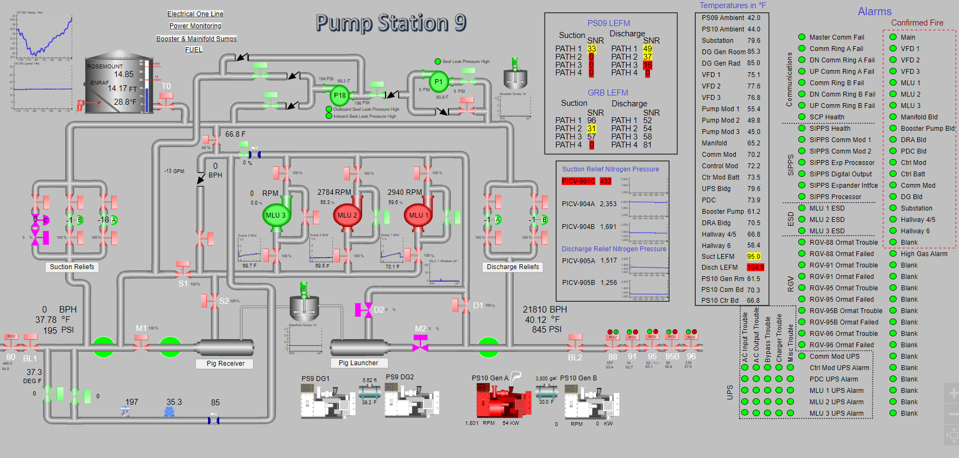
Automation and Control
SR enabled remote monitoring and control to a degree never before achievable.

Slide 32
The Low Flow Challenge

Slide 33
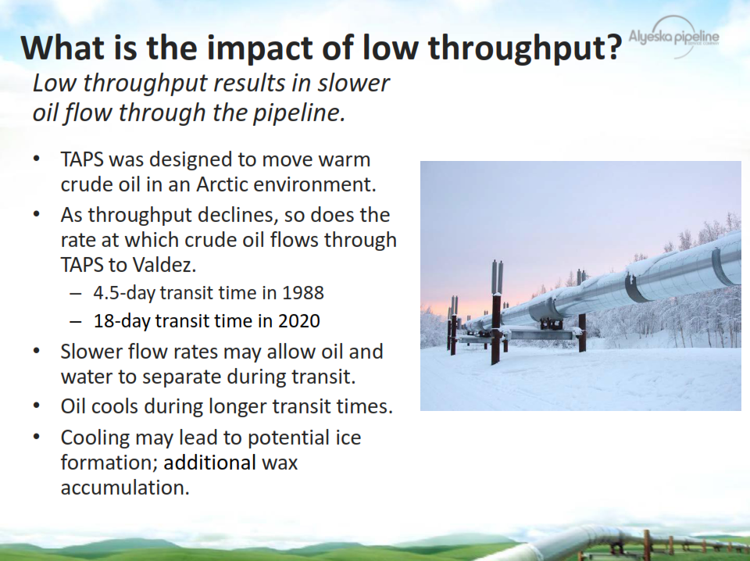

Slide 34
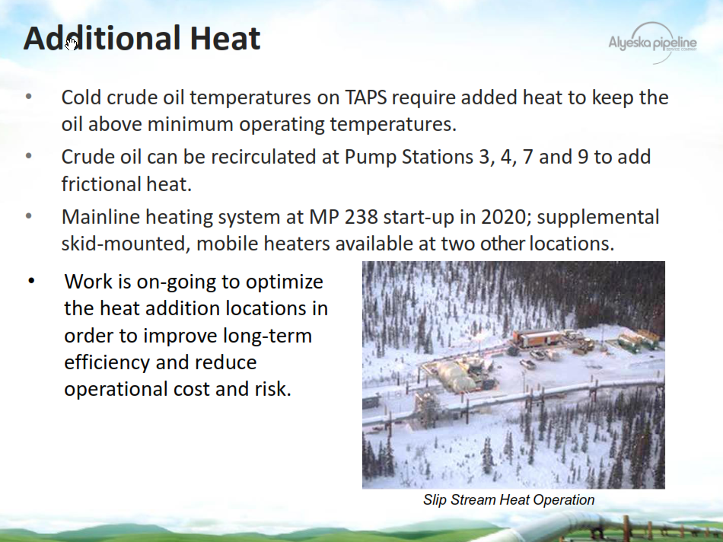

Slide 35
Forward to TAPS100

Slide 36
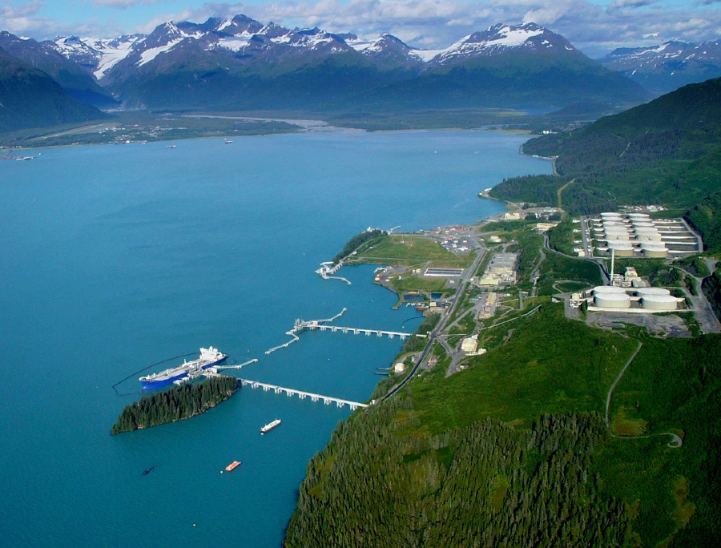
A Period of Stability
Throughput stabilized at ≈500,000 bbl/day
Heating kits are robust and scalable
OPPORTUNITIES FOR OPTIMIZATION:
  Pump Station 5
  Valdez Marine Terminal Power/ Vapor (under study)

Slide 37
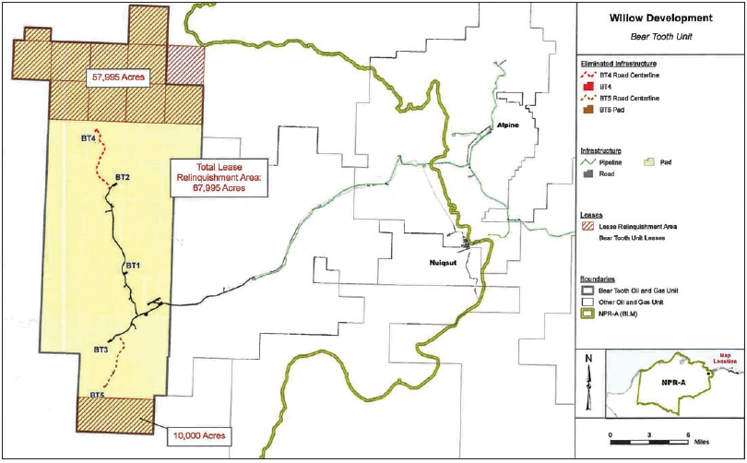
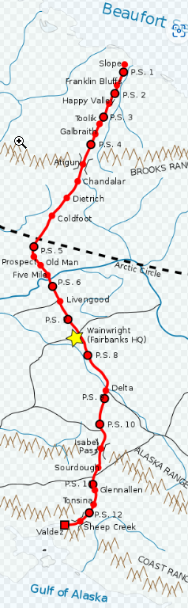
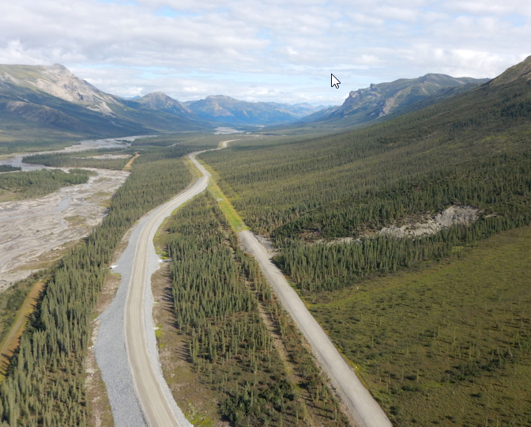
Challenges and Opportunities Ahead
New projects (Willow and Pikka): boost throughput
Right of Way Renewal 2034
Thawing permafrost & Geo-hazards

Slide 38
QUESTIONS

