Slide 1


Building an Industry: CCUS as the Foundation for Expanding CO₂-EOR
Scott Quillinan, Senior Director, Research
School of Energy Resources
University of Wyoming
Presented to
The Energy Council
2025 Annual Meeting
September 18-20, 2025
Notes:
Major take away-Is that carbon capture and storage and CO2-EOR work together to create a viable carbon management industry.

Slide 2

Outline:
National Landscape for CCUS
National Policies and Legislative Frameworks Supporting CCUS
Innovations and Demonstration Projects in Carbon Capture
Challenges and Regulatory Complexities in CCUS Implementation
Synergies for Storage for Enhanced Oil Recovery

Slide 3
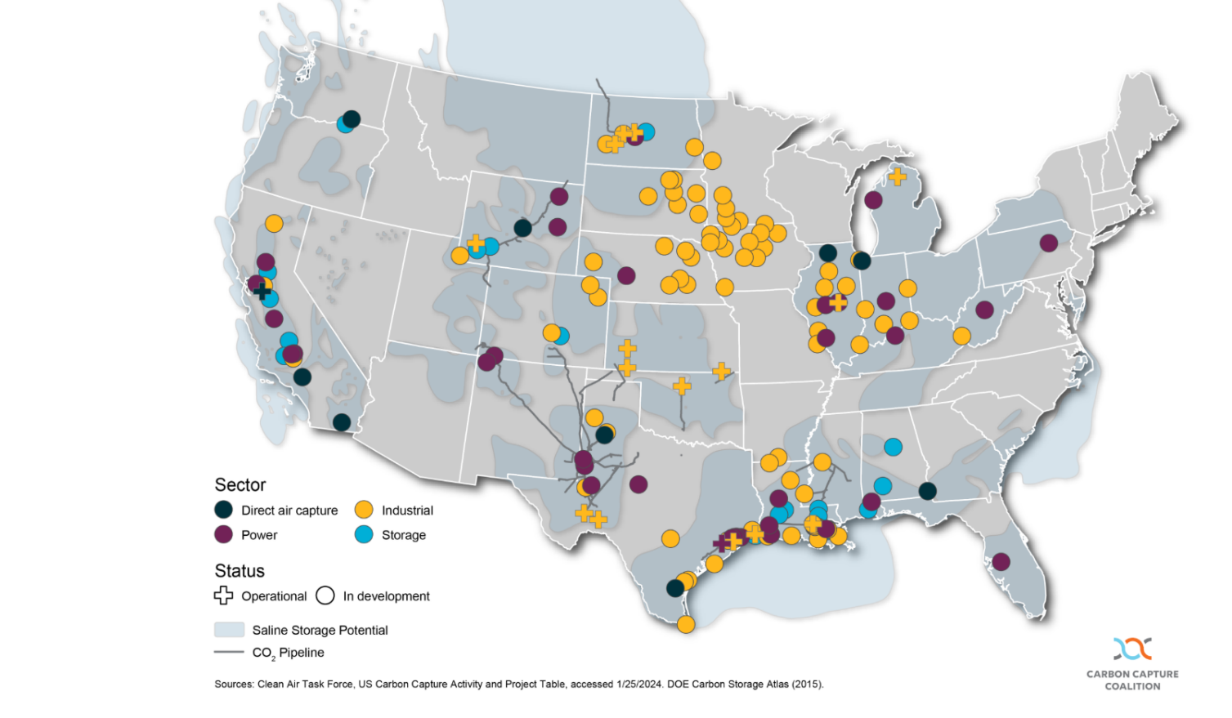

US CCUS Industry Snapshot
Nearly 200 projects announced in the U.S. (CCC, 2024)
Sectors involved: power, industrials (cement, steel, refining), hydrogen
CO₂-EOR is not shown on this map, but should be included
Offers and option for data centers to develop their own reliable, low-emissions power
https://carboncapturecoalition.org/geologic-storages-role-in-scaling-carbon-management/
Notes:
Nationally momentum has been growing. Nearly 200 CCUS projects have been announced across the country, across many different sectors including power, industrial (cement and steel), hydrogen, and even to provide baseload power for data centers.

Slide 4
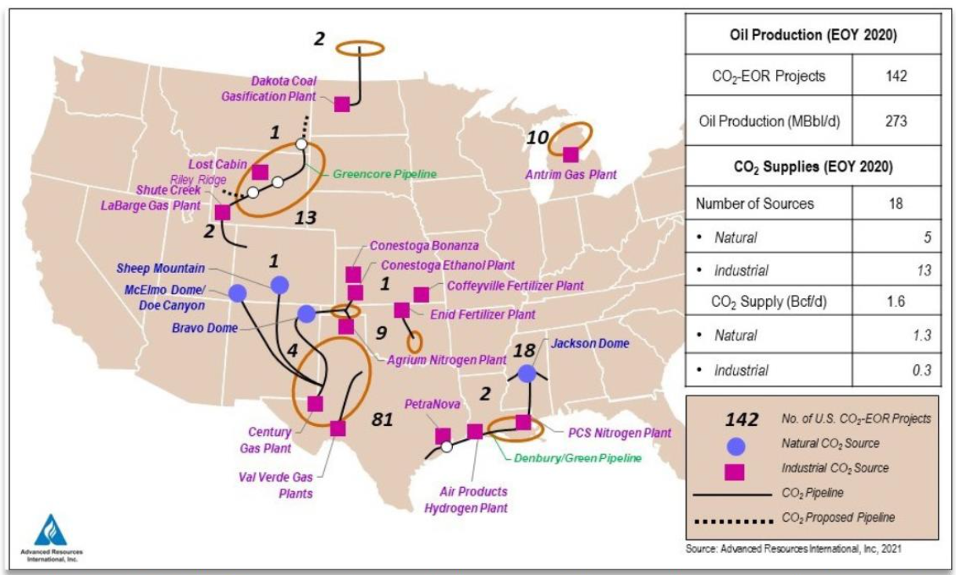
US CCUS Industry: EOR
Notes:
Now let’s talk about CO2-EOR a part of the CCUS story that often gets over-looked. The U.S. has about 140 active CO2-EOR projects and produce roughly 273k bbls/d. The Permain leads in production (185k) followed by the Gulf Coast (39K) and the Rockies at (37K).
The takeaway is here is that CO2-EOR is an established national industry with decades of operational experience, ready to scale with new sources of captured CO2. For CCUS to truly succeed, EOR and storage must grow together.

Slide 5
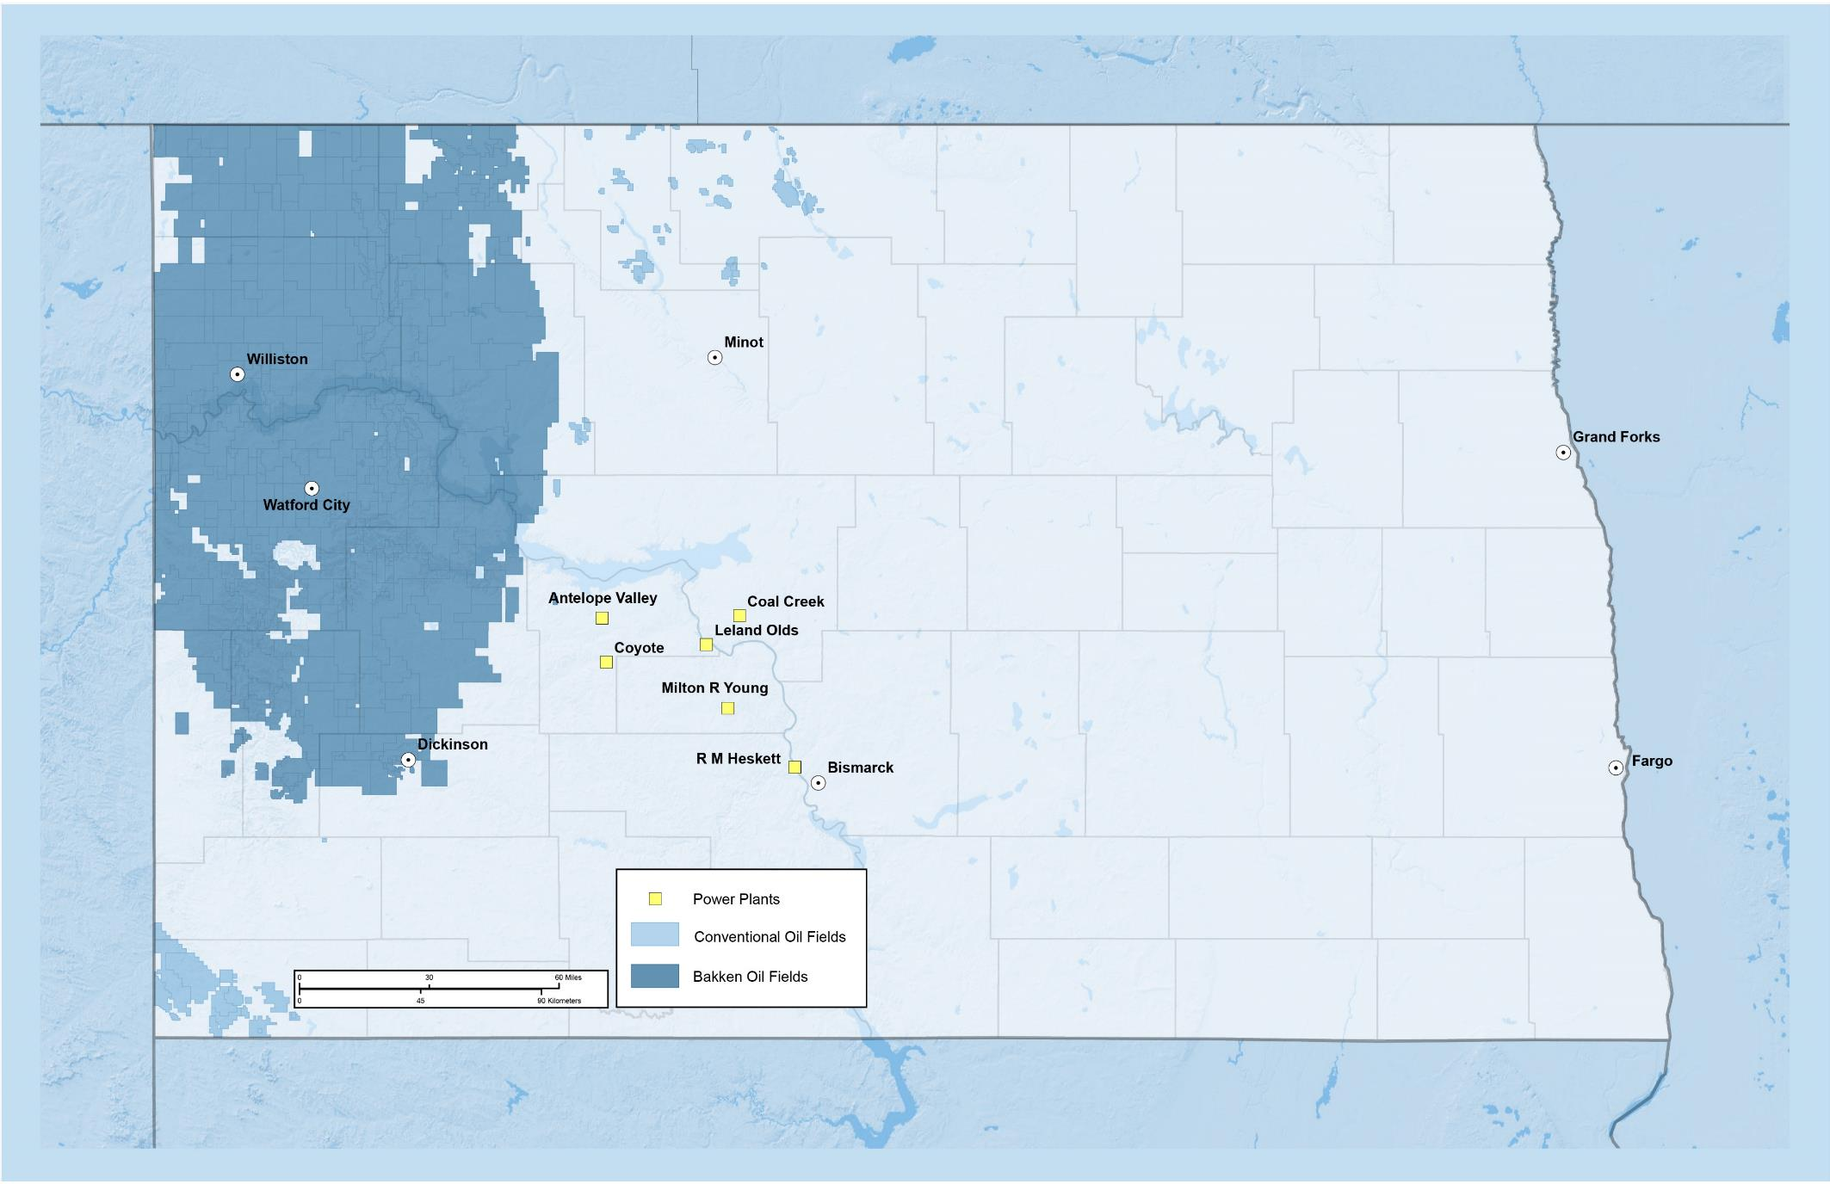
CCUS in the Bakken
Over 20 Years
93 million - 294 million
Tonnes of CO₂ Stored
Could Produce
340 million to 1 billion
Barrels of Reduced Carbon Intensity Oil
Ref: Peck, Azzolina, and Guillot, 2024. North Dakota 20-year CO₂ EOR forecast, Final Report prepared for Bank of North Dakota, Energy & Environmental Research Center 2024-EERC-11-06, 52.
Notes:
I’d also like to share the potential for CCUS in North Dakota….

Slide 6
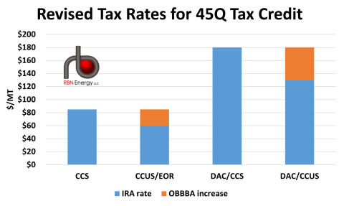
One Big Beautiful Bill Act (OBBBA)
45Q fared well in OBBBA
  Introduced new restrictions for foreign entities of concern
  Maintains credit eligibility for projects that began before 2033
  Maintains transferability and direct pay
EOR-parity
  $85/ton for permanent storage or use in products like CO₂-EOR
  $180/ton for direct air capture and storage or use
Effects
Encourages CO₂-EOR by creating a level playing field
Supports the U.S. energy sector making more projects viable
Notes:
Wyoming actually had a bill in motion that would have closed the gap between CO2 EOR and dedicated storage. The reason is simple, the state makes much more revenue when oil is produced. However, the federal billed moved fast enough that Wyoming's action didn't see a difference. However, today the legislature is considering a pool of funds to further incentivize EOR, including a matching funds program that could be used for up front investment (you could ask Rep Heiner how you'd like him to talk about that).

Slide 7
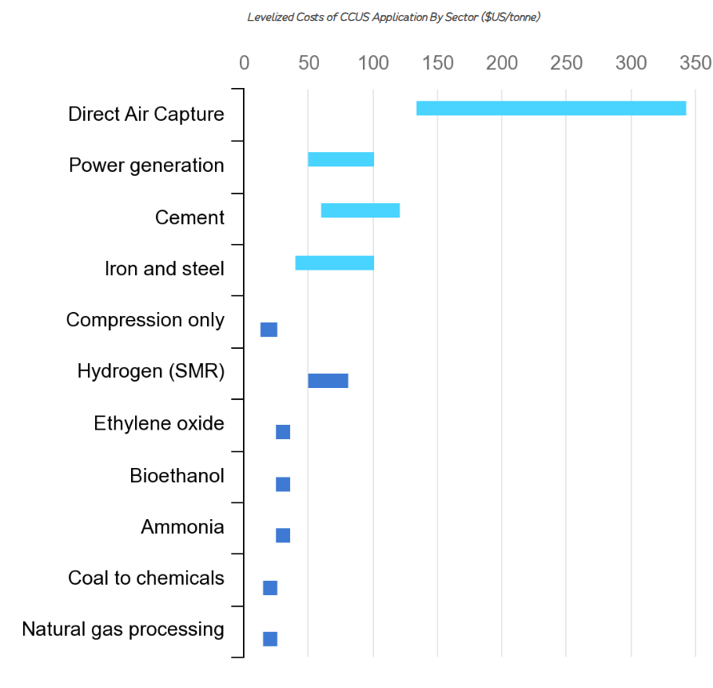
Challenges to CCUS
  Challenges
    Increasing CO₂-EOR requires additional sourcesof CO₂
    Cost
        Cost of capture
        EOR requires high capital investment and extended return on investment
    Regulatory complexity and infrastructure build-out for Class VI wells and interstate CO₂ pipelines
    Public perception
  Opportunities
    Extending life existing coal and natural gas plants
    Learning by doing
    Enhancing domestic oil production through CO₂-EOR
    Incentivizing new industries
https://rpbenergyeconomics.com/ccus-and-clean-energy-transition-new-era/
Notes:
At the same time, challenges remain: high capital and operating costs, regulatory complexities with class Vi wells and interstate pipelines, attaining a social license to operate, and the difficulty of siting projects on federal lands.
But the opportunities… extending the life of existing plants, thereby stabilizing the grid, and supporting new industries…out weigh the hurdles.

Slide 8
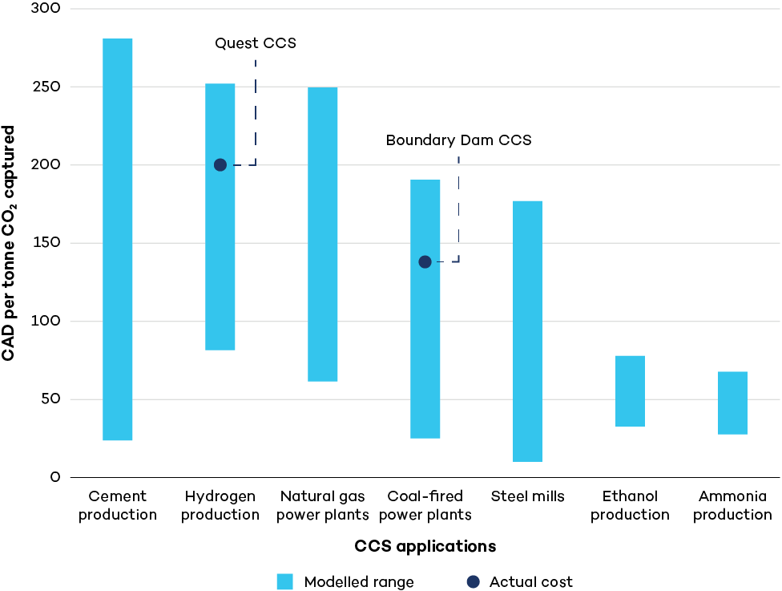
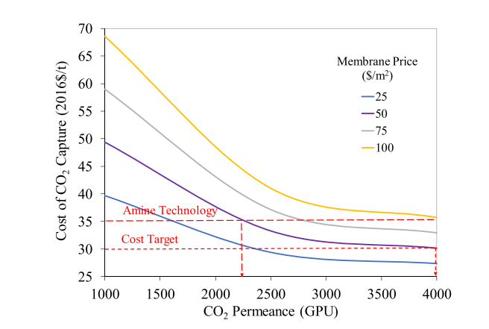
Cost of Capture
Notes:
Note that the costs in the graph on the left hand side are Canadian dollars, so reduce these numbers by about 25%
It's important to work on other technologies for capture as some may yield lower costs than conventional. In addition, costs of all technologies tend to decrease as the technologies are applied.

Slide 9
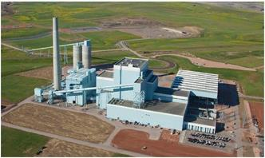
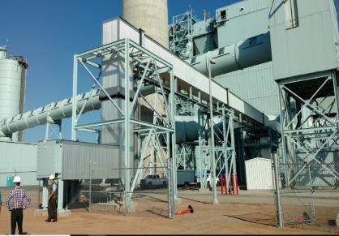

Addressing CCUS Challenges: Cost of Capture
Dry Fork Station:
Built in 2007, on-line in 2011
385 MW coal-fired plant
3.3 million tons of CO₂/year
Operating life span through 2070
Wyoming Integrated Test Center:
Commercial-Scale Front-End Engineering Study for MTR’s Membrane CO₂ Capture Process (DE-FE0031846)
Novel Next Generation Sorbent System for Post-Combustion CO₂ Capture – TDA Research, Inc. (DE-FE0031734)
Kawasaki Heavy Industries and JCOAL novel solid sorbent capture technology

Slide 10
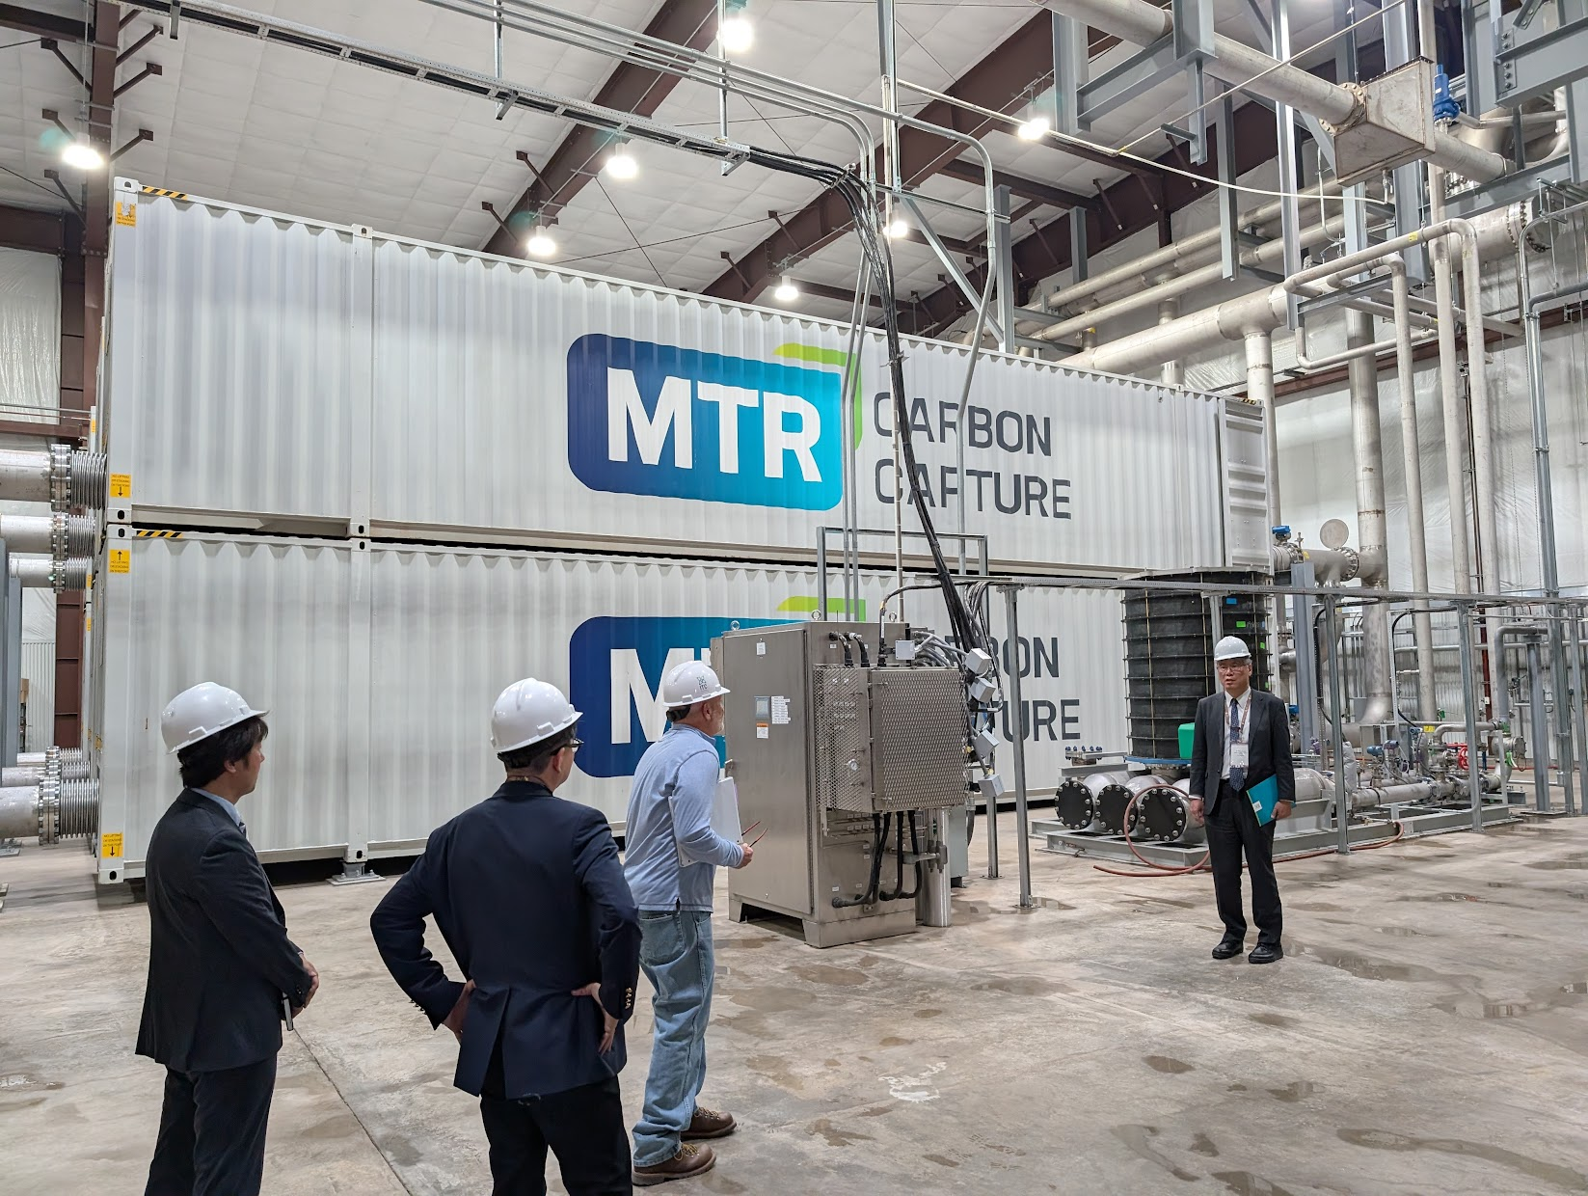
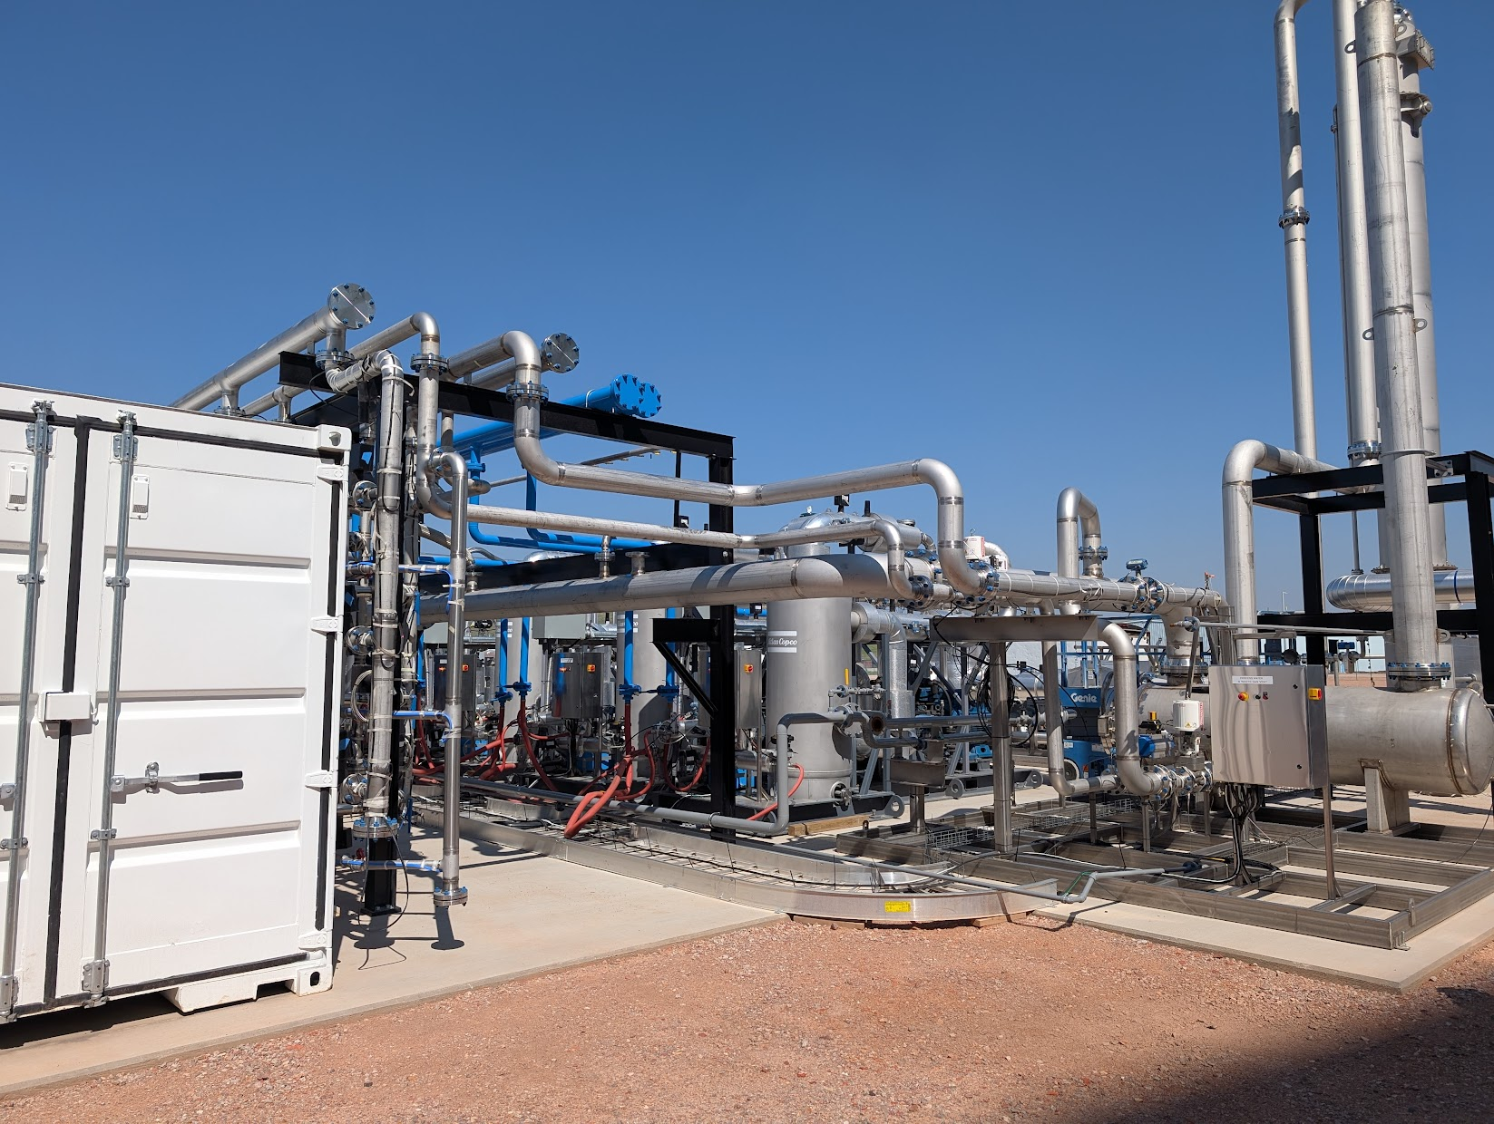
Novel Carbon Capture Projects
Novel Capture Projects in Wyoming
  8 Rivers pre-FEED
    Allam-Fetvedt Cycle (AFC)-
      Oxyfuel process that uses CO₂ to drive a power generation
    Evaluating a Wyoming power plant and proximal oil fields are being evaluated for CO₂-EOR
    Require CO2 storage back up
  Membrane Technology Research (MTR) large-scale pilot
    Membranes have high CO₂ selectivity
    Easily scalable
    Large-scale pilot located at the Wyoming Integrated Test Center

Slide 11
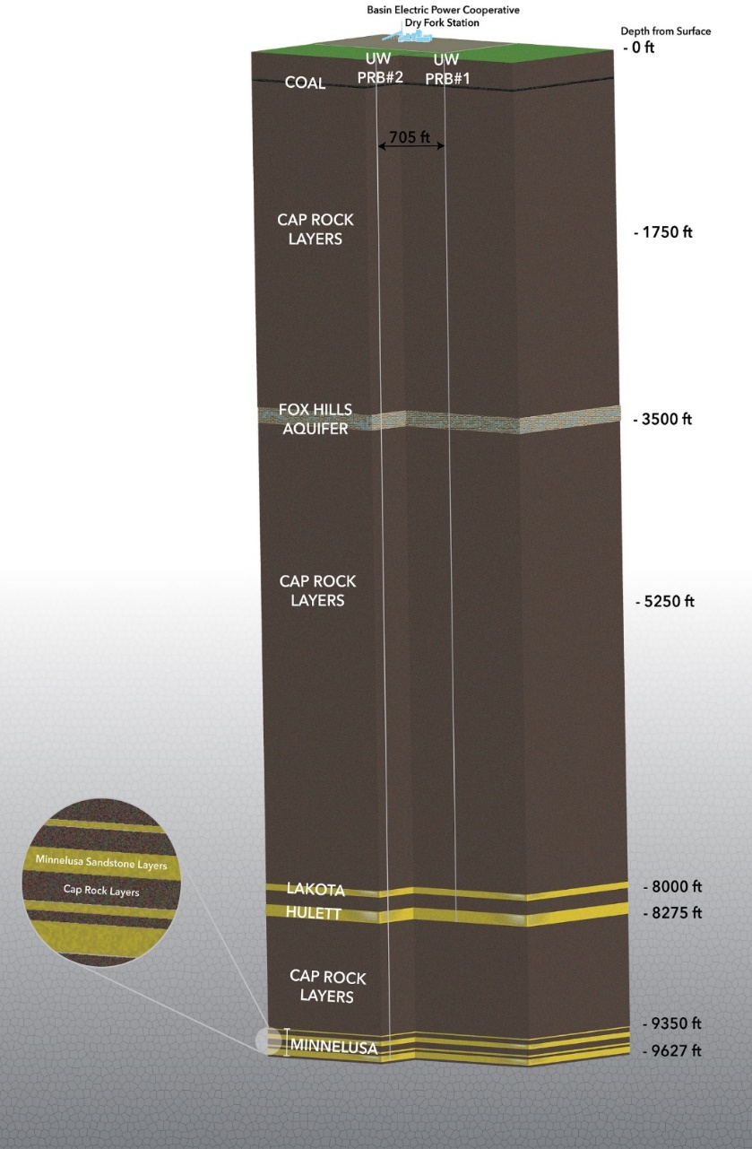
CCUS Regulation: Class VI (geologic storage) (1/2)
Class VI Well Overview
  Regulated under the EPA’s UIC Program
  Designed for the safe geologic storage of CO₂ and protection of underground drinking water sources
Key Regulatory Requirements​
  Site Characterization: Detailed geologic, hydrologic, and geochemical analysis must prove safe storage
  Well Construction Standards: Multiple casing and cement layers to isolate CO₂ from groundwater​
  Injection & Operating Plans: Must demonstrate pressure management and containment of the CO₂ plume

Slide 12
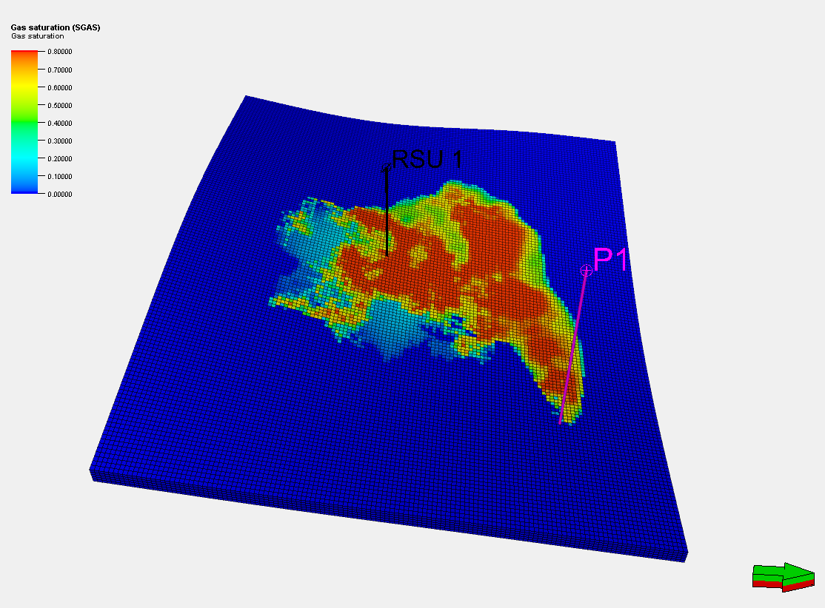
CCUS Regulation: Class VI (geologic storage) (2/2)
Key Regulatory Requirements​ (cont.)
  Monitoring, Reporting, and Verification (MRV): Continuous tracking of injection, subsurface plume migration, and groundwater quality.
  Financial Assurance: Operators must provide funds (bonds/trusts) to cover closure and post-injection care
  Post-Injection Site Care (PISC): Long-term monitoring and site closure requirements, typically for 50+years
Jurisdiction​
  EPA issues permits in most states
  States with Class VI primacy (e.g., ND, WY, WV, LA, and AZ; TX expected soon ) regulate directly, under EPA oversight
  Coordination with other agencies (state environmental, oil & gas, water resources, Tribal authorities) is often required

Slide 13
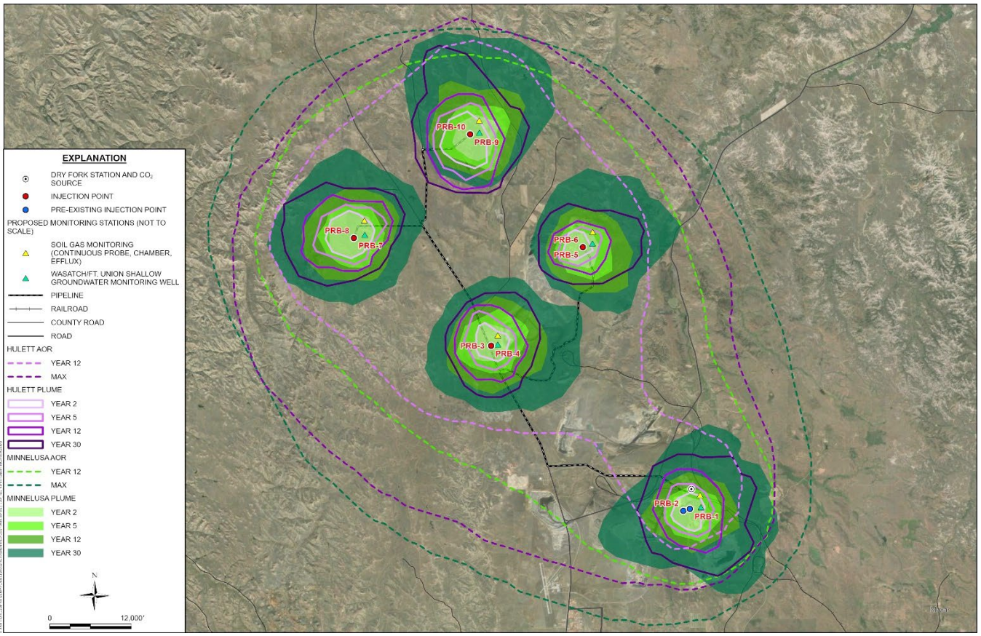
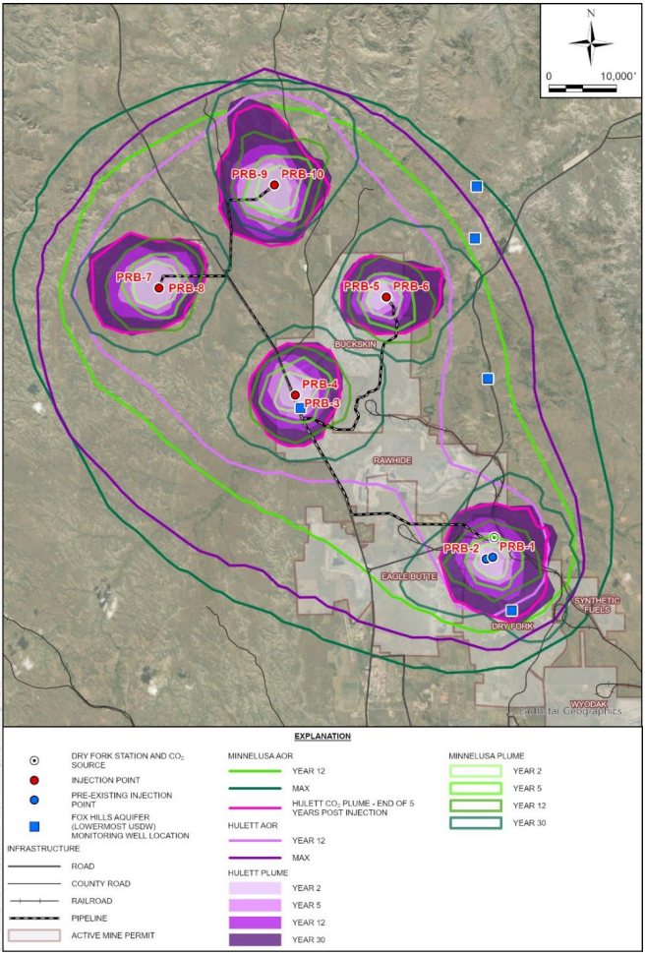
Example of CCUS field development
Purple = Hulett Mbr.
Green = Minnelusa Fm.
Post-injection monitoring strategy
Combination injection/monitoring wells
10 shallow groundwater monitoring well
6 wells monitoring deepest USDW
Example from the Wyoming CarbonSAFE Project
13

Slide 14
Wyoming Legal Framework for CCUS
Year / Code | Law / Regulation | Primary Purpose
DEQ Primacy (2020) | EPA delegated UIC Class VI regulation | Allow state-level permitting
HB 89 (2008) | Defining pore space ownership | Clarify property rights
HB 90 (2008) | DEQ regulation via UIC | Define permitting authority
HB 57 (2009) | Mineral rights dominance | Clarify subsurface rights conflicts
HB 58 (2009) | CO₂ operator liability | Specify legal responsibility for injected CO₂
HB 80 (2009) | Unitization consent threshold | Require 80% owner consent
HB 17 (2010) | Sequestration revenue account creation | Funding for monitoring & closure
W.S. § 35‑11‑313 (2024) | Defines jurisdiction for DEQ/WOGCC | Set rigorous permitting process
SF 47 (2022) | State liability after 20 yrs | Shift stewardship to state post-injection
Wyo. Code R. § 020‑29‑4 | Injection fee regulation | Ensure financial assurance through special account
Wyo. Code R. § 055‑3‑3‑43 | Unitization hearing & consent rules | Fair pore space coordination

Slide 15
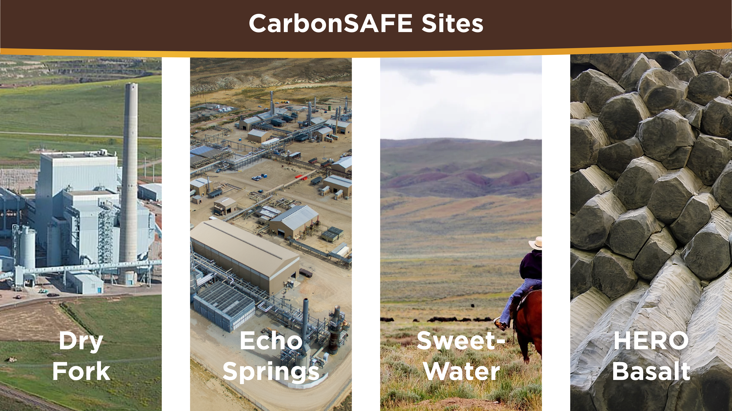
Need slide sharing four CarbonSAFE sites
Dry Fork
Echo Springs
Sweetwater
Hero Basalt
Notes:
Scott narrative: This would be a good time to mention that we’re really excited to work on these projects, but having trouble getting these contracts in place. We can do this gently. Noting that 1) it is hard to manage this level of uncertainty, 2) costs increase with such delays

Slide 16
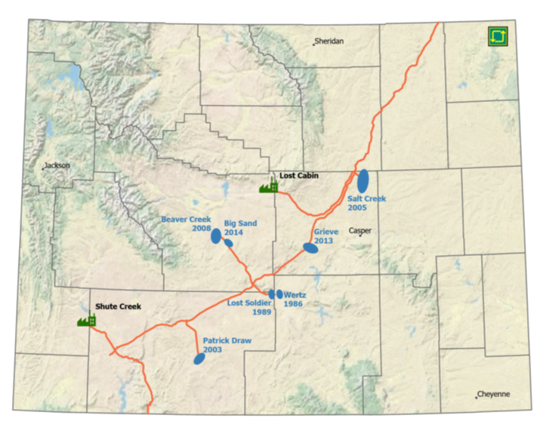
Wyoming: CO₂ EOR
  Challenges facing CO2-EOR
  CO₂ supply and infrastructure
    Limited CO₂ sources
    Pipeline networks are insufficient in many regions
  Economics
    High upfront costs
    Volatility in oil prices
  Technical
    Reservoir heterogeneity and sweep efficiency
    CO₂ breakthrough
    Delayed and declining incremental production
Opportunities
  10-20% increased recovery
  Federal incentives improve economics
  Regional economic development
Current CO₂-EOR Projects and CO₂ Sources
In Wyoming, CO₂ for EOR applications comes from the ExxonMobil Shute Creek Capture Project and the Contango Lost Cabin Gas plant. Currently about 370 MMcfd is available for EOR.
From the WY Enhanced Oil Recovery Institute
Notes:
In Wyoming between 1986 and 2024 EOR has added 173M barrels and associated tax revenue of $1.16B

Slide 17
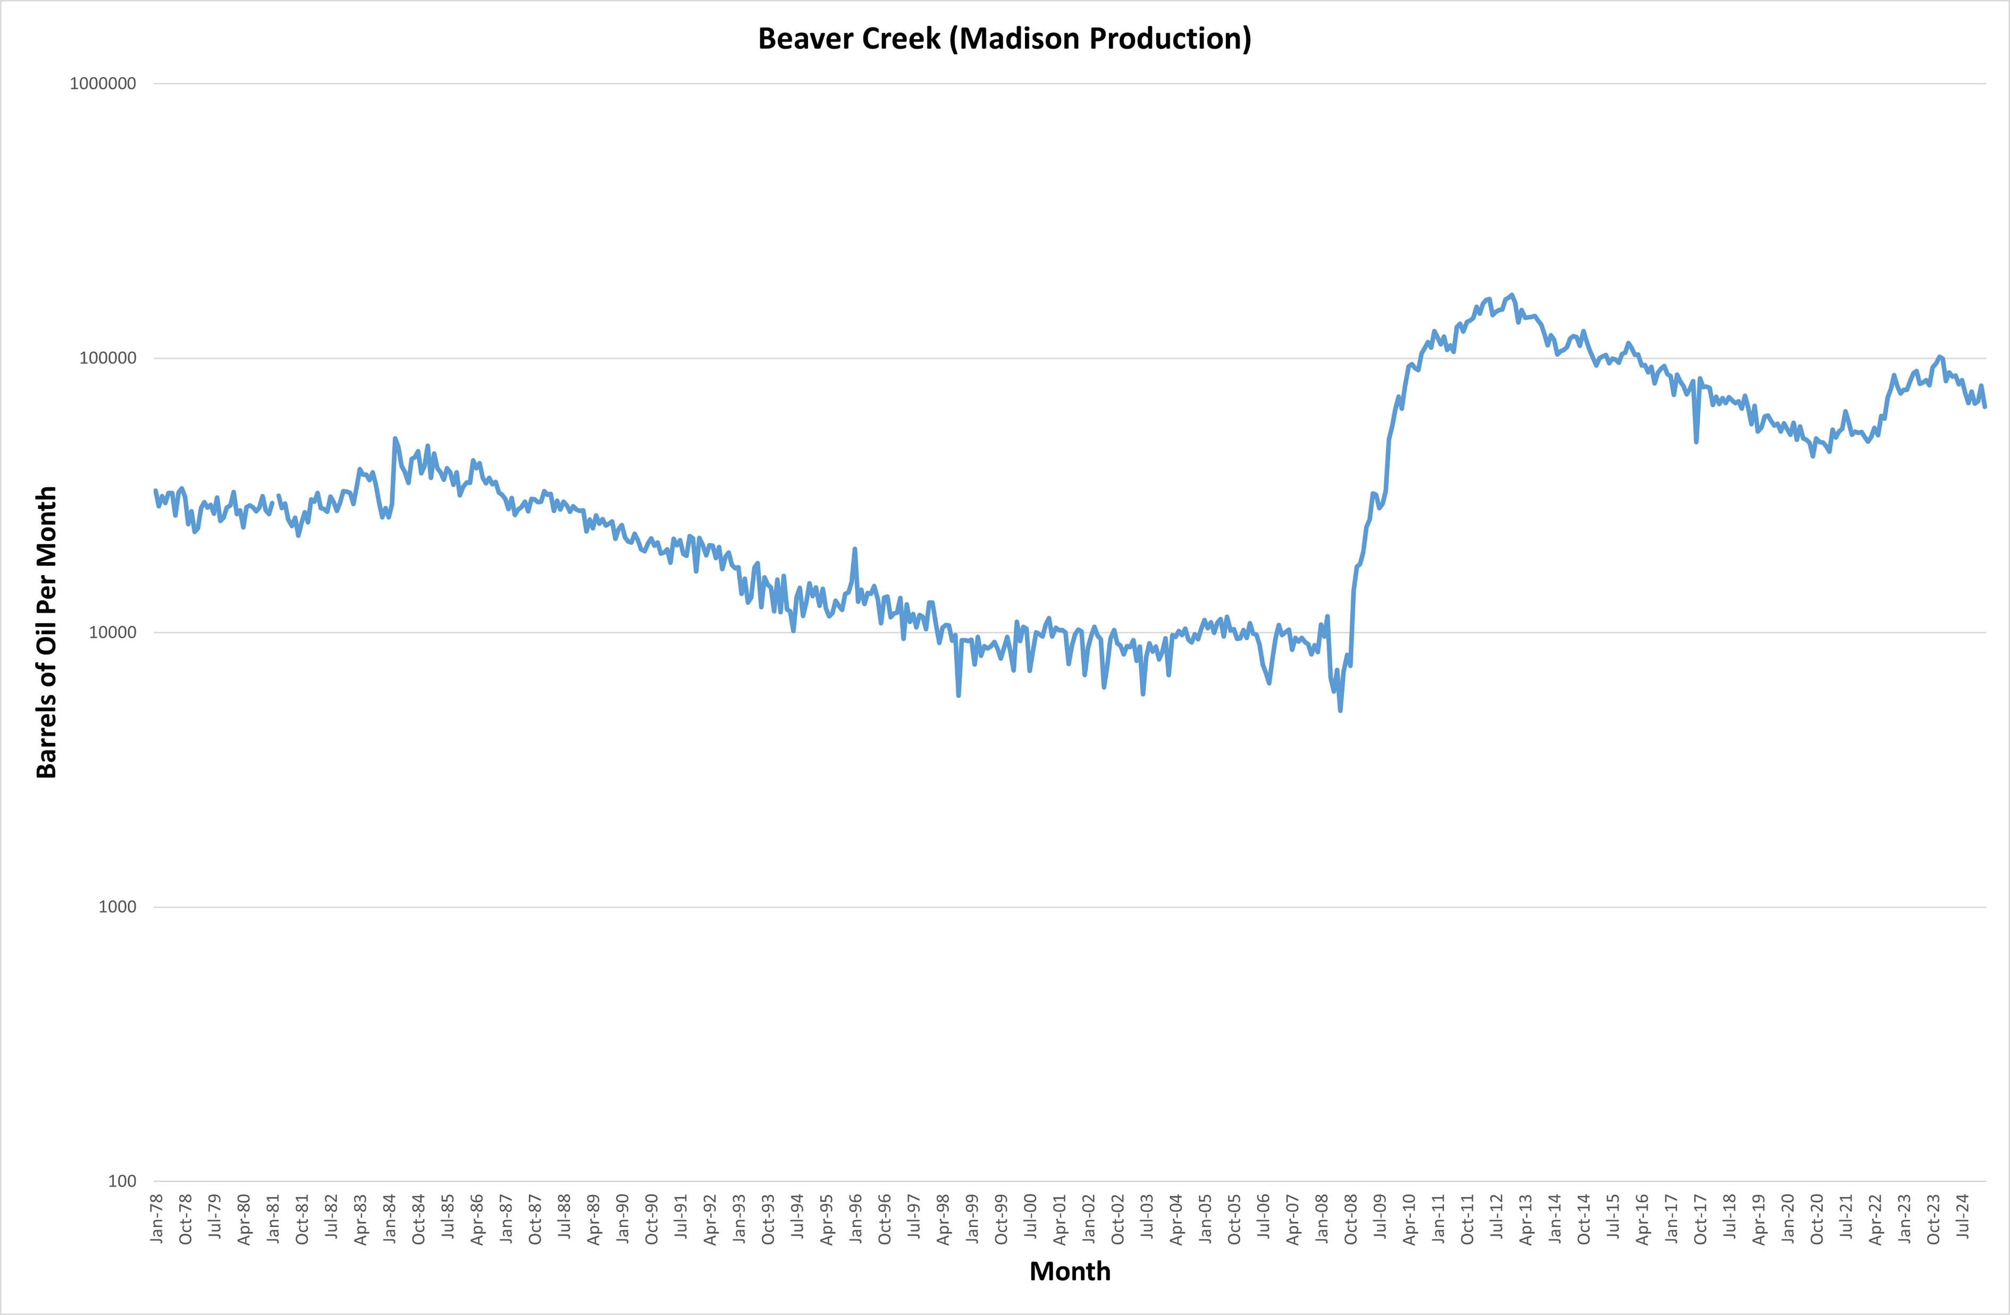
Wyoming: CO₂ EOR Upside
Example of EOR Production Curve
CO₂ Injection Response 2009
Waterflooding started in 1959
CO₂ Injection Started 2005
Incremental Oil Production ~15.9 million barrels thru 2024
Secondary Production Trend
Example provided by the WY EORI

Slide 18
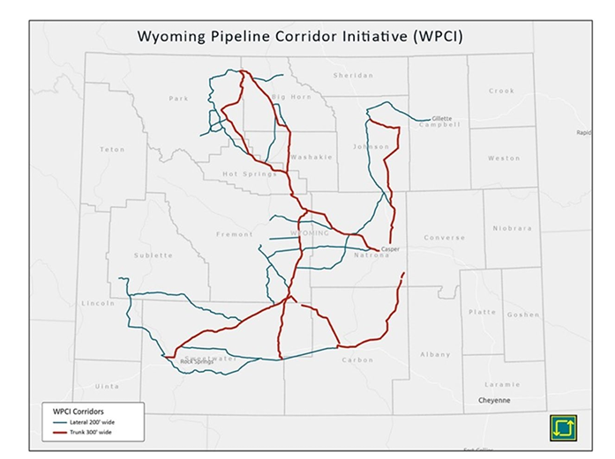
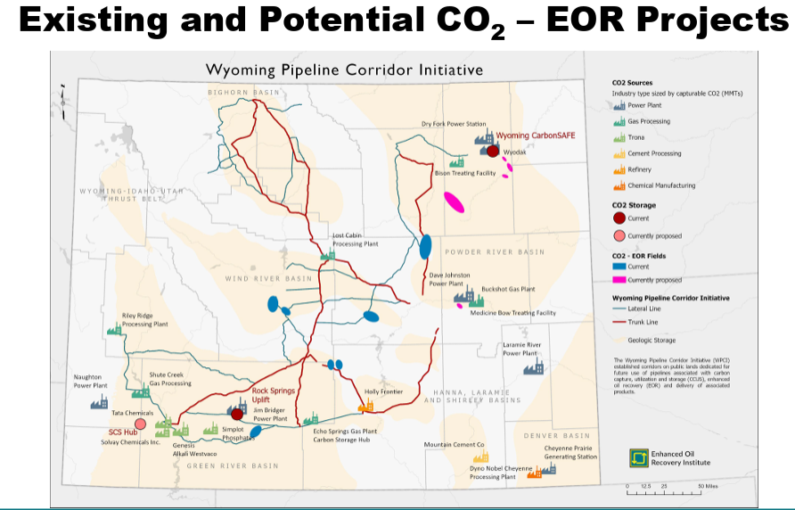
Wyoming Pipeline Corridor Initiative

Slide 19
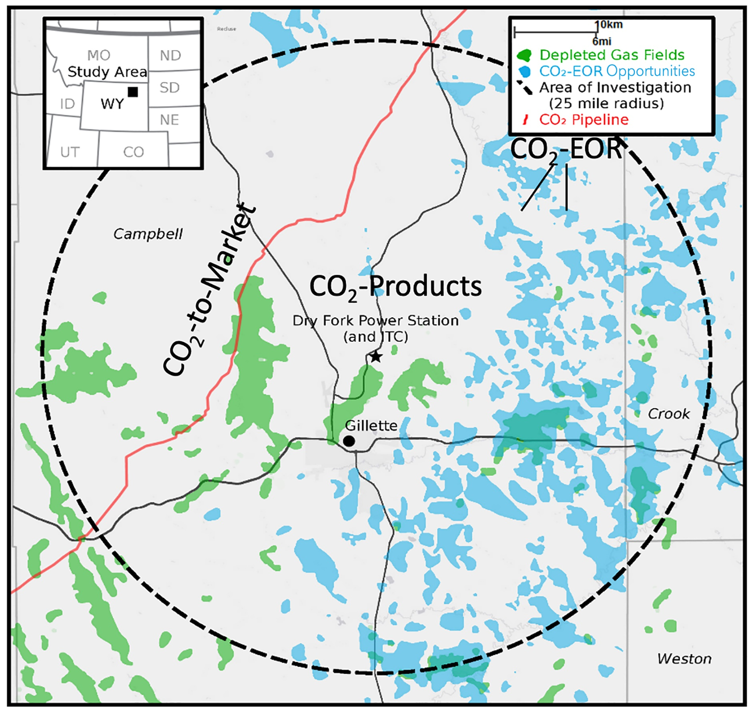
Synergy: EOR + Backup Storage
Why Pair Capture, EOR & Storage?
Continuous Utilization: CO₂ infrastructure (pipelines, compressors, wells) serves both EOR and dedicated storage
Redundancy: Provides insurance against reservoir underperformance, regulatory delays, or EOR decline
Operational Flexibility: Allows balancing between CO₂ sales for EOR and pure storage when market or policy conditions shift
Example from the Wyoming CarbonSAFE Project
Notes:
The Synergy
Capture fuels EOR.
EOR validates and finances the system.
Backup storage guarantees balance and scalability.
Carbon capture supplies the molecules, EOR puts them to work, and a backup storage site ensures none are left behind.

Slide 20
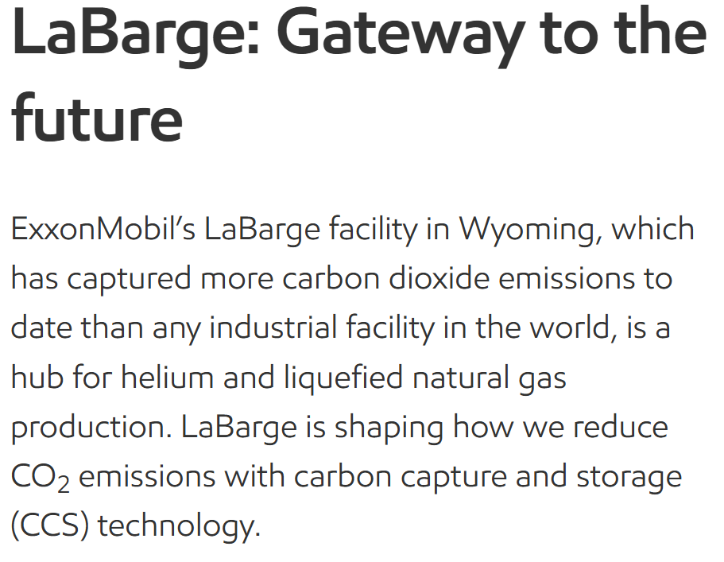
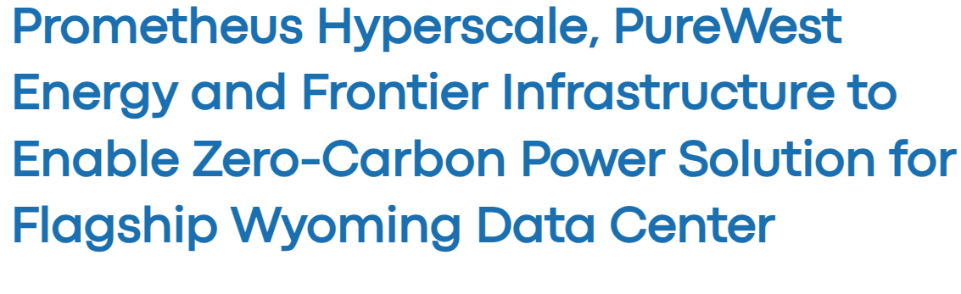




Synergy in Action

Slide 21
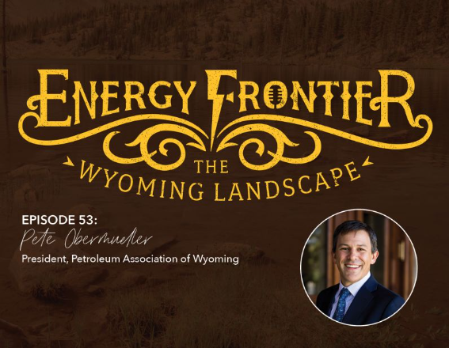
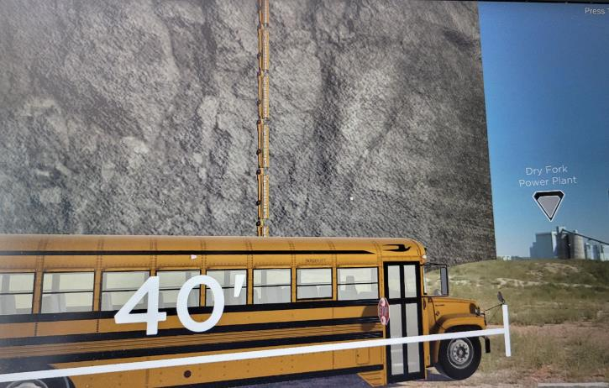
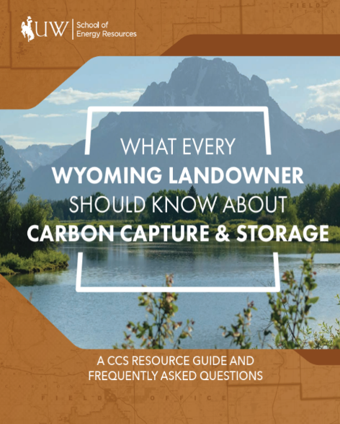
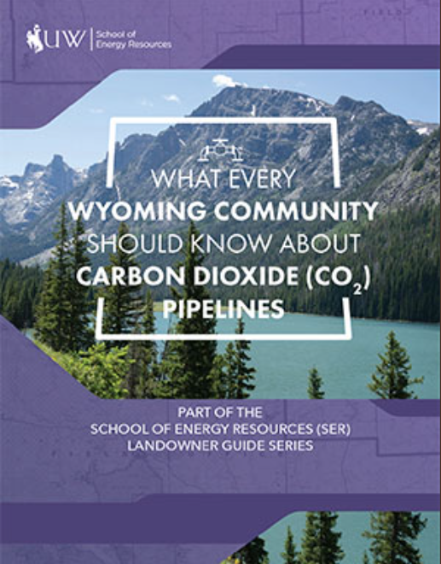
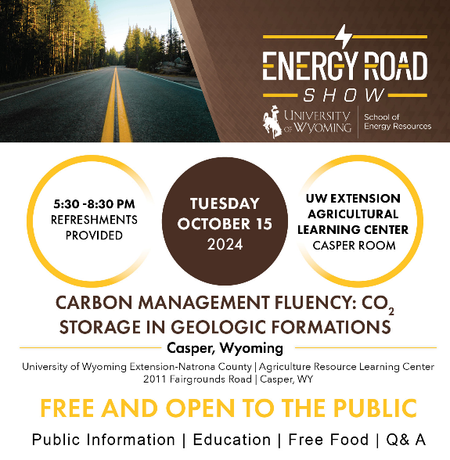
PUBLIC PERCEPTION: CCUS OUTREACH
21

Slide 22


Partnering on CCUS

Slide 23
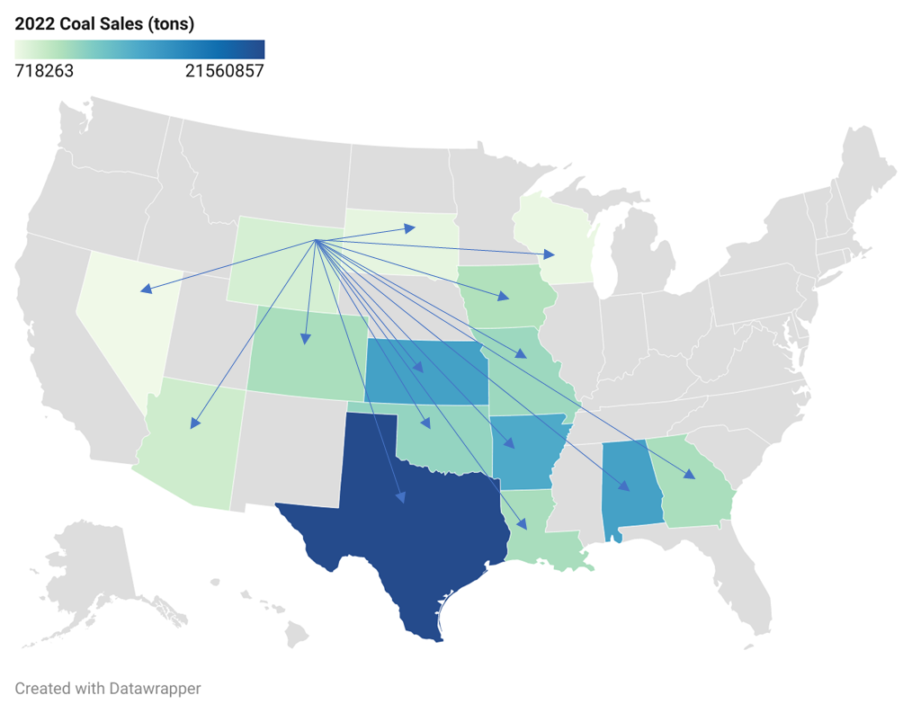
Wyoming Coal CCS Stakeholder Base
PRB Coal Sales to Facilities less than 50 years old
Wyoming PRB consumers (power and industry)
81 WY PRB coal fired units at 42 facilities <50 years old
Name plate capacity of over 40,000 MW
Consumed over 100 million tons of coal in 2022
Form EIA-923 detailed data with previous form data (EIA-906/920)
Project contact: David Lucke, DWLucke@uwyo.edu
Notes:
Wyoming coal consumers span much of the US. With existing stakeholders such as the University of Wyoming and various coal-fired units, there is a strong foundation for collaboration to advance CCUS and we've seen interest, both in the work happening on capture at the ITC as well as storage. This network will be instrumental in driving forward our carbon capture and storage efforts, ensuring that we leverage the expertise and resources available in the state. If you have a power plant that consumes PRB coal and is outside the state of Wyoming, we may be able to help assess opportunities. Please reach out.
______

Slide 24
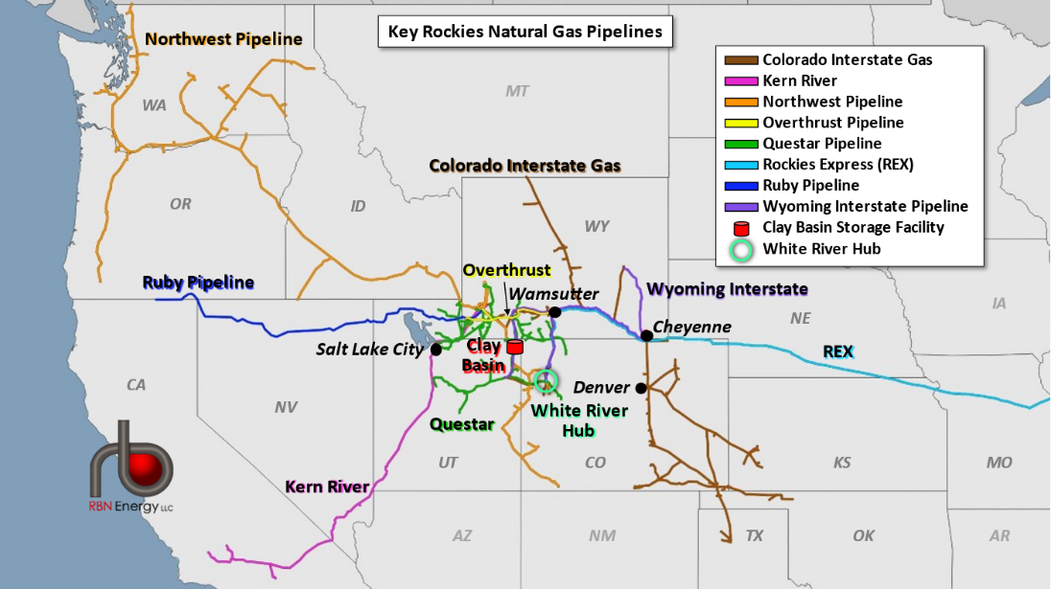
HERO Basalt
WY CCUS STAKEHOLDERS
24
Notes:
We're already working outside the state to support Wyoming's energy sales....

Slide 25


https://www.linkedin.com/school/university-of-wyoming-school-of-energy-resources/

Slide 26
Building an Industry: CCUS as the Foundation for Expanding CO₂-EOR
Scott Quillinan, Senior Director, Research
School of Energy Resources
University of Wyoming
Presented to
The Energy Council
2025 Annual Meeting
September 18-20, 2025
Notes:
Major take away-Is that carbon capture and storage and CO2-EOR work together to create a viable carbon management industry.

