Slide 1

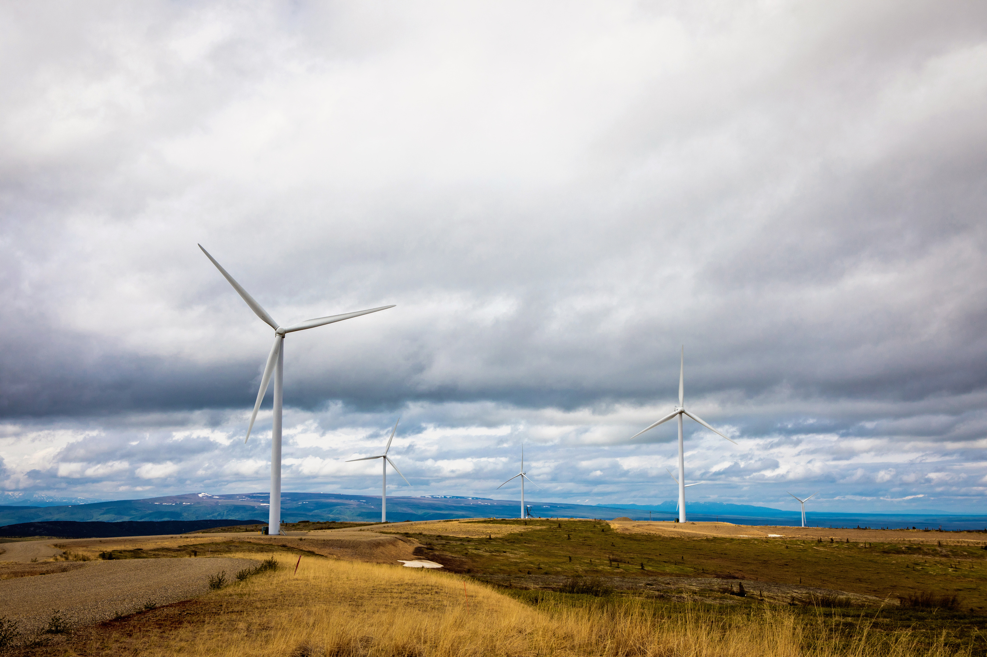

ENERGY STORAGE CAPABILITIES
Travis Million
President & CEO
September 19, 2025

Slide 2
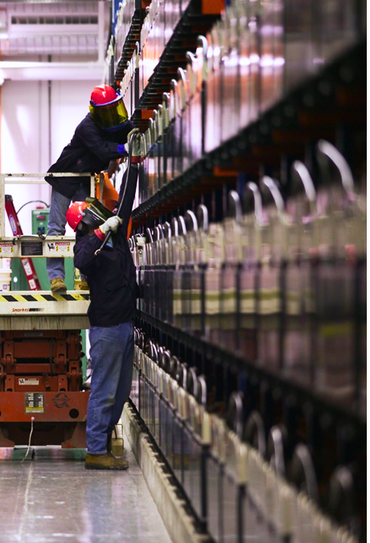
BATTERY ENERGY STORAGE SYSTEM (BESS)
GVEA Overview
Existing BESS
46MW - 15 min
New BESS
(2x) 40MW - 2 hour
Long Duration
50MW - 24 hour

Slide 3
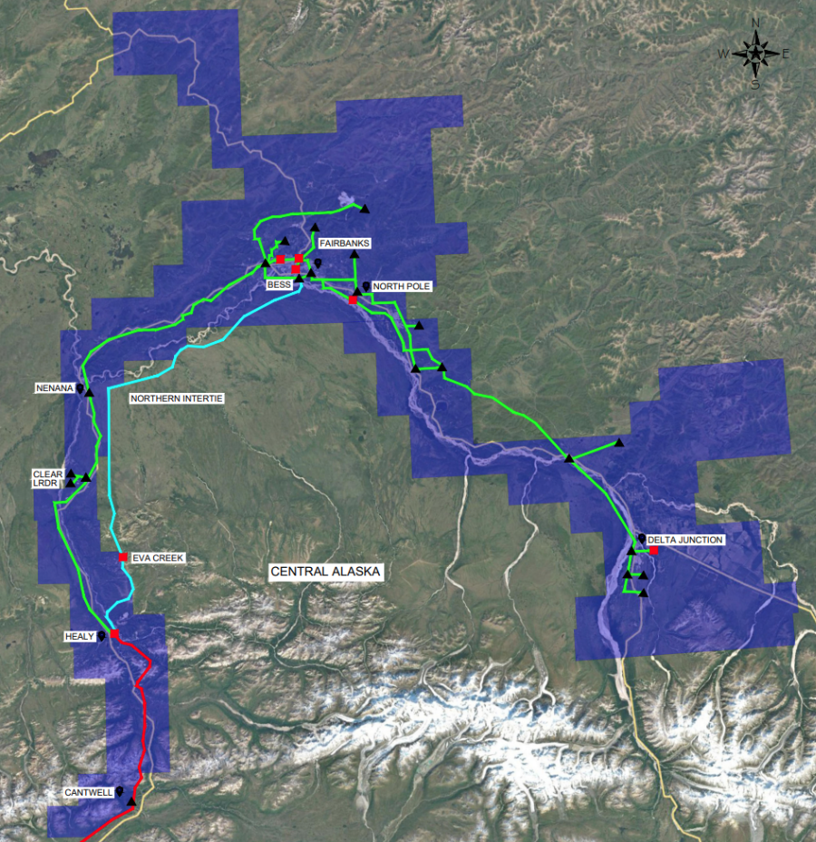
GVEA Snapshot
Over 36,000 members
~50,000 meters
Serving over 100,000 residents
Nearly 3,500 miles of power lines
Nine generation facilities
35 Substations
Five military installations

Slide 4
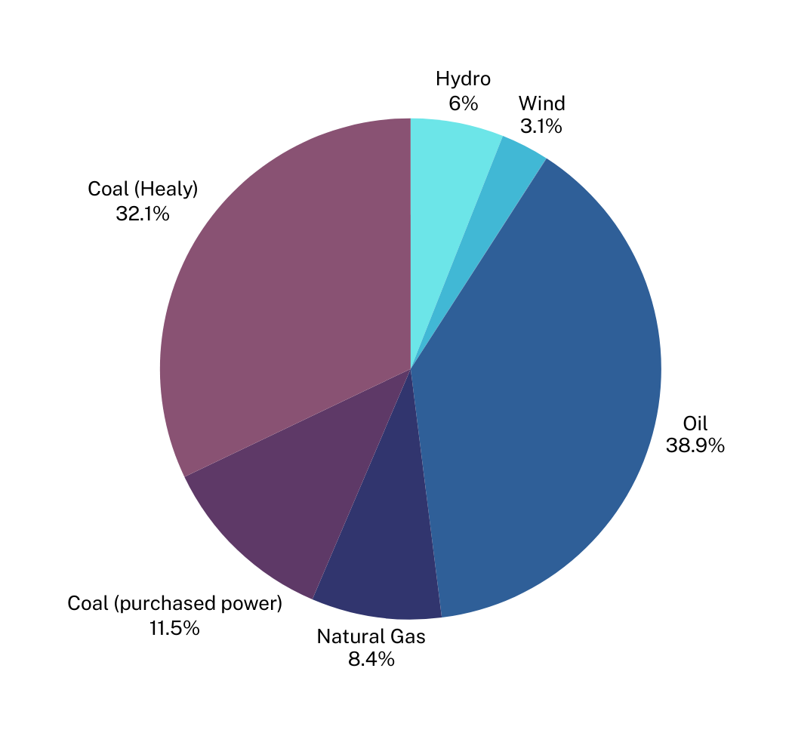
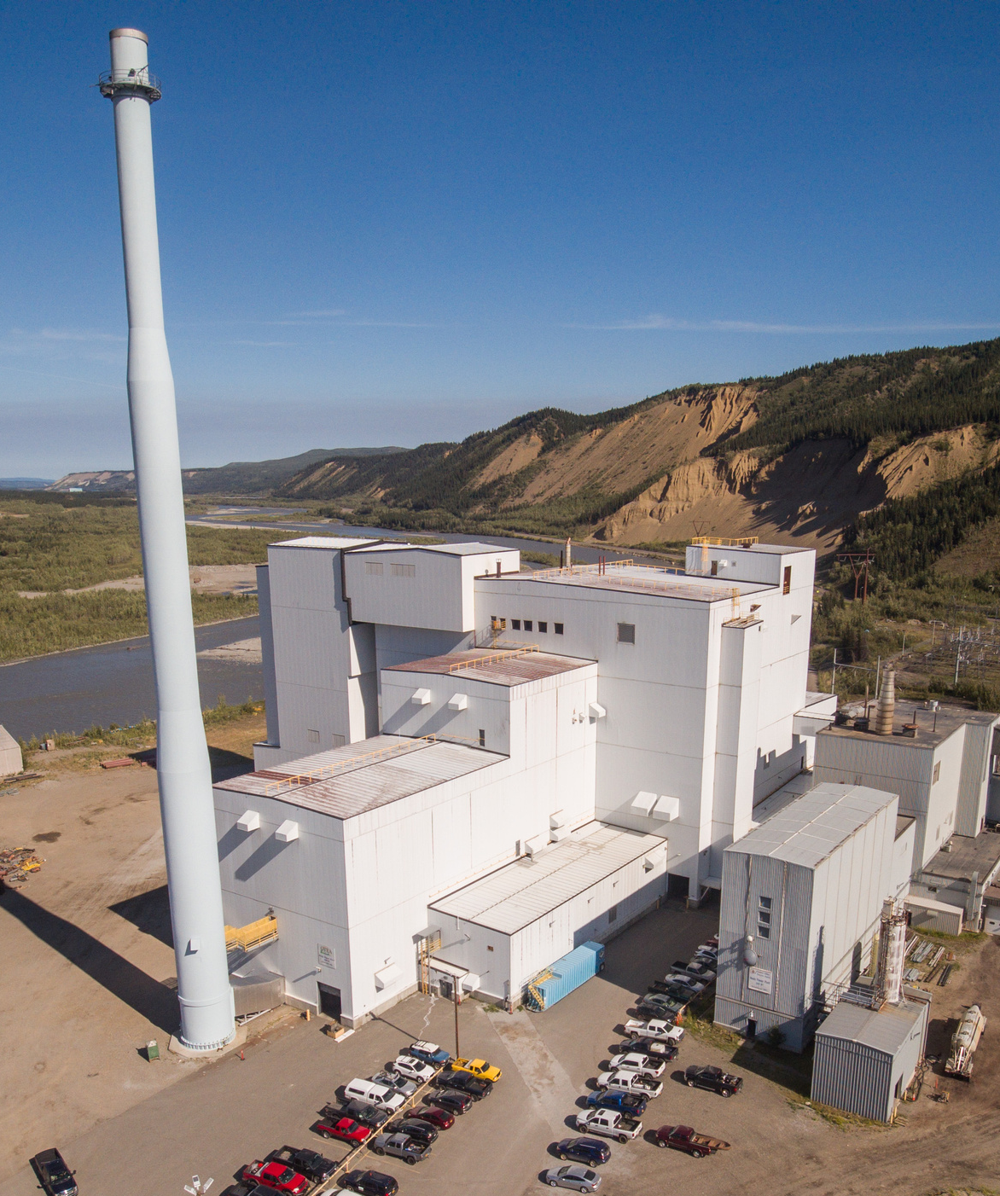
GVEA’s Energy Portfolio
2024
Solar
0.03%
Four oil fired plants - 243 MW
Zehnder Power Plant
Delta Power Plant
North Pole Power Plant
North Pole Expansion Power Plant
Two coal fired plants - 88 MW
Healy Unit 1
Healy Unit 2
Hydroelectric - 15 MW
Bradley Lake
Eva Creek Wind - 25 MW
Solar - 562 kW
Local Coal Purchases - ~30 MW
via Aurora Energy and University of Alaska Fairbanks Contracts
371.5 MW GENERATION CAPACITY
---
2024 Peak Load was 205.5 MW

Slide 5

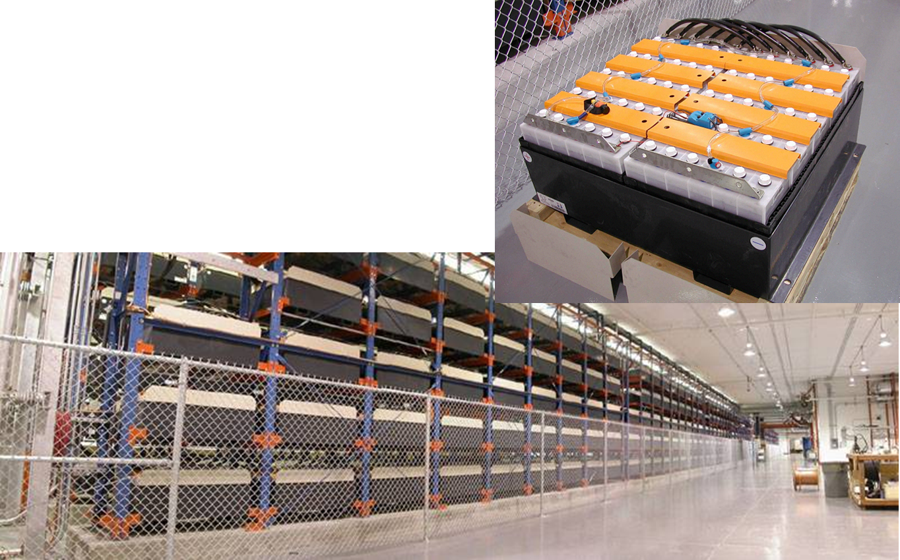
Nickel Cadmium (NiCad)
25MW - 15 min
46MW - 5 min

Slide 6
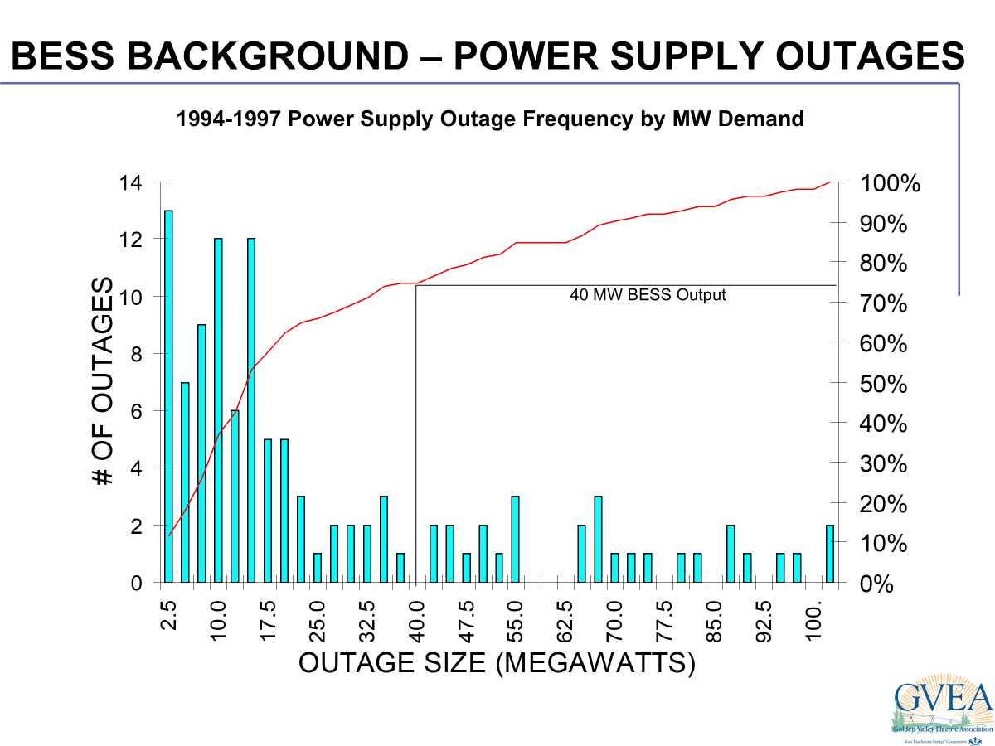

Slide 7
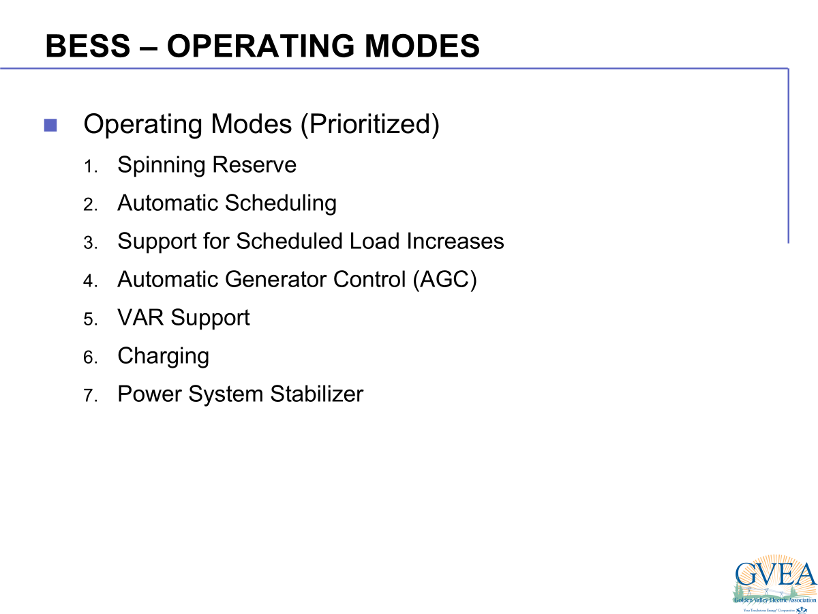

Slide 8
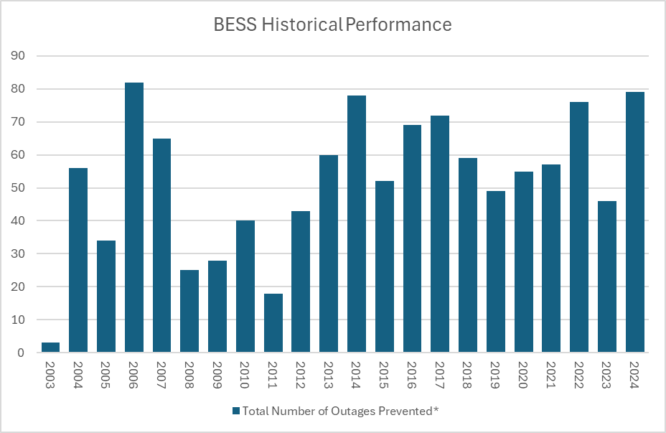

Slide 9

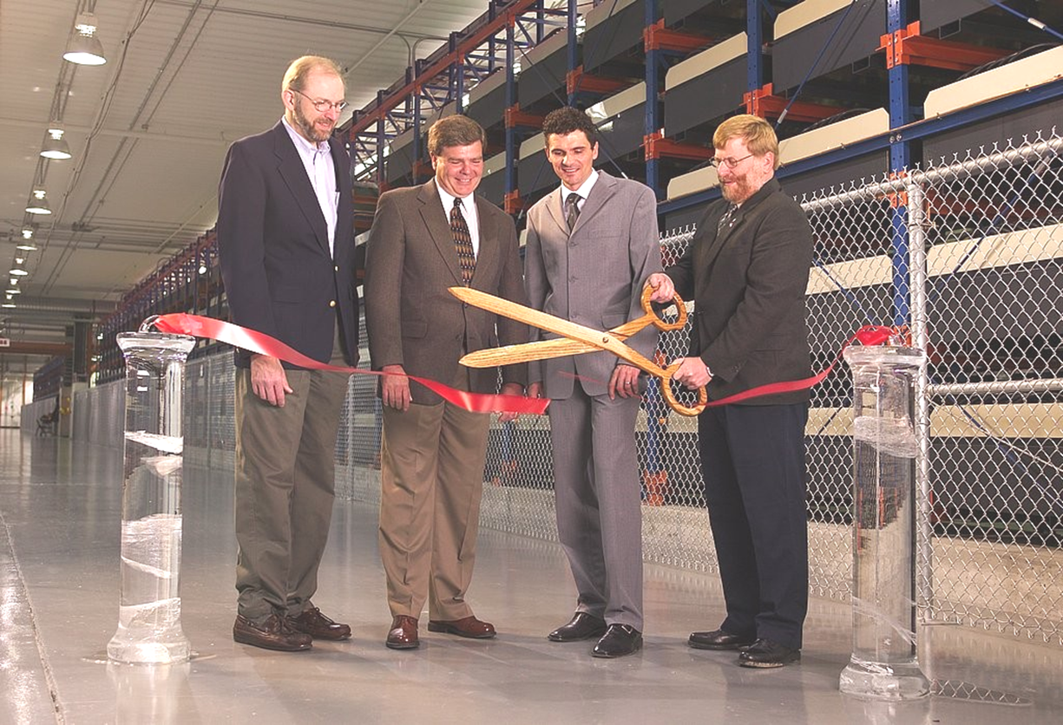
December 10, 2003
Most Powerful BESS
46 MW for 5 Minutes
Highest Voltage Battery
>5 kV DC

Slide 10
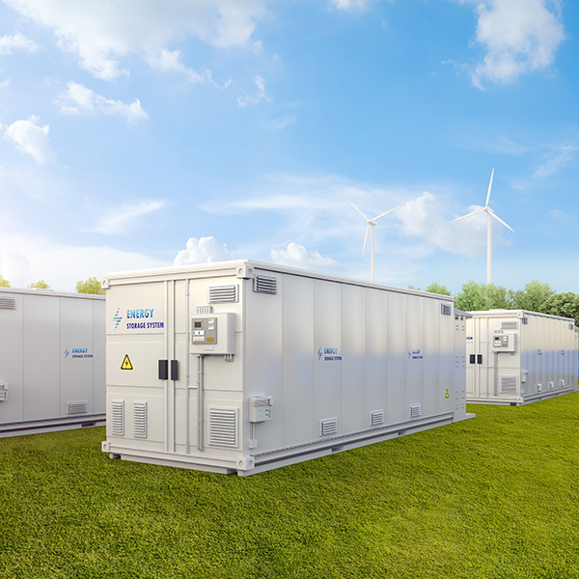
Lithium-ion (Li-ion)
BESS
Faster charge rate and longer duration than current BESS
Primary needs
Regulating non-dispatchable (wind) generating resources
Frequency support
Outage support
Spinning reserve

Slide 11
Lithium-ion (Li-ion)BESS
$100M Award through the Powering Affordable Clean Energy (PACE) USDA RUS program
2 x 40MW 2 hour BESS systems
Scheduled to be online in 2028

Slide 12
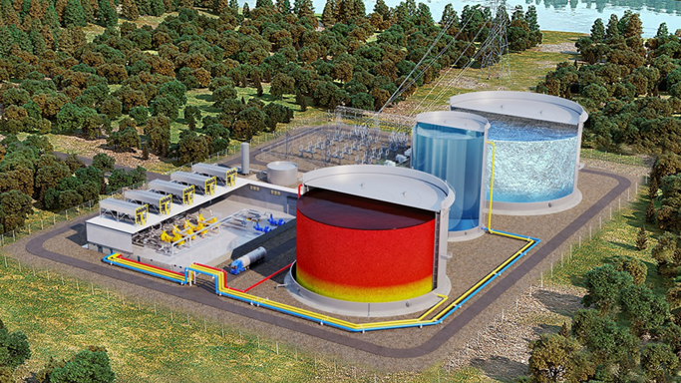

Long Duration Energy Storage (LDES)

Slide 13
U.S. Department of Energy (DOE) awards project to deploy 100 MW, 1.2 GWh utility-scale long-duration energy storage (LDES) of pumped thermal energy storage (PTES)
$50M DOE contribution

Slide 14
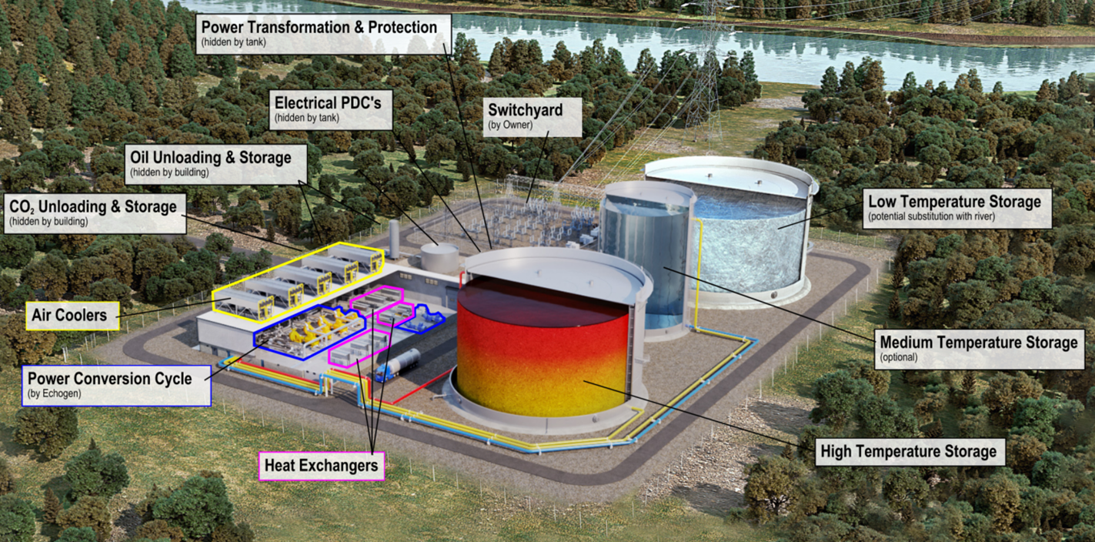

Slide 15
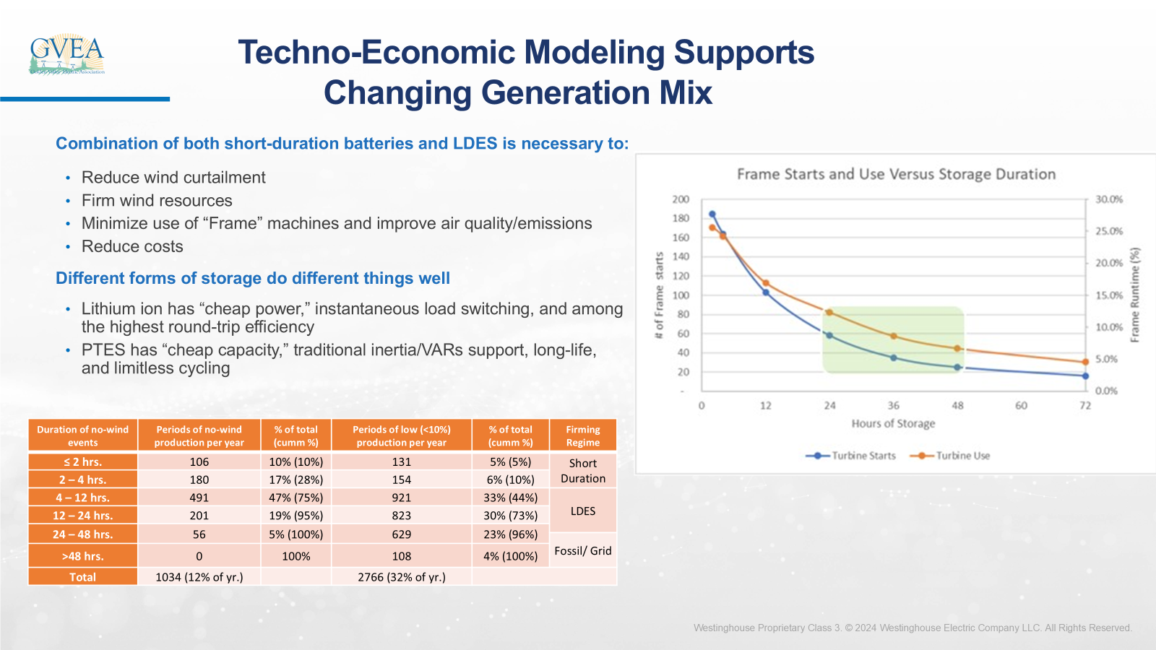

Slide 16
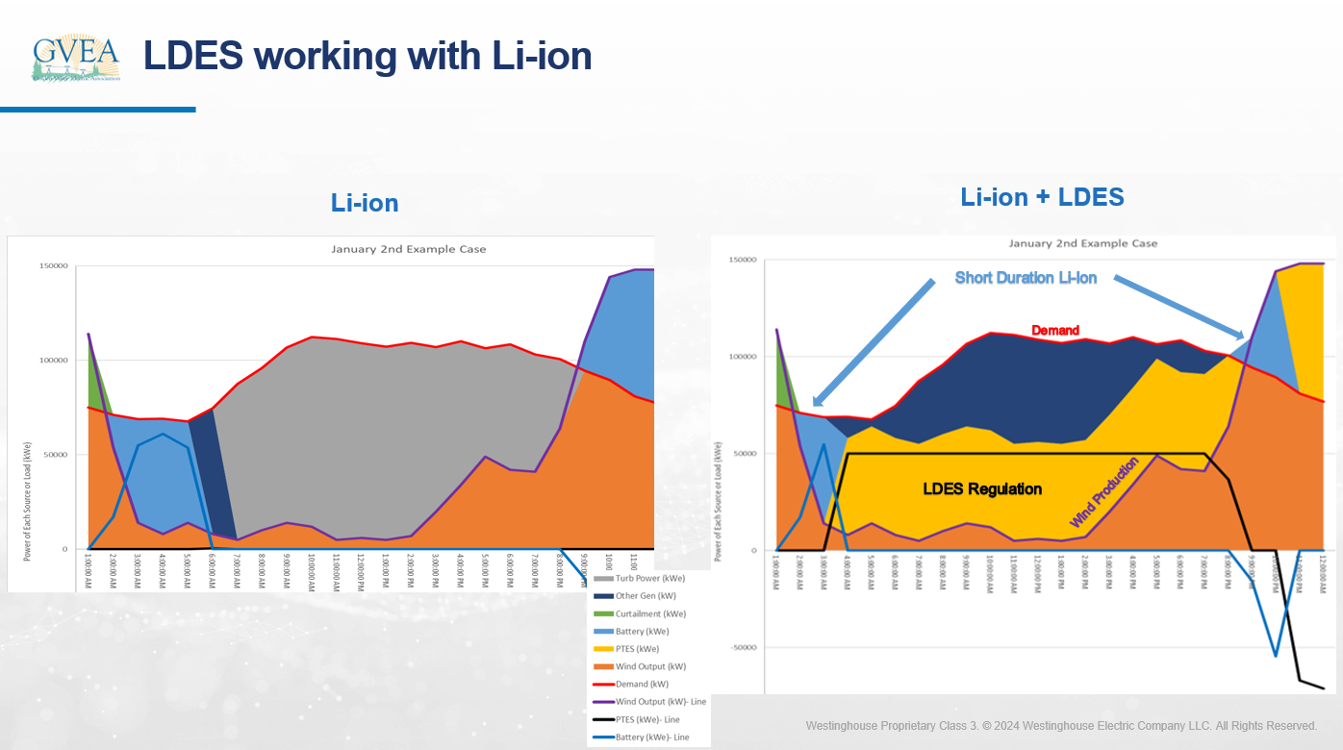

Slide 17
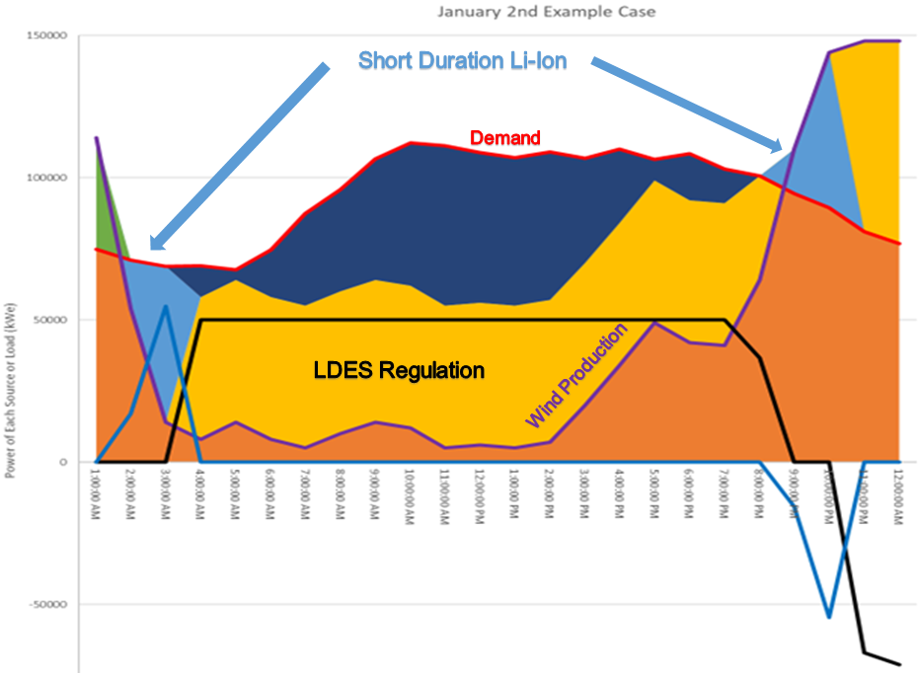
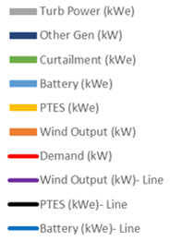

Slide 18
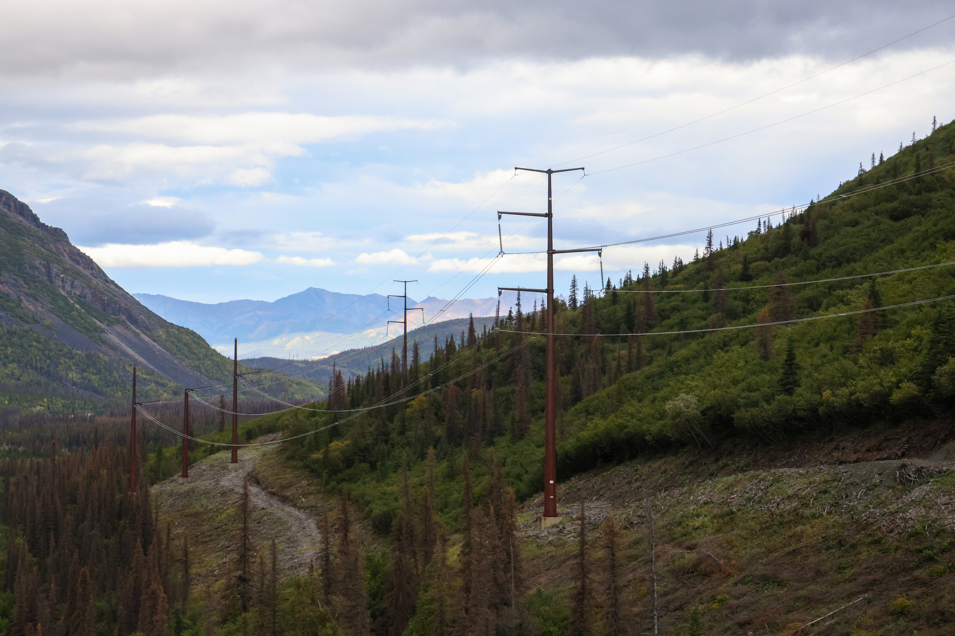

Questions?

