Slide 1
Energy Council UAB Seminar
Dr. Gwen Holdmann
Alaska Center for Energy & Power (ACEP)
University of Alaska Fairbanks

Slide 2
Energy Considerations to Sustain Economic Growth: The Future of Nuclear Energy
Dr. Gwen Holdmann
Alaska Center for Energy & Power (ACEP)
University of Alaska Fairbanks

Slide 3
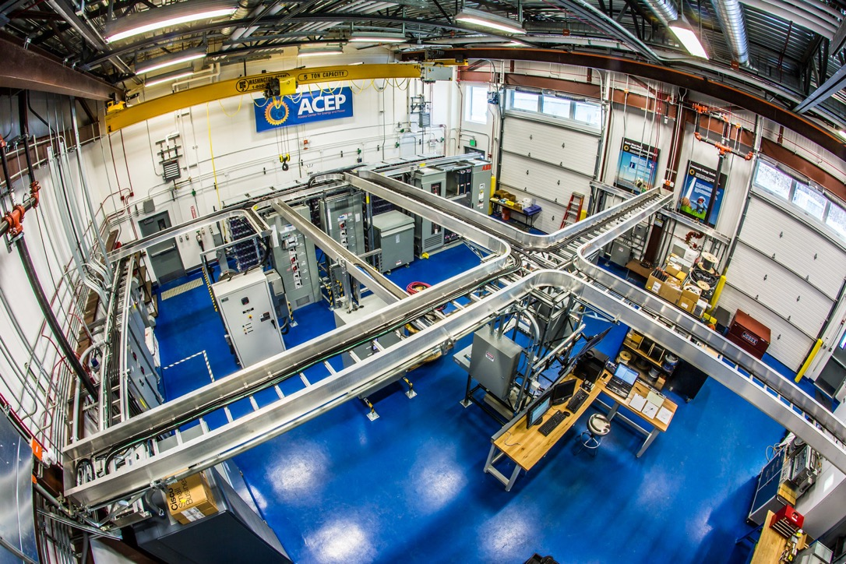
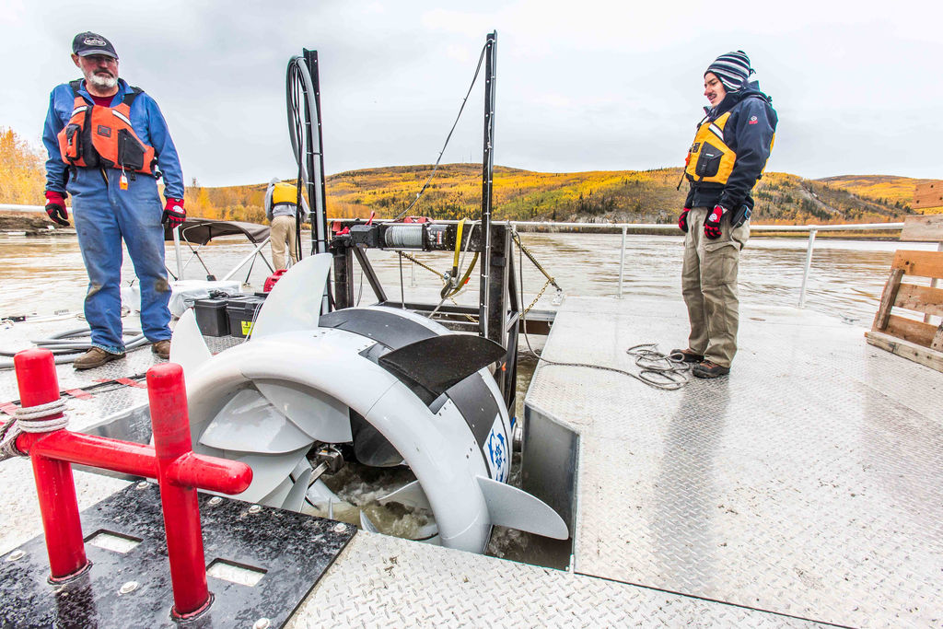
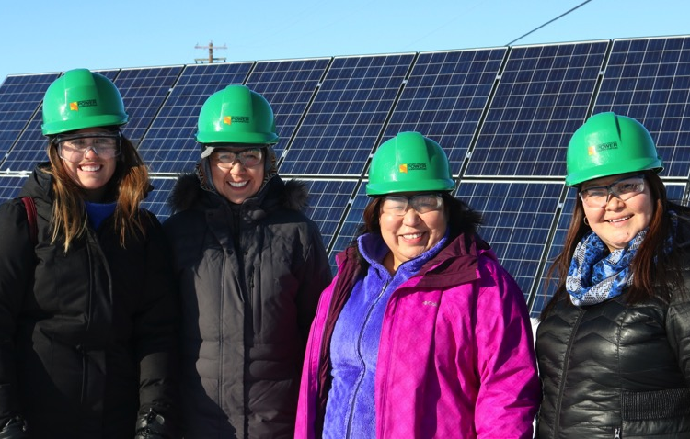
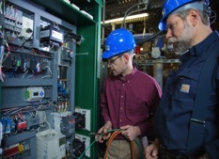

Alaska Center for Energy and Power (ACEP)
Fostering development of practical, innovative and cost-effective energy solutions for Alaska and beyond
Applied energy research
Technology testing & optimization
Energy systems modeling & analysis
Policy support & public education

Slide 4
Presentation Outline
Introduction: What are Advanced Reactors?
Public Perceptions of Nuclear Energy
Key Attributes and Benefits of Advanced Reactors
“Sliding Door” Moments in Nuclear History
Building Trust and the Role of Universities
Looking Ahead: Lessons from the Past, Opportunities
for the Future

Slide 5
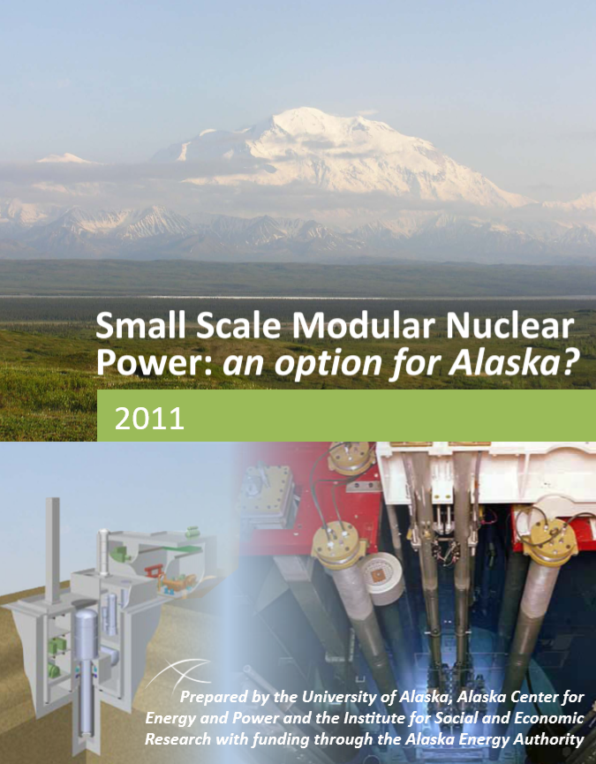
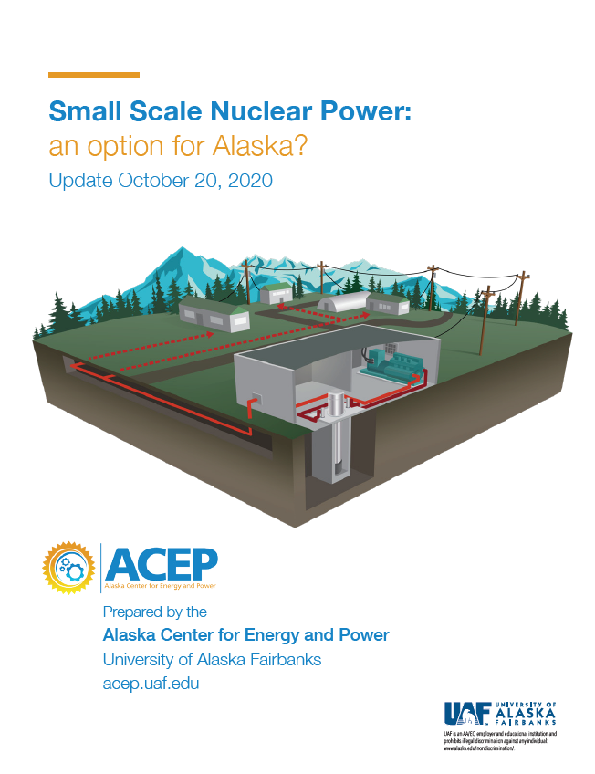
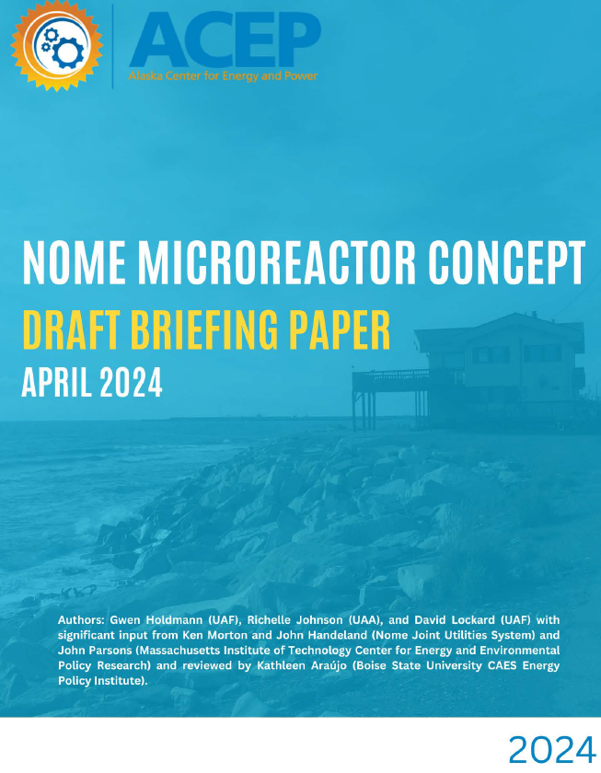
ACEP Studies on Small/Advanced Nuclear

Slide 6
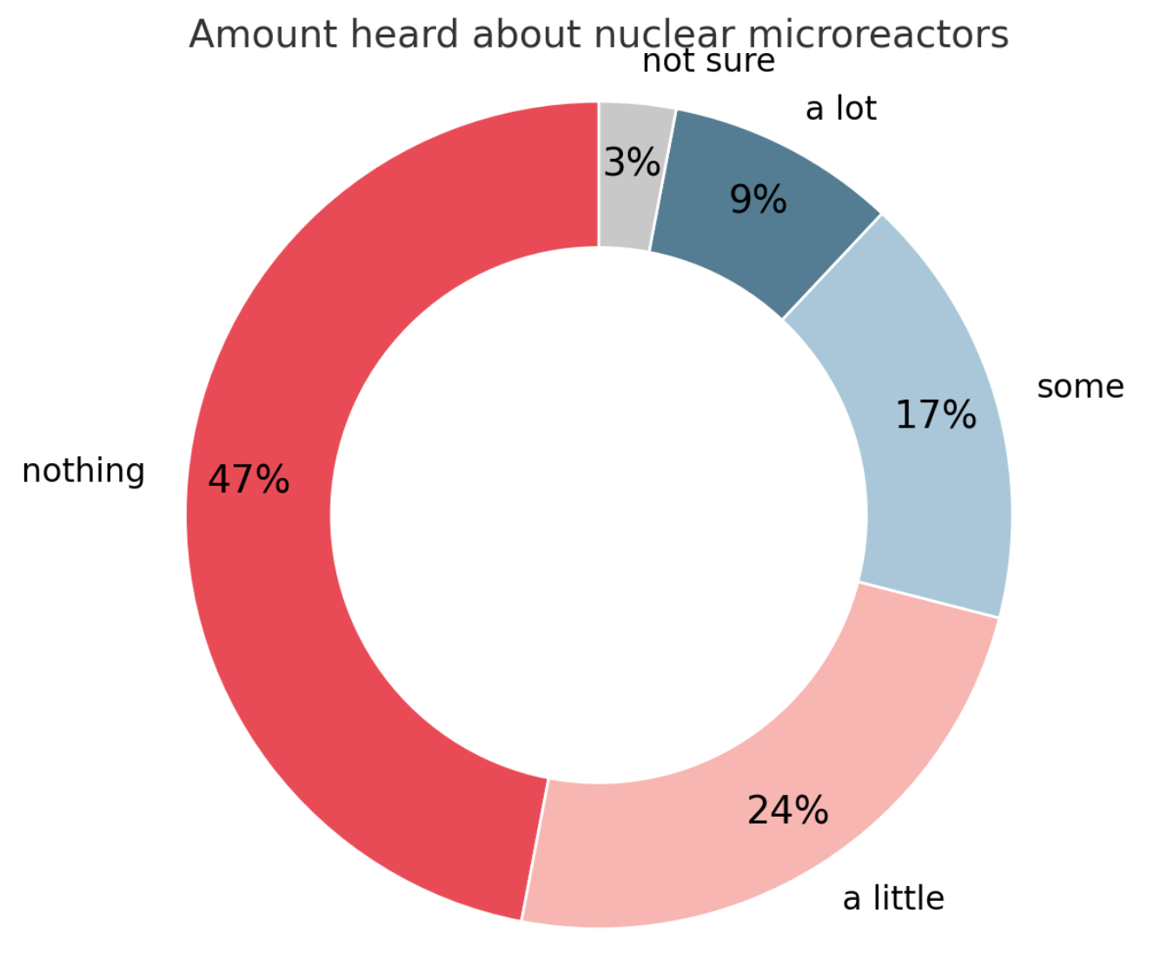
Public Awareness of Advanced Reactors
When it comes to advanced reactors/microreactors, there is a large information gap …

Slide 7
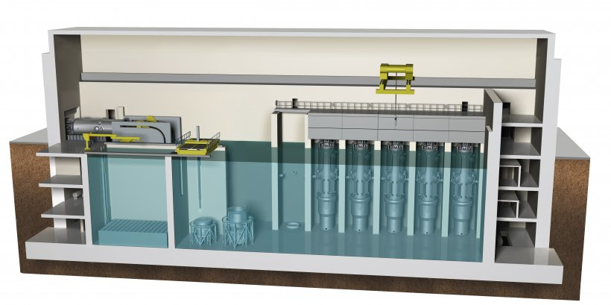
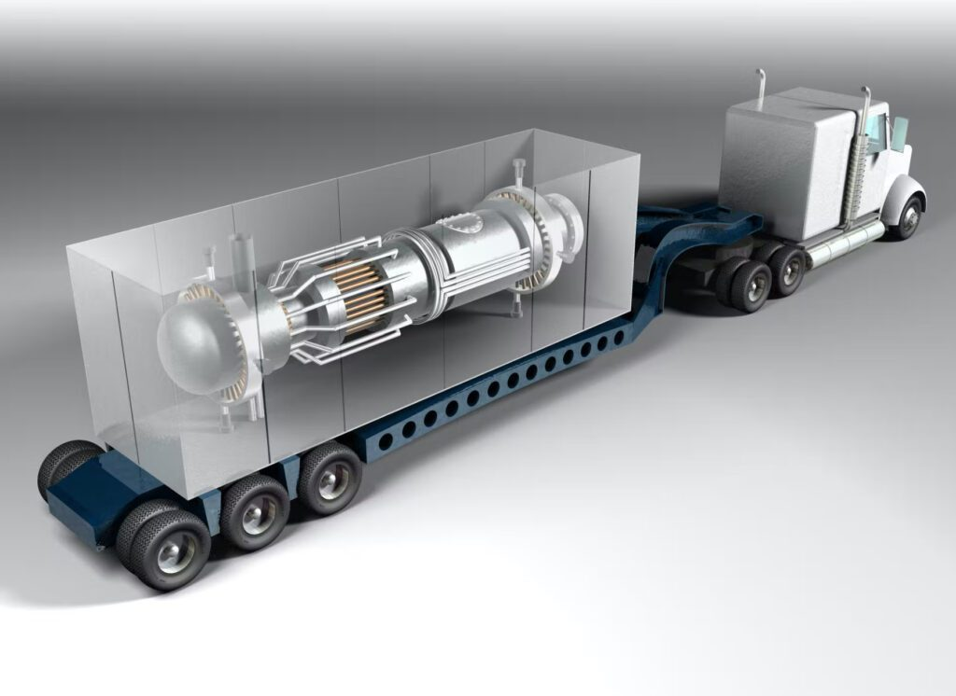
What are advanced nuclear reactors?
Variety of new reactor designs that are designed to be safer, more efficient, and cheaper than traditional reactors
Employ passively safe operating and fuel designs
Many do not require water for cooling
Factory fabricated and transportable nearly fully assembled
Examples: Left - Nuscale (77MWe per module); Right - Project Pele BWXT reactor (5MW)

Slide 8
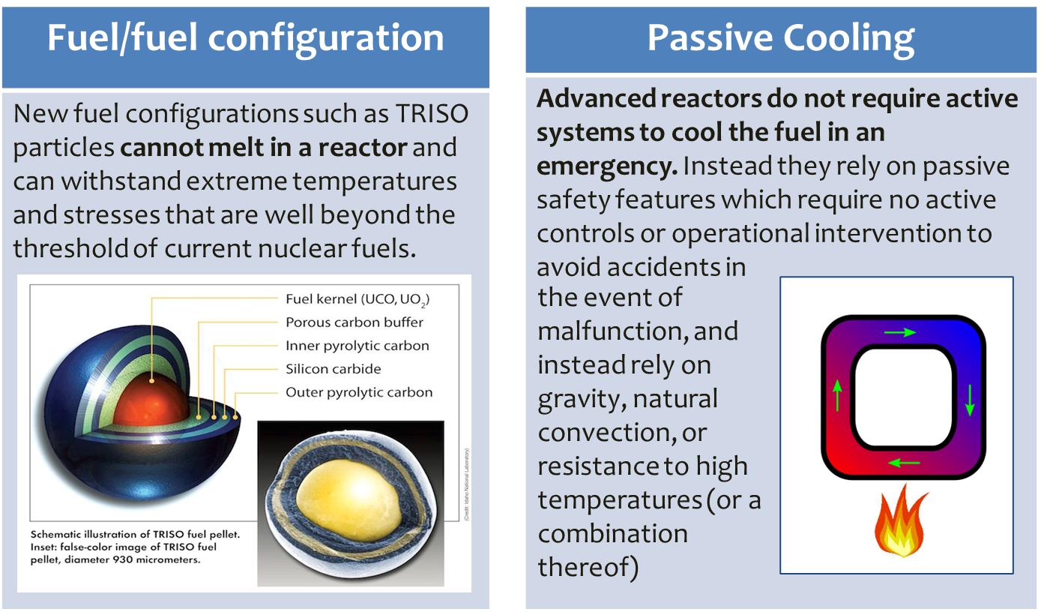
What Does Passive Safety Mean?

Slide 9
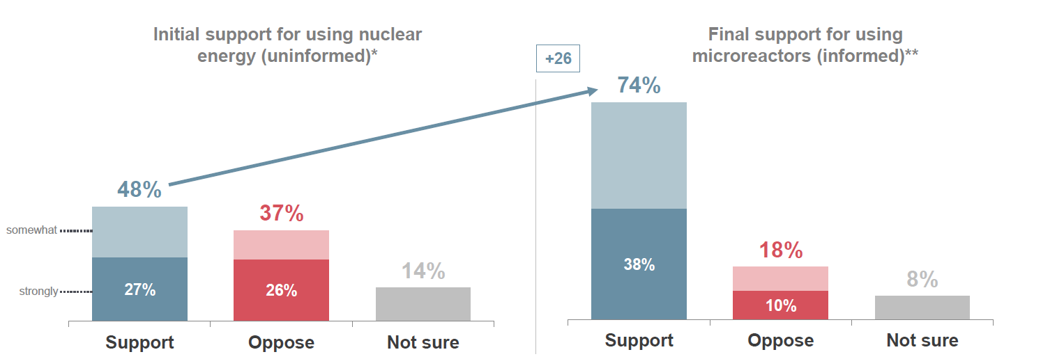
Public Perception of Advanced Reactors

Slide 10
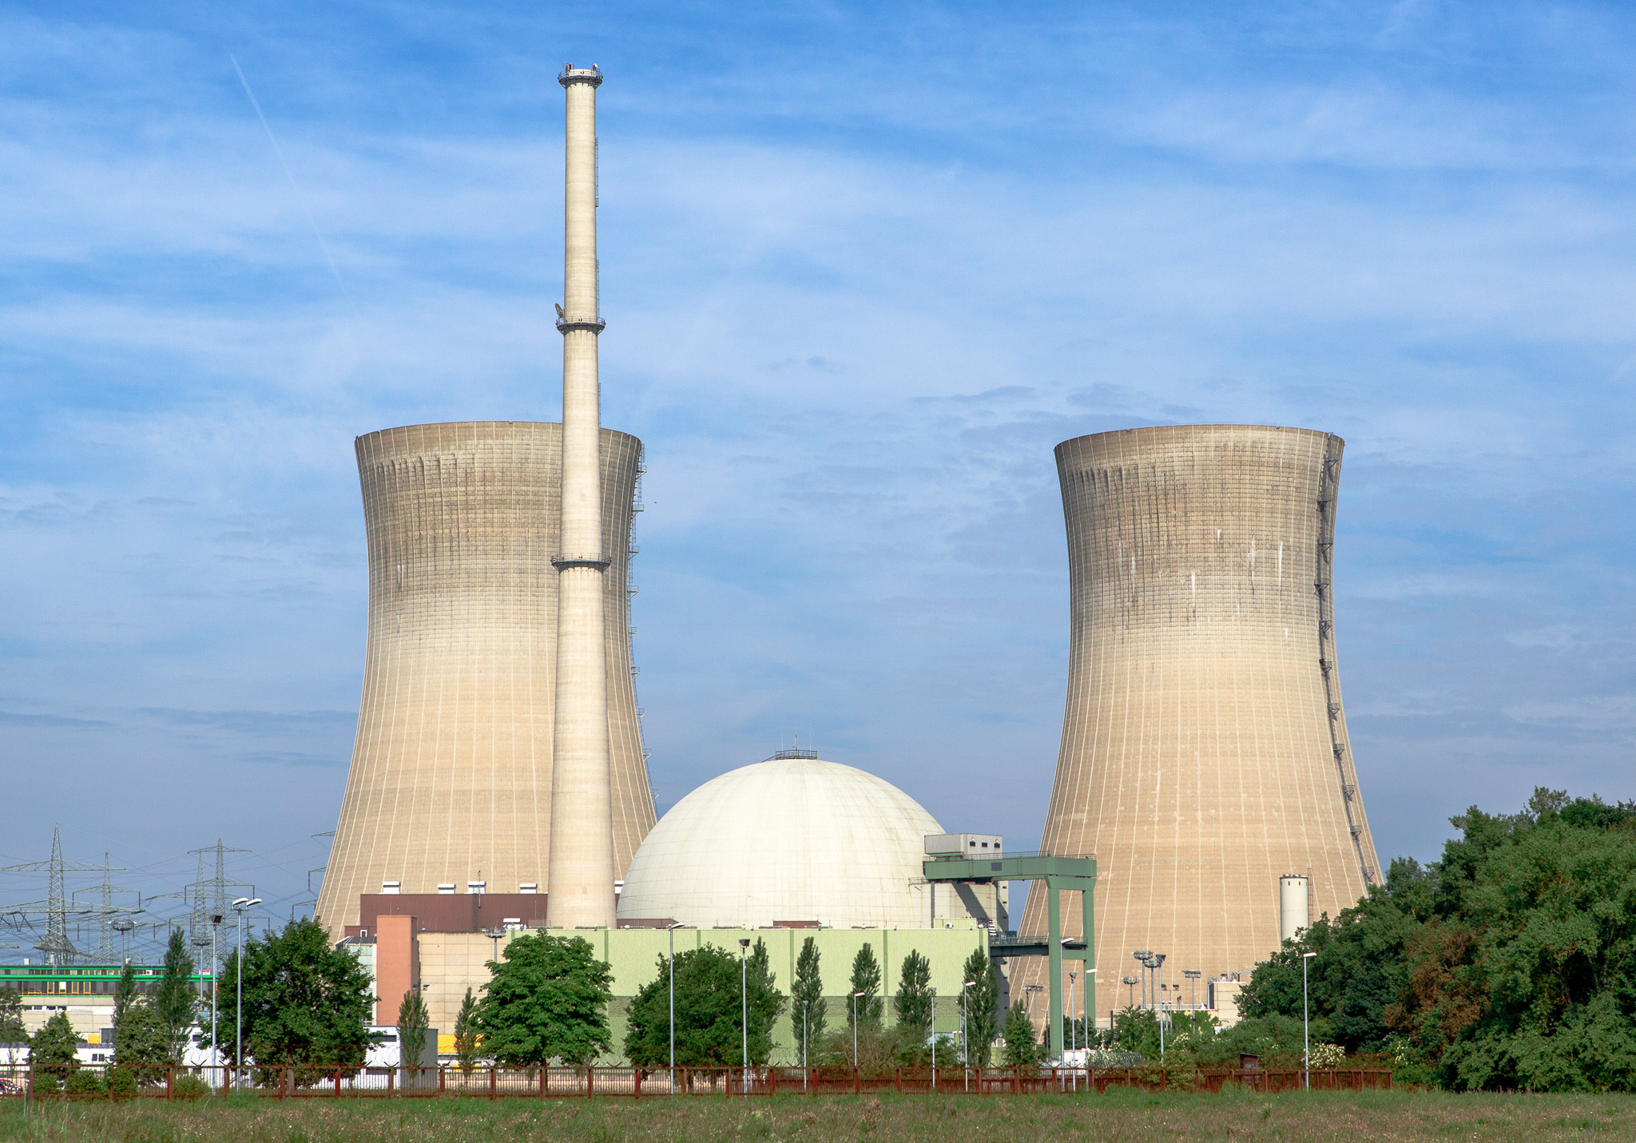
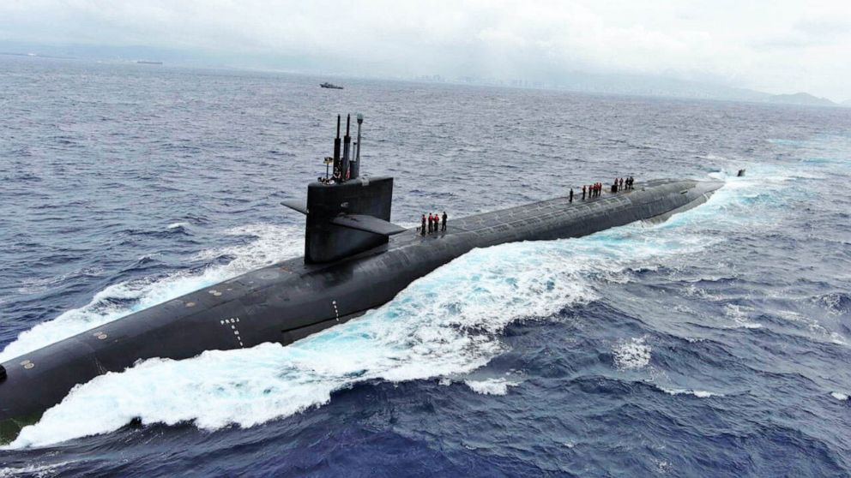
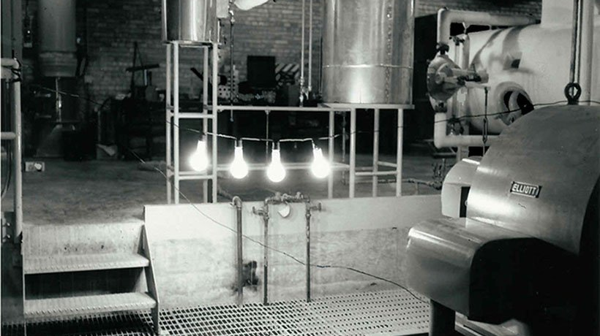
Conventional Nuclear Energy
Nuclear energy produces 20% of electric power in the US, equivalent to all renewable energy resources together, including hydropower

Slide 11
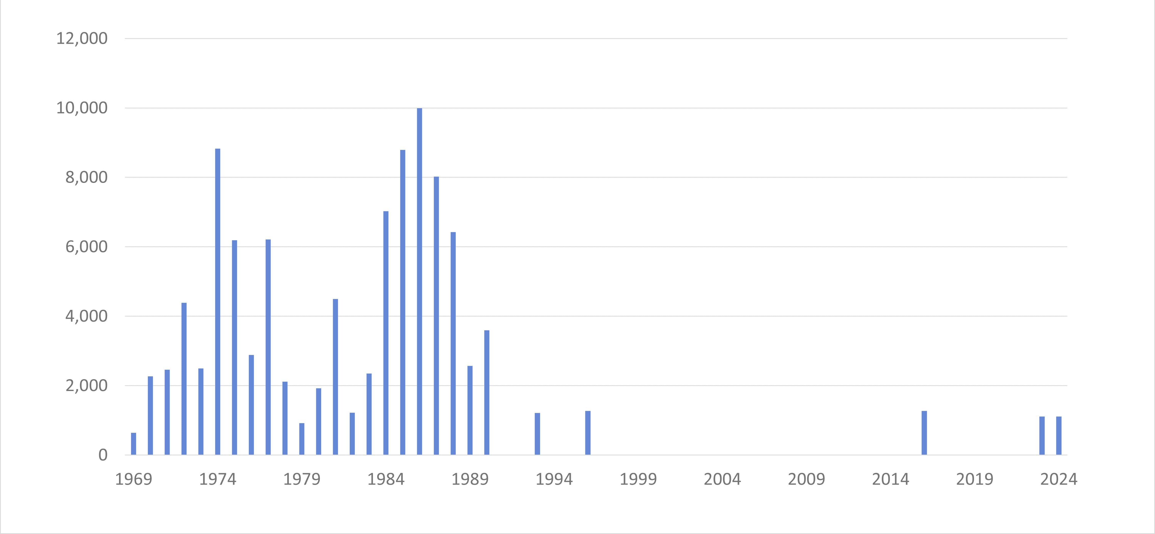
U.S. Nuclear Power New Capacity (1969-2024)
As of April 2024, there were 94 nuclear power reactors across 28 states in the United States. Currently, 12 states have restrictions on building new nuclear power facilities: California, Connecticut, Hawaii, Illinois, Maine, Massachusetts, Minnesota, New Jersey, New York, Oregon, Rhode Island, and Vermont.
Source: U.S. Energy Information Administration Monthly Electric Generator Inventory

Slide 12
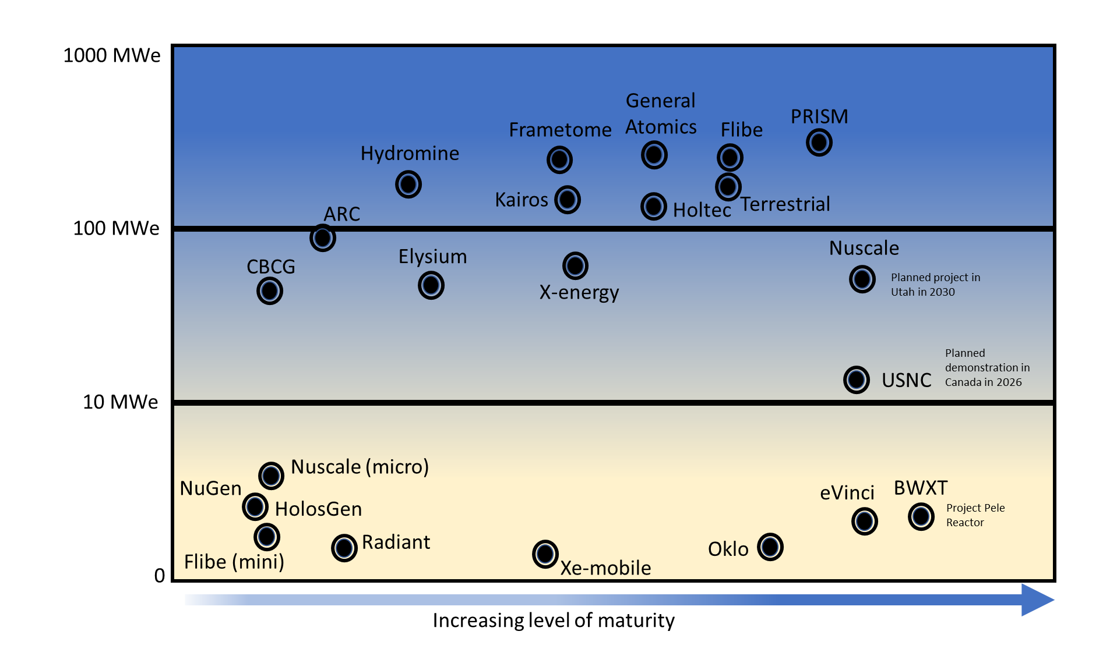
Level of Maturity for Microreactor and Small Modular Reactor Designs
* Chart from ACEP 2020 report to the legislature, not up to date on progress of individual vendors

Slide 13
Level of Maturity for Microreactor and Small Modular Reactor Designs
NRC design certification
* Chart from ACEP 2020 report to the legislature, not up to date on progress of individual vendors
NRC approval of instrument and control system

Slide 14
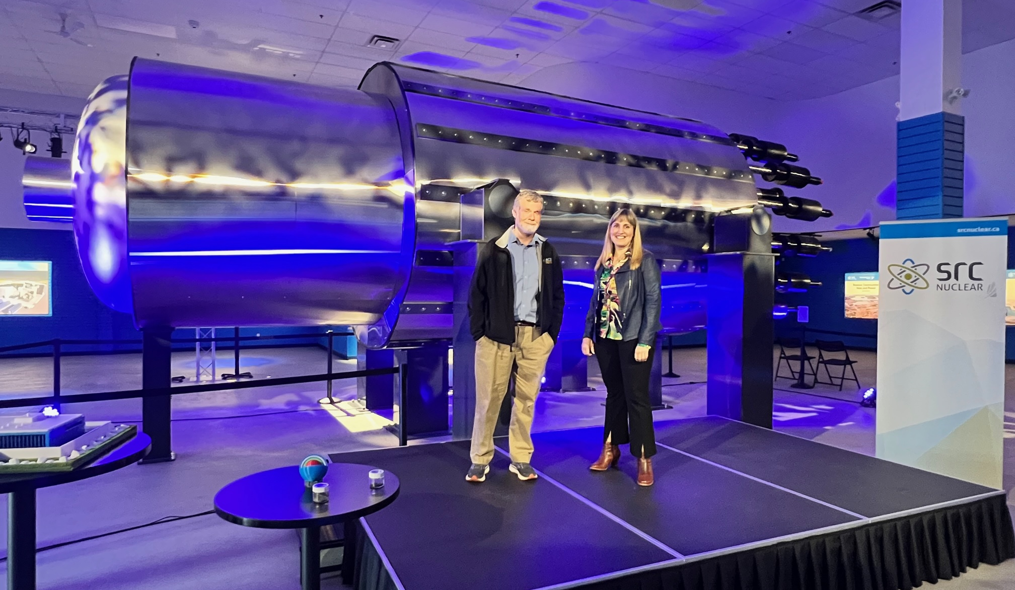

Slide 15
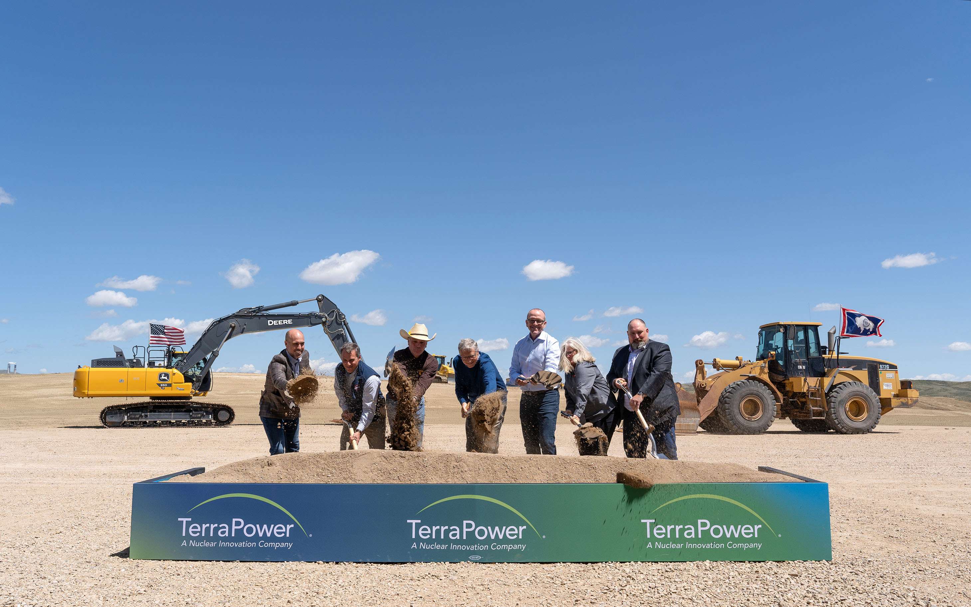
Kemmerer, WY TerraPower (345MWe)
TerraPower was the first developer to submit a construction permit application for a commercial advanced reactor (non-light-water) to the NRC. NRC plans to complete review by December 31, 2025

Slide 16


“Sliding Door” Moments

Slide 17
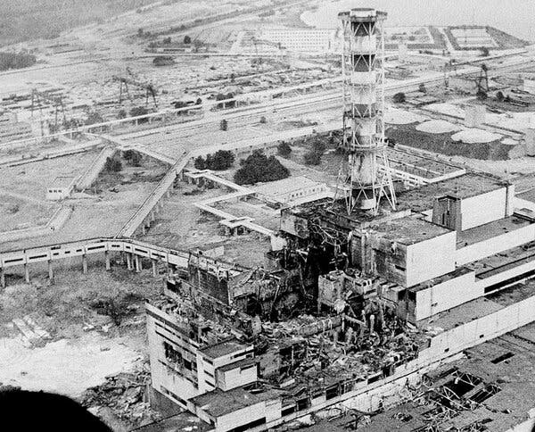
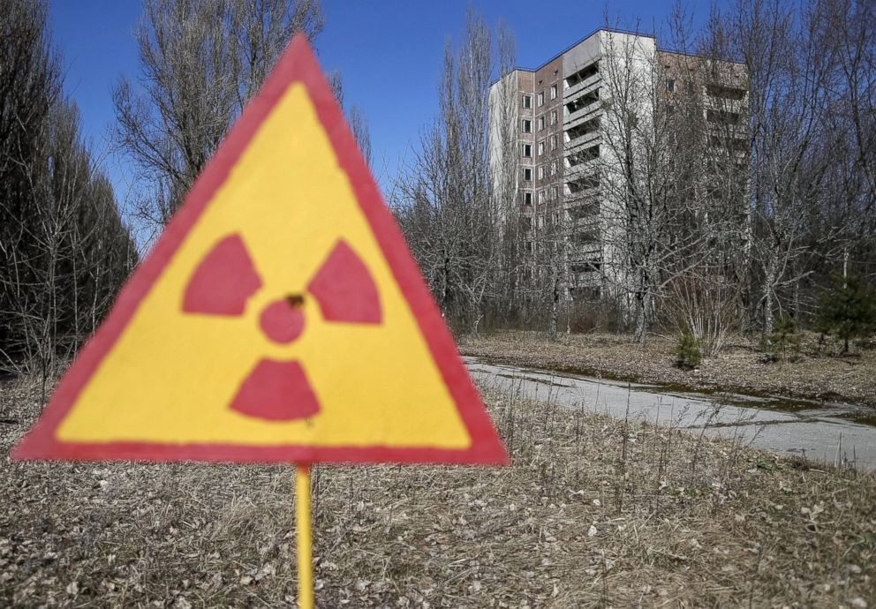
April 1986 – Sliding Door Moment for Nuclear
The 1986 Chernobyl disaster began when a reactor exploded during a safety test, spreading radioactive material across much of Europe. It remains the most serious accident in the history of civilian nuclear power

Slide 18
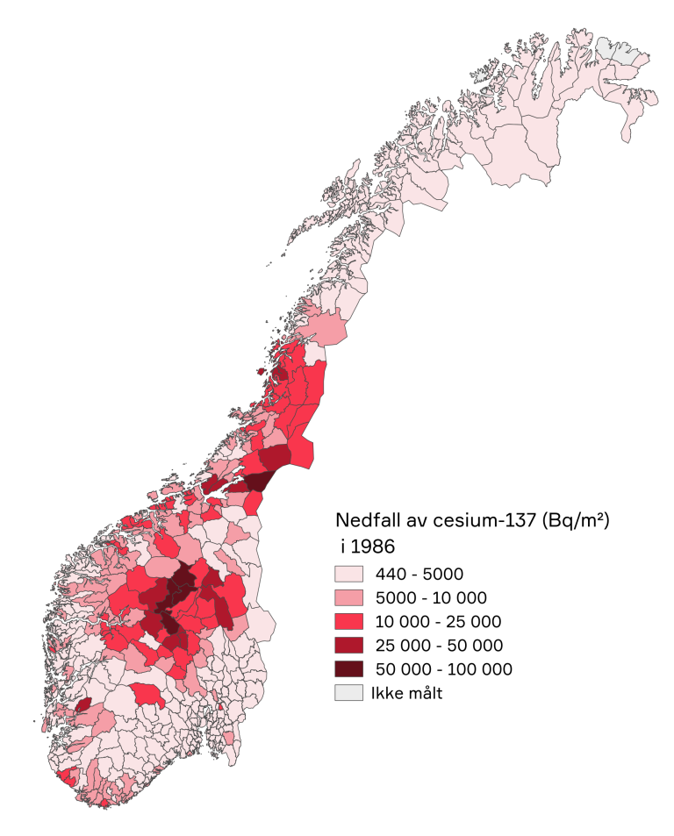
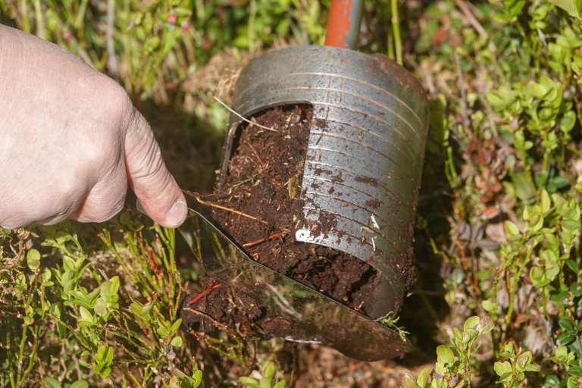
April 1986 – Sliding Door Moment for Nuclear
The Chernobyl accident in 1986 caused radioactive fallout over large parts of Norway, and radioactive contamination are still present in the soil in the most contaminated areas (caesium-137)

Slide 19
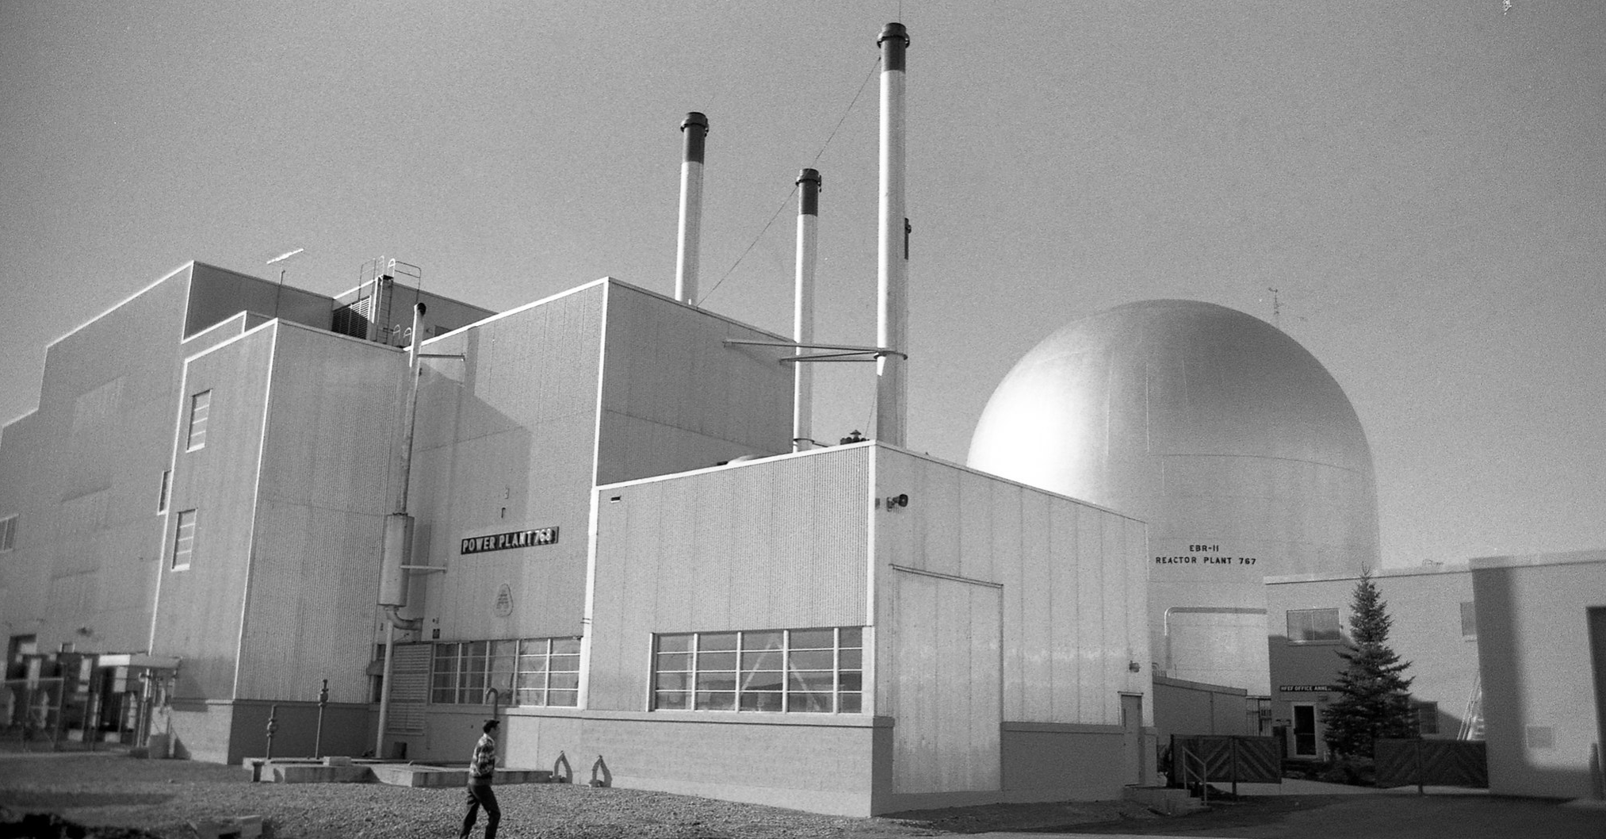
April 1986 – Sliding Door Moment for Nuclear
On April 3, 1986, two tests at EBR-II were conducted that simulated accidents involving loss of coolant flow. Even with its normal shutdown devices disabled, the reactor shut itself down safely without overheating anywhere in the system.
"Back in 1986, we actually gave a small prototype advanced fast reactor a couple of chances to melt down," says Argonne nuclear engineer Pete Planchon, who led the 1986 tests. "It politely refused both times."
Notes:
Loss of coolant flow → reactor shut down safely. Loss of heat removal → reactor stabilized by physics alone.

Slide 20
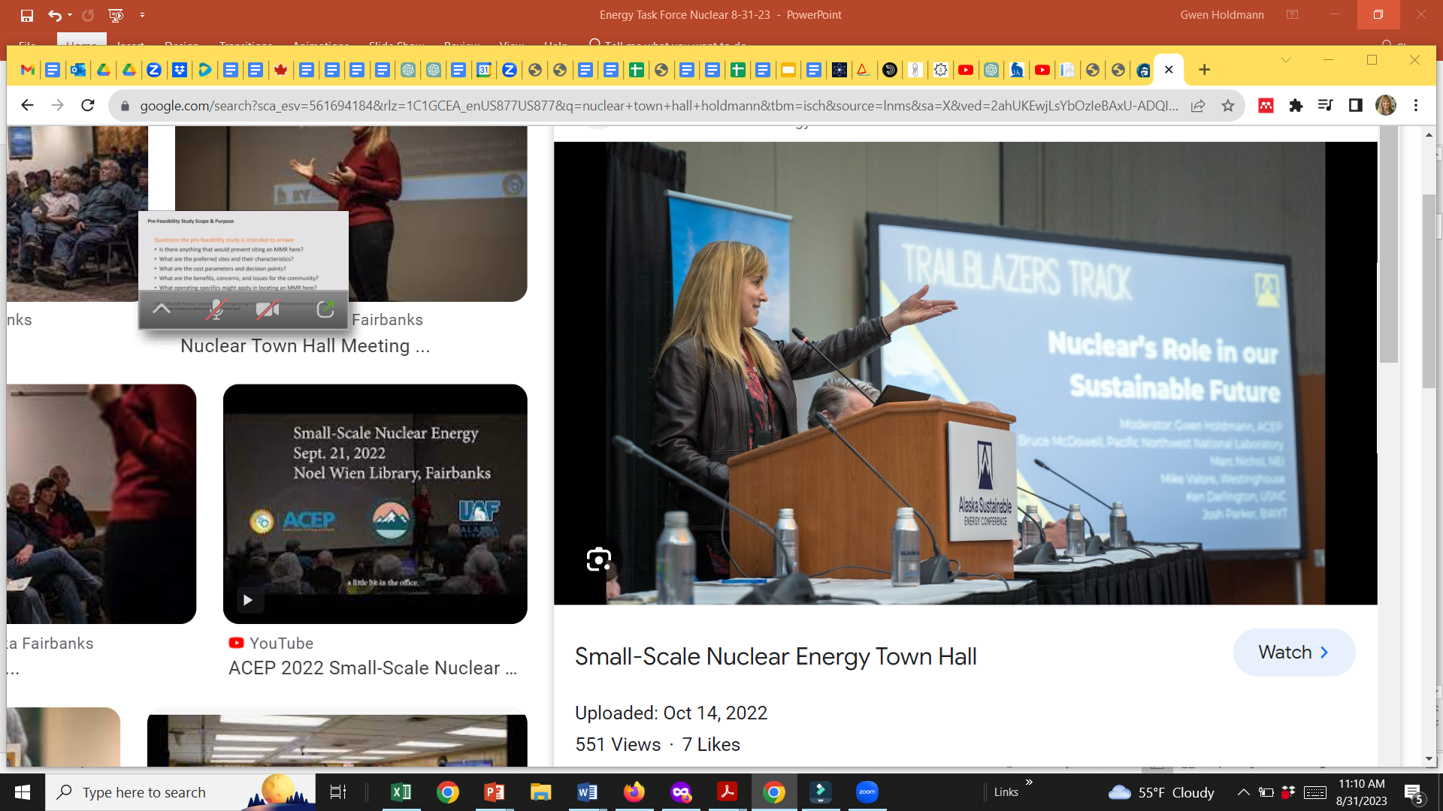
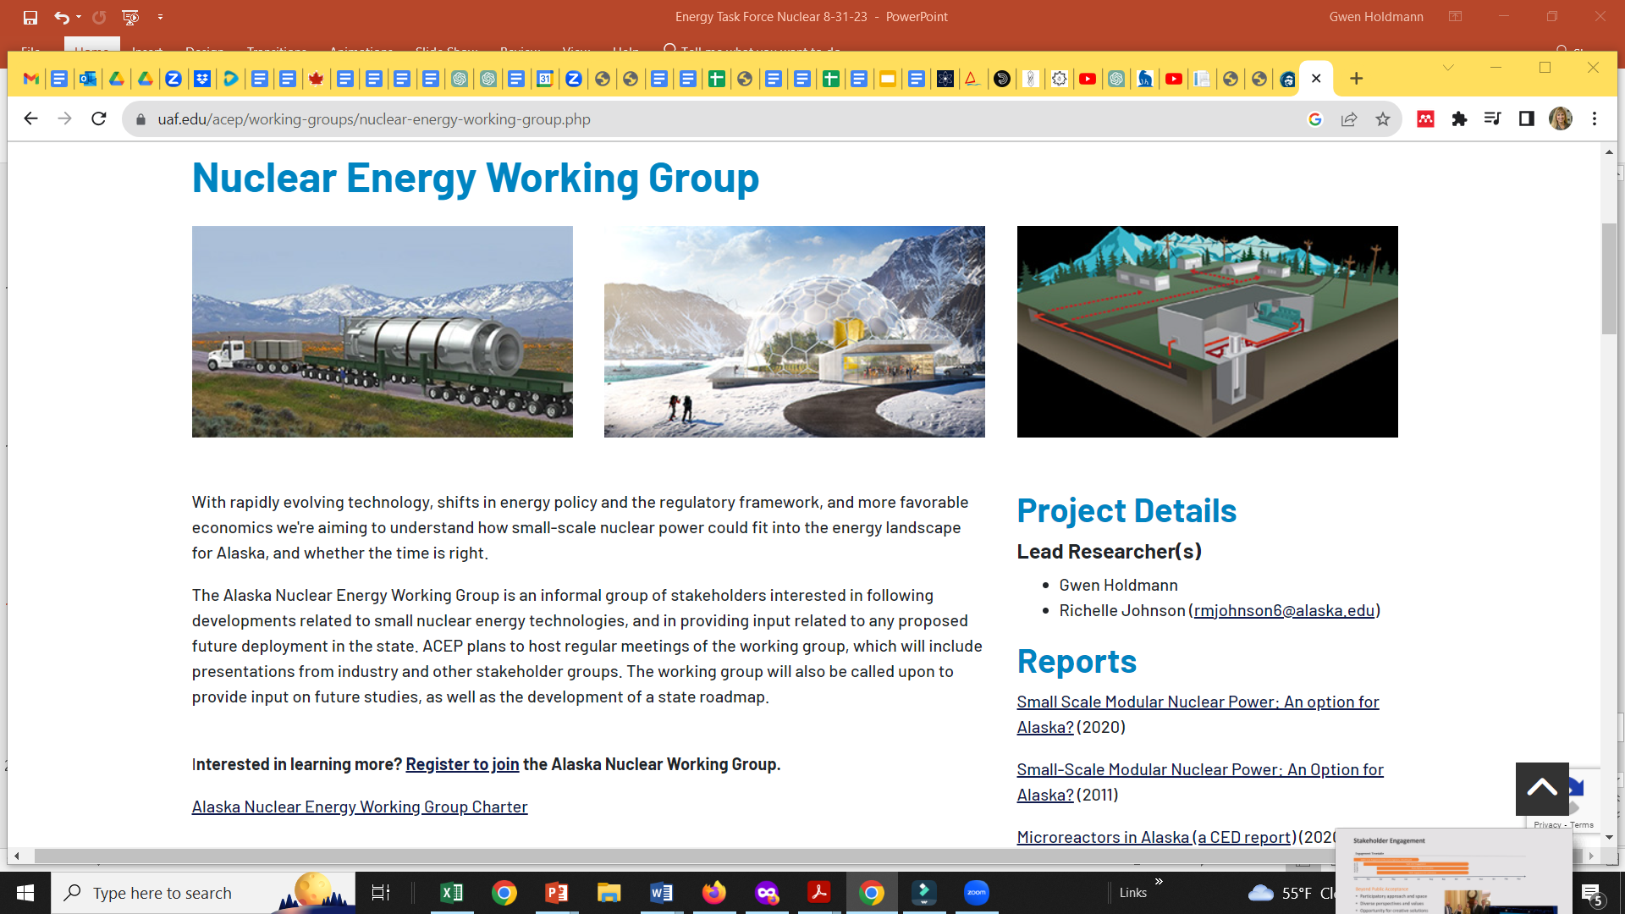
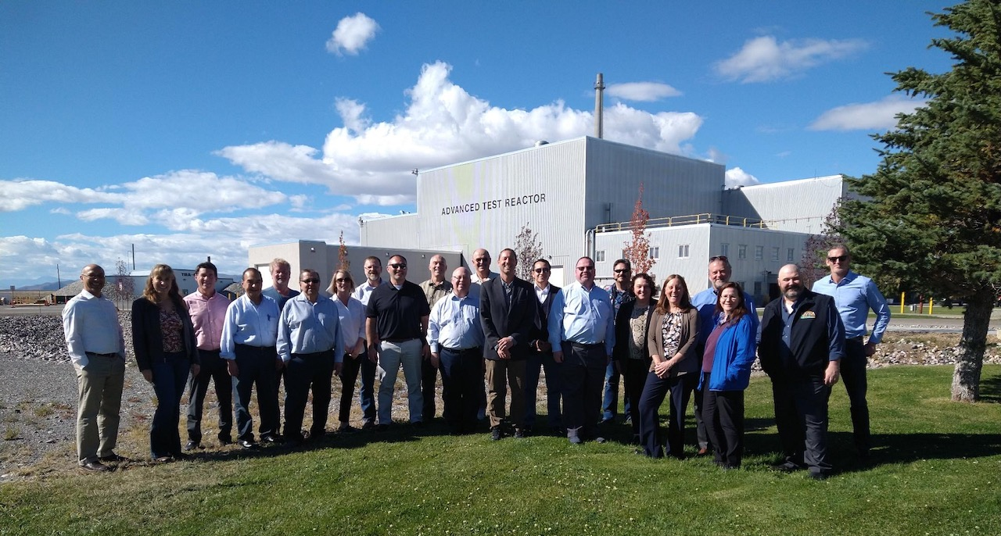
General public
Industry and interested public
Elected officials and state leaders

Slide 21
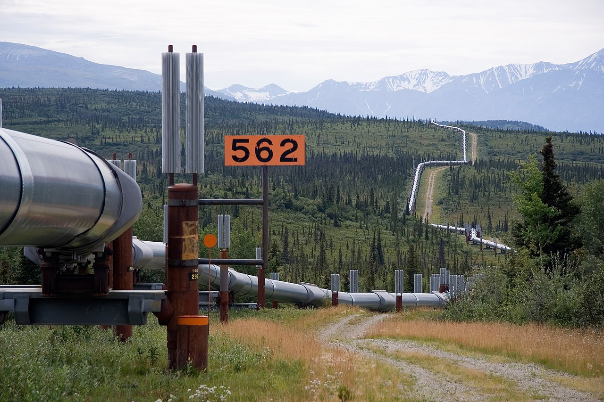

Slide 22
What are Advanced Microreactors?
Microreactors are an emerging class of small advanced reactors with the following general attributes:
Output of 1 to 10’s of MWe **
Do not require water for cooling
Factory fabricated and transportable nearly fully assembled.
Requires a small operational footprint.
Employs passively safe operating and fuel designs
Long intervals without refueling

Slide 23
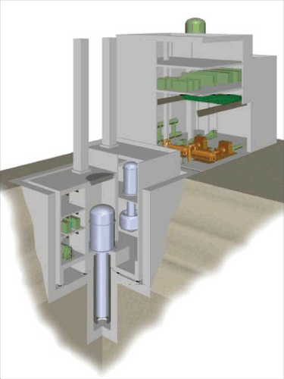
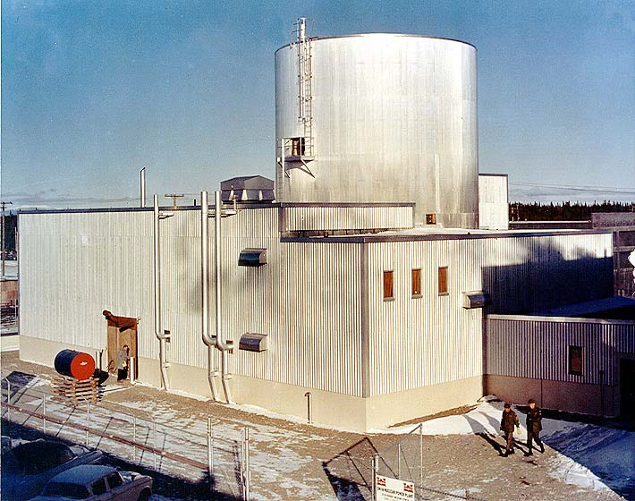
Nuclear Technology in Alaska
Fort Greely SM1 microreactor. Commissioned in 1962, decommissioned in 1972. 20.2 MW_{th}, generated 1.6 MW_{e}
Galena, AK Toshiba 4S 10MW “nuclear battery” (circa~2008)
Left: Fort Greely SM1 primary reactor facility;
Right: Toshiba 4S Artist rendering

Slide 24
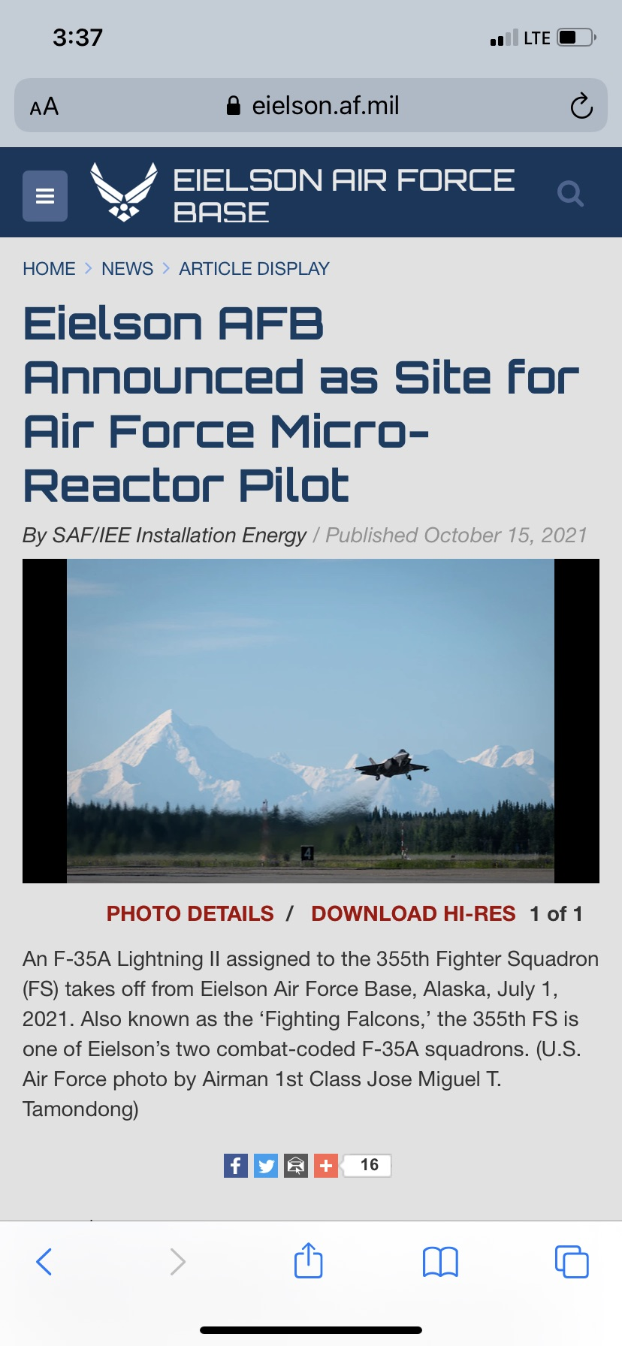
Eielson AFB Microreactor Project
2019 National Defense Authorization Act (NDAA) required the DoD to seek to develop a pilot program for the development of at least one micro-reactor by December 2027.
Will be licensed as a commercial reactor project through a PPA with the Air Force (possibly the first in the country).
Oklo was issued a notice of intent to award in mid-2025.

Slide 25
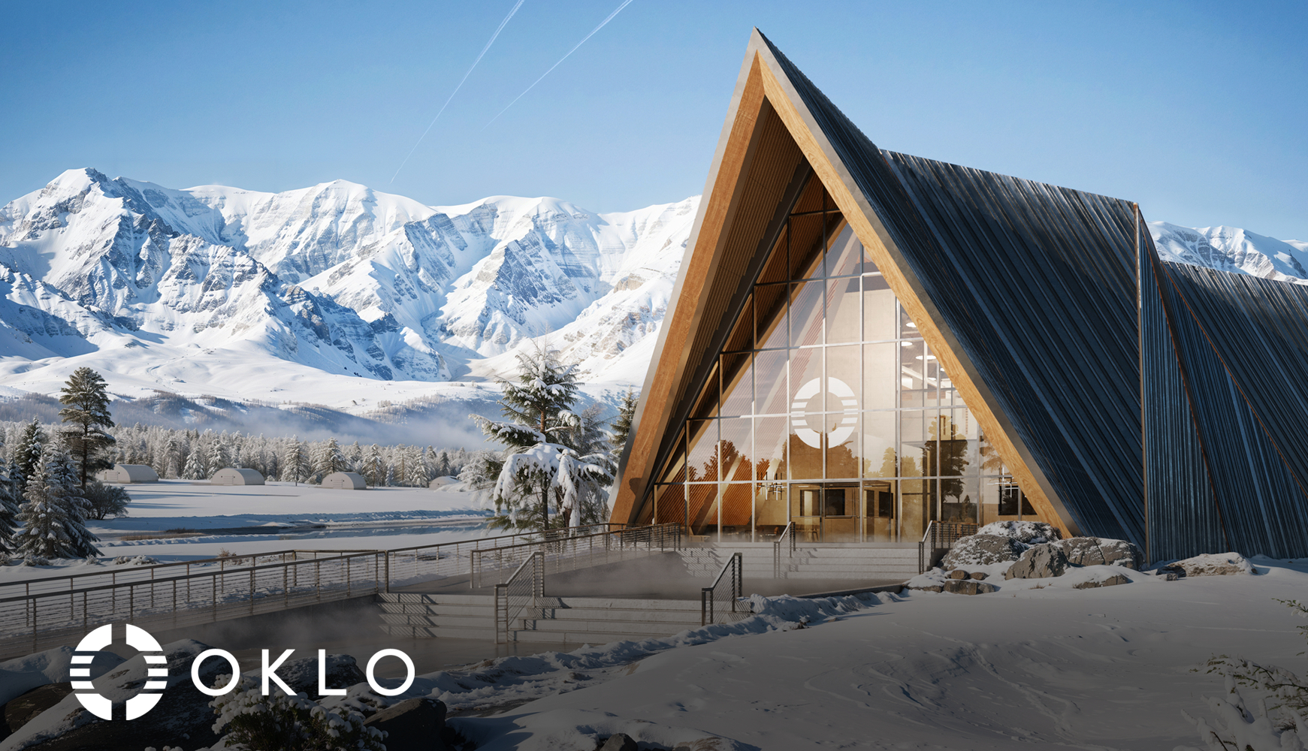
Eielson AFB Microreactor Project
Oklo was awarded a notice of intent to award in mid-2025
Notes:
TerraPower’s main nuclear reactor, the Natrium, will have a capacity of 345 megawatts of electrical energy (MWe), where the first Oklo reactor, called the Aurora, is expected to have a capacity of 1.5 MWe, making it a true micro-reactor.

Slide 26
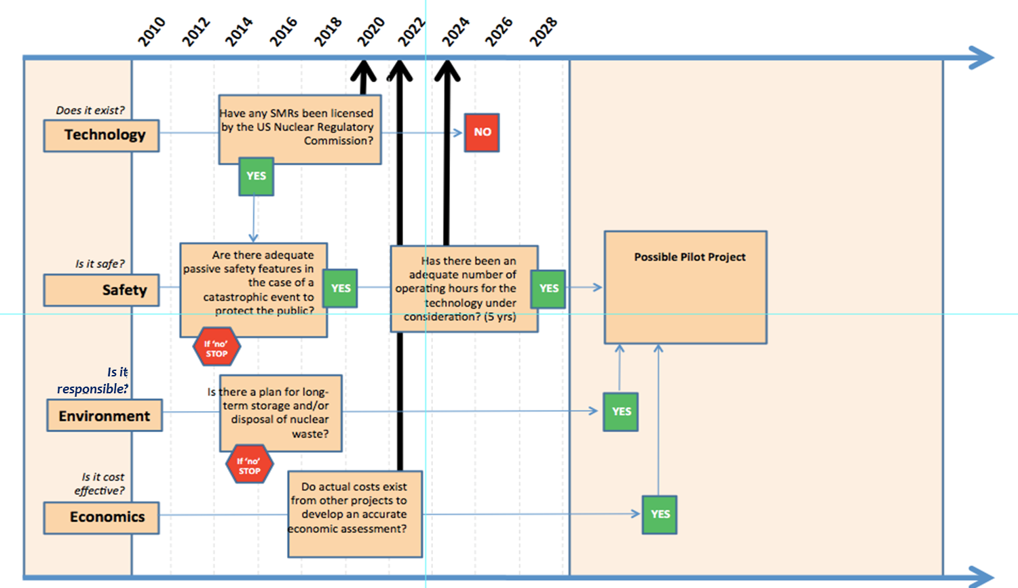
Alaska Roadmap
Does it exist?
Is it safe?
Is it responsible?
Is it cost effective?

Slide 27
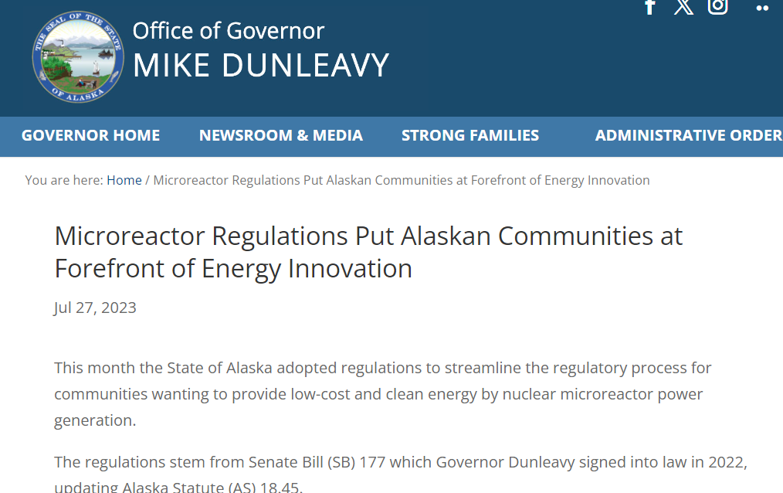
SB 177 – Updating State Statutes on Nuclear
Enacted in 2023, included a separate category for small reactors under 50 MW that was less restrictive than previous regulations for nuclear energy in Alaska.
Alaska was one of the first states to recognize advanced reactors and seek to reduce barriers to adoption

Slide 28
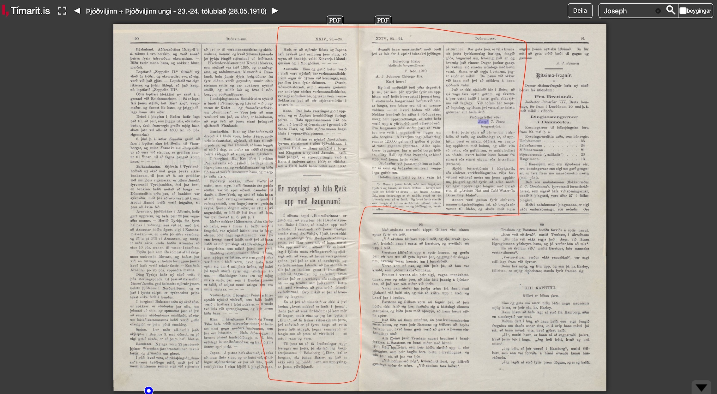
Final Thoughts: Guess the Technology
“Engineers of our time devise many peculiar inventions—often so astonishing they seem like fabrications. Yet time and again, what was once thought impossible has proved achievable, reminding us to be cautious before dismissing any idea, however implausible it may first appear.”

Slide 29


Thank You!
Dr. Gwen Holdmann, Chief Scientist
Gwen.Holdmann@alaska.edu
https://www.uaf.edu/acep
Alaska Center for Energy & Power (ACEP)
University of Alaska Fairbanks
Westinghouse eVinci life-size
mock-up in Saskatoon, Saskatchewan

