Slide 1
The Water–Energy Nexus
Robert B. Sowby, Ph.D., P.E., ENV SP
Brigham Young University
The Energy Council
2024 Global Energy and Environmental Issues Conference
Dec. 6, 2024 | Salt Lake City

Slide 2
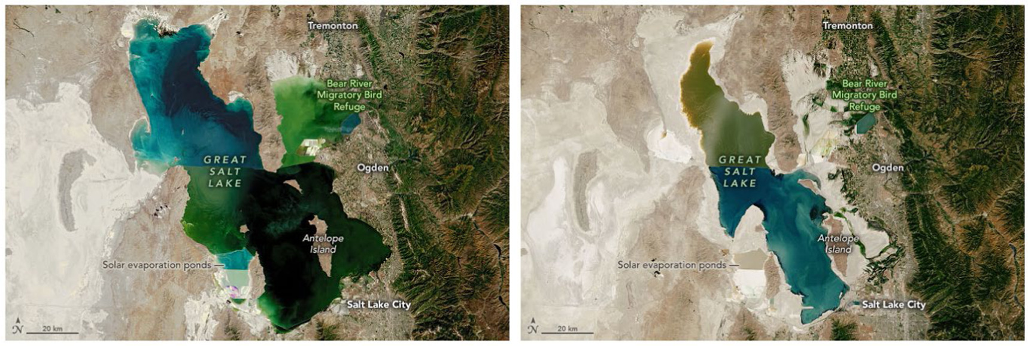
1986 and 2022
Notes:
Vanishing act
Lost 2/3 of area, 3/4 of water
Doesn’t show loss of groundwater; crust is rebounding

Slide 3

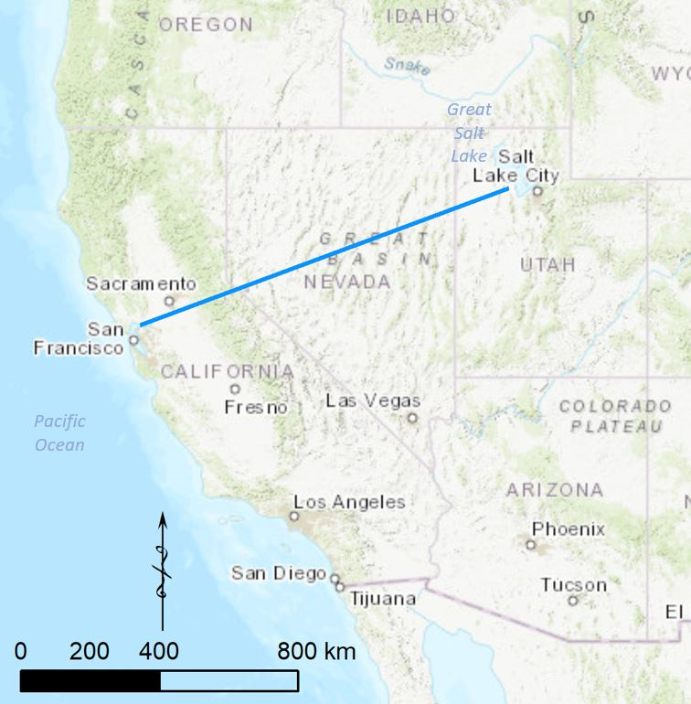
Pumping Pacific Ocean Water to Great Salt Lake
400 MW
11% of UT elec.
$300M/yr
1 MMT CO₂e/yr
200,000 cars

Slide 4
The Nexus
Energy for Water
(pumping, treatment, water heating, wastewater)
WATER
ENERGY
Water for Energy
(thermoelectric cooling, steam, hydropower)

Slide 5
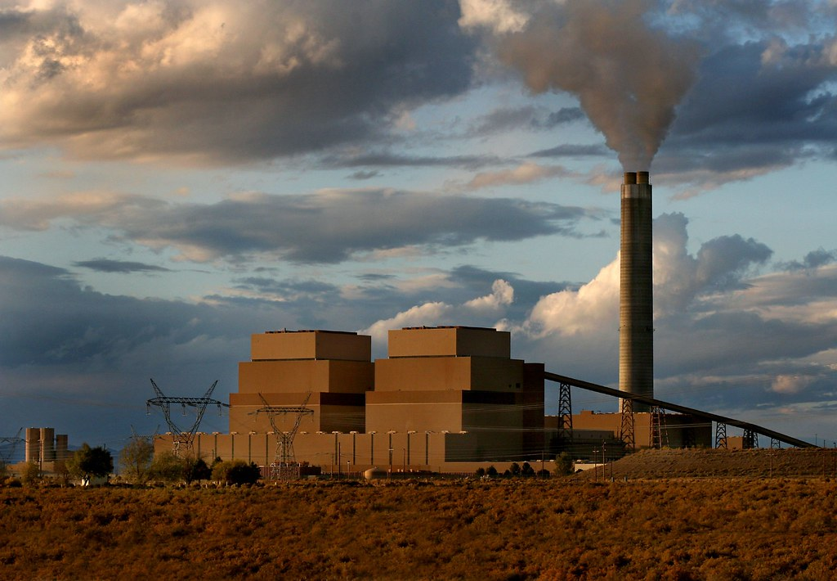
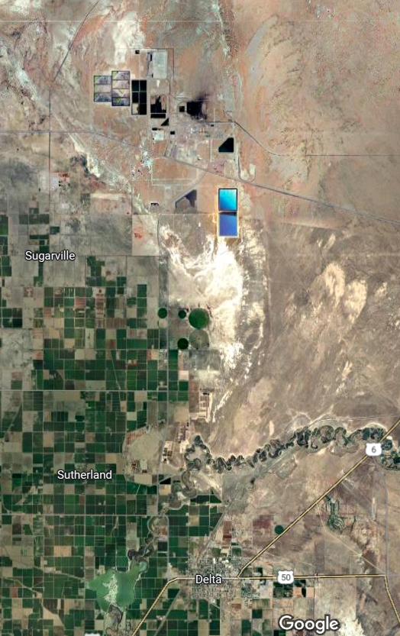
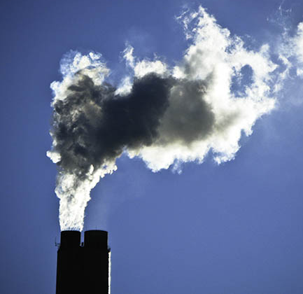
Water for Energy
Intermountain Power Project
Thermoelectric power:
41% of all U.S. water withdrawals
(Dieter et al. 2018)

Slide 6
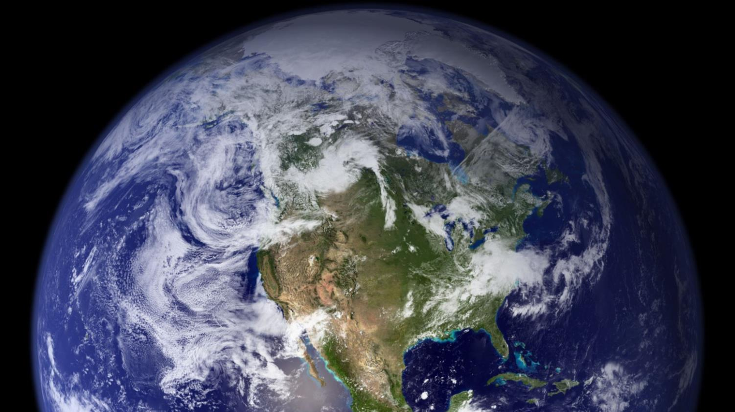
Notes:
Lots of water on Earth—oceans, clouds, groundwater, rivers, lakes, ice—all three phases—but not directly consumable. We overcome these challenges with energy.

Slide 7
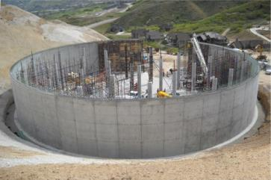
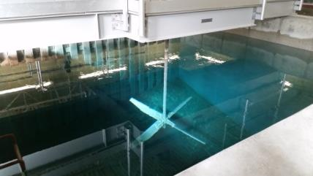
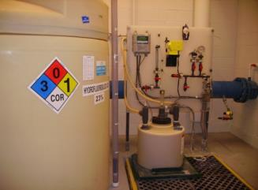
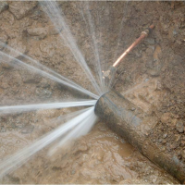
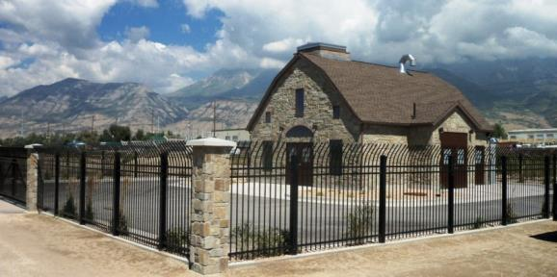
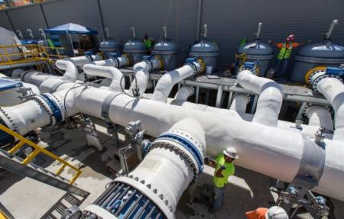
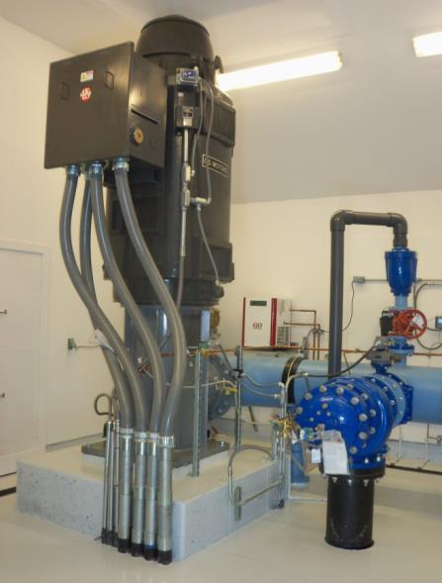
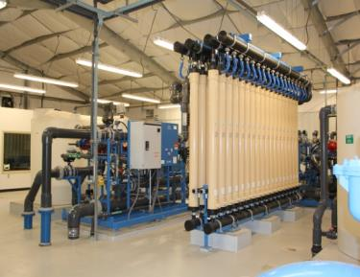
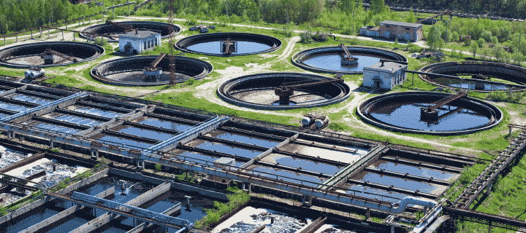
Notes:
We use energy to move water to the right place, treat it to the right quality, and store it for the right time.

Slide 8
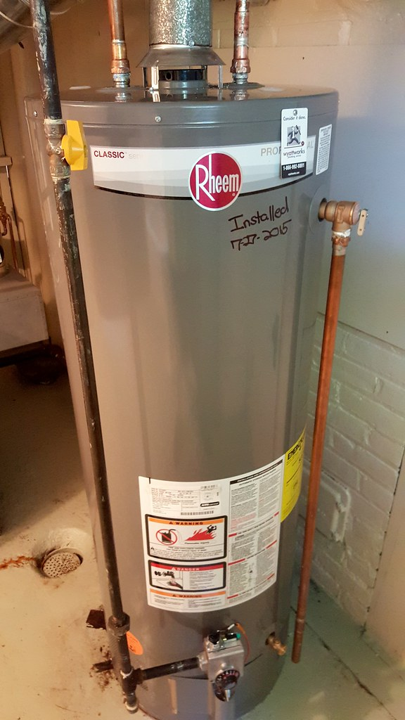
Energy for Water
U.S.: 13% of total energy (Sanders and Webber 2012)
Utah: 7% of total energy (DWRe 2012)
California: 19% of electricity and 30% of natural gas (CEC 2005)
Idaho: 34%–49% of electricity (Tidwell et al. 2014)

Slide 9

Energy for Water

Slide 10
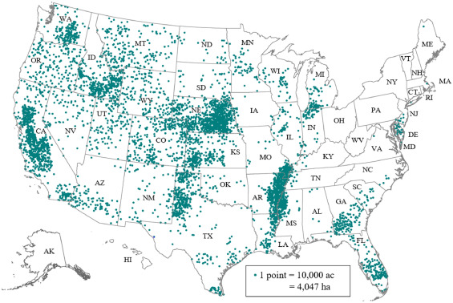
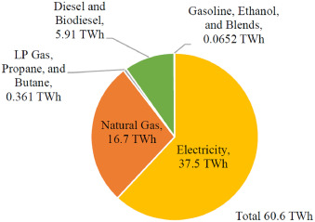
Energy for Water: Irrigation
1% of all U.S. energy
Sowby and Dicataldo 2022

Slide 11
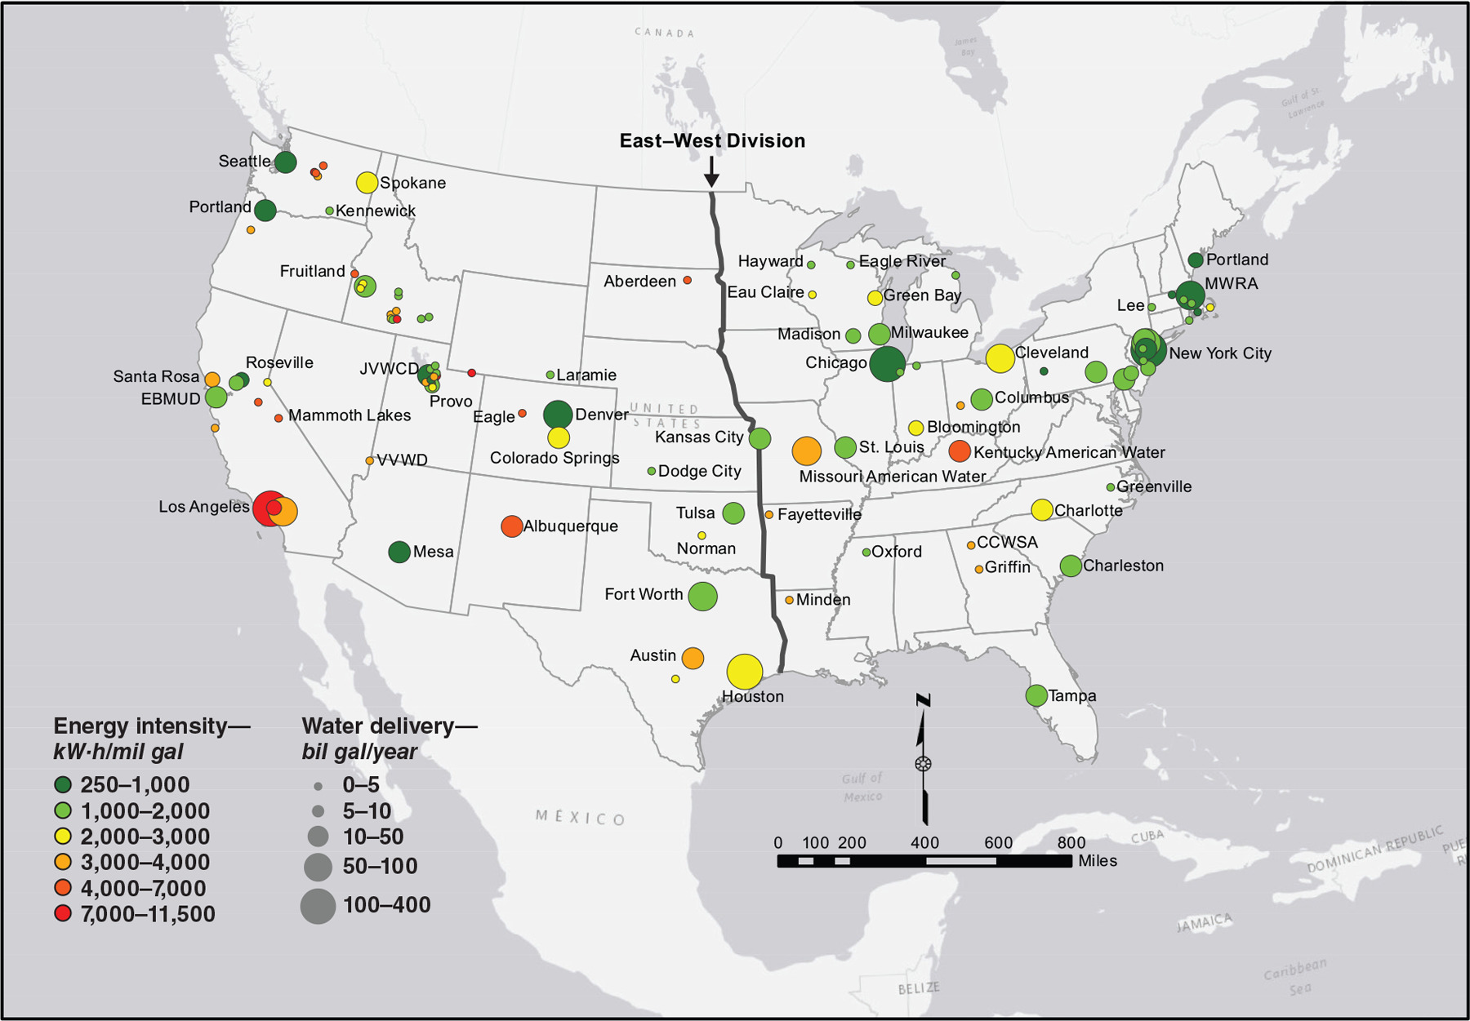
Energy for Water:
Drinking Water
1%–2% of all U.S. energy
Sowby and Burian 2017

Slide 12

Optimized Water System
ENERGY
EFFICIENCY
OPTIMIZED
SYSTEM
HYDRAULIC PERFORMANCE
WATER QUALITY
Jones and Sowby 2014

Slide 13
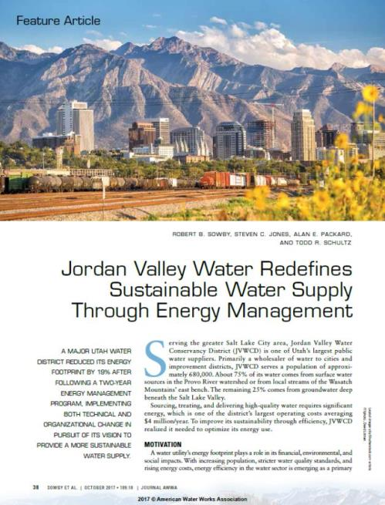
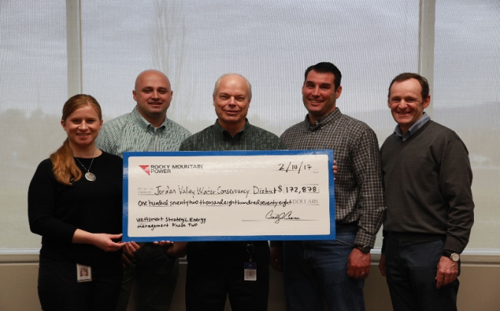
JORDAN VALLEY WATER CONSERVANCY DISTRICT
Salt Lake City, UT | 700,000 people
19% reduction from baseline

Slide 15
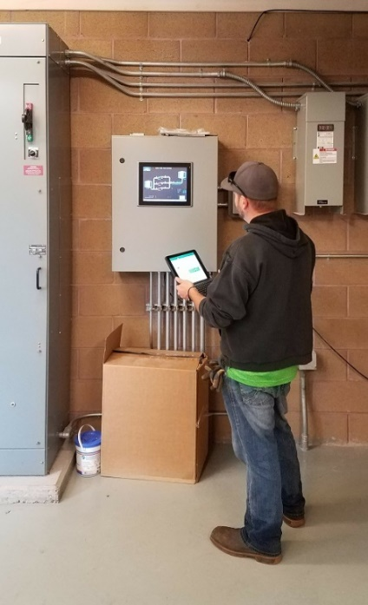
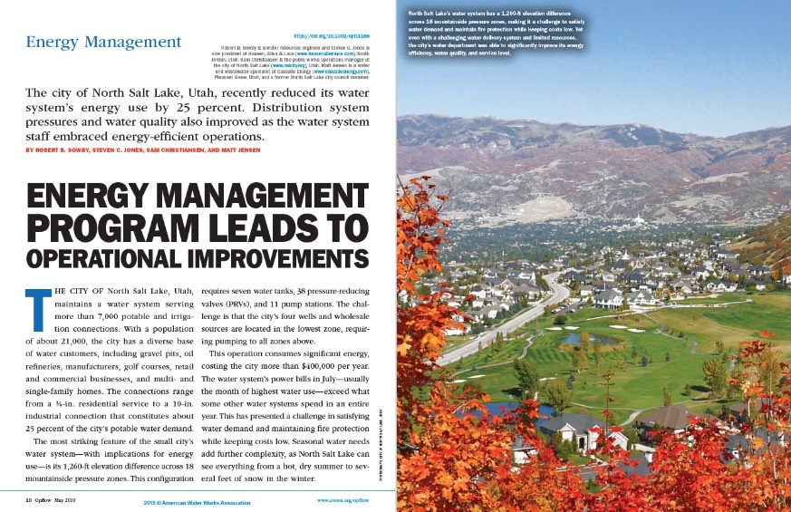
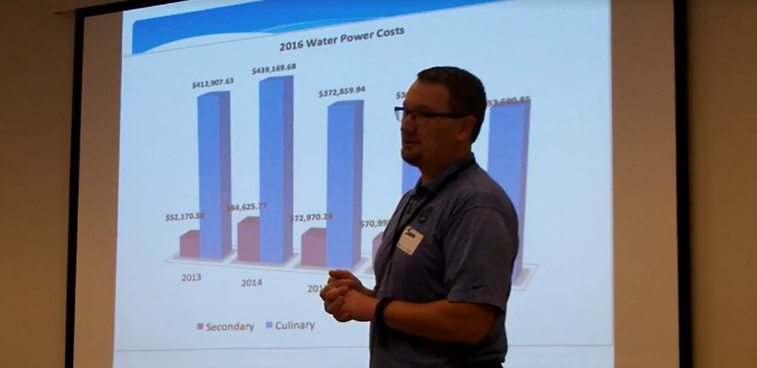
CITY OF NORTH SALT LAKE, UTAH
21,000 people
25% reduction from baseline

Slide 16
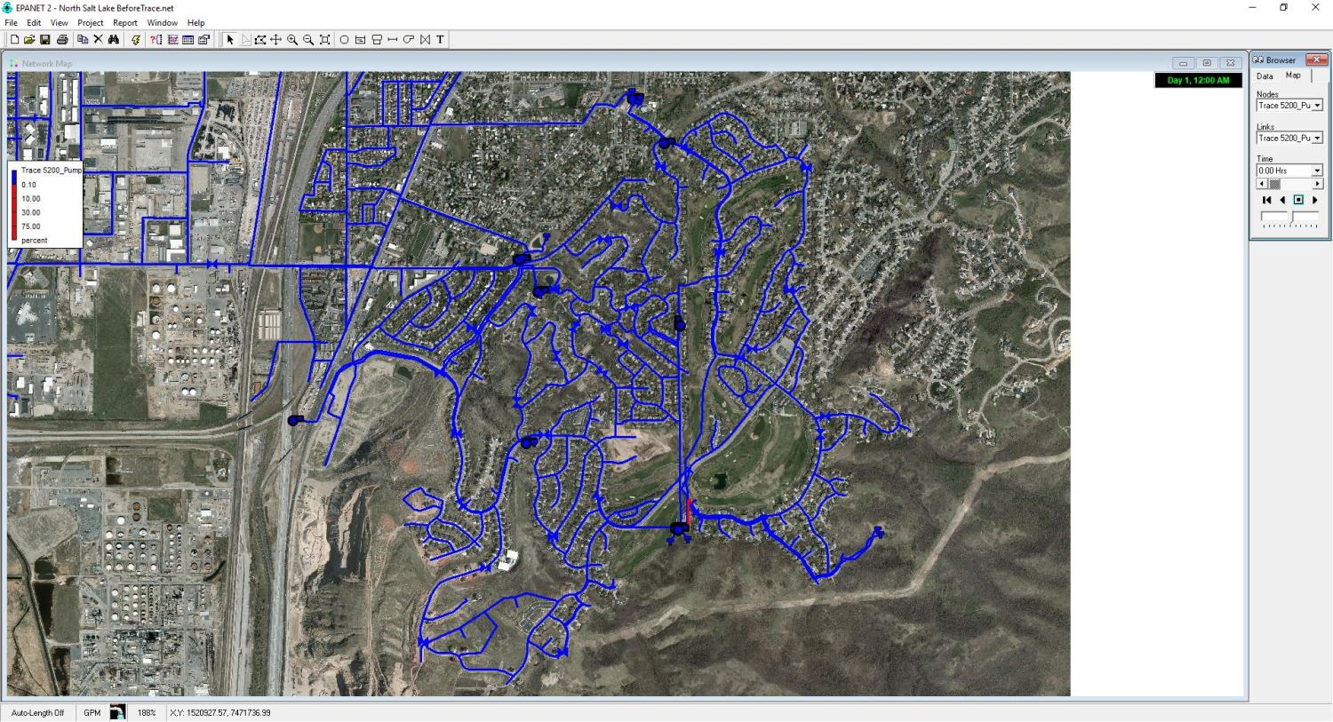
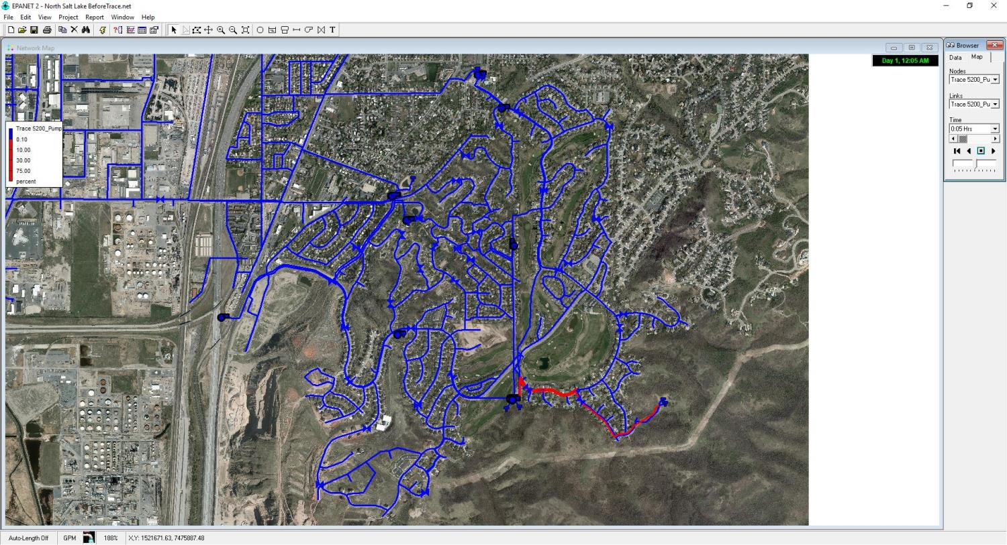

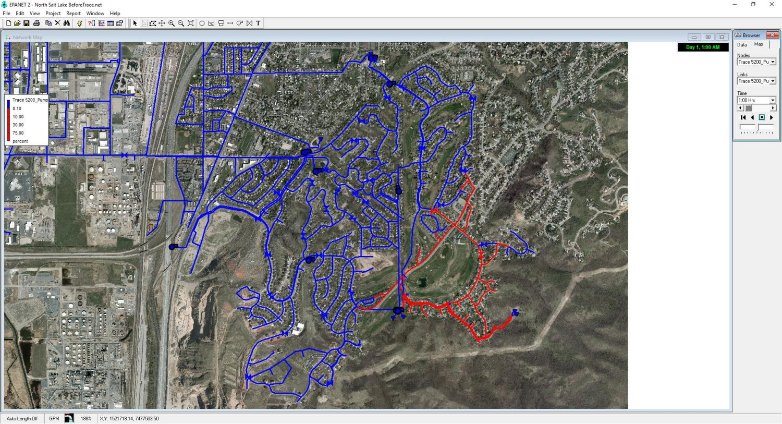
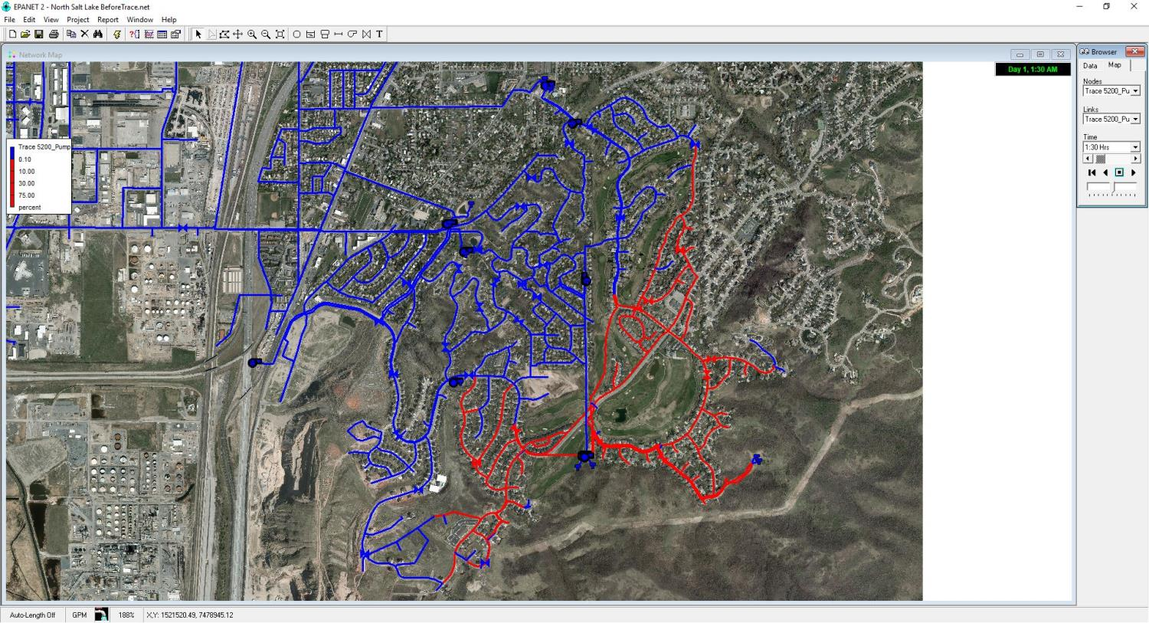
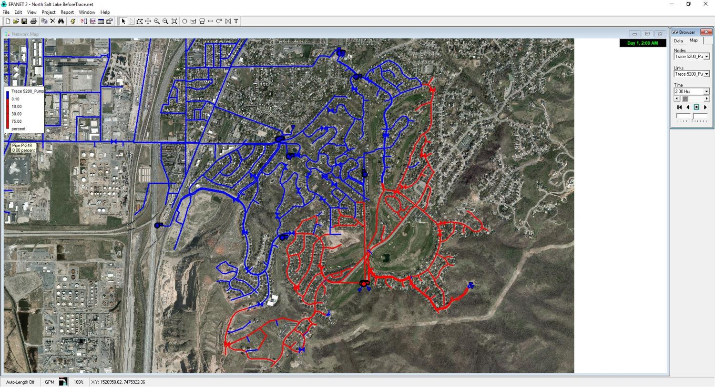
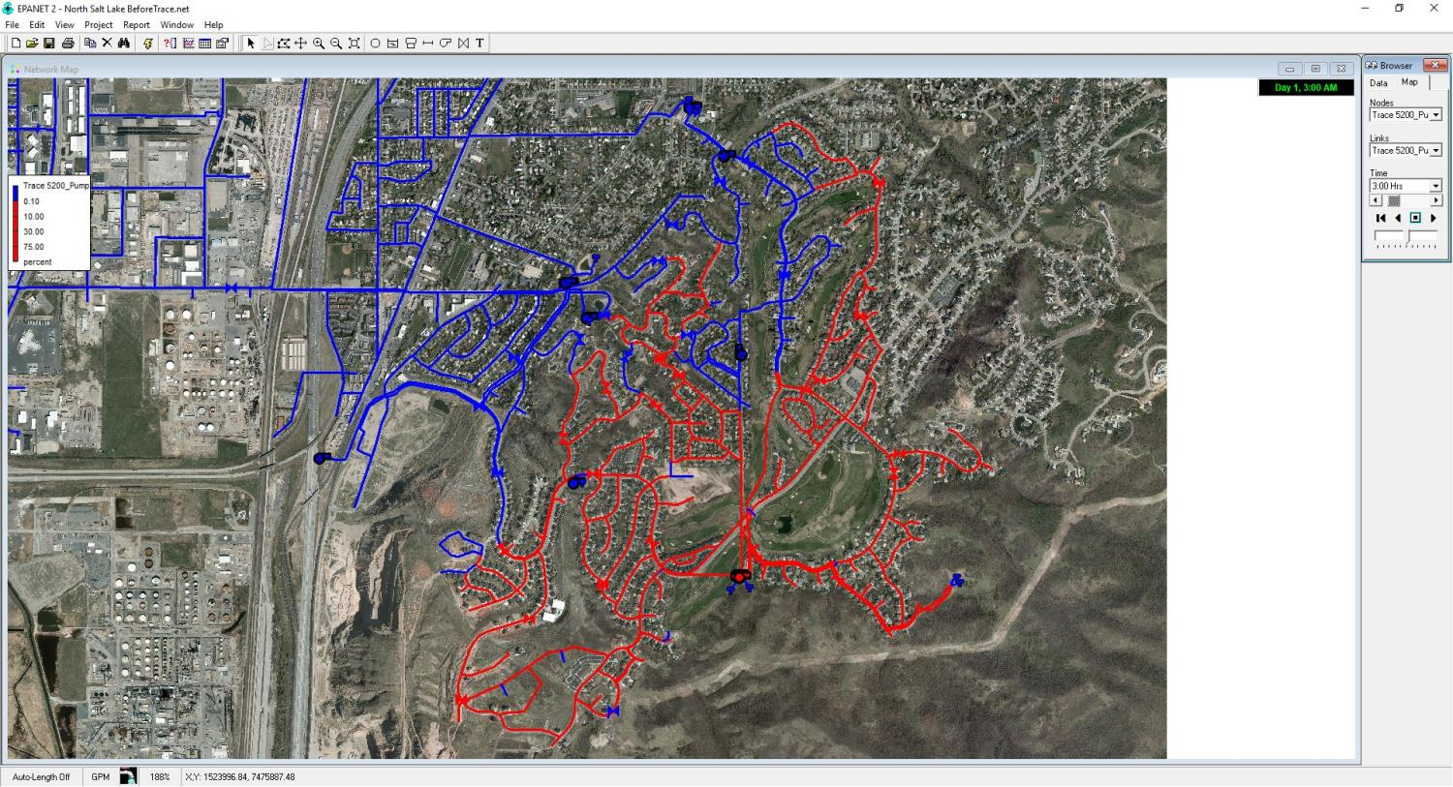
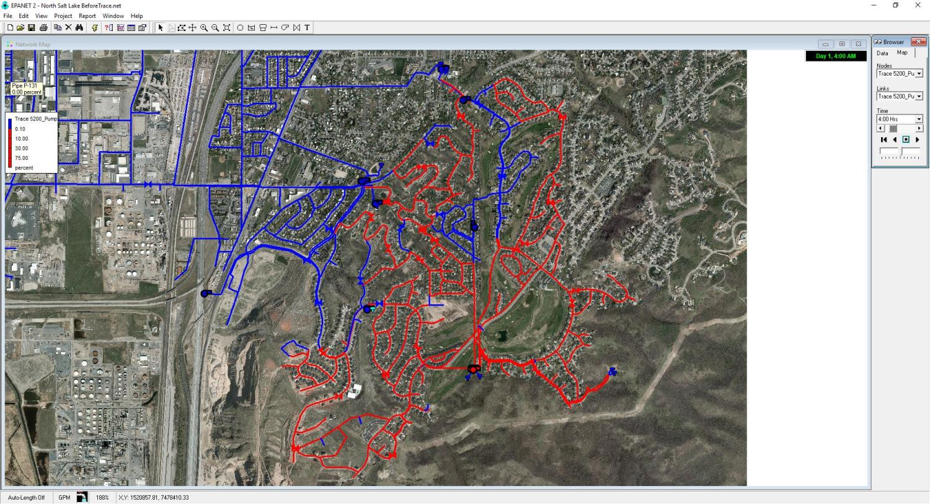
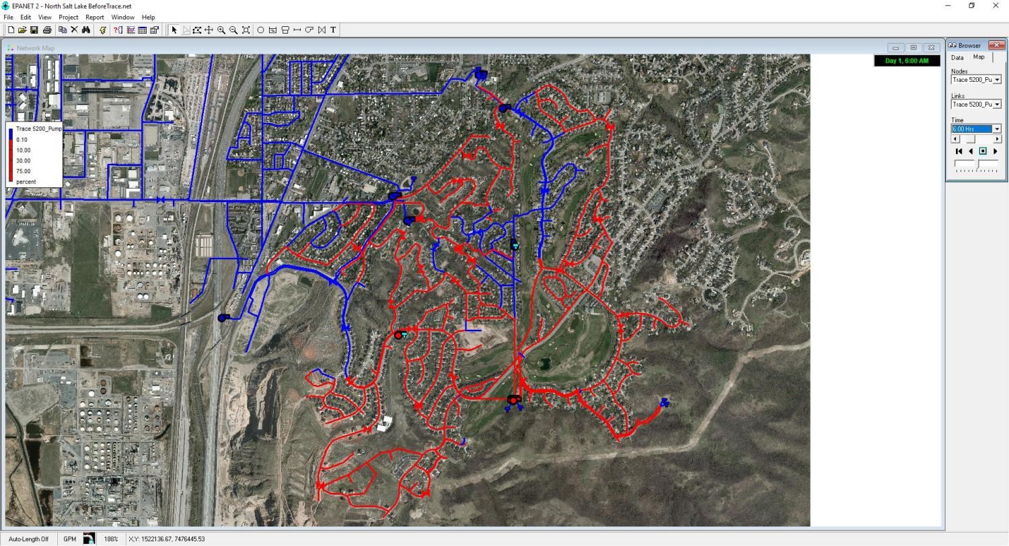
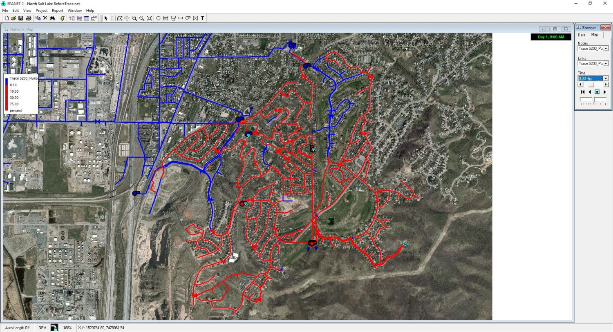
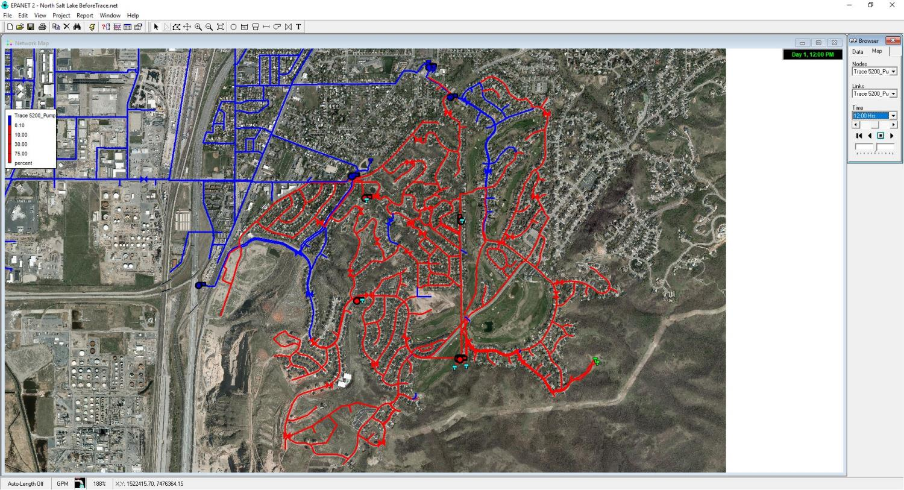
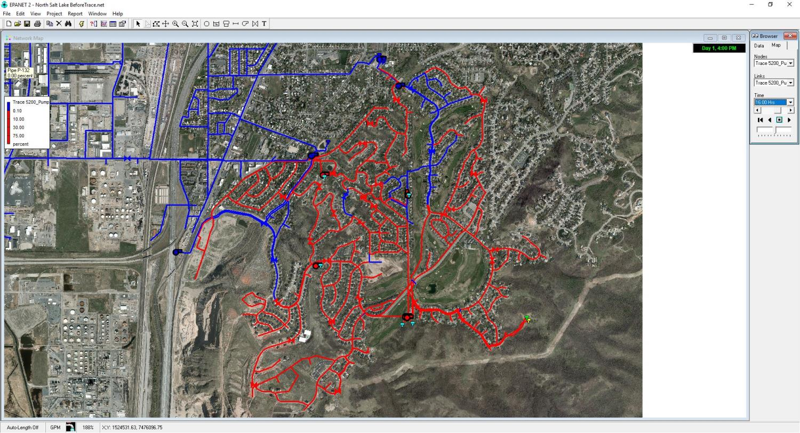
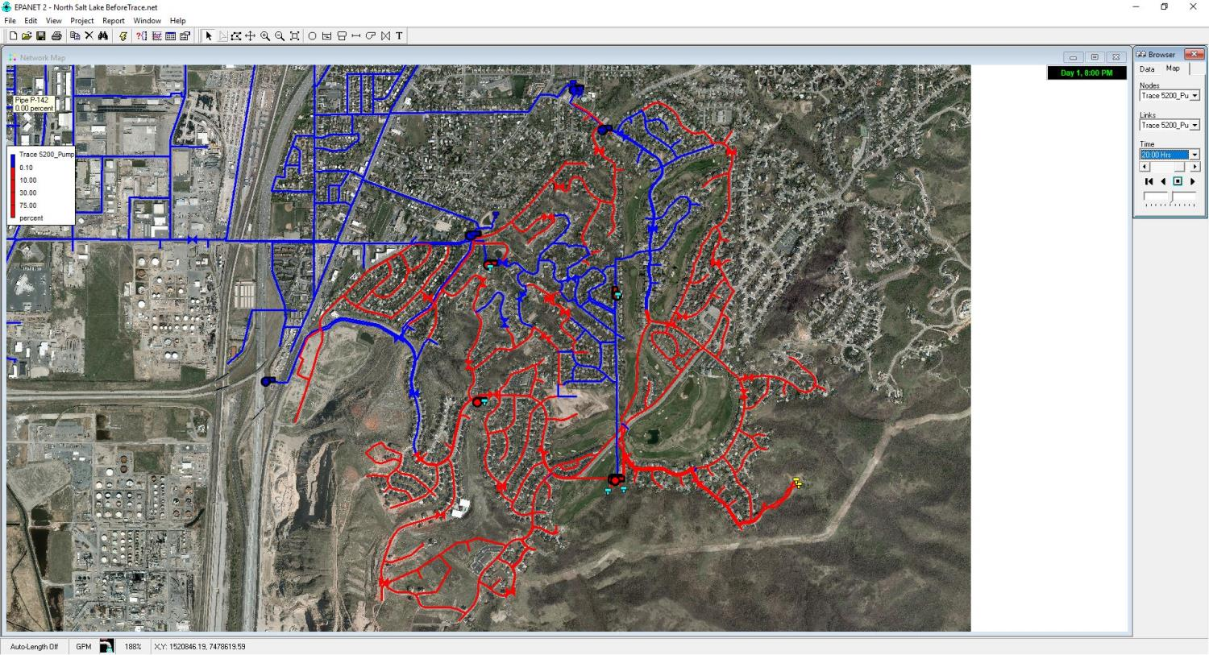


Low elevation
Pumping in Circles
BEFORE
High elevation
Notes:
[Maybe cut this slide]

Slide 17
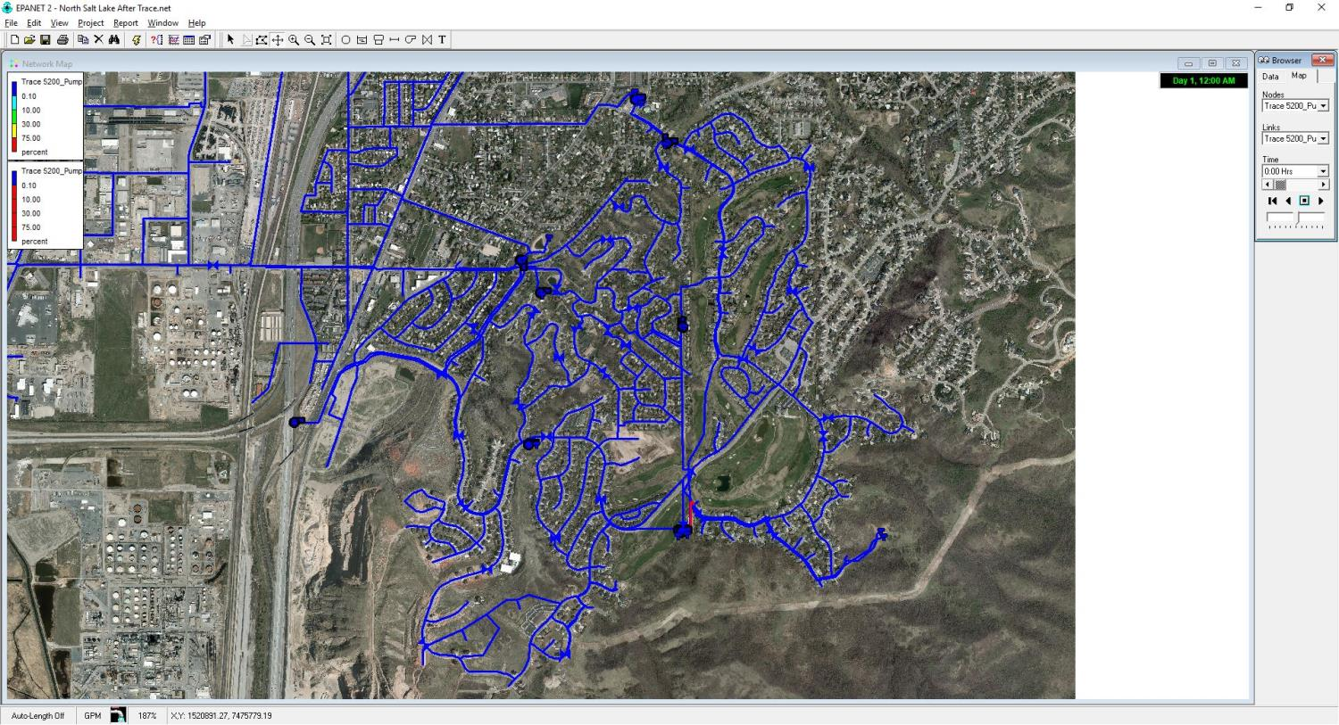
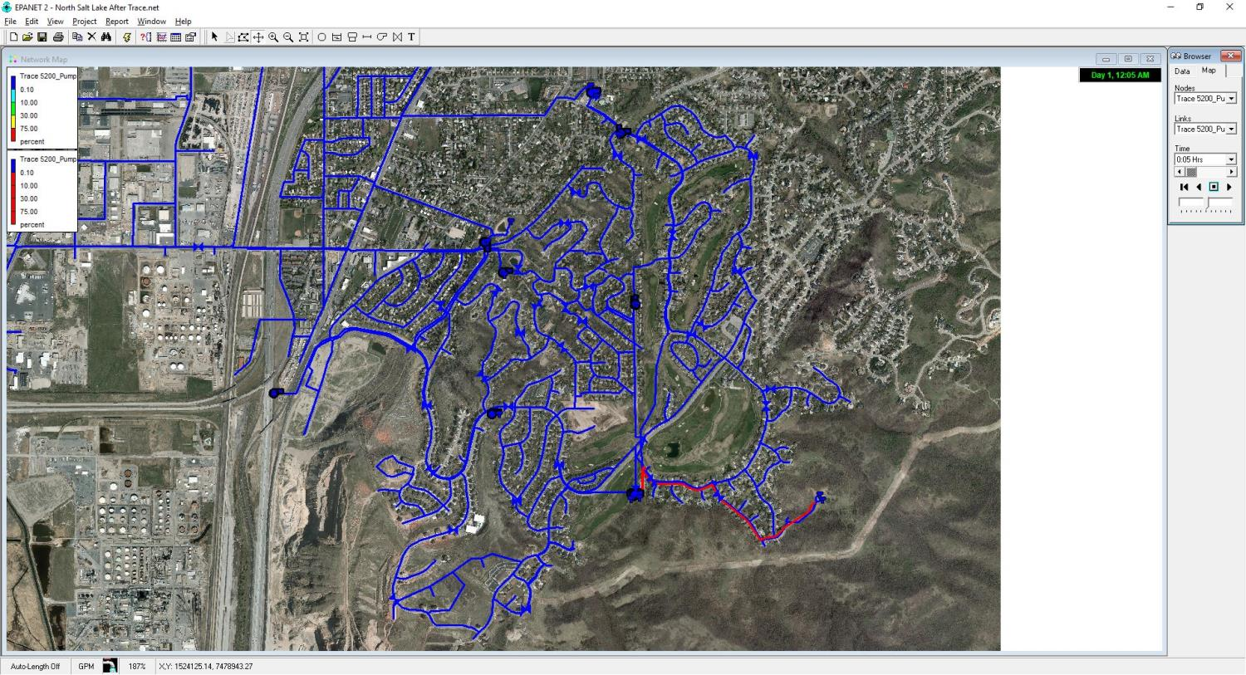
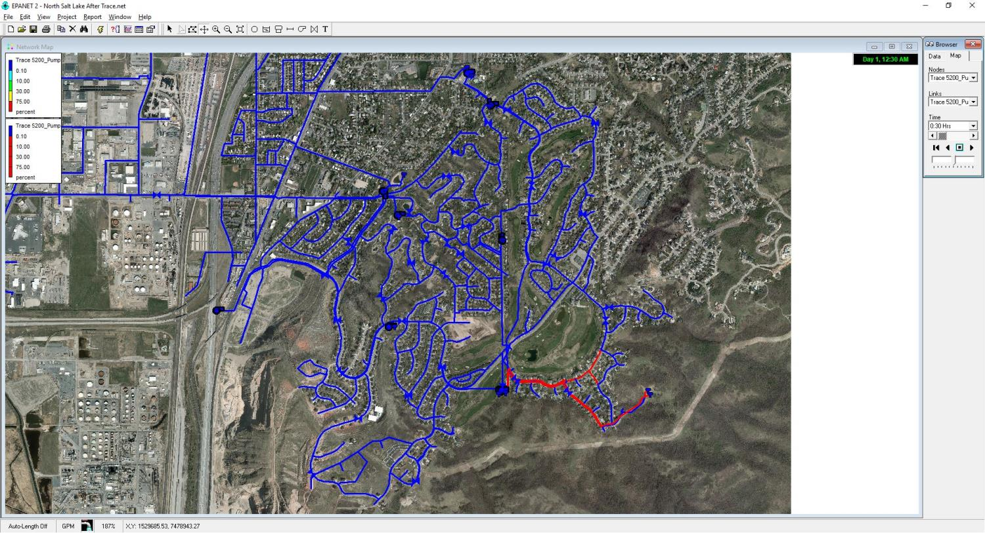
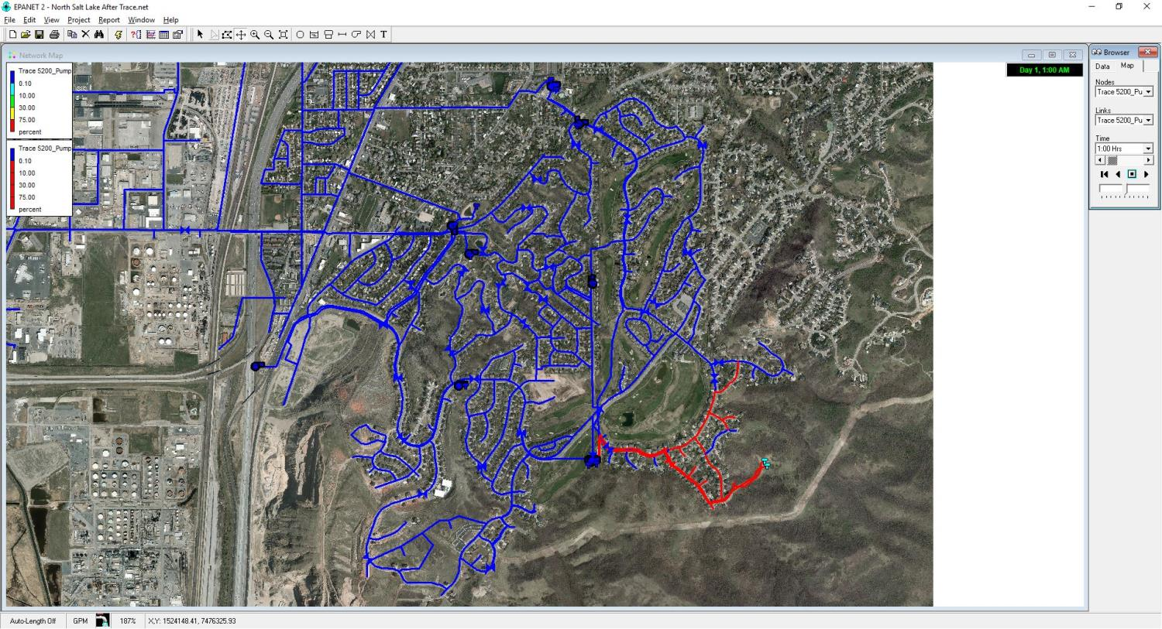

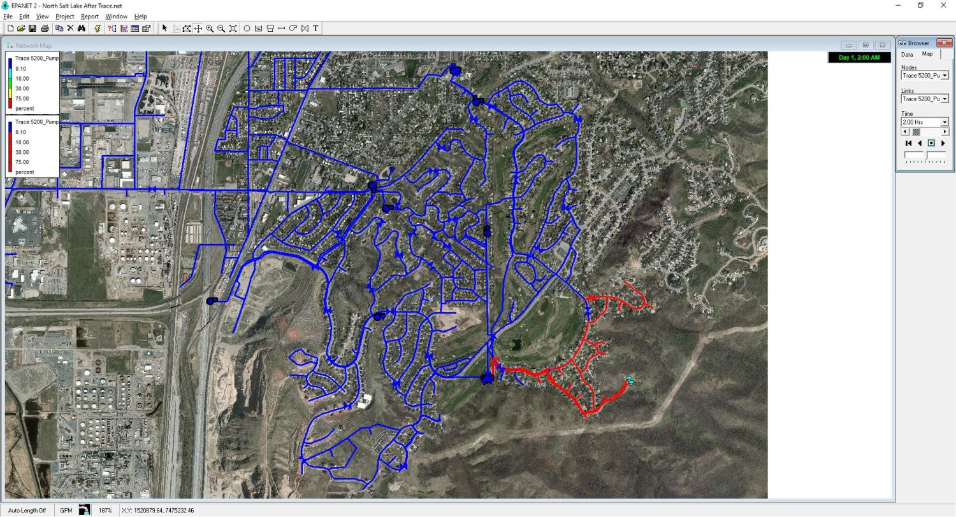
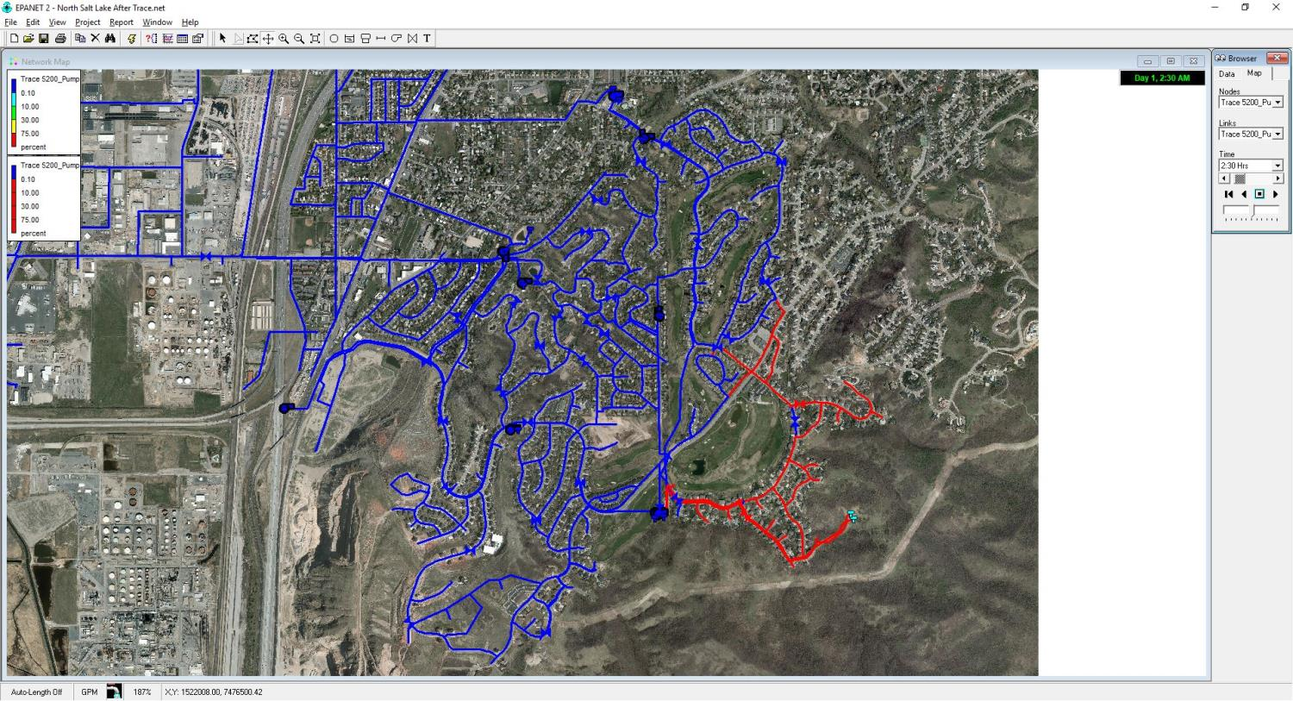
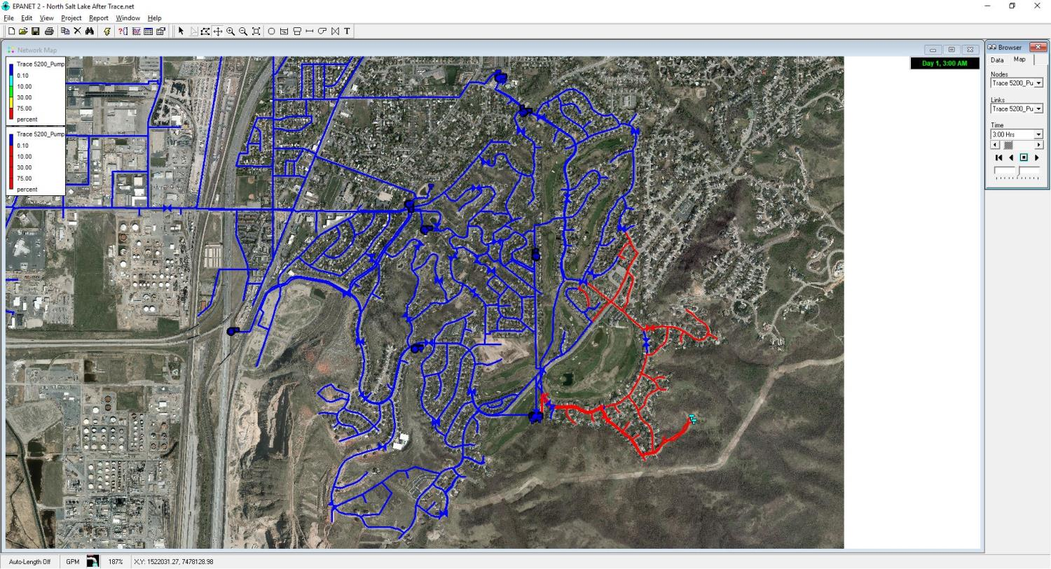




Low elevation
Pumping in Circles
AFTER
High elevation
Notes:
[Maybe cut this slide]

Slide 18
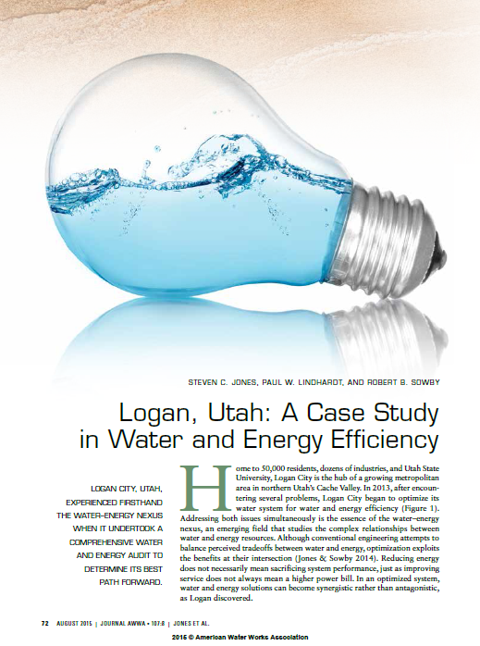
LOGAN CITY, UTAH
50,000 people
32% energy cost reduction from baseline
↓ 40%
↓ 17%
↓ 32%

Slide 19
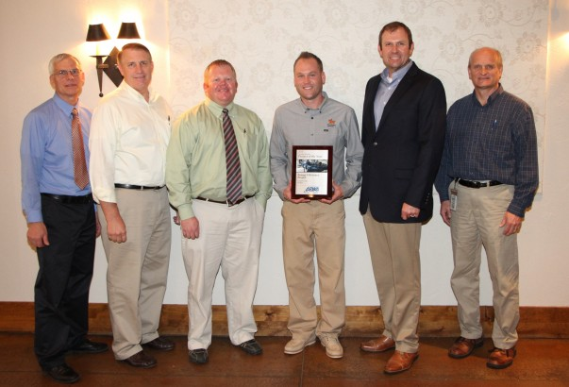
The savings and operational efficiency have continued each year since 2013. … If the current savings continue, the payback period for this project will be shorter than projected.
—Paul Lindhardt, W/WW Manager
Notes:
[Maybe cut this slide]

Slide 20
The Nexus
Energy for Water
(pumping, treatment, water heating, wastewater)
WATER
ENERGY
Water for Energy
(thermoelectric cooling, steam, hydropower)

Slide 21
Water conservation is energy conservation

