Slide 1
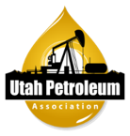
Utah’s Liquid Fuels Landscape
Rikki Hrenko-Browning
President, Utah Petroleum Association (UPA)
Rhrenko-browning@utahpetroleum.org
Notes:
advance the responsible development of Utah’s natural resources and manufacture of fuels that drive Utah’s economy.

Slide 2
Utah Liquid Fuels Landscape
Agenda
Introductions
Value chain basics: from well head to gas station
Utah's unique waxy crude
Background on Utah refineries
Depart for tour of the Chevron and Marathon SLC refineries
Notes:
Scheduled to be back by 3:30 if not sooner

Slide 3
Value Chain Basics
Source: AFPM
Notes:
From well head to gas station
the “oil” industry is actually several different industries that work together to make the fuels and products we all depend on. The three we talk about the most are upstream, downstream and midstream.
Upstream extracts feedstocks used to produce fuels and petrochemicals
Midstream moves and stores feedstocks and finished products.
Downstream processes crude oil and natural gas into finished products

Slide 4
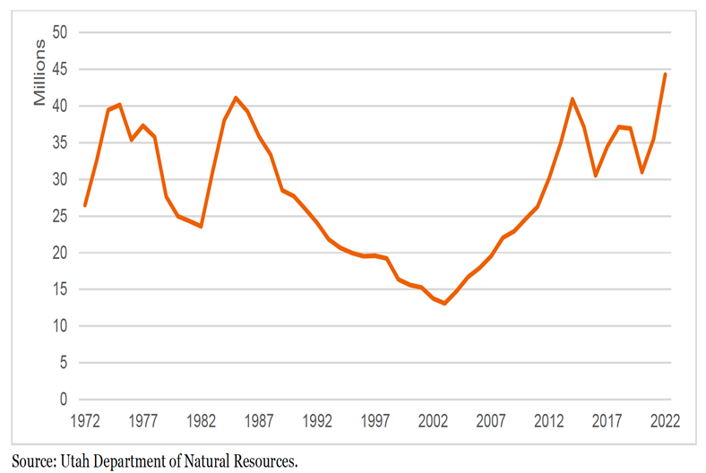
Utah's Upstream Production on the Upswing
What state did Utah overtake to become the 9th largest oil producer?
Source: Statistica, Crude Oil Production by State, 2023
10th 9th nationally for oil production
11th nationally for gas production

Slide 5
Where and How Do We Get Crude in Utah?
Crude Supply into Salt Lake Valley
Truck - Utah Waxy Crude
Pipeline (Frontier) - WY crude and West Canadian Crudes
Pipeline (CPL Rangley) – Rangely CO Crude
Major sources of crude supply are regional
Other crudes can be trucked or railed in if needed
Unique properties of local wax and condensate can make transportation challenging
Landlocked refineries do not have access to waterborne crude like the US Gulf Coast and West Coast refining hubs
Notes:
Regional crude: Rockies (WY, CO – on this map), Canadian crudes, and Uinta Basin in central Utah
Rocky Mountain – majority by pipeline; can be trucked in
Canada – by pipeline
Utah – by truck

Slide 6
New Rail Export Market is Driving Crude Growth
Notes:
Basin to SLC = 100+ miles
Basin to help = 55 miles

Slide 7
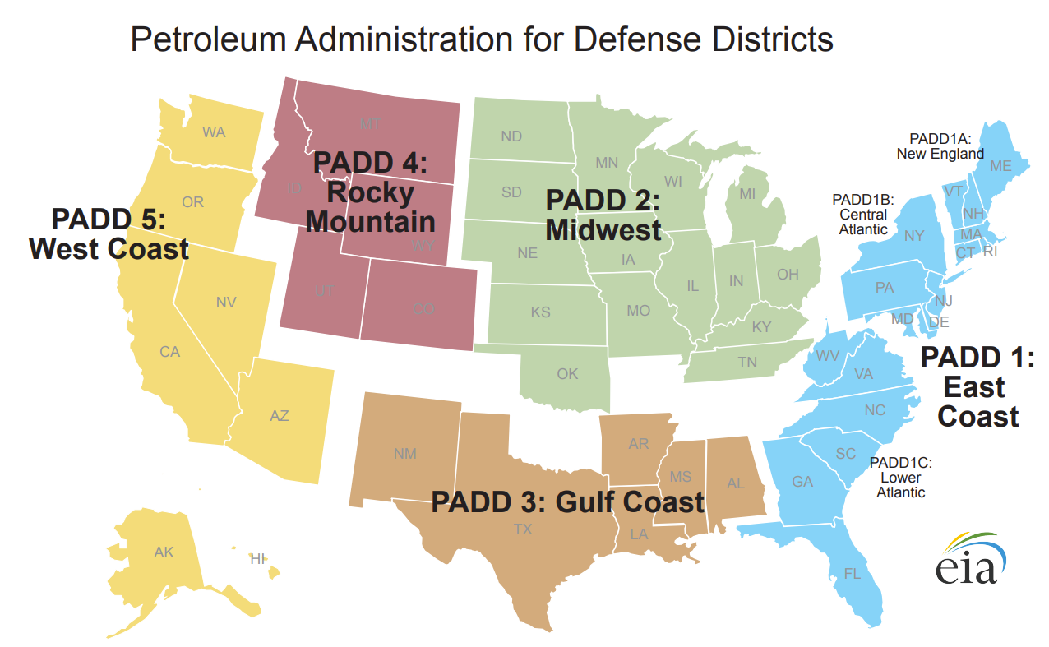
What is a PADD?
Petroleum Administration for Defense Districts (PADDs) are 5 geographic aggregations of the 50 States
During World War II the Petroleum Administration for War, used these five districts to ration gasoline
Utah is in PADD 4, but due to the Rocky Mountains and lack of pipeline connections to the east, operates regionally with markets in PADD 5.

Slide 8
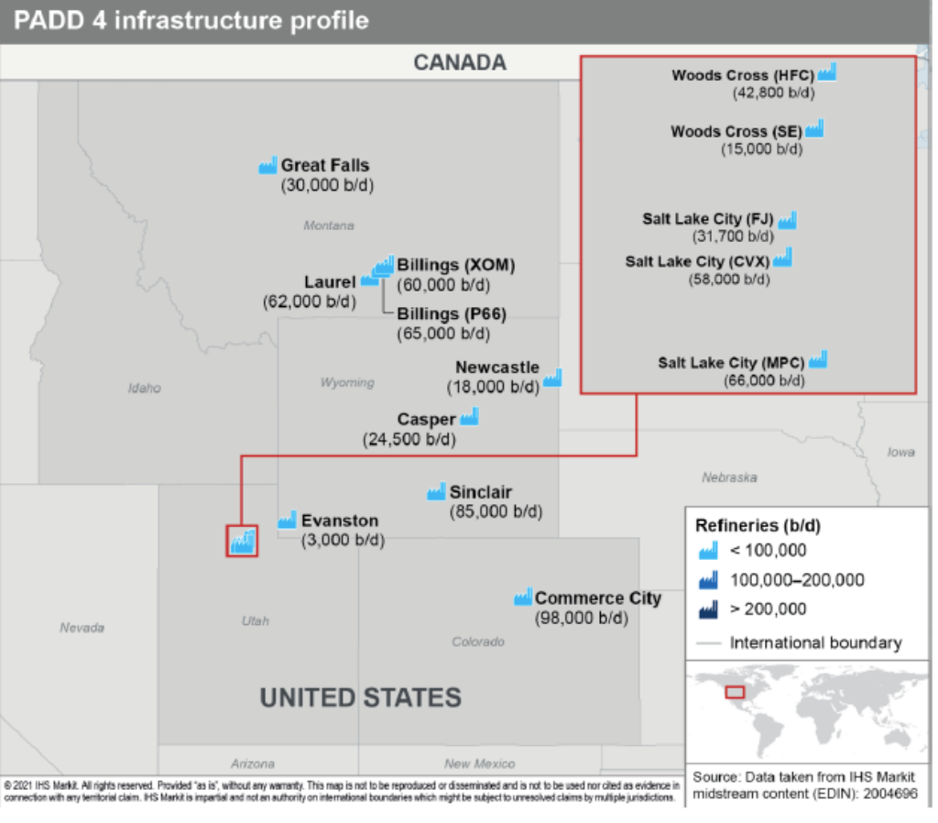
Refineries in Utah and PADD 4
Salt Lake City refineries
Marathon
Chevron
HF Sinclair
Big West
Silver Eagle
Regional Commentary
Salt Lake City, Billings, and Denver form major regional refining hubs representing ~ 70% of PADD 4 capacity
All refineries are relatively small with limited complexity (<U.S. Avg. of 144,000/day)
Fuel demand growing faster than any US region
PADD 4 enjoys the highest utilization rate
Source: IHS PADD 4 Infrastructure Profile (Oct 2021)
Notes:
PADD 4

Slide 9
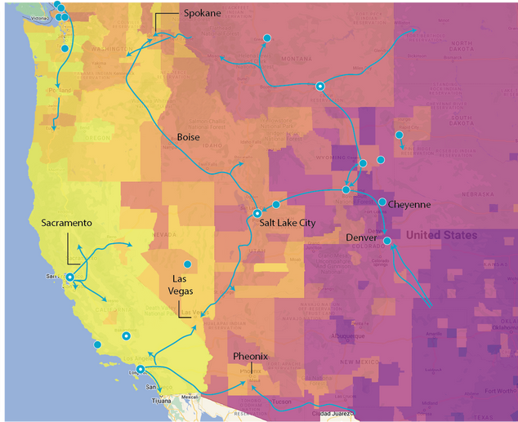
What Fuels Are Produced & Where Are They Sold?
Three main products
Gasoline
Diesel
Jet fuel
Distribution channels
Retail stations
Major airlines
Railroads
Wholesale distributors
Majority of fuel consumed in Utah is produced in Utah!
Notes:
Which products and how distributed
Gasoline: retail stations (some are company owned; some a franchise model with independent owners); unbranded (Costco model)
Diesel: travel centers, railroads, wholesalers, as well as retail stations
Jet: major airlines and wholesale distributors
Jet – only CVX and MPC produce jet here in UT; transported directly via pipeline to SLC Int’l; can also provide to other regional airports, Hill AFB, etc.

Slide 10
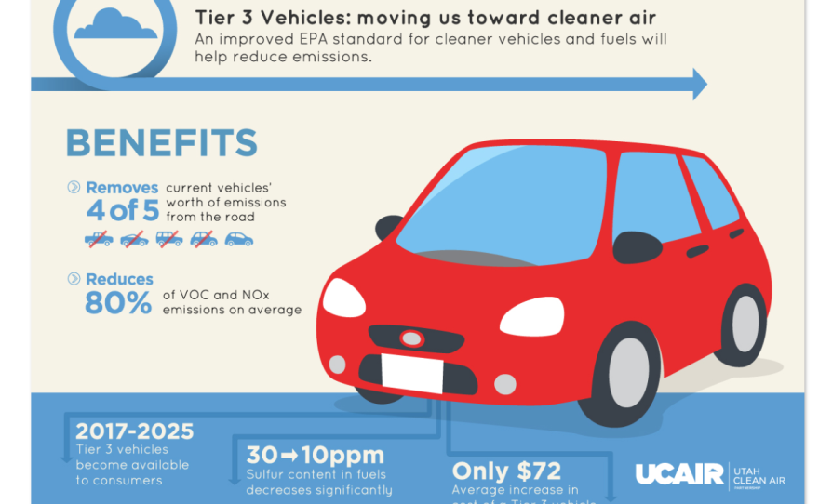
Tier 3 Fuel Investments Drive Air Quality Benefits
Tier 3 Fuel in Utah
Federal requirement and voluntary commitment in Utah
Multimillion dollar facility investments
4 of 5 refineries producing locally
Tier 3 Fuel supplied to most retail stations in Utah
Notes:
Inside the fenceline, Chevron has reduced their emissions by almost 90% since the 1990s. Similar for Marathon, almost 90% since 1993.
Of the emission sources impacting local air quality, the 5 refineries are a very small part, only a few %.

Slide 11
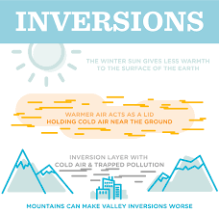

Slide 12
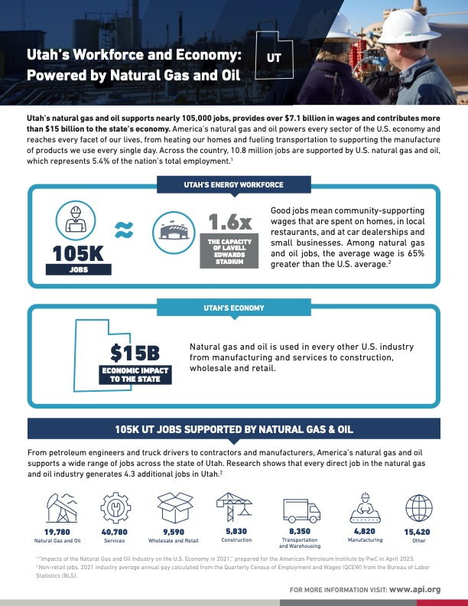
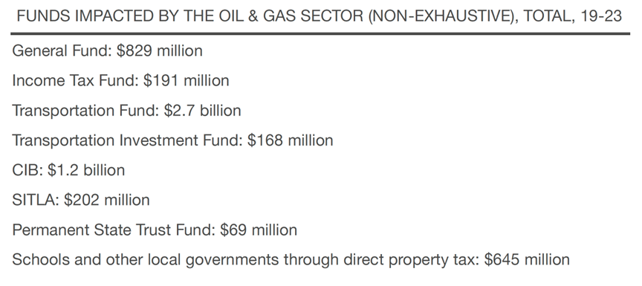
Schools, Public Safety, Roads, and Much More!
Utah’s Oil and Gas Industry has provided $5.5 billion from FY2019-FY2023
Notes:
Severance tax goes to
-tribal distributions
-permanent state trust fund (infra and econ diversification account)
-regulatory distributions
-general fund

Slide 13
Questions?
Rikki Hrenko-Browning
President, Utah Petroleum Association (UPA)
Rhrenko-browning@utahpetroleum.org

Slide 14
appendix

Slide 15
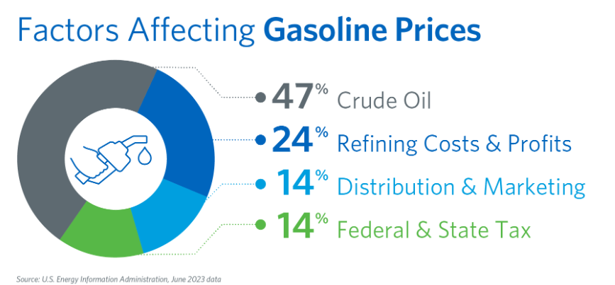
Infographic source: AFPM

Slide 16
Refining Process
Refining processes defined by:
Heating (and cooling)
Adding pressure
Adding Catalyst
Main refining processes include:
Separation (distillation)
Conversion of molecules
Treatment to remove impurities
Blending
Source: AFPM
Notes:
Like a gigantic chemistry set – main actions are heating (and cooling) of liquids, pressurizing liquids, and adding catalyst to encourage chemical reaction.
Main processes are:
Separation
Crude oil is heated in furnaces and separated into liquids and vapors in distillation units. The liquids and vapors are separated into fractions based on their weight and boiling point.
Conversion
The fractions from distillation are transformed into streams that become finished products. This involves breaking up long hydrocarbon molecules into smaller, more useful molecules.
Treatment
The final touches are applied to the products. This includes removing contaminants like sulfur, nitrogen, and heavy metals.
Blending
Various streams are blended into finished petroleum products. For example, refineries combine gasoline blending components and ethanol to make retail gasoline

