Slide 1
Energy Council
Jaclyn Presnal, Vice President New Energy Ventures
December 2024

Slide 2
Growing Electricity Demand Requires Additional Generation
Electrification of heating and transport, powering data centers for the AI-driven future will create growth in power demand not seen in past two decades
U.S. Net On-Grid Power Demand
Electricity demand experiencing
3x
faster growth per year
this decade vs. prior decade driven by EV growth and emergence of large load data centers
Source: S&P Global Commodity Insights © 2024.
Notes:
Market Intelligence Punchy Facts:
Electricity demand is projected to grow by 1% per year through 2030 — fueled, in part, by datacenters and other large loads (datacenters, manufacturing and industrial facilities, electrification of oil and gas operations and cryptocurrency mining facilities)
By 2030, incremental demand growth attributed to large loads nears 150 TWh — equivalent to NYISO annual demand in 2023
The pace of growth in electricity usage accelerates further as electrification intensifies in the 2030s, with growth averaging 1.3% per year 2030-2040 across the US Lower 48
Other Notes for Mkt Intel:
Electrification and renewables will drive higher demand for natural gas pipeline and storage capacity
Growing renewables requires reliable natural gas as firming backstop
Date source: S&P Global Planning Case, October 2023

Slide 3
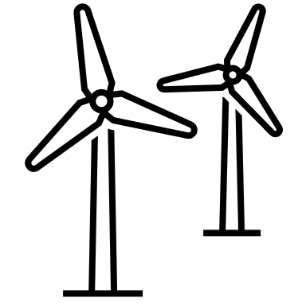
U.S. CO₂ Emissions Declined With Increased Natural Gas Generation
Natural gas increased to
39% from 18% market share
2.4B
metric tons CO₂
39%
2.0B
metric tons CO₂
U.S. Electric Power Sector: CO₂ Emissions vs. Natural Gas Market Share
Shift to natural gas directly responsible for reducing ~500 MM metric tons of CO₂ or ~60% of the total reduction
1.5B
metric tons CO₂
26%
18%
Equivalent to the CO₂ emissions saved by running
2x as many wind turbines as the U.S. has today
2005
2013
2022
Sources: U.S. Energy Information Administration (EIA), January 2024; Environmental Protection Agency (EPA) Greenhouse Gas Equivalencies Calculator.
Notes:
Market Intelligence Punchy Facts:
Replacing coal with natural gas reduced the carbon intensity of US power generation, as natural gas releases around half as much CO2 as coal per unit of energy consumed
Other Notes for Mkt Intel:
Fuel switching from coal to gas helped decreased the carbon intensity of US’ electricity generation by > 4% in 2022 vs 2021
from 392 metric tons of CO2 per GWh in 2021 to 376 metric tons of CO2 per GWh in 2022
Between January 2021 and December 2022, 25 GW of coal-fired generating capacity retired while >17 GW of new and highly efficient natural gas-fired generating capacity had been installed
Per EIA, 58% of the CO2 emissions reductions in electric power sector 2005-2021 was due to switching from coal to natural gas while 42% is attributed to renewables
There were 870 million metric tons of emissions reductions in the total US electric power sector from 2005-2022; 58 percent, or ~500 million metric tons, of this reduction is from coal to gas switching. A ~500 million metric reduction in emissions is equivalent to ~112 million gasoline-powered passenger vehicles taken off the road for one year
504,319,280 metric tons CO2
Equivalent to CO2 emissions from: 112 Million gasoline cars for one year
Equivalent to CO2 emissions from: 64 Million homes' energy use for one year
Equivalent to CO2 emissions from: 98 Million homes' electricity use for one year
Equivalent to CO2 emissions from: 3 Million railcars' worth of coal burned
Equivalent to CO2 emissions from: 1 Billion barrels of oil consumed
Equivalent to CO2 avoided by running: 140 thousand wind turbines for a year or ~twice the amount of wind turbines in the US
(as of Jan-2022 there were ~70,800 wind turbines in the US How many turbines are contained in the U.S. Wind Turbine Database? | U.S. Geological Survey (usgs.gov) )
Equivalent to CO2 avoided by switching: 19 Billion incandescent lightbulbs to LEDs
Equivalent to CO2 sequestered by planting & growing: 8 Billion tree seedlings for 10 years
Equivalent to CO2 sequestered by preserving & preventing conversion to cropland: 3 Million acres of US forests
Equivalent to CO2 sequestered by: 603 Million acres of US forests for one year

Slide 4
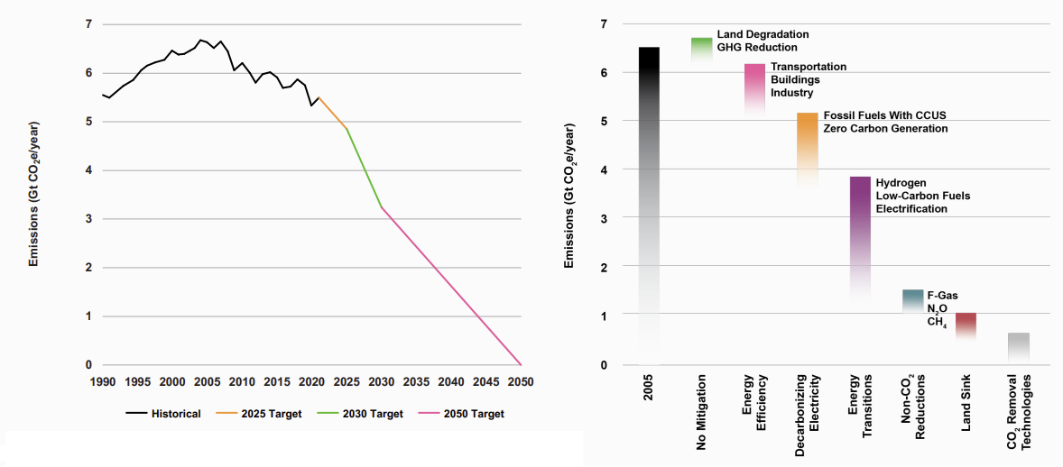
U.S. Net Zero Requires “All of the Above” Approach
CCUS a necessary component to achieve targets and cut ~200 million tonnes annually
Source | Enverus Intelligence® Research, United States Executive Office of the President
Notes:
The grid needs clean, firm power and gas with CCUS provides an option for low-carbon power supply
Policy expansion is putting ‘low hanging fruit’ projects (ethanol, gas processing, some blue hydrogen) in the money. Whether CCS can make the leap to much larger opportunities in heavy industry & power is one of the biggest uncertainties of the energy transition.
Amine solvents are the commercially available incumbent to beat. Emerging technologies (better amines, membranes, solid sorbents, and cryogenics) aim to solve for the high energy requirements, CAPEX intensive infrastructure, and environmental concerns of amines.
The cost of capture depends on the concentration of CO2 in the flue gas. The 45Q appears to make CCS attractive for high concentration flue gas sources, but lower concentration streams remain questionable.
‘low hanging fruit’ of CCS: i.e. industrial facilities with very high CO₂ concentration effluent (such as ethanol plants).

Slide 5
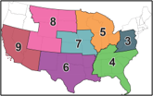
Class VI Application Momentum
Challenges and Opportunities
Despite 500+ million tonnes per annum of announced CCUS capacity, the industry has only one third of 2023 projects operational and just 4% of 2025 projects under construction due to permitting delays and carbon pricing uncertainties.
Currently, 28 states have defined pore space ownership and/or have specific CCUS policy
Texas and Louisiana lead the way with the most projects in pre-construction - 132 and 86 projects respectively
Supportive state and federal policy can pave the way for new infrastructure to support this nascent energy economy
Ready
Not Ready
Region 3
Region 4
Region 5
Region 3
Region 4
Region 5
Region 6
Region 7
Region 8
Region 6
Region 7
Region 8
Region 9
Region 9
Source | Enverus Intelligence® Research, Enverus FoundationsTM – Carbon Innovations, EPA
Notes:
CO2 transport and storage are critical to CCUS emerging as an industry. Pipelines are the most economic and viable mode of transporting carbon to geologic sinks for long-term sequestration. Saline formations are geographically abundant and the dominate storage pathway for long-term sequestration.
regulatory uncertainty and cost are key challenges to project deployment

Slide 6
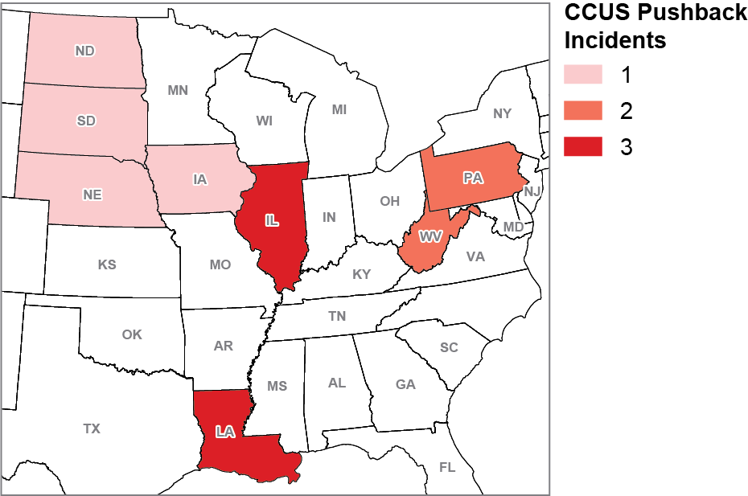
Acceleration in Permitting Challenges
CO₂ Pipelines' Biggest Concern
MVP pipeline is over $4 billion over budget and about six years behind schedule, largely because of regulatory and legal pushback from environmental groups.
PennEast natural gas pipeline is canceled after seven years of regulator pushback.
Navigator CO₂ Ventures
announces the cancellation of its Heartland Greenway Project.
CO₂ leak from XOM's pipeline near Sulphur, Louisiana, raises concerns about the safety and regulation of carbon capture infrastructure.
Keystone XL pipeline is canceled after ~10 years of legal battles and opposition.
The U.S. federal government continues to consider new CO₂ pipeline safety rules. It remains unclear when these rules might be approved.
Livingston Parish Council approves a 12-month moratorium on Class V drilling and seismic for characterization of CO₂ storage reservoirs.
South Dakota regulators deny Summit Carbon Solutions' permit application. Summit announces intentions to reapply.
Atlantic Coast natural gas pipeline is canceled after six years primarily due to environmental lawsuits.
Illinois implements safety requirements for CO₂ pipelines and imposes a temporary ban on their construction.
2020
2021
2022
Twenty Iowa counties file objections to planned CO₂ pipelines.
2023
2024
Over 30 environmental advocacy groups call for Governor Josh Shapiro to veto the bill paving the way for Pennsylvania to seek Class VI primacy.
North Dakota regulators initially deny Summit Carbon Solutions a siting permit but later grant the company's request for reconsideration.
Environmental groups file a legal challenge seeking to reverse the EPA's decision to grant Louisiana primacy over Class VI wells.
Thirteen Congress members write to President Biden requesting a moratorium on federal permitting of new CO₂ pipelines until new
safety regulations are finalized.
One Earth Energy's 7.34-mile CO₂ pipeline permit is denied.
Source | Enverus Intelligence® Research, 1) Slate, 2) CBC, 3) Utility Dive, 4) Natural Gas Intel, 5) Reuters, 6) Unfiltered with Kiran, 7) The Advocate, 8) AP News, 9) AP News, 10) Oil and Gas Journal, 11) AP News, 12) Carbon Herald, 13) The Guardian, 14) Iowa Capital Dispatch, 15) Gibson Dunn, 16) Environmental Health News, 17) UT News
Notes:
The bottom left map indicates states in which there were incidents where projects were put forth and there was pushback that prevented the projects to progress. Overall, this shows the need for federal regulation of CO2 pipelines to resolve regulatory uncertainty and clarify safety standards.

Slide 7
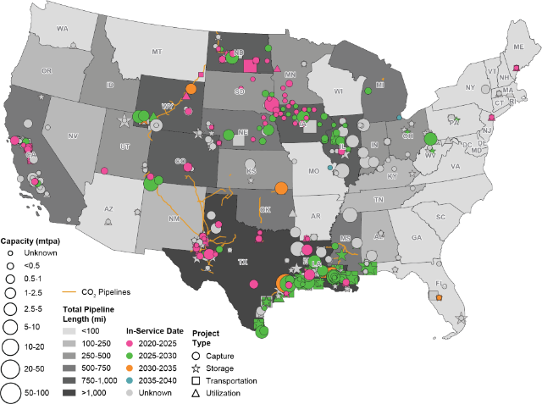
Growing Demand for CCS Midstream Solutions
Growing demand for additional midstream infrastructure to support sequestration hubs
154 applications for Class VI Well Permits under EPA review as of November 22, 20241
States can attract and enable CCS projects by supporting permit reform; including supporting the continuation of the 45Q portion of the IRA
Without the ability to obtain rights of way through a federal level process more weight is on state-enabled legislation to foster these ecosystems for long haul CO2 transportation.
Source | Enverus Intelligence® Research, Prism FoundationsTM – Carbon Innovation, Prism Infrastructure, Prism FoundationsTM, EPA
Note | Assumes announced capture projects will be connected in hub-scale networks. Accounts for existing infrastructure. Trunkline timing assumes a consistent buildout through time until 2050. Required distribution lines taken from disclosures in class VI applications. In cases where distribution lines are not disclosed an average per well was taken from applications (~2 miles per project per well) and applied to all projects.
1.) This does not include states that have their own review process due to Primacy
Notes:
Proposals for CO2 pipelines to be regulated by FERC have been raised. When we consider large scale policy framework, need to make sure they hit the mark correctly the first time.
There is a correlation between permit reform and public perception. With FERC’s oversight developers would be required to have early engagement with communities.

