Slide 1
Utah’s Strategic Energy Plan:
Consumer First Policies
Energy Council Conference

Slide 2
The Power of Energy
“The bottom 2% of Americans ALL live better than John D. Rockefeller was living when I was 6 years old. John D. Rockefeller was the richest man in the world, and today you can get better medicine, better education, better entertainment, better transportation–you can do everything better than he could.”
– Warren Buffett

Slide 3
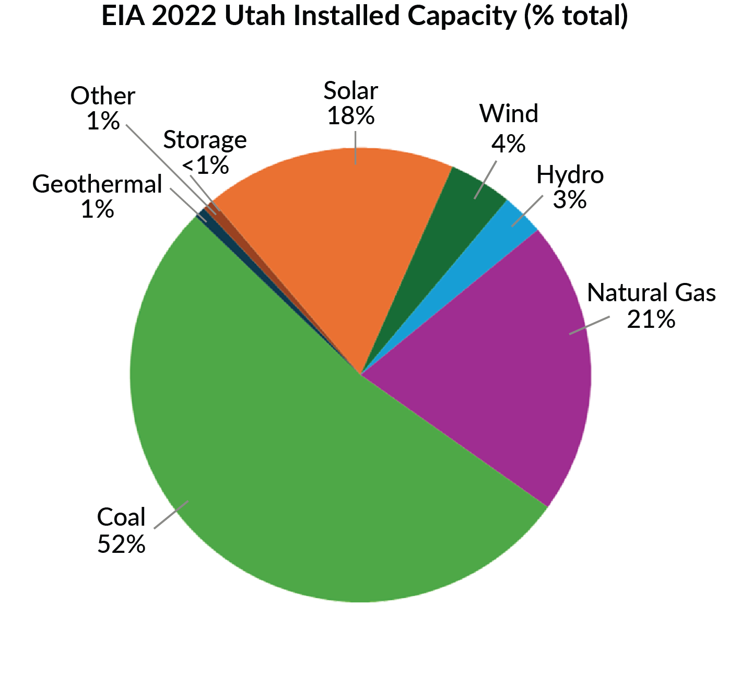
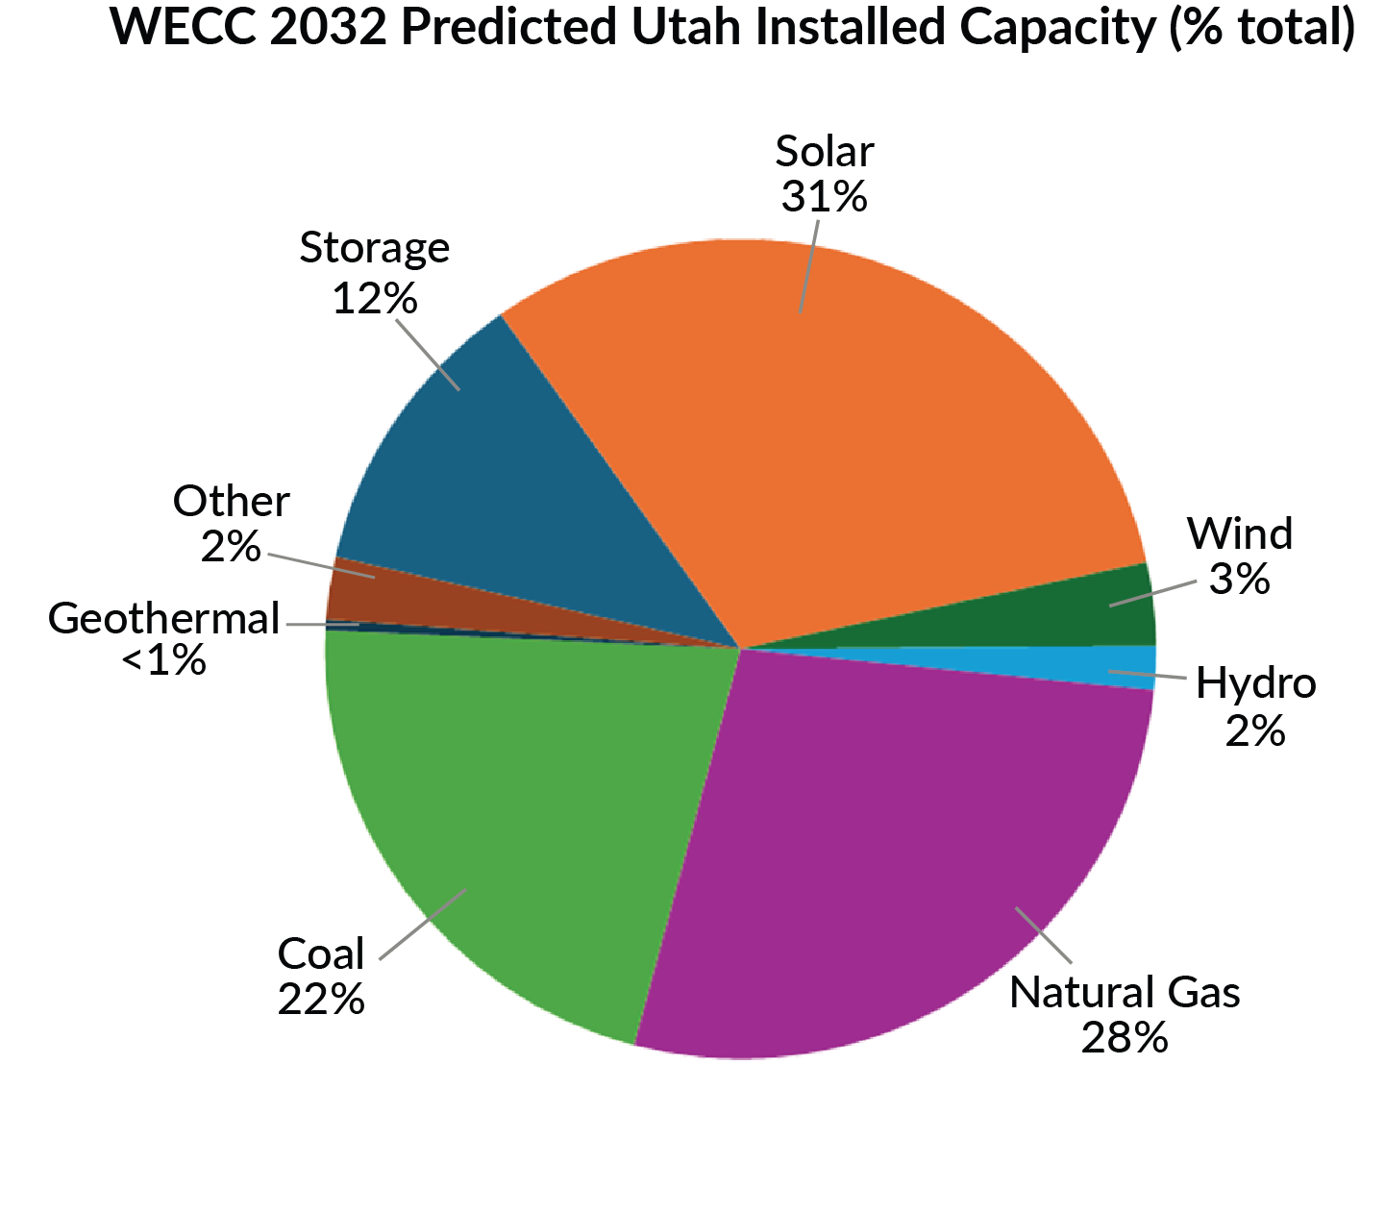
Resource Focus
Notes:
What does this tell you about the value to the consumer

Slide 4
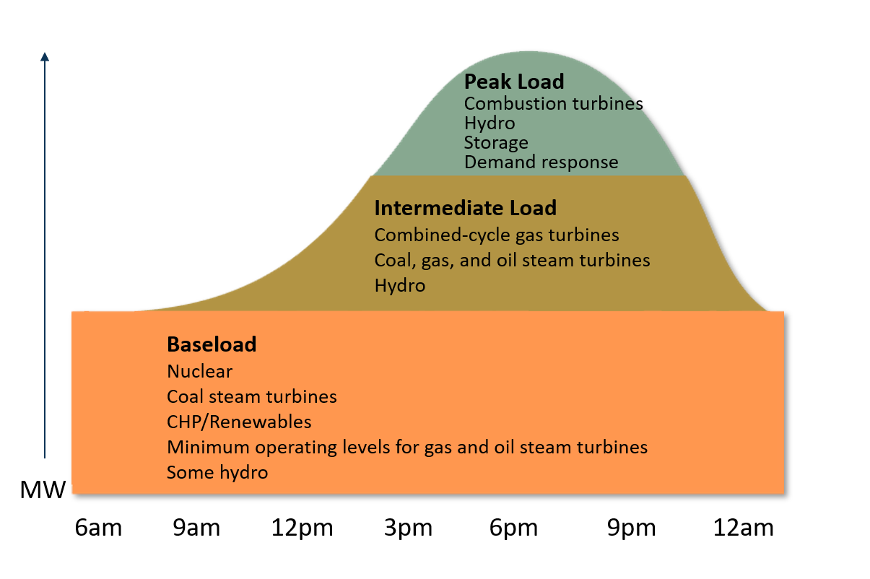
Consumer Demand & Capacity Values

Slide 5
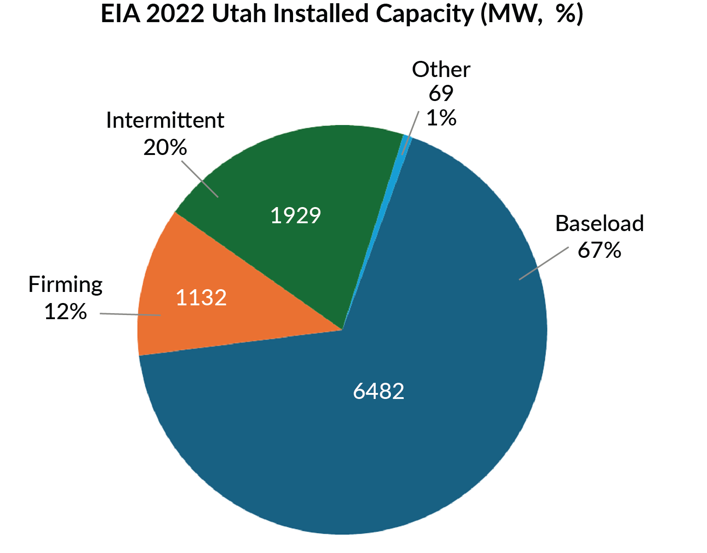
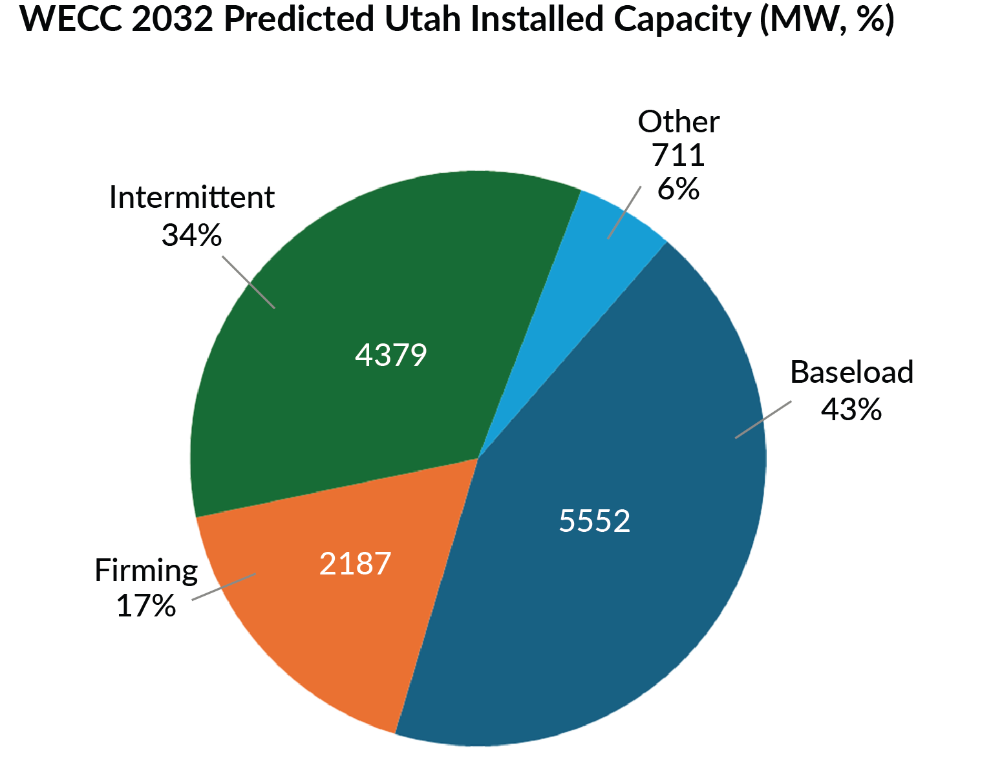
Systematic Value
*The gains in intermittent and firming resources do not cover the losses in baseload

Slide 6
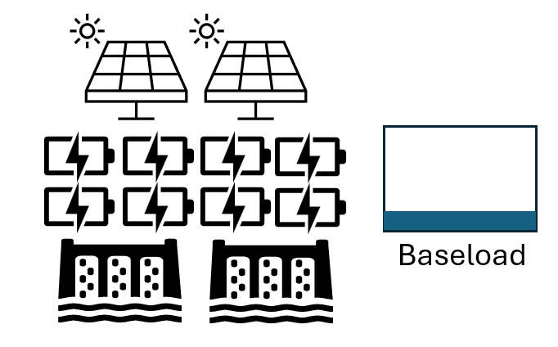
Resource Design and System Value
*The design of a resource decides how it acts within the system

Slide 7
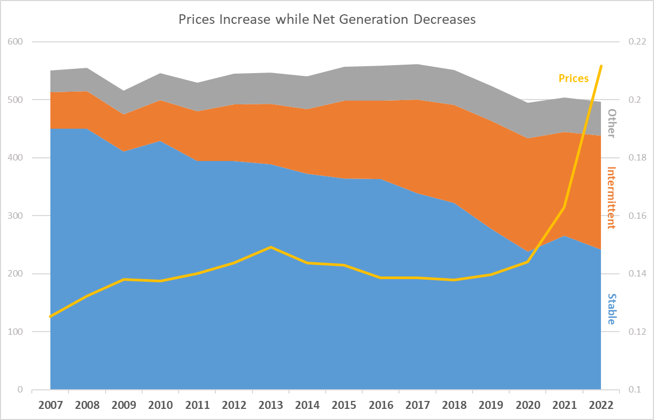
Not All “Megawatts” are the same
Is it possible to double nameplate “capacity” but produce less power?
Areas of consideration:
Misleading capacity values
Time of need value
Resource intensity to get a MW to a consumer

Slide 8
Levelized Costs
Levelized cost of energy (LCOE) is a financial tool for comparisons between diverse resources
LCOE is used to:
Average total costs of building and operating an asset per unit of electricity over a specific period
Primarily financial metric, not operation or system focused
However, it is being used to drive decisions when cost is only one factor
Demand – not accounted for
Integration – not accounted for
Systemic Operation - not accounted for
*Building the cheapest option does not necessarily
translate into savings

Slide 9
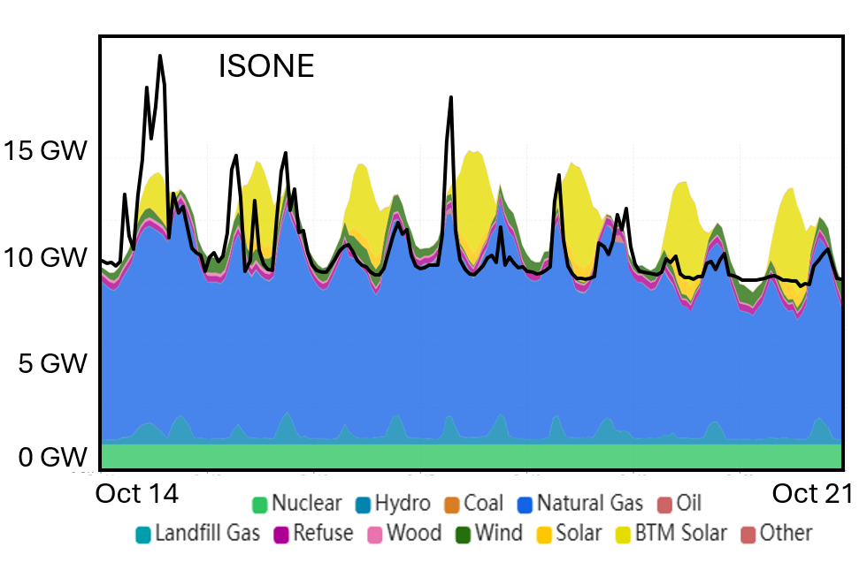
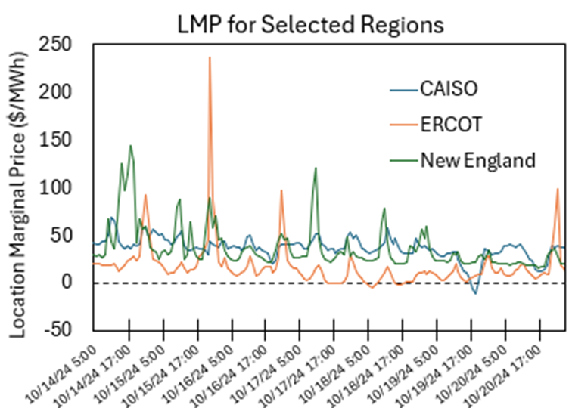
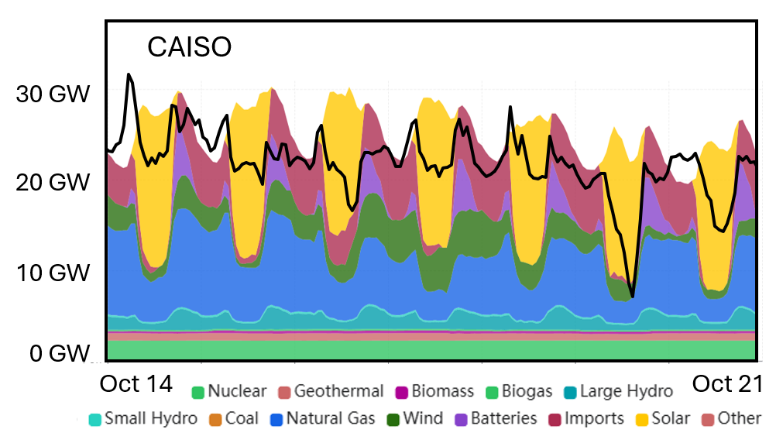
Levelized Costs - Where are the Savings?

Slide 10
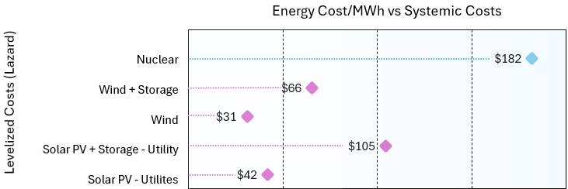
Levelized Costs

Slide 11
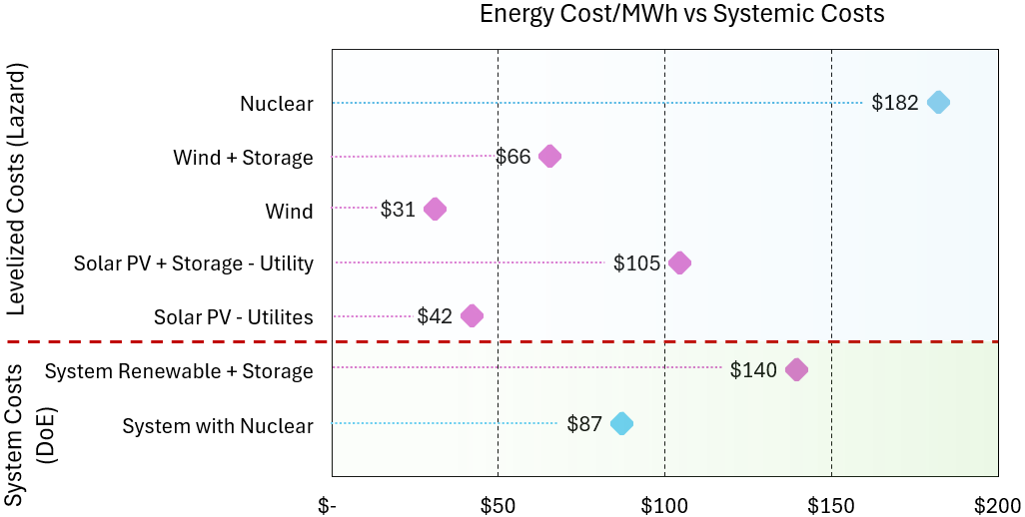

Slide 12
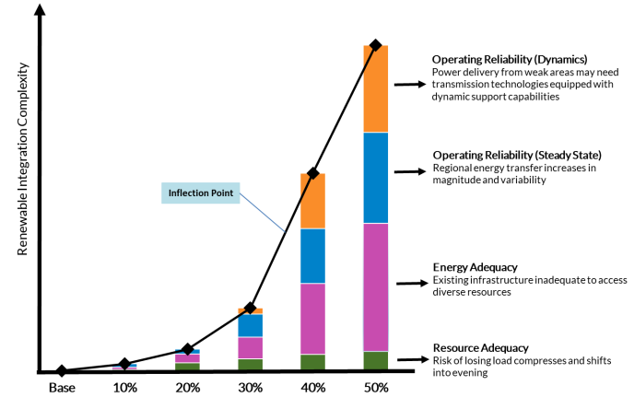
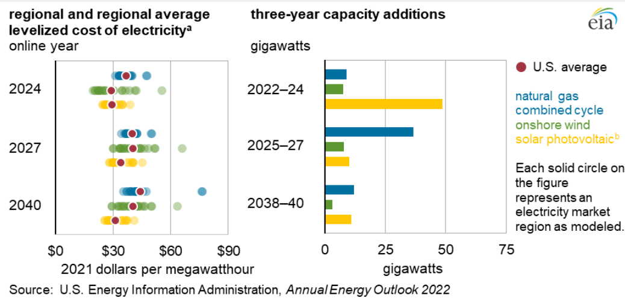
Systemic Costs - Complexity in the Grid
*Energy needs to be looked at holistically to account for the systemic costs
As intermittent generation reaches greater penetrations, huge complexity arises
This necessitates entirely new management and infrastructure needs
Considering only LCOE, in 2027 solar should be primarily built
Instead natural gas is being predicted, because it fits the systemic needs

Slide 13
Drivers of Systemic Costs
Considering the system-wide picture of energy is complex
Many parameters impact each other in unpredictable ways
Factors that impact the system:
Weather
Storage
Infrastructure
Materials
Load Profiles

Slide 14
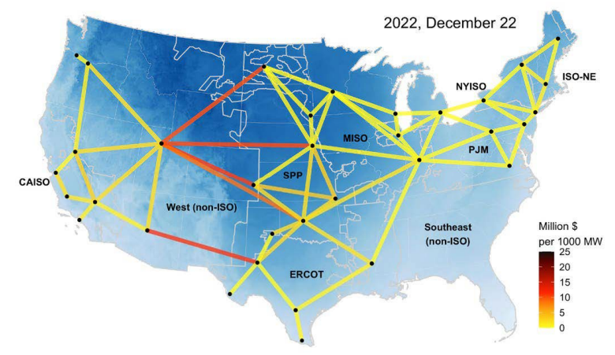
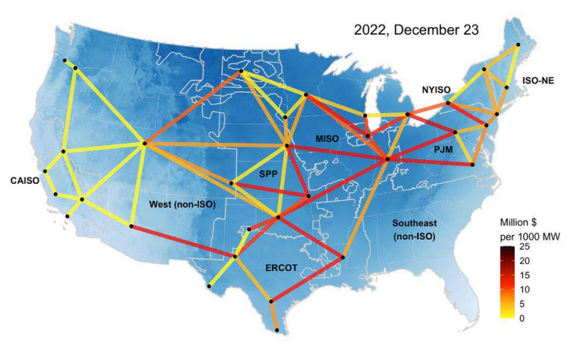
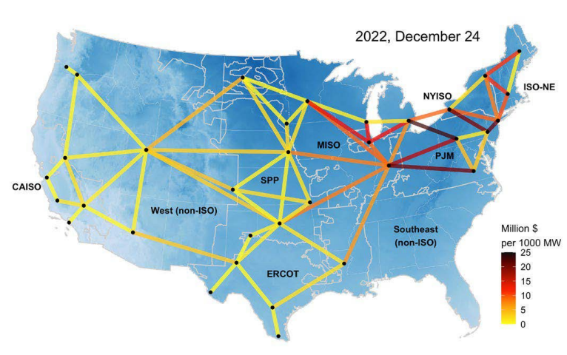
Drivers of Systemic Costs - Extreme Weather
*The larger an area the grid takes up, the more susceptible to weather
Notes:
Double punch, cuts generation while increases demand

Slide 15
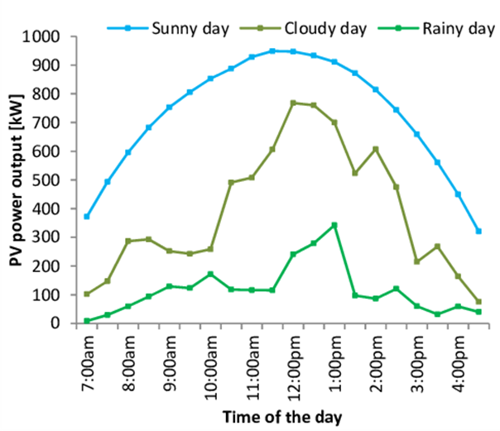
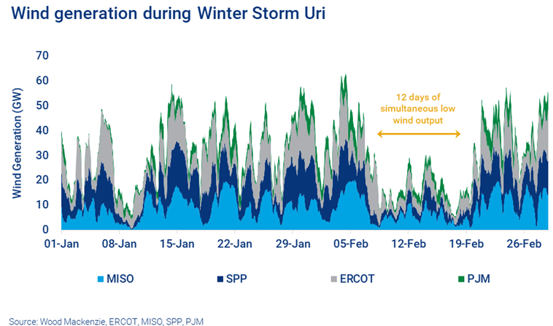
Drivers of Systemic Costs - Mild Weather
*Less extreme weather patterns are an issue as intermittent energy share increases
Requires building extra capacity, storage, or transmission

Slide 16
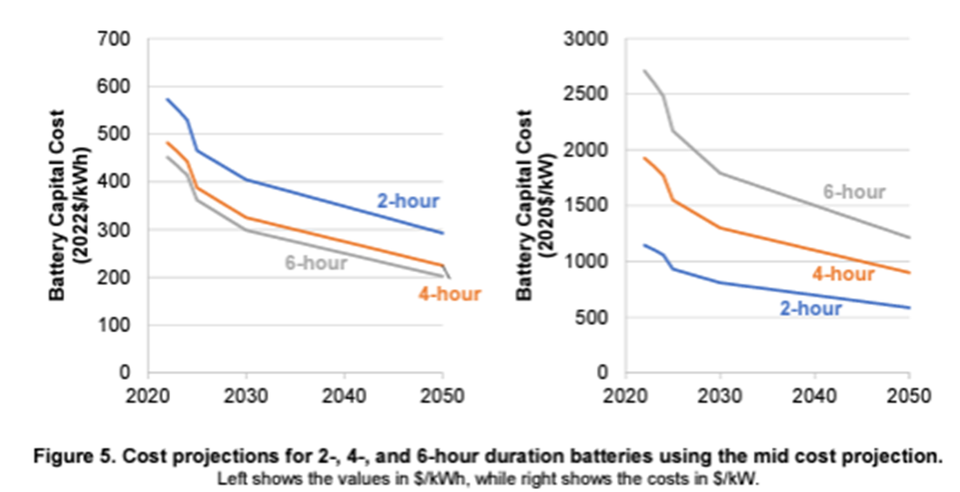
Drivers of Systemic Costs - Storage
*The type of storage used matters as well
Of the 15.8 GW of storage in the USA (2023), 10.5 GW, 66%, was primarily used for arbitrage

Slide 17
Drivers of Systemic Costs - Infrastructure
*Energy density of resources also equates to land use and transmission

Slide 18
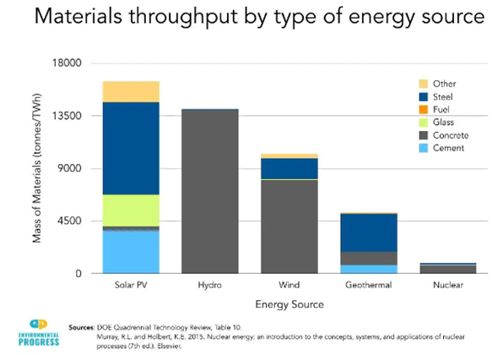
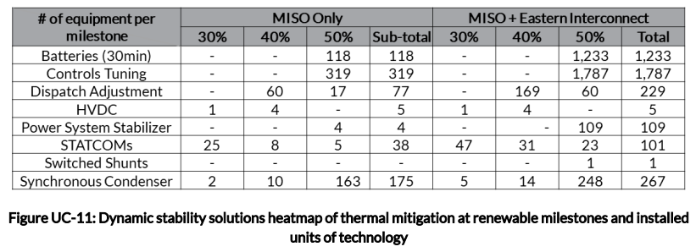
Drivers of Systemic Costs - Materials
*The various generators have vastly different material requirements
Not limited to critical elements, base material costs vary substantially
Increasing variable penetration also requires grid components
Cascading system costs arise that the generators typically don’t own

Slide 19
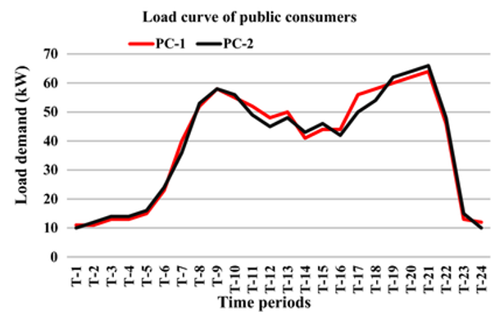
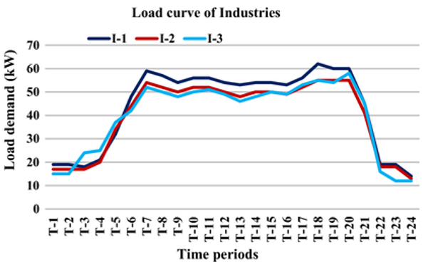
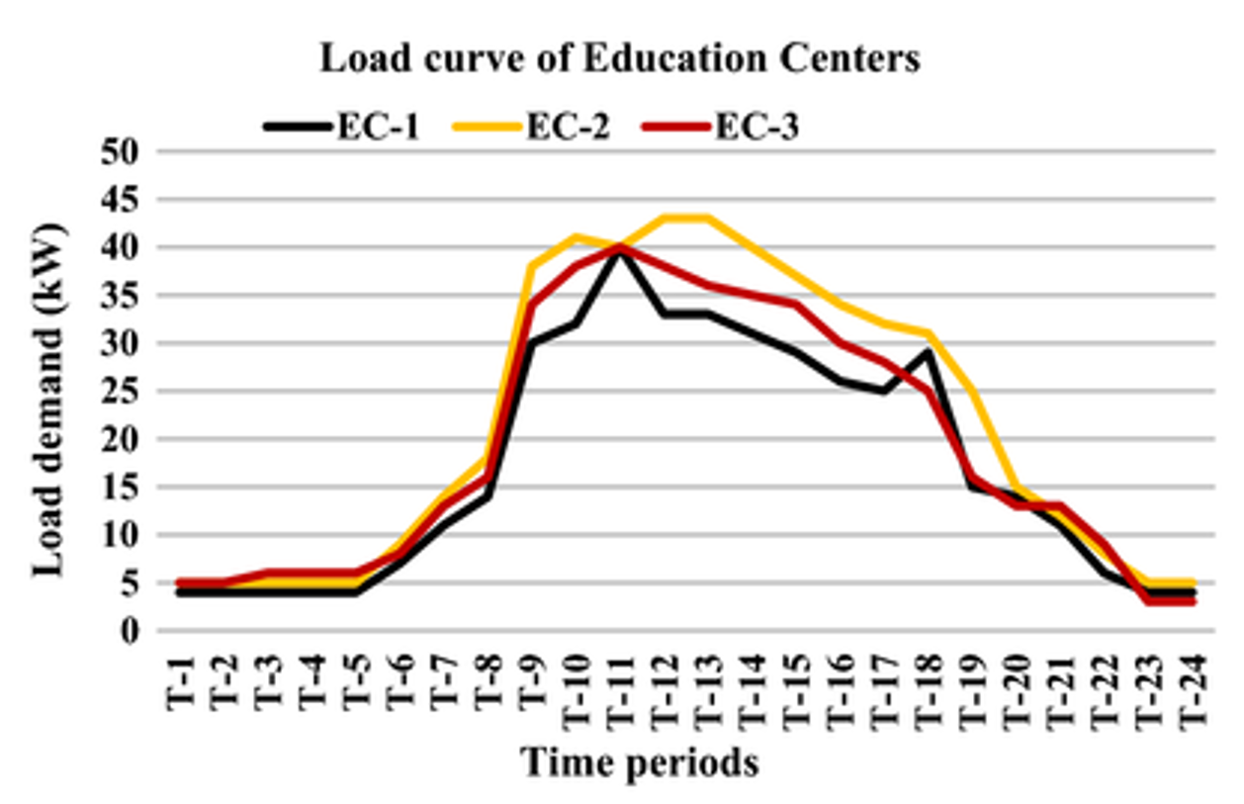
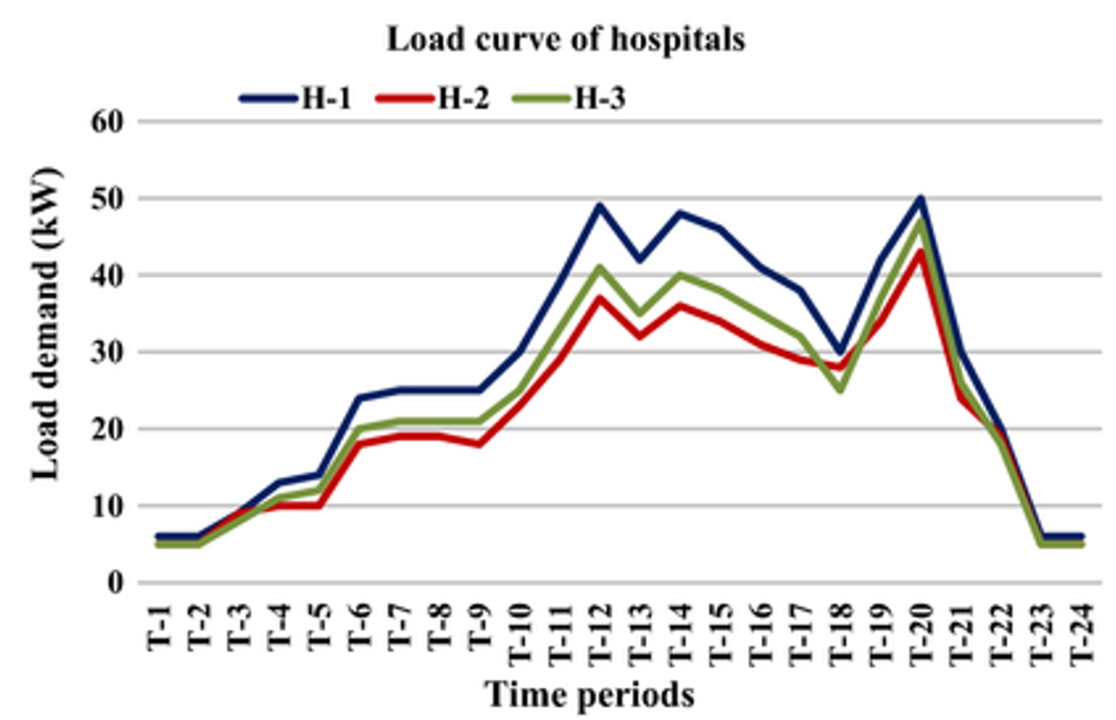
Drivers of Systemic Costs - Load Profiles
*Mismatch between demand and generation is the heart of the intermittent challenge

Slide 20
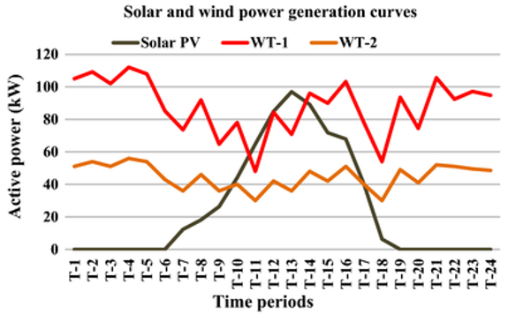
Drivers of Systemic Costs - Load Profiles with Consumer Demand

Slide 21
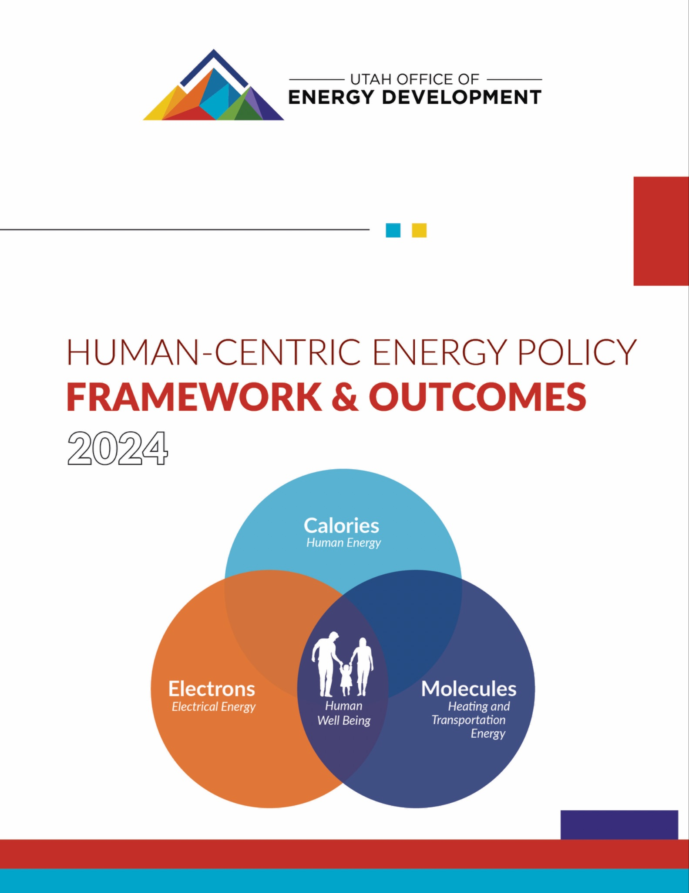
Principle vs Preference Strategies

Slide 22
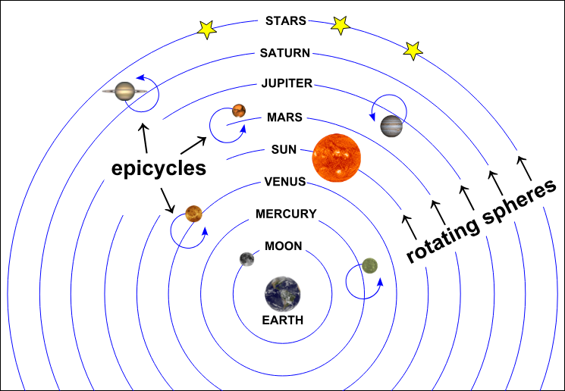
Starting with the correct foundation is critical

Slide 23
Energy the Utah Way: Consumer-First Policies
“Utah will develop its energy resources and plan its energy future with a focus on human well-being and quality of life, recognizing that reliable access to energy is vital for human health, adaptation, economic growth, and prosperity” - Utah State Code 79-6-301 (1)(a)(i)
Seven attributes (in priority order)
Adequate
Reliable
Dispatchable
Affordable
Sustainable
Secure
Clean

Slide 24
Truing Market and Consumer Impact
Market Truing:
Correcting Market signals to align with impact and value to the consumers. e.g. move from energy only market to a capacity type of market.
Enhance System Reliability: Set performance standards and require resources to meet the standard. Ensuring that any changes to the utility's asset portfolio do not compromise the reliability and affordability of the electric service, especially during times of peak demand. Maximizing value not necessarily production.
Promote Accountability: Hold utilities accountable for their investment decisions by requiring evidence demonstrating the efficacy and reliability of new asset designs and how they systematically meet consumers' needs in a reliable and affordable manner. Strengthen the front end by enhancing the Integrated Resource Planning (IRP) review process, giving it as much emphasis as we do rate cases.
Facilitate Transparent Decision-Making: Mandate detailed disclosures and evaluations in rate adjustment applications based on metrics that align with consumer value and impact, enabling better regulatory oversight and informed decision-making by the commission.

Slide 25
Thank you!

