Slide 1
Energy and Water Needs of the Coming Digital Age
December 7, 2024
Global Energy and Environmental Issues Conference
Emy Lesofski | Director, Energy Advisor to the Gov.
Utah Office of Energy Development

Slide 2
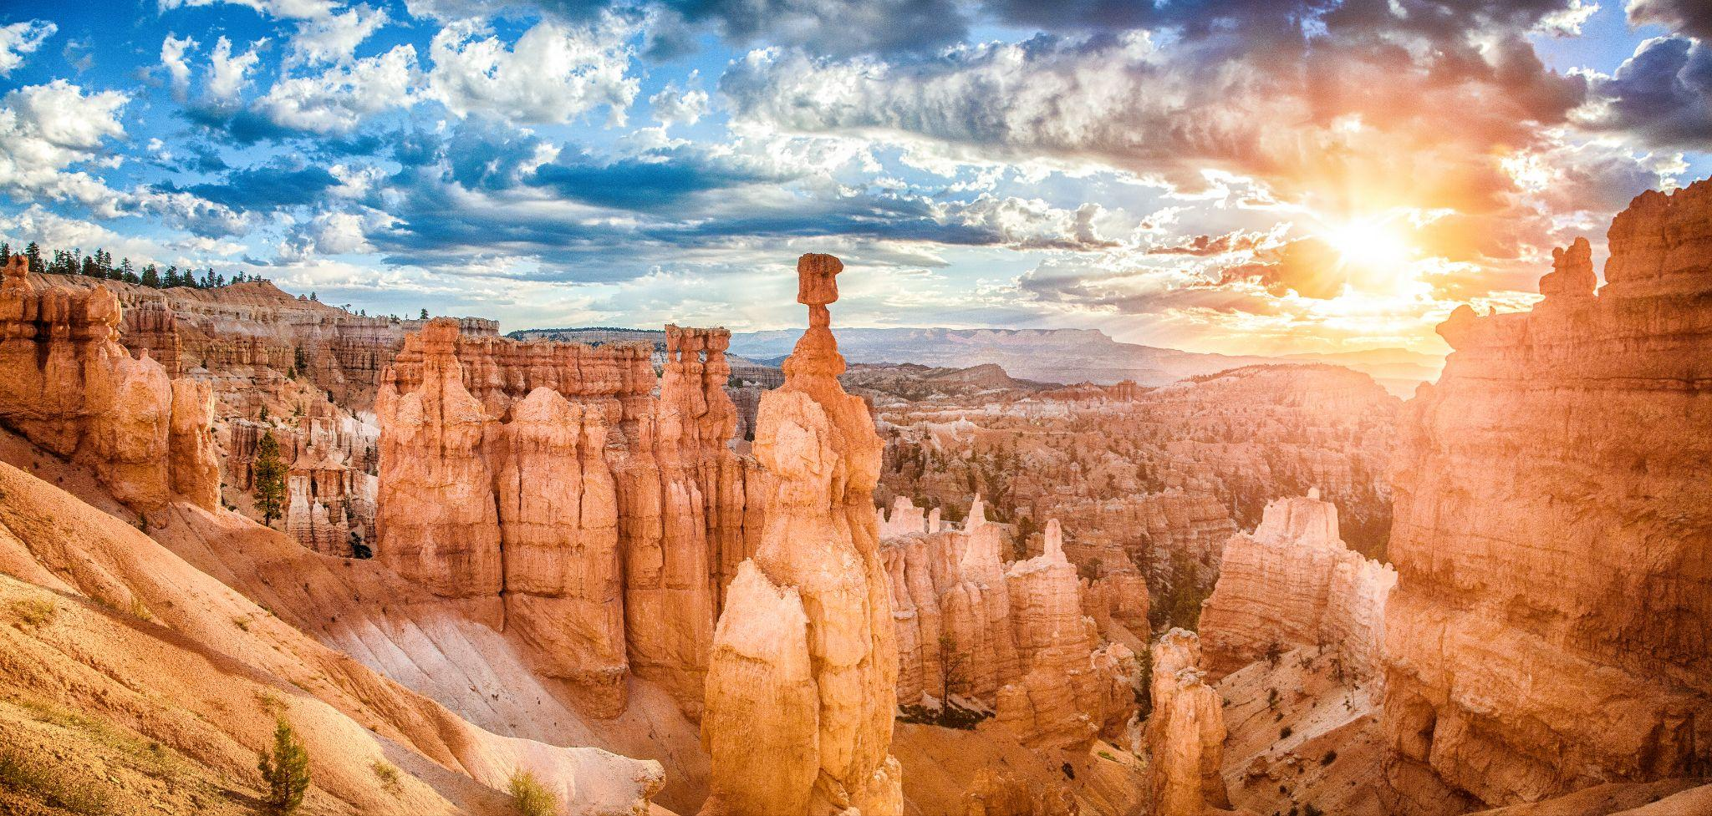
Balancing competing demands

Slide 3
Water consumption and energy resources
The figure on the left shows water consumption by energy resource in gallon/MW hour.
*Modified from University of Utah Energy and Geosciences Institute. Water for Power Study (2023).

Slide 4
Water impacts our work as we manage and protect Utah’s natural resources
Enhancing water certainty and security
Improving the health and resilience of our lands, resources, watersheds and wildlife
Advancing the stewardship of our public lands and natural history
Elevating outdoor recreation
Expanding Utah’s energy and minerals portfolio

Slide 5
Digital age
Internet
Artificial intelligence
Cloud computing
Data centers
Air cooling vs liquid cooling

Slide 6
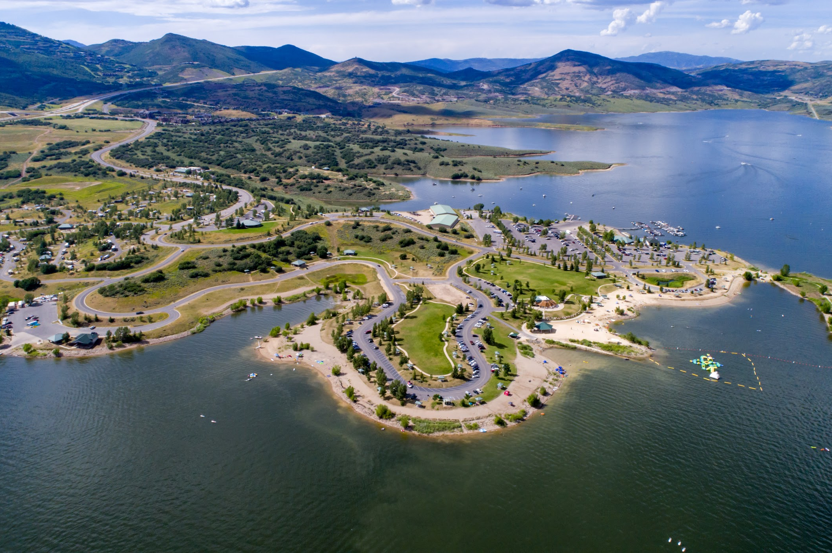
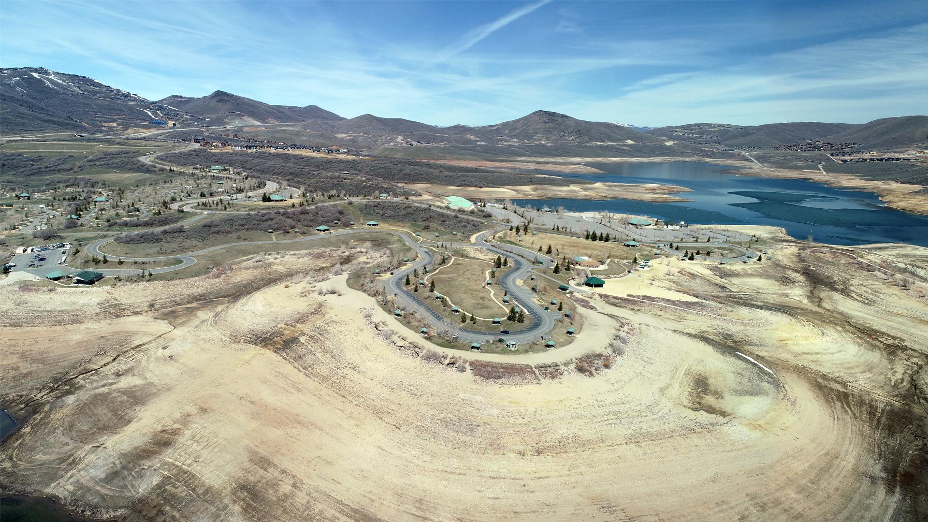
95% of Utah’s water supply comes from snowpack
Jordanelle (2024, 2023)
Jordanelle 2022

Slide 7
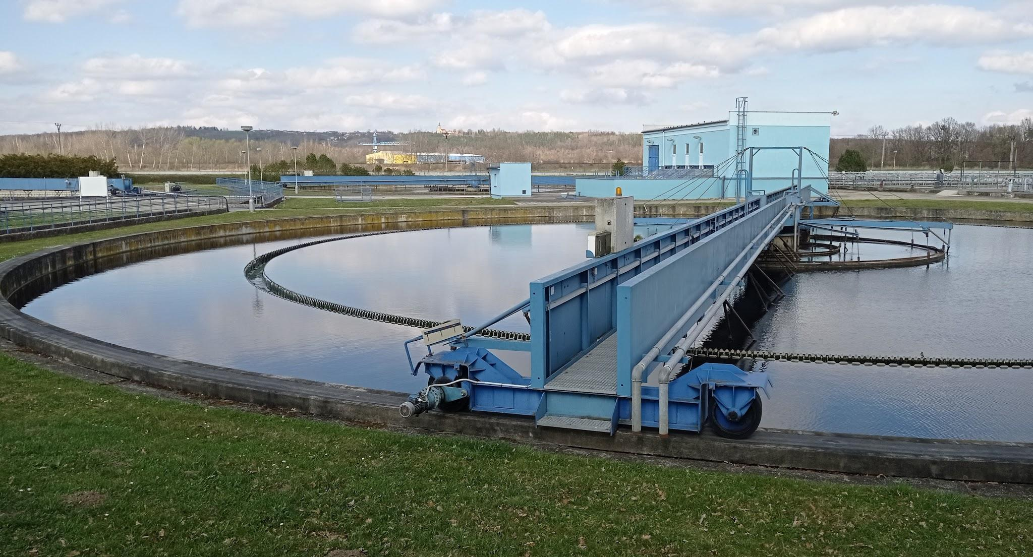
Energy efficiencies
More energy efficient buildings
Retrofits
Water resource recovery
Tax credits and rebates
*Technologies
Closed-loop systems
Steam capture
2023
2022

Slide 8
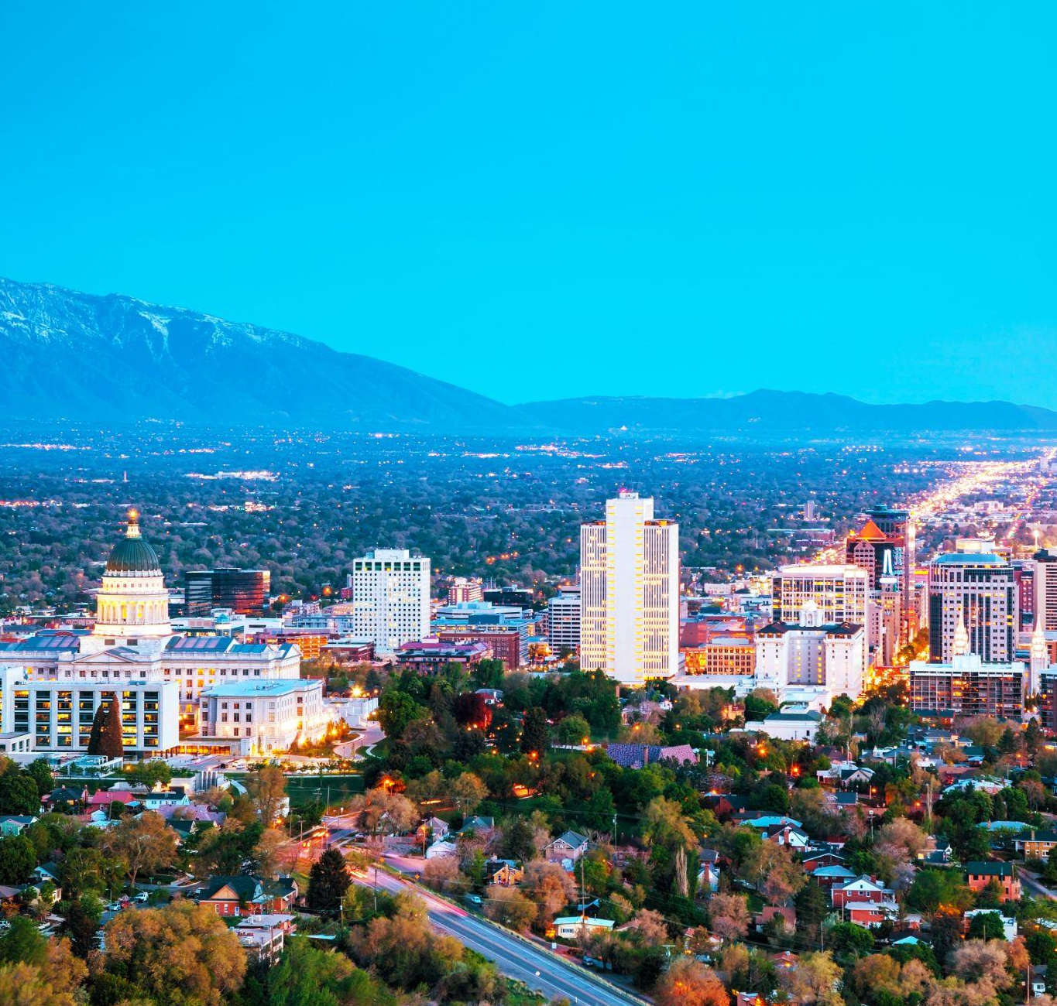
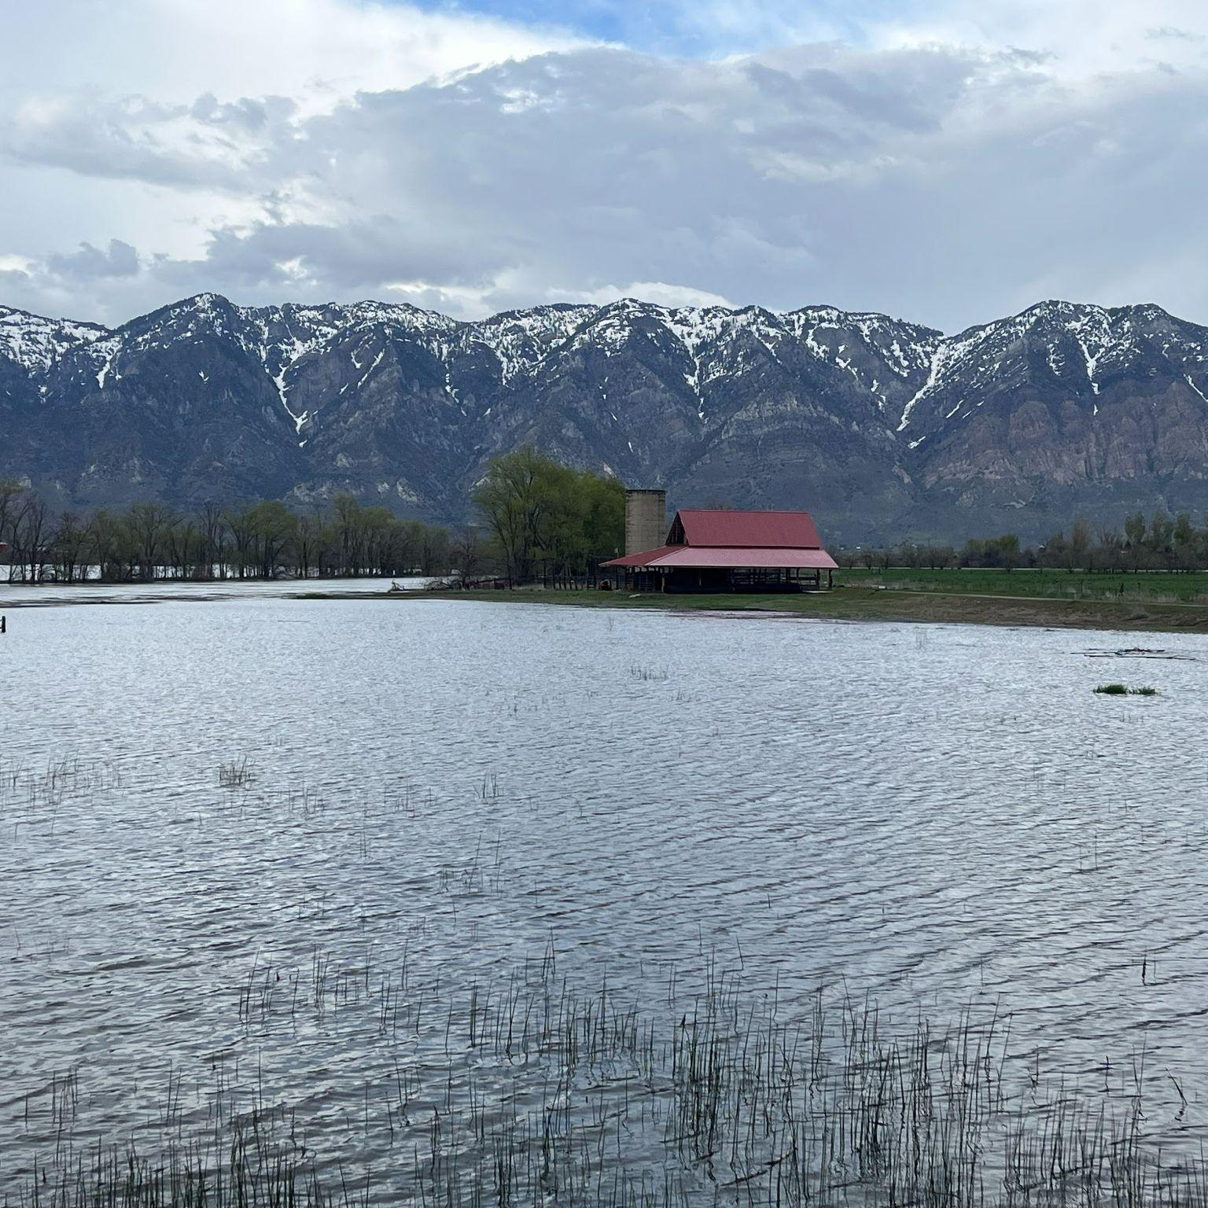
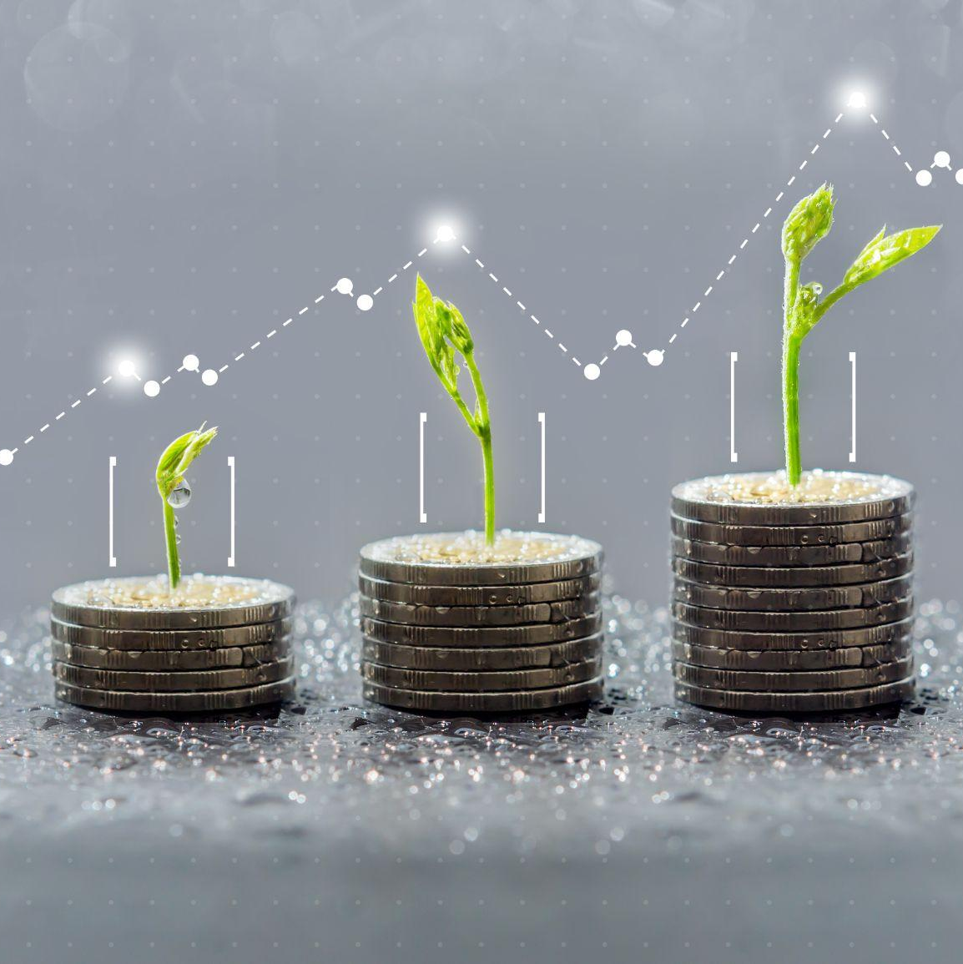
Risks
Growth
Drought
Complacency
Funding &
Competing Interests
Utah is consistently one of the fastest-growing states in the nation, and that means more water and more energy needs
Utah is either in drought or preparing for the next one, and that impacts our water supply, which, in turn, impacts mining and energy development
One good water year doesn’t mean all is well – we always need to be efficient with our water use and mindful of both energy needs and development
Agriculture
Environment / Wetlands
Municipal & Industrial
Power generation
Mining / Mineral Extraction

Slide 9
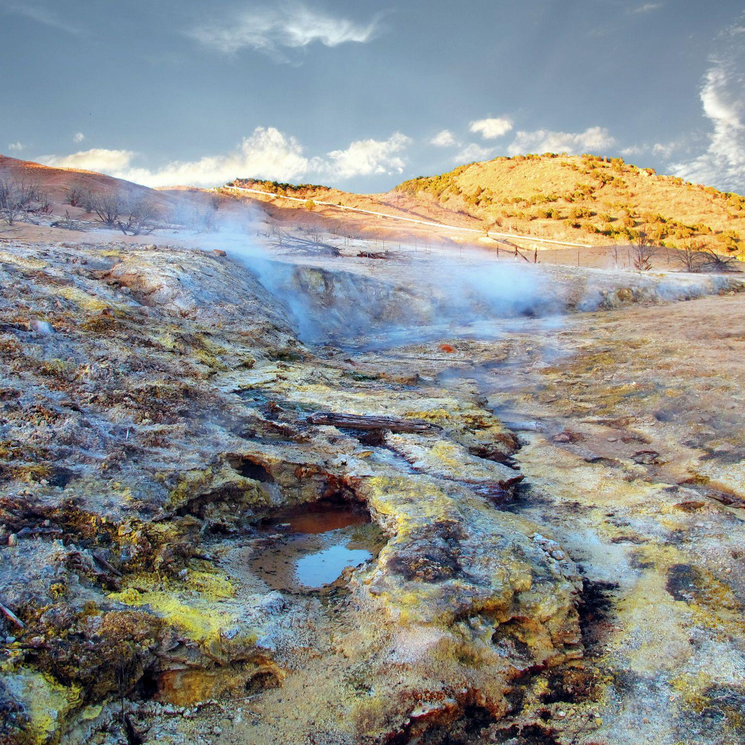
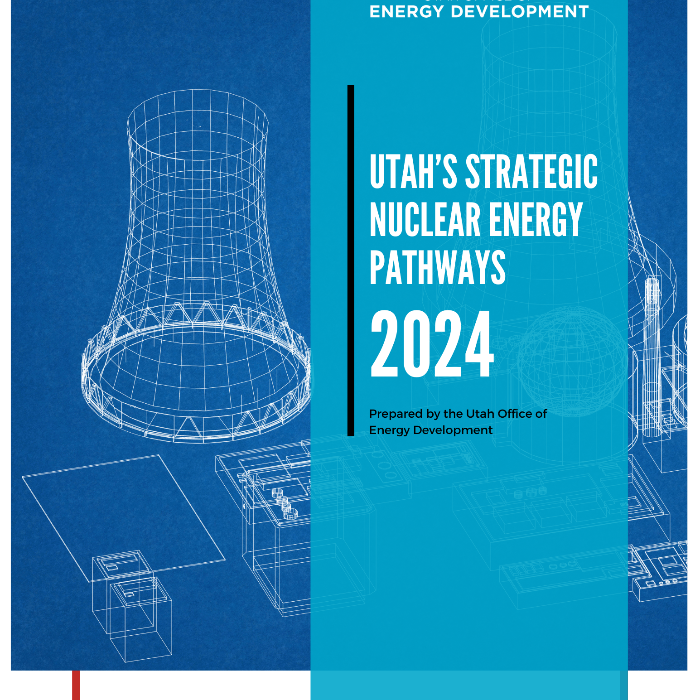
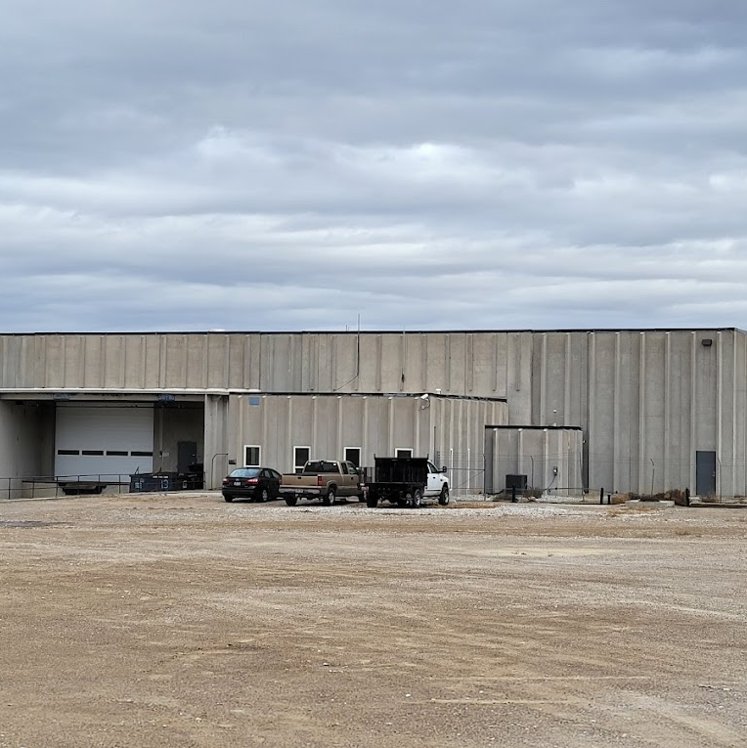
Solutions
Policy
Geothermal
Nuclear
Innovation
Policy is the guardrail for sound-decision making
Utah has vast untapped geothermal potential that is clean, renewable and available 24/7
Nuclear technologies are safer, cleaner and more efficient than traditional nuclear
The Utah San Rafael Energy Lab will be increasing energy efficiencies and moving innovations from lab to market

Slide 10
Operation Gigawatt
Increasing transmission capacity so we can get power from where it’s generated to where it’s needed;
Expanding and developing more energy production like geothermal and nuclear;
Enhancing our policies to enable clean, reliable energy;
Investing in innovation and research.

Slide 11
Thank you.
Emy Lesofski
Director, Energy Advisor to the Governor
emylesofski@utah.gov
801.538.8732

