Slide 1
CCUS
The Energy Council
December 6, 2024

Slide 2
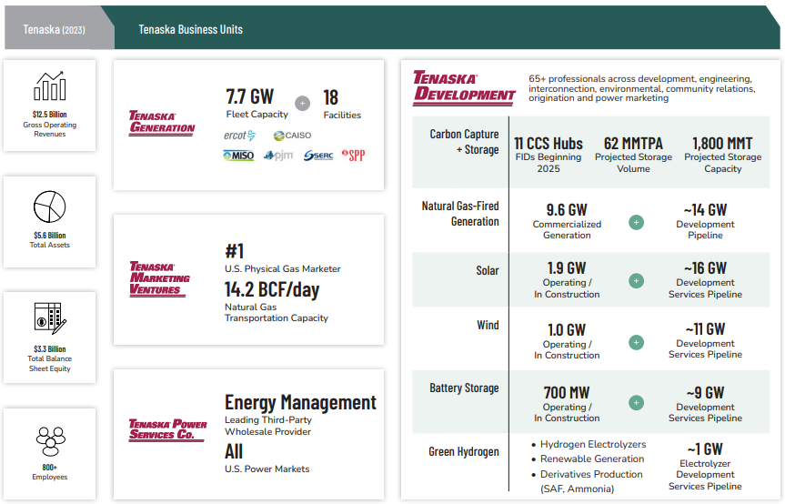

Slide 3

What is CO₂?
Carbon dioxide (CO₂) is an inert gas that occurs both naturally and as a byproduct of industrial processes such as:
  Production of ethanol and hydrogen
  Combustion of coal, natural gas, gasoline and other carbon-based fuels
CO₂ is being emitted into the atmosphere at record levels
CO₂ is non-flammable and non-combustible

Slide 4
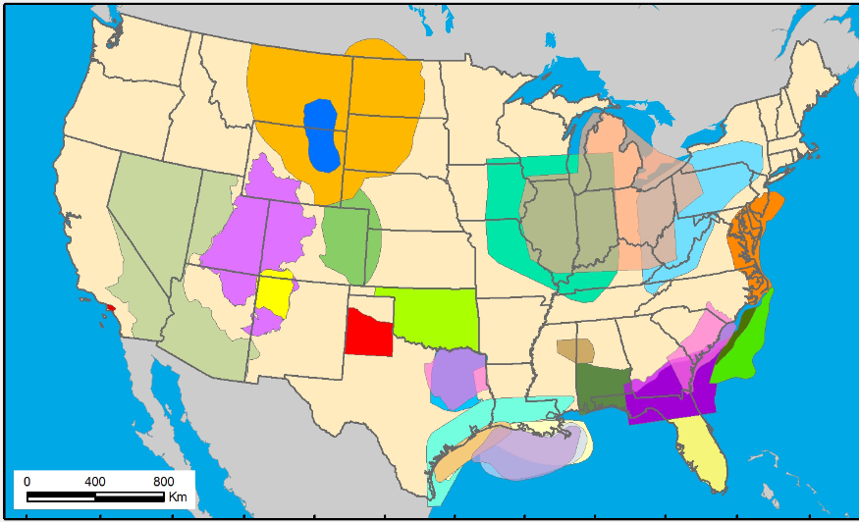
Where can we store CO₂?
There are a number of factors that Tenaska considers when siting a CCS project, including:
  Geology that provides access to safe and secure CO₂ storage
  Regions that have a high concentration of emissions sources
  Communities that are welcoming to the economic benefits

Slide 5
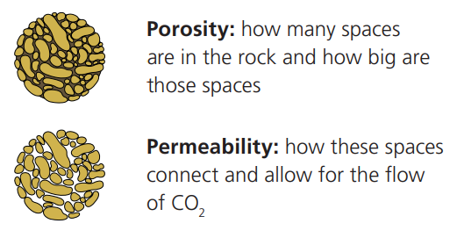
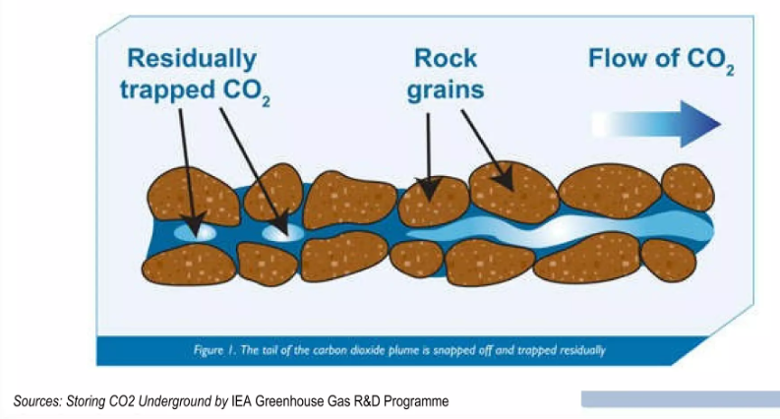
What is Pore Space?
Pore space is the empty space within and between rocks, similar to holes in a sponge
When we consider the appropriate geology for a CCS project, we look for porosity and permeability of the pore space
Notes:
The types of rock that are well suited for CO2 storage are sandstone and dolomite. These rocks, in essence, absorb the CO2 like sponge. Another important factor is a thick layer of caprock, such as shale or evaporite/salt-, that seals the top of the porous rock, creating an impermeable barrier that prevents the stored CO2 from migrating upward. Together – the porous rock and the caprock – create an all-natural storage space. This region has sufficient porous rock – with the right combination of porosity and permeability – overlaid with caprock to support a CCS project.

Slide 6
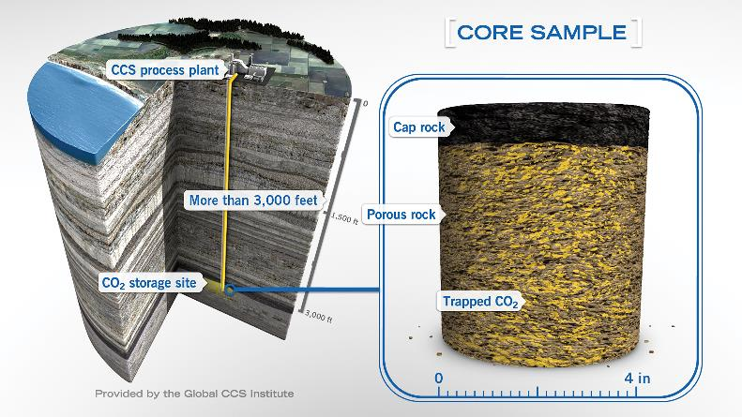
Where is the pore space?
Liquefied CO₂ is deposited into “pore space” in the geologic formations deep, deep underground

Slide 7
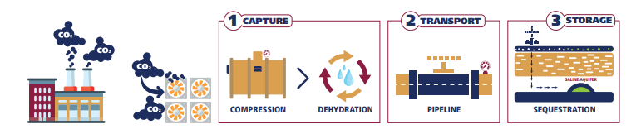
What is the CCS value chain?
CCS captures CO₂ emissions produced by manufacturers and industrial facilities before they enter the atmosphere
Captured CO₂ is liquified, transported and permanently stored deep underground beneath a thick layer of impermeable cap rock
CO₂ then naturally mineralizes and dissolves over time

Slide 9
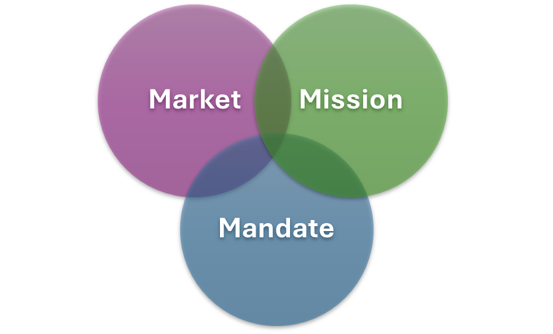
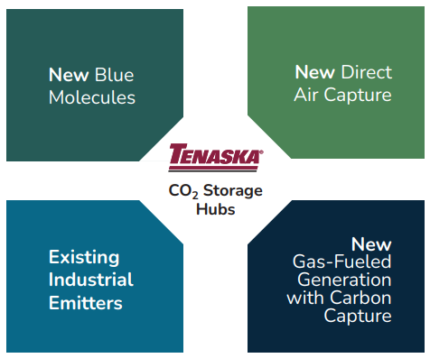
What is the opportunity?

