Slide 1
Vincent J. DiCosimo
December 7, 2024
Salt Lake City, Utah

Slide 2
The Role of Natural Gas in Modern Industry and Society

Slide 3
Naturally Loved- Naturally
May 12, 2022
“The Modern World Can’t Exist Without These Four Ingredients. They All Require Fossil Fuels”
Cement
Steel
Plastics
Ammonia (fertilizers)

Slide 4
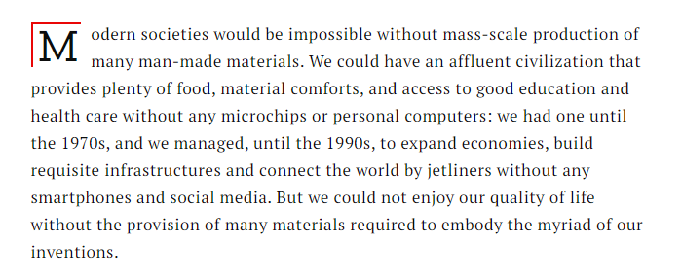
Modern Societies
Time Magazine May 12, 2022 The Modern World Can’t Exist Without These Four Ingredients. They All Require Fossil Fuels By Vaclav Smil

Slide 5
U.S. Natural Gas Macro Overview
…and domestic U.S. natural gas demand remains strong…
…while natural gas production is near all-time highs (and projected to grow further)…
103 BCF
The top five natural gas-producing states and their percentage shares of total U.S. natural gas production in 2022 were:
Texas24.6%
Pennsylvania21.8%
Louisiana9.9%
West Virginia7.4%
Oklahoma6.7%
…with increasing U.S. natural gas exports (largely in the form of LNG)…
6.2 BCF
Source: Bloomberg and EIA.
PROPRIETARY AND CONFIDENTIAL INFORMATION

Slide 6
U.S. Natural Gas Storage and Demand
Nearly a decade of underinvestment in additional natural gas storage capacity and infrastructure…
…and despite total gas working inventories slightly above 5-yr highs,
when compared to demand, storage is near all-time lows!
…has led to gas storage capacity relative to total demand near all-time lows…
Source: Bloomberg and EIA.
Note: Days of demand cover = Storage / Daily gas demand. Represents the days of gas demand available in storage.
PROPRIETARY AND CONFIDENTIAL INFORMATION

Slide 7
U.S. LNG Exports Grow to 30 BCF/D by 2030
U.S. LNG Growth by Project (Operational + Under Construction)
Global LNG demand is set to increase by ~5%/yr driven by higher energy consumption (Asia), security of energy supply (Europe), and broader decarbonization initiatives (Global)
Global LNG supply could grow by ~50% through 2030 purely from projects that are under construction and due to start-up in the coming years
The U.S. and Qatar remain the biggest suppliers with a combined market share of ~50% by 2030
U.S. liquefaction capacity (including only projects under construction) nearly doubles from ~12 Bcf/d at the end of 2023 to ~23 Bcf/d by 2030
Another ~16 Bcf/d of U.S. LNG capacity by 2030 from projects have been proposed but not yet sanctioned
Source: Company Reports, EIA, and Scotiabank.
PROPRIETARY AND CONFIDENTIAL INFORMATION

Slide 8
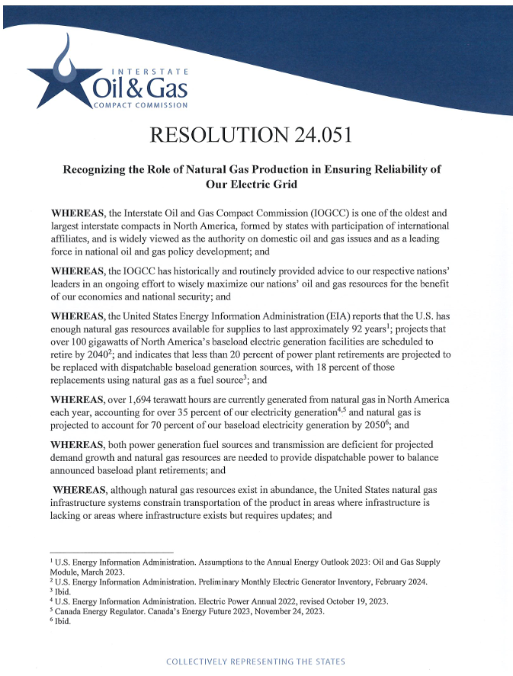
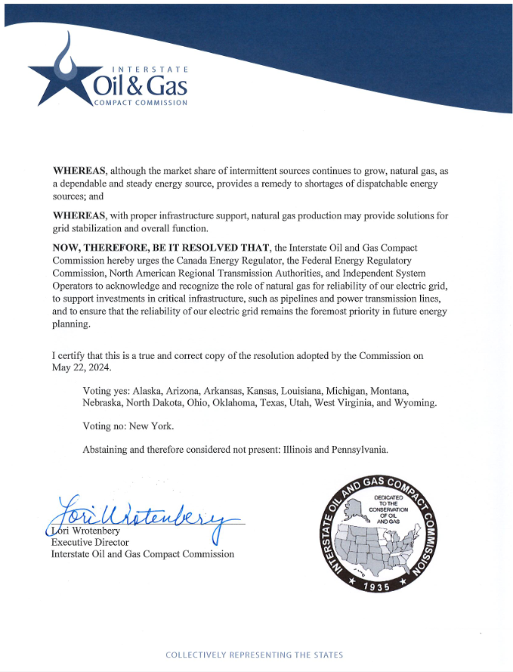
y Natural Gas in the Role of Energy Production and Grid Reliability

Slide 9
Electric Power Demands 34% of Total Energy *
Note: Total Energy Includes All Sources: gasoline, jet, coal, natural gas, fuel oil etc.

Slide 10
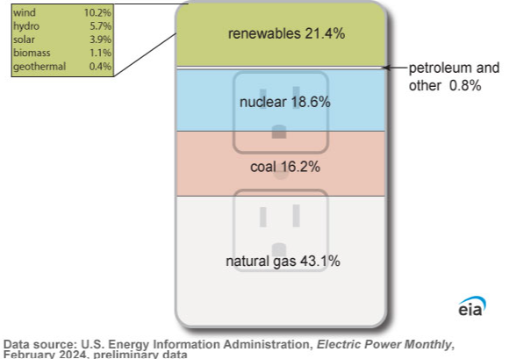
U.S. Power Generation by Fuel Sources= Natural Gas #1
U.S. net power generation YTD in 2024 is 4% above net generation in 2019- BUT IS IT ENOUGH?
Total Renewable generation represents 21.4% of total U.S. power supply (vs 9% in 2019)
Despite renewable penetration, power generation supplied by natural gas has increased 20% since 2019 and represents ~43% of total U.S. power generation (vs ~38% 5-yr avg)
Natural gas (and renewables) has more than offset lower coal usage, which is down 30% since 2019 (~16% of current supply stack vs ~24% in 2019)
34 %
Source :EIA.
PROPRIETARY AND CONFIDENTIAL INFORMATION

Slide 11
Annual U.S. Electricity Generation By Energy Source
Must Have These to Avoid Grid Failure with Rising Demand
Firm Pipeline Transport
Firm Storage
Contracts
Firm Fuel Contracts
Retirements:
Coal Plants
Nuclear
Combined Cycle Gas
&
Impossible Permitting
Source: EIA Monthly Energy Review May 2024

Slide 12
U.S. Data Centers Could Use Almost 9% of the Grid by 2030
Nine of the top 10 U.S. electric utilities said data centers were a main source of customer growth.
Minimum uptime guarantees requirements are 99.99% uptime per year.
Difference between Crypto and Data Centers- UPTIME
Only Natural Gas or Nuclear Power Generation can provide 99.99%
Source: Electric Power Research Institute

Slide 13
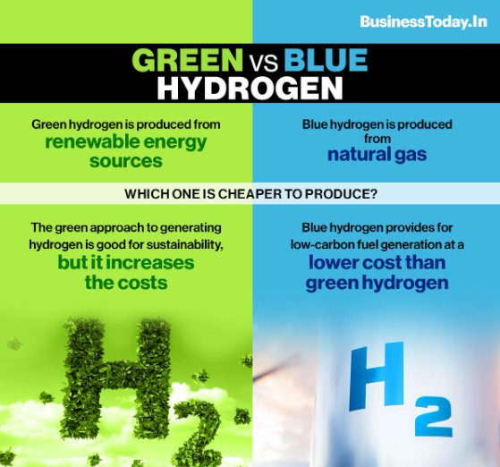
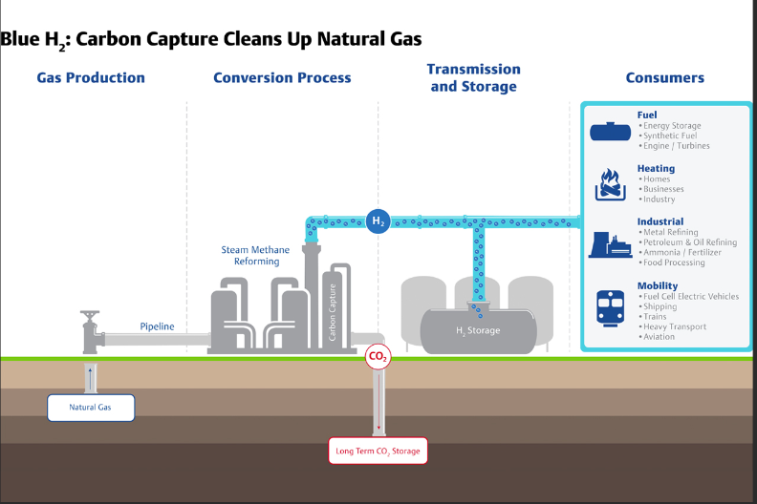
Natural Gas Reforming for Hydrogen Production with CCS
Source: Emerson.com

Slide 14
By 2050 Global Energy Demand Increases by Nearly 50%!
Source: EIA

Slide 15
Gas Consumption by Global Region
The United States, Russia, China, Iran and Japan are the world’s largest natural gas consumers.
The US alone is responsible for 21.7% of global natural gas use.
Annual natural consumption is measured in terawatt-hours (TWh)

Slide 16
Since 1950 a 3X Increase in Demand in all Fuel Sources
Even with renewables
in the fuel mix, all fuels
have grown.
Natural Gas continues to grow as the most clean and reliable fuel.

Slide 17
Natural Gas (Methane) Is So Much More
The Petrochemical Industry uses all of these molecules as feedstocks for products.

Slide 18
The World of Petrochemical Products From Natural Gas
Demand for plastics has nearly doubled since 2000.
Petrochemicals are expected to be the largest driver of world oil demand growth, surpassing that of gasoline or diesel by 2030.
Source: AI created from Copilot

Slide 19
Securing Jobs, Energy Security and National Security
Source: AI generated by Copilot

Slide 20
THANK YOU!
Contact: vdicosimo@targaresources.com
PROPRIETARY AND CONFIDENTIAL INFORMATION

