Slide 1








Electricity in transition: are we up to the challenge? An oil and gas perspective.
Energy Council 2024 Global Energy and Environmental Issues Conference, Grand America Hotel, Salt Lake City, Utah December 6, 2024.
    David E. Dismukes, Ph.D.
    Professor Emeritus
    Center for Energy Studies
    Louisiana State University

Slide 2
Takeaways....Opportunities and challenges.
Last two decades has focused exclusively on higher cost renewable energy development and integration. This includes billions in RE generation and supporting transmission related investment.
Billions in direct and indirect subsidies expended to support these RE investments including numerous federal and state policies affording unheard of levels of development “de-risking.”
Result: higher ratepayer costs and not a lot of capacity “juice for the squeeze.”
While RTOs were originally designed to facilitate open and non-discriminatory competition, they have become the facilitators of progressive energy policy.
Chickens are coming home to roost: markets across the country have become increasingly capacity constrained when we are seeing the potential for trend-breaking expansive demand growth.
Those states reasserting their energy policy sovereignty will likely be the ones securing success in economic development and low-cost energy.
© LSU Center for Energy Studies

Slide 3
Overreliance on intermittent resource
© LSU Center for Energy Studies

Slide 4
Intermittent Resources
Historic fuel mix trends (generation shares of total)
While natural gas continues to be the workhorse of the industry, renewables/intermittent resources are clawing away at market share.
Source: Energy Information Administration Form 923 and 860.

Slide 5
Intermittent Resources
Current PJM interconnection queue
Over 75 percent of the current PJM queue is tied to renewable energy (~167GW). This increases to 95 percent if storage is included (~210 GW).

Slide 6
Intermittent Resources
Current SPP transmission interconnection queue.
The current SPP transmission interconnection queue only has 7,000 MW of announced natural gas generation capacity.
Over 62 percent (~67 GW) of all generation seeking interconnection into SPP is renewable with another 31 percent being battery-related.
The over-emphasis on variable generation resources poses challenges during peak demand periods and for the reliability needs.
Source: Southwest Power Pool (2024). Generator Interconnection Active Request Listing. Available at: https://opsportal.spp.org/Studies/GIActive.

Slide 7
Intermittent Resources
PJM BRA 026-2027 ELCC Ratings
Fossil-fuel based technologies have the highest capacity rankings and the most reliability to meet critical new loads.
Source: PJM, ELCC Class Ratings for the 2026/2027 Base Residual Auction.

Slide 8
Intermittent Resources
PJM projected ELCC
The effective capacity for natural gas is only expected to increase while renewables, even OSW, is forecast to fall considerably by 2035.
Source: (1) PJM, Preliminary ELCC Class Ratings for period Delivery Year 2026/27 - Delivery Year 2034/35.

Slide 9
Capital investment implications
© LSU Center for Energy Studies

Slide 10
Investment
Historic & forecast electric/multi-utility capital investment
Historic total capex has been growing at an annual average rate of over 10 percent driven in large part by “lines” investment.
Forecast
Source: S&P Global Database

Slide 11
Investment
Historic & forecast electric transmission investment
Transmission capex historically grew at a moderate annual average rate (six percent) but is now anticipated to increase by as much as seven to 15 percent (excluding 2028).
Forecast
Source: S&P Global Database

Slide 12
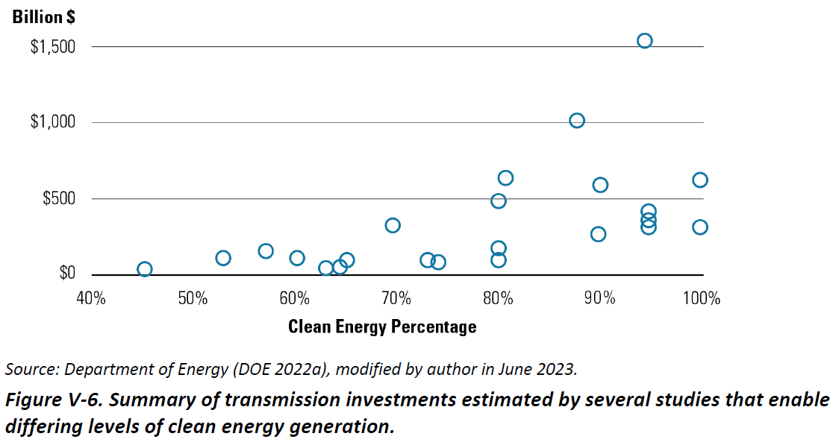
Investment
DOE projected transmission investment “needs.”
By prioritizing solar and wind over more reliable generation such as natural gas, RTOs are driving up transmission costs for ratepayers.
Circles represent 23 individual study estimates indicating high renewable energy levels will require around $500 billion in transmission investments alone.
Source: Department of Energy, National Transmission Needs Study, October 2023.
© LSU Center for Energy Studies

Slide 13
Investment
MISO historic and projected capital investment levels.
Historic and project transmission investment is increasing rapidly.
The first portfolio of projects were approved in the 2021 MTEP cycle causing a three-fold increase in spending from 2020 to 2021.
The second portfolio of projects have been proposed in the 2024 MTEP cycle. The $30 billion proposal is over six times the ten-year historical average.

Slide 14
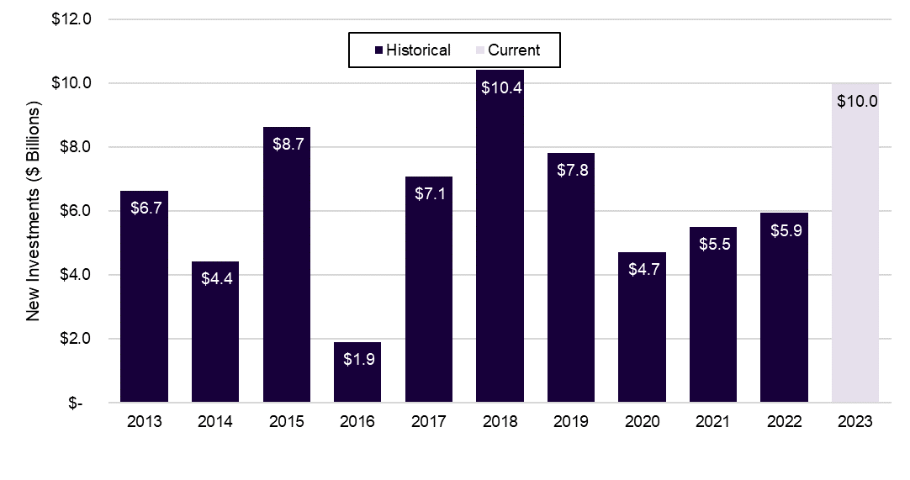
Investment
PJM transmission spending plans.
The most recent 2023 RTEP budget approved approximately $10 billion in new transmission spending, or 58 percent more than the ten-year inflation-adjusted average.
Source: (1) PJM, RTEP 2023, March 2024.
© LSU Center for Energy Studies

Slide 15
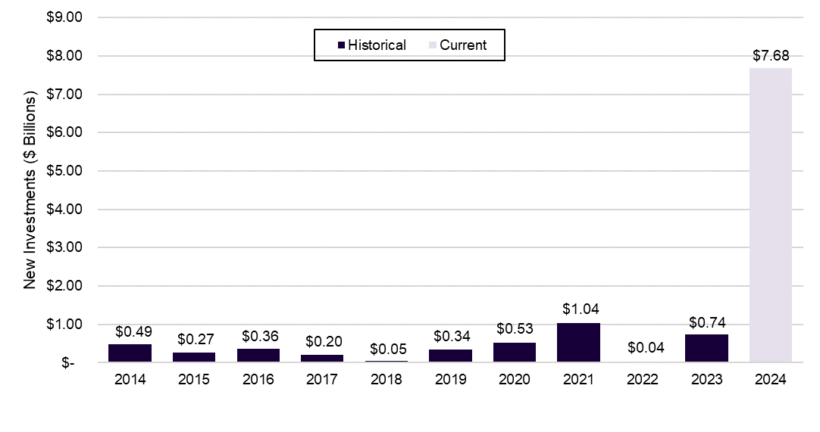
Investment
SPP transmission spending plans.
The most recent ITEP budget in 2024 approved over $7 billion in new transmission spending. The 2024 budget is over 18 times the ten-year average.
Source: (1) SPP, 2014-2024 Integrated Transmission Planning Assessment Reports.
© LSU Center for Energy Studies

Slide 16
Investment
Regulator concerns (2021 FERC proceeding on transmission reforms).
The Utah regulators (“UPSC”) argues that “imposing the tremendous costs associated with certain states’ statutory mandates to alter their generation mix on ratepayers in other states, who have no representation in those other states’ legislatures, is not consistent with cost causation.”
The North Dakota regulators (“NDPSC”) notes that “ratepayers should not have to pay twice for decarbonization: once through state investment, and a second time through transmission and cost allocation methodologies resulting from out-of-state interests and corporate goals.”
Source: (1) FERC Docket No. RM21-17-000, Comments of the Utah Public Service Commission, Filed on October 8, 2021. (2) FERC Docket No. RM21-17-000, Comments of Louisville Gas and Electric Company and Kentucky Utilities Company, Filed on October 12, 2021. (3) FERC Docket No. RM21-17-000, Comments of North Dakota Public Service Commission, Filed on October 12, 2021.
© LSU Center for Energy Studies

Slide 17
Investment
Regulator concerns (2022 FERC proceeding on MISO’s cost allocations).
The Louisiana Public Service Commission (“LPSC”) “continues to oppose efforts to make huge transmission investments to support new renewable generation in preference to other types of generation and then to allocate the costs of that transmission to all loads with no correlating benefits.”
LPSC notes “the real beneficiaries of that investment [transmission] are the generators and buyers of the intermittent power the planned transmission will serve … It is not just or reasonable to also impose upon them the immense costs of an extensive transmission build-out to carry remote renewable generation without a transparent demonstration that it will increased [sic] reliability, at a reasonable cost to Louisiana.”
Industrial customers argue that “MISO’s proposal inappropriately shifts certain network upgrade costs to load and provides uneconomic pricing signals for generators to locate further from load.”
Source: (1) FERC Docket No. ER22-995-000, Comments on Behalf of the Louisiana Public Service Commission, Filed on March 7, 2022. (2) FERC Docket No. RM21-17-000, Comments of the Louisiana Public Service Commission, Filed on October 12, 2021.
© LSU Center for Energy Studies

Slide 18
Investment
Consumer concerns (2022 MISO Board feedback on transmission proposals).
Iowa Office of Consumer Advocate (“IOCA”) argued that MISO’s transmission plan “assumes an unreasonable amount of resource deployment (approximately three gigawatts of Solar and/or Solar + Storage) that is not supported or corroborated by the near or midterm goals of LRZ 3 electric utilities.”
IOCA argued that “MISO should not justify the need for additional capital investment by counting economic benefits derived from accomplishing goals and avoiding risks that MISO is not required to nor burdened with achieving, such as decarbonization.”
IOCA argued that “little consideration [was] given to transmission alternatives that could have been used as the first option to forego the construction of additional transmission infrastructure and make more efficient use of existing transmission infrastructure.”
Source: (1) MISO, Stakeholder Feedback: Draft LRTP Tranche 1 Portfolio Report – Addendum to MTEP21 Report. Accessed on November 24, 2024.
© LSU Center for Energy Studies

Slide 19
Capacity challenges
© LSU Center for Energy Studies

Slide 20
Capacity challenges
EIA generation forecast
EIA anticipates continued heavy reliance on renewables to almost half of generation mix – nor that renewables now “cannibalizes” natural gas.
historic
forecast
Renewables 42 percent in 2050
21 percent in 2020
Source: EIA Annual Energy Outlook 2021

Slide 21
Capacity challenges
SPP historic and projected reserve margins
SPP is currently seeing and anticipating significant deterioration in reserve margins over time despite continued massive investment.
Post 2026 reserve shortfalls
Source: Reproduced from SPP forecast in SPP (2024) Our Generational Challenge.

Slide 22
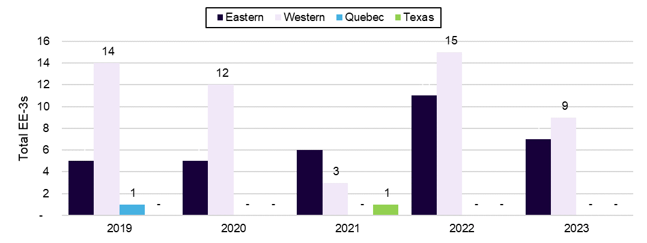
Capacity challenges
Energy emergency alert trends.
An energy emergency alert (“EEA”) is a real-time indication of potential and actual energy emergencies within an interconnection. An EEA-3 is reported when firm load interruption is imminent or in progress. EEA trends may provide an indication of capacity, energy, and/or transmission insufficiency.
All EEA-3s in 2023 were associated with periods of reduced generation or import capacity combined with a heavy load day.
Source: (1) NERC, 2024 State of Reliability, June 2024, Page 51.
© LSU Center for Energy Studies

Slide 23
Has the juice been worth the squeeze?
© LSU Center for Energy Studies

Slide 24
Challenged benefits
Historic retail electricity price trends (residential, industrial)
Pre-2021, residential retail prices were increasing at an already accelerated rate of 2.3 percent per year. Post-2021 increases are over 5.8 percent.
Cents per kWh
Post 2021 industrial electricity rates are up by over 5.5 percent.
Source: U.S. Energy Information Administration. "Electricity Data Browser." Accessed November 26, 2024

Slide 25
Challenged benefits
U.S. energy affordability for median income.
The energy affordability index without transfer payments for a U.S. median income household increased from 3.8 percent in 2015 to 5.0 percent in 2024.
Median Income
Energy Affordability Ratio
Note – the large increases in transfer payments starting in 2020 are “masking” energy affordability for average (median) households – in other words, government subsidies is the only thing making electricity affordable.
Source: ACS Community Survey, EIA Residential Consumption Survey, EIA Energy Expenditures, EIA Electric and Natural Gas Prices, Congressional Budget Office’s Distribution of Household Income reports.

Slide 26
Challenged benefits
U.S. energy affordability for low-income households
Low-income energy affordability, with and without transfer payments, are above burdensome levels. Low-income households have seen high levels of energy burden since 2015 and a majority of their income comes from transfer payments.
Low-Income
Energy Affordability Ratio
Federal subsidies play an even bigger role in making electricity affordable for lower income households.
Six percent “burdensome” threshold
Source: ACS Community Survey, EIA Residential Consumption Survey, EIA Energy Expenditures, EIA Electric and Natural Gas Prices, Congressional Budget Office’s Distribution of Household Income reports.

Slide 27
Challenged benefits
Emissions reductions, 2006-2023
Carbon emissions reductions in the fuel mixed used for electricity generation are significantly greater from the shift towards natural gas-fired generation versus increases in zero-carbon generation like renewables.
Million metric tons of CO2
Source: EIA, U.S. Energy-Related Dioxide Emissions, 2023 Report Appendix and Methodology, Figure A-7 CO2 Emissions Relative to 2005 Caused by Change in the Fuel Mix of Electricity Generation. April 2024.

Slide 28
A new era of rapid electricity usage?
© LSU Center for Energy Studies

Slide 29
Electricity usage
Illustration: historic and projected electricity usage trends.
A new era of electricity growth that will need to be powered with a reliable, non-intermittent electricity source.
Electricity Use
(GWH)
Rising growth, increased UPC, new end uses (First era electrification, ISPs)
Low-cost natural gas
No growth, flat UPC, high-cost natural gas
Rising growth, increased UPC, new end-uses (datacenters, second era electrification, transportation), high-cost natural gas
1989
2005
2024
2030
Year
Source: Illustrative, author’s constructed developed/modified from SPP (2024) Our Generational Challenge. p.7 from original New York Times graphic.

Slide 30
Electricity usage
Revised change in forecast peak demand (2028, Grid Strategies)
Most forecasts have seen dramatic changes (increases) over the last year, driven in large part by technology-induced changes in electricity usage.
17 GW forecast change in one year
Source: Canary Media from 2024 Grid Strategies Report and Forecast. https://www.canarymedia.com/articles/transmission/suddenly-us-electricity-demand-is-spiking-can-the-grid-keep-up

Slide 31


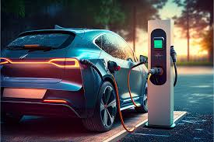
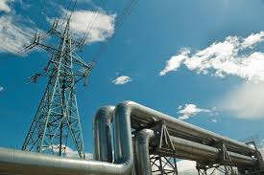
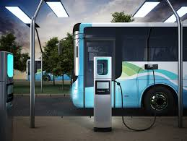


Electricity usage
New sources of electricity growth
Energy production & manufacturing
Industrial electrification
Transportation
Building & commercial electrification
Datacenters
Source: Authors’ construct.

Slide 32

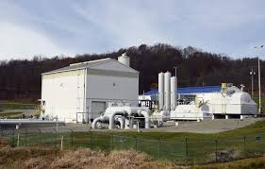
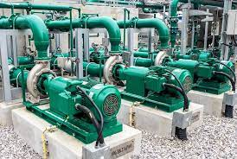
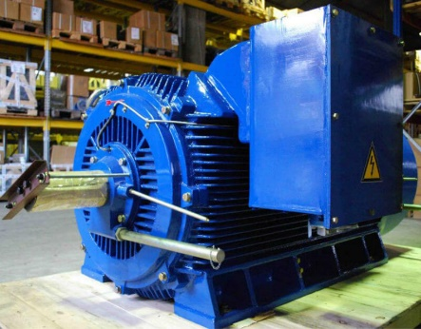
Electricity usage
Changing end-uses: oil and gas industry applications.
Industry has been moving more and more towards electrical end-uses over several decades, arguably dating back to the CAAA of 1990.
Examples in the natural gas midstream industry include moving compression fuel from pipeline gas to electricity – which had considerable implications in during Winter Storm Uri in 2021.
Other examples include moving other forms of compression, motors, pumps, and other forms of mechanical energy and using electricity rather than natural gas, waste fuels, and other fossil-based options.
© LSU Center for Energy Studies

Slide 33
Electricity usage
Top raking industrial electricity sales growth states (2014 to 2023)
States with the fastest industrial electricity sales growth over past five years are those supporting oil and gas operations (and are Energy Council members)
Source: U.S. Energy Information Administration. "Electricity Data by State." Accessed November 26, 2024. https://www.eia.gov/electricity/data/state/.

Slide 34
Electricity usage
Datacenter functions.
Cloud Computing
Dominant function in many data centers today, as services like Amazon Web Services (AWS), Microsoft Azure, and Google Cloud.
Content Delivery Networks (CDNs)
Store and deliver digital content such as streaming videos, websites, and software updates. Companies like Netflix, YouTube, and Akamai rely on data centers to distribute content globally,
Enterprise Data Storage and Processing
Businesses use data centers to store sensitive data, manage databases, and process various computational tasks.
Significant driver of data center activity for machine learning models, particularly for tasks such as natural language processing (NLP), image recognition, and data analytics.
Artificial Intelligence (AI)
Cryptocurrency Mining
While cryptocurrency mining is a highly energy-intensive activity and is rapidly growing usage function​.
Telecommunications and Internet Services
Telecommunications companies and Internet Service Providers (ISPs) are for communication-based activities.
Scientific Research and High-Performance Computing (HPC)
Some data centers are dedicated to scientific research, where high-performance computing clusters are used for tasks like simulations, data modeling, and genome research.
Source: Authors’ construct from various sources.

Slide 35
Electricity usage
Economic sectors supported by global data centers.
Datacenters support the economic activities of numerous important economic sectors including not only data and technology providers, but sectors like banking and healthcare.
Note: Banking, Financial Services, and Insurance (“BSFI”).
Source: Grand View Research. (2022). Data Center Market Size, Share & Trends Analysis Report By End-use (Cloud Service Provider, Technology Provider, Telecom, BFSI), By Region, And Segment Forecasts, 2023 - 2030.
© LSU Center for Energy Studies
Notes:
35

Slide 36
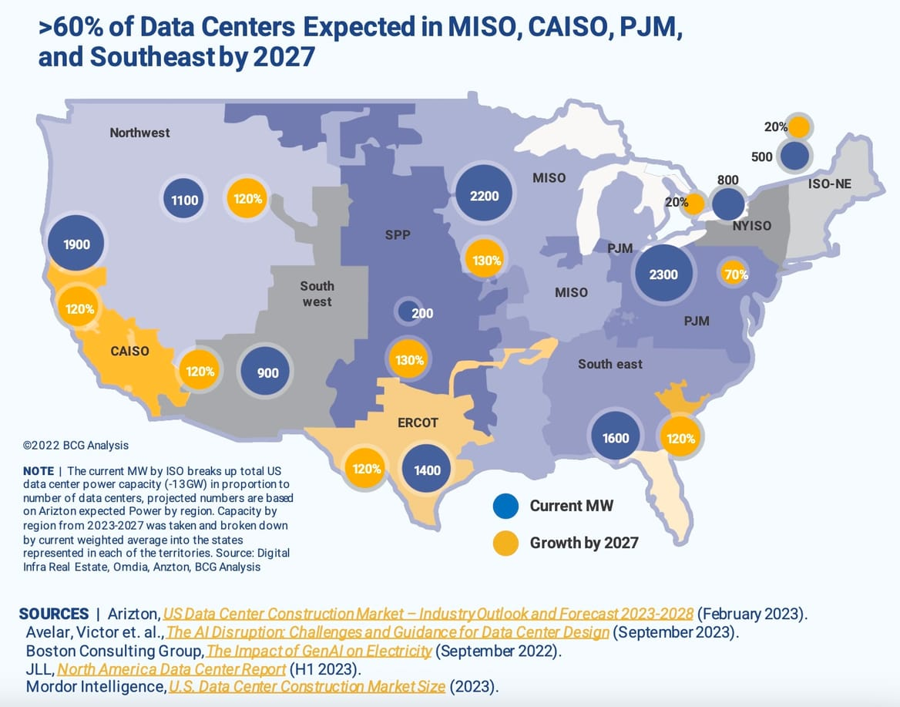
Electricity usage
BCG forecast datacenter load growth potentials.
Most active regions in the U.S. are anticipated to see triple digit increases in datacenter electricity demand.
MISO ~5,000 MW by 2027.
SPP ~ 446 MW by 2027.
PJM ~4,000 MW by 2027.
SERC ~3,500 MW by 2027.
ERCOT ~3,00 MW by 2027.
Source: Canary Media from various sources including Boston Consulting forecast. https://www.canarymedia.com/articles/transmission/suddenly-us-electricity-demand-is-spiking-can-the-grid-keep-up

Slide 37
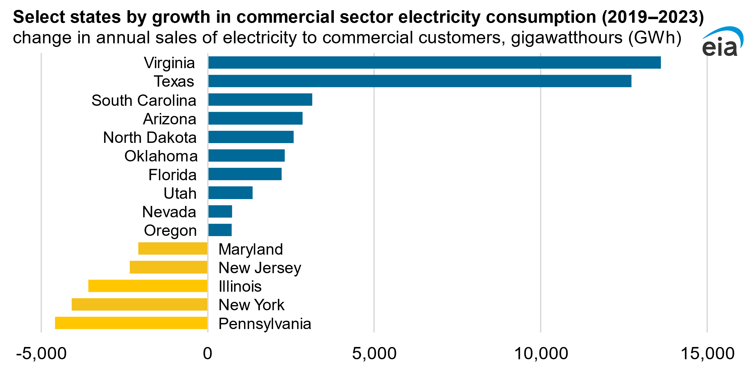
Electricity usage
Select states commercial electricity growth.
States with the highest concentration of datacenters are seeing the fastest commercial sector electricity growth
Sources: Energy Information Administration, 2024.
© LSU Center for Energy Studies

Slide 38
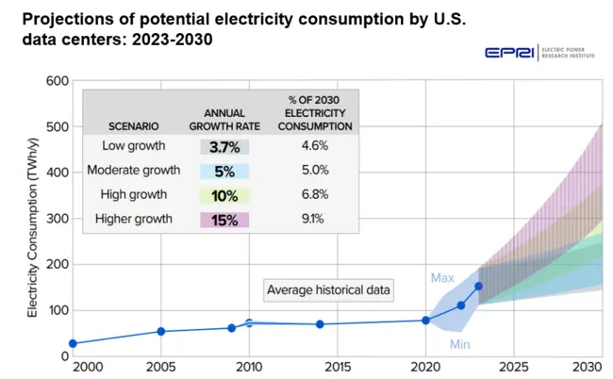
Electricity usage
EPRI projected datacenter usage
EPRI envisions dramatic changes in electricity growth coming from datacenters alone – potentially up to 9 percent on annual basis: this is a level of sector-specific growth not seen since the late 1960s.
Source: EPRI

Slide 39
Electricity usage
U.S. data center projected consumption.
Prior studies estimate the U.S. will see between 452 to over 900 new data centers needing between 22 GW to 46 GW. These are expected to create up to 1.5 million jobs.
Note: U.S. data center consumption is estimated using EPRI’s data for 44 states. Net Rentable Square Feet (“NRSF”).
Sources:
Electric Power Research Institute. Strategies for Non-Wires Alternatives: Evolving the Grid with Customer Solutions. May 2024, Product ID: 3002028905.
Oxford Economics. The Economic Impact of Google Data Centers in the United States. October 2022. Produced by Oxford Economics, 2022.
Nam D. Pham, Ph.D., & Mary Donovan. Data Centers: Jobs and Opportunities in Communities Nationwide. U.S. Chamber of Commerce Technology Engagement Center (C_TEC), May 2017.

Slide 40
Conclusions
© LSU Center for Energy Studies

Slide 41

Conclusions
Center for Energy Studies
Center for Energy Studies
Conclusions.
What’s needed:
More reliable, quickly developed natural gas fired generation.
More flexibility from policy and utilities.
More utility accountability (part of the solution or part of the problem)
Recognition of the significant economic development opportunities leveraged by electricity (industrial growth, transportation, technology).
Everyone pays their fair share:
  No cross subsidies from one customer class to another: residential customers should not be subsidizing new or existing load growth.
  No special preferences (or burdens) on one form of electricity intensive economic development over another (current large, high load factor customers should be given equal opportunities for their growth potentials).
Avoid the regulatory gimmicks of the day that remove the authority and oversight of regulators and places those decisions (pricing, investment) in the hands of institutions with alternative agendas.
© LSU Center for Energy Studies

Slide 42


Questions, comments, and discussion.
David E. Dismukes, Ph.D.
Professor Emeritus
Center for Energy Studies
Louisiana State University
Email: dismukes@lsu.edu
Phone: 225-578-4343
URL: www.enrg.lsu.edu
David E. Dismukes, Ph.D.
Consulting Economist/Managing Partner
Acadian Consulting Group, LLC
5800 One Perkins Place Drive, Suite 5-F
Baton Rouge, LA 70808
Ph: 225.769.2603
daviddismukes@acadianconsulting.com
URL: www.acadianconsulting.com
© LSU Center for Energy Studies

