Slide 1
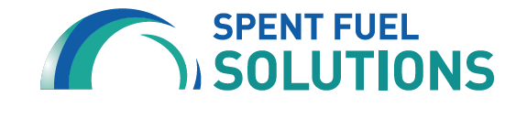
Solving the U.S. Spent Fuel Challenge
December 7, 2024
Notes:
Introductions
We are here on behalf of Spent Fuel Solutions, a coalition formed in 2021 to advocate for federally licensed spent fuel storage and disposal.

Slide 2
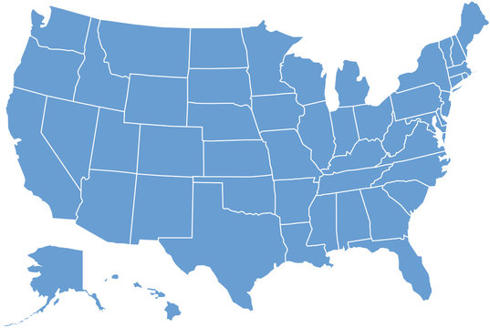


U.S. Nuclear Generation
Operating commercial nuclear power plant
Shut-down site
Energy Council member with spent fuel storage
Locations are approximate.
Notes:
Before we get into details about the spent fuel challenge and why we believe federal action is critical, we’d like to take a step back and talk more broadly about the history of nuclear power in the U.S.
The first nuclear power plant in the United States began operating in 1958.
Nuclear generation peaked at 112 reactors with a capacity of nearly 100,000 megawatts.
There are currently 93 operating commercial reactors at 54 plants in 28 states.
Located in Georgia, the nation’s newest reactor came online in August 2023.
Nuclear plants accounted for approximately 19-20% of U.S. electricity generation from 1990-2021.

Slide 3
Spent Fuel Stockpile
1-999 Metric Tons | 1,000-4,999 Metric Tons |  | 5,000-9,999 Metric Tons | 10,000+ Metric Tons
Iowa Kansas Maine Massachusetts Missouri New Hampshire Oregon Vermont Washington | Alabama Arizona Arkansas California Connecticut Delaware Florida Georgia Louisiana Maryland Michigan | Minnesota Mississippi Nebraska New Jersey New York North Carolina Ohio Tennessee Texas Virginia Wisconsin | Pennsylvania South Carolina | Illinois
Notes:
With the growth of nuclear generation came a growing stockpile of spent nuclear fuel.
Today, there are approximately 86,000 metric tons of stranded spent nuclear fuel.
The amount continues to increase by about 2,000 metric tons each year and is expected to exceed 100,000 metric tons by 2030.
Right now, the spent fuel is safely stored on site at 76 operating or shutdown nuclear plants in 34 states.
But there are still a number of reasons why off-site storage and disposal solutions are urgently needed.

Slide 4
Why Federal Action is Needed:
Financial Costs and Generational Equity
$10.6
BILLION
$30
BILLION
$46
BILLION
In damages paid by U.S. taxpayers for ongoing on-site spent fuel storage
Projected costs to taxpayers without federal action
Pre-paid by nuclear utility customers for repository development
Notes:
First, the financial costs of on-site storage are significant – and growing.
Taxpayers have paid $10.6 billion in damages to cover the costs of continued spent fuel storage at nuclear reactor sites.
These costs could reach more than $30 billion if the federal government does not take action to relocate the spent fuel.
Nuclear utility customers have also pre-paid $46 billion, including interest income, for the development of a repository.
We also believe this is a matter of generational equity.
As the generation that benefitted from electricity generated at nuclear power plants across the nation, it is our responsibility to provide a solution for the spent nuclear fuel.
We owe it to future generations to address this issue and should not pass the burden and costs of finding storage and disposal solutions on to them.

Slide 5

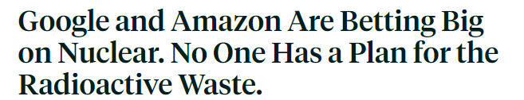


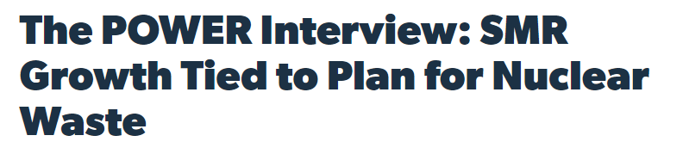
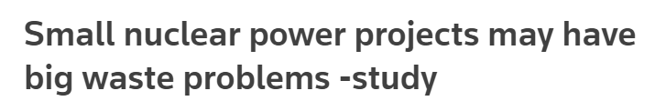
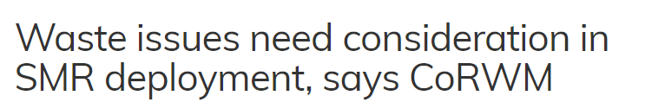

Why Federal Action is Needed:
Support for New Nuclear Resources
Notes:
Over the past several years, we have seen growing momentum and support for new nuclear generation sources.
Technologies such as small modular reactors, or SMRs, are constantly improving.
A recent poll also found that 56% of Americans support more nuclear power, up from 43% in 2016.
We’ve also seen big names like Google, Amazon and Bill Gates investing in nuclear.
But the lack of a federally licensed interim storage facility or permanent repository remains an obstacle for growth in this sector.

Slide 6
History of Spent Fuel Management
1987:
NWPA is amended to designate Yucca Mountain, Nevada as only repository site for further study.
2009:
DOE suspends work on Yucca Mountain.
1957:
National Academy of Sciences recommends deep geologic disposal.
1998:
DOE misses deadline to assume title and begin disposing of spent fuel.
1972:
Government abandons Lyon site due to opposition and technical concerns.
2012:
BRC recommends consent-based siting.
1950
1960
1970
1980
1990
2000
2010
2020
1970:
U.S. begins looking for a site and selects Lyon, Kansas.
1982:
Congress passes Nuclear Waste Policy Act (NWPA).
2002:
President Bush approves Yucca Mountain; Nevada Governor opposes.
2010:
Blue Ribbon Commission on America’s Nuclear Future (BRC) convenes.
1988:
Department of Energy (DOE) begins studying Yucca Mountain.
Notes:
The federal government’s attempts to effectively manage spent nuclear fuel have progressed in starts and stops.
The need for a deep geological repository was recognized as early as the 1950s, but initial siting efforts failed in the 1970s.
The early 1980s saw a renewed interest in spent fuel with the passage of the Nuclear Waste Policy Act.
This legislation identified three potential repository sites but was amended in 1987 to designate Yucca Mountain as the only repository site for further study.
These studies began in 1988 and continued through 2002, when President Bush approved the site.
However, Yucca Mountain received strong opposition from Nevada Governor Kenny Guinn and numerous other stakeholders.
As a result, DOE was directed to cease work on the repository in 2009.
Then, the following year, Energy Secretary Steven Chu convened Blue Ribbon Commission on America’s Nuclear Future (BRC).
This group of experts developed a final report that recommended a new approach to developing spent fuel solutions: consent-based siting.

Slide 7
What is Consent-Based Siting?
Consent-based siting is an international best practice that follows a simple premise: that a community must decide for itself whether it is willing to consent to hosting a spent fuel storage or disposal site.
Notes:
Consent-based siting seeks to identify an informed and willing community that understands the risks and benefits of hosting a spent fuel repository or consolidated interim storage site.

Slide 8
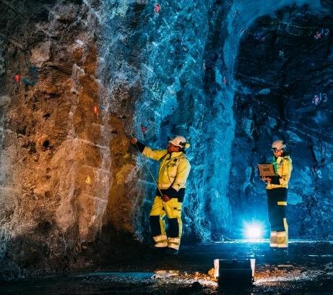
International Success Stories
Notes:
After a consent-based siting process that began in the 1990s, Finland approved the Onkalo spent fuel repository in 2000.
The facility recently completed the first stage of a trial run and is on track to begin operating in 2025.
The Swedish government approved a spent fuel repository at Forsmark in January 2022.
The company developing the site received an environmental permit to build and operate the repository in October 2024.
Late last month, Canada’s Nuclear Waste Management Organization announced that it has selected the Wabigoon Lake Ojiway Nation and Township of Ignace as its repository site.
Canada will now begin the regulatory approval process.
In September 2022, Switzerland selected a site for its deep geological repository.
Swiss authorities are expected to make a final decision in 2029.
Finally, France’s Cigeo project reached a key milestone in 2022, securing a declaration of public utility.
A public inquiry is planned for 2026 to obtain feedback on the facility.

Slide 9
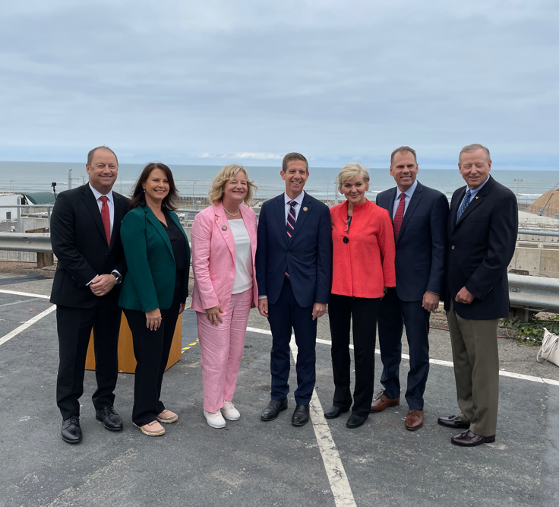
DOE Consortia:
American Nuclear Society
Arizona State University
Boise State University
Clemson University
Energy Communities Alliance
Good Energy Collective
Holtec International
Keystone Policy Center
Missouri University of Science & Tech.
North Carolina State University
Rensselaer Polytechnic Institute
Vanderbilt University
Consent-Based Siting in the U.S.
Notes:
Recognizing these international successes, and the recommendations from the Blue Ribbon Commission, DOE launched its own consent-based siting program in late 2021.
The department began by issuing an RFI to solicit feedback and subsequently awarded $26 million to 12 consortia.
The consortia will work with communities interested in DOE’s community-centered approach to storing and disposing of spent nuclear fuel.
Unlike international programs, the consortia are specifically focused on consolidated interim storage, or CIS, rather than a deep geological repository.
CIS facilities are above-ground, temporary storage sites that are very similar to the on-site storage found at nuclear power plants.

Slide 10

Consent-Based Siting Roadmap
We Are Here
STAGE 1:
PLANNING & CAPACITY BUILDING
Build relationships, mutual learning, and develop a common understanding of waste management-related topics.
STAGE 2:
SITE SCREENING & ASSESSMENT
Issue initial criteria for suitable sites followed by a national call for volunteers, community-led development of additional criteria, preliminary and detailed assessments.
STAGE 3:
NEGOTIATION & IMPLEMENTATION
Negotiate agreements with willing and informed host communities with licensing, construction, and operation activities to follow.
Notes:
With these steps, we are in the first stage of a three-phased process.
DOE expects this process to result in one or more operating CIS facilities in 10-15 years.

Slide 11
Required Legislative Changes
PRIORITY 1
SINGLE-PURPOSE ORGANIZATION: Congressional authorization to form a single-purpose, autonomous federal organization to assume management of the program from the U.S. Department of Energy (DOE).
PRIORITY 2
RELIABLE FUNDING: Reliable and adequate funding such as access to the Nuclear Waste Fund.
PRIORITY 3
CONSENT-BASED REPOSITORY SITING: Authorize a flexible, consent-based repository siting program that does not designate a particular repository, whether Yucca Mountain or other.
PRIORITY 4
REVISED LINKAGE: Revisit the linkage between CIS and a repository to allow for near-term offsite storage, with flexibility to allow input from potential host communities without defining consent.
Notes:
However, achieving this goal will require changes to federal law.
Our coalition has adopted four policy priorities based on the Blue Ribbon Commission’s recommendations.
First, we are seeking Congressional authorization to form a single-purpose, autonomous federal organization to assume management of the program from the DOE.
We believe establishing an independent entity is critical to ensuring continuity across administrations and continuing the decades-long process of developing a CIS or permanent disposal facility.
Once established, this entity must also have access to reliable funding.
Third, Congress must authorize a flexible, consent-based repository siting program that does not designate a particular repository, whether that be Yucca Mountain or another site.
While we recognize that Yucca Mountain must be retained as an option to help ensure bipartisan support, we would also like to see more flexibility to implement a consent-based siting process for a repository in addition to CIS.
Finally, new legislation must revisit the linkage between CIS and a repository to allow for near-term offsite storage, with flexibility to allow input from potential host communities (without defining consent).
CIS construction is currently tied to construction authorization for a repository.
We understand and agree that communities hosting CIS facilities must have some assurance that they will not become permanent storage sites by default.
However, we would like legislation to revisit the linkage between CIS and a repository to provide more flexibility.

Slide 12
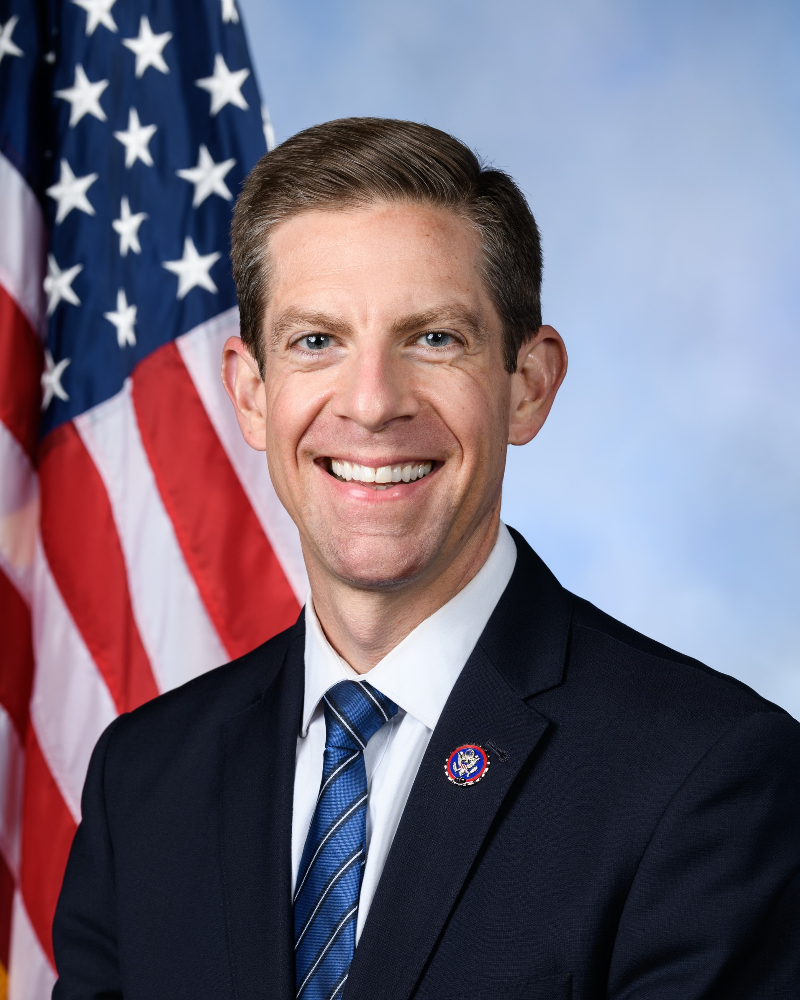
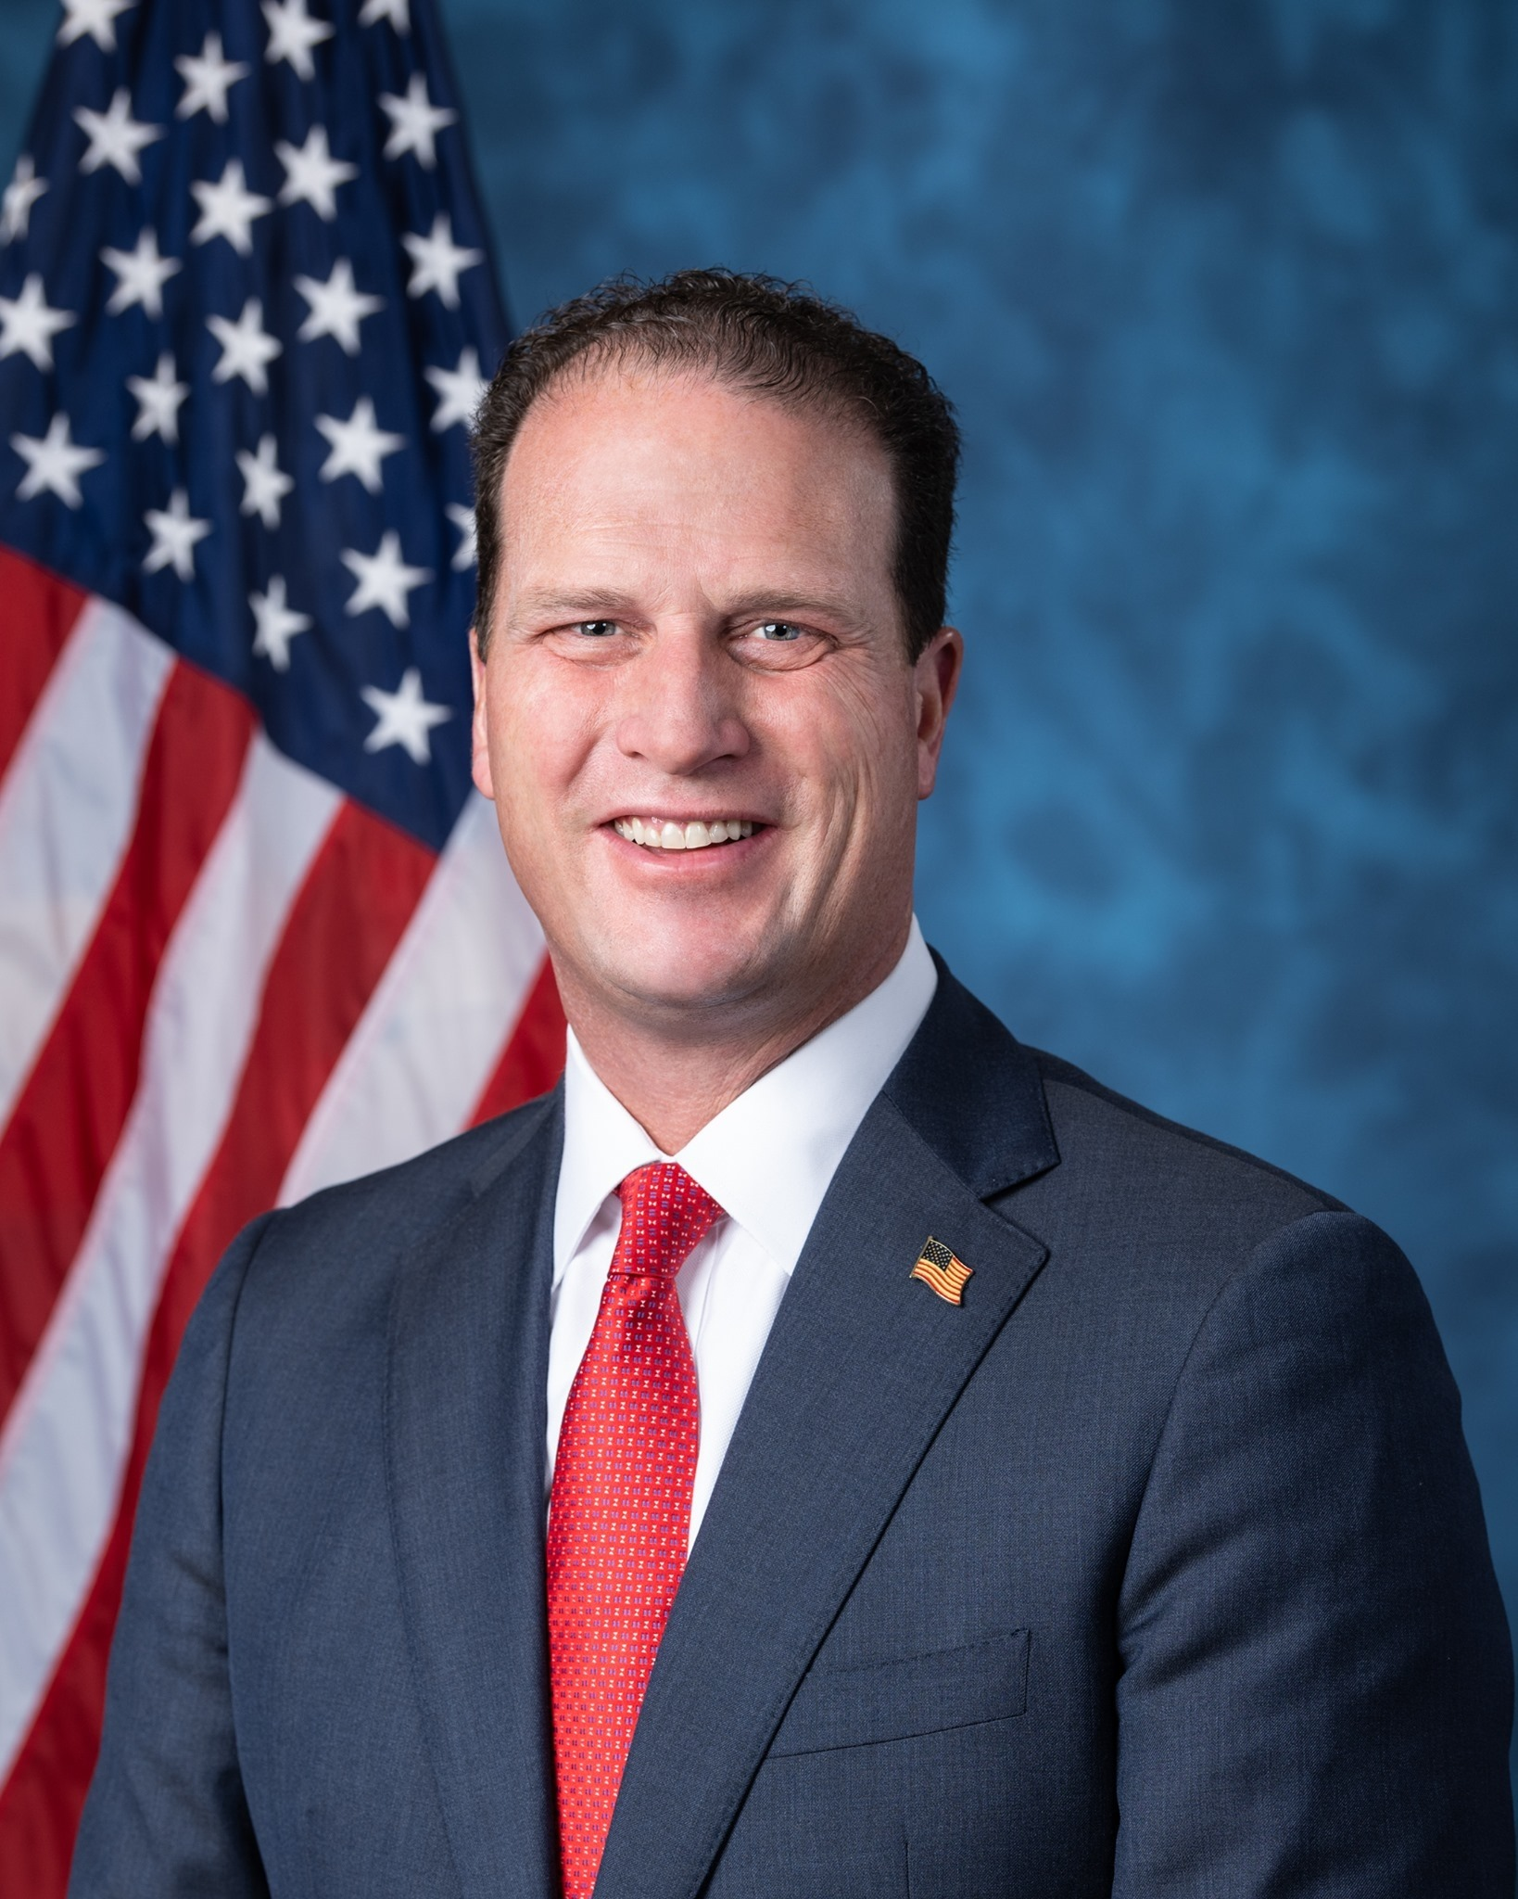
Nuclear Waste Administration Act of 2024
Rep. Mike Levin (D-CA)
Rep. August Pfluger (R-TX)
Notes:
In the fall, Representative Mike Levin (D-CA) and Representative August Pfluger (R-TX) introduced the bipartisan Nuclear Waste Administration Act of 2024.
This proposed legislation is consistent with our policy priorities, and we plan to advocate for it in the coming year.

Slide 13
Our Requests
Join Spent Fuel Solutions and help us advocate for the Nuclear Waste Administration Act of 2024.
Encourage your Representatives to co-sponsor the proposed legislation and join the Spent Nuclear Fuel Solutions Caucus.
Notes:
We recognize this will require bipartisan support from across the country.
That is why we are here to request your help.
We respectfully ask that you consider joining our coalition at no cost as a Supporting Member and help us with our federal advocacy efforts.
This could involve reaching out to ask your local representatives to co-sponsor the bill and join the Spent Nuclear Fuel Solutions Caucus, as well as helping us build support in your state.

Slide 14



Thank You
Email:
Manuel.Camargo@sce.com
Phone:
213.361.3661
Online:
Spentfuelsolutionsnow.com
Notes:
Thank you very much for allowing us to present to you today.
We would be happy to answer any questions you may have.

