Slide 1
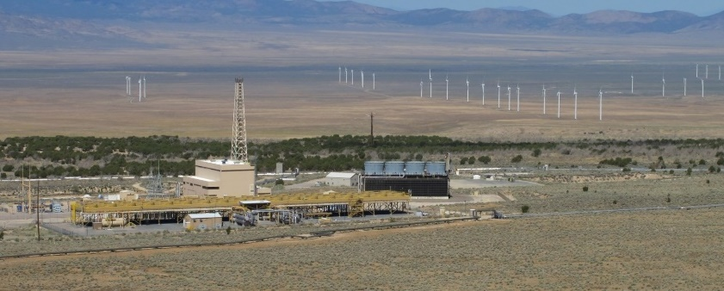
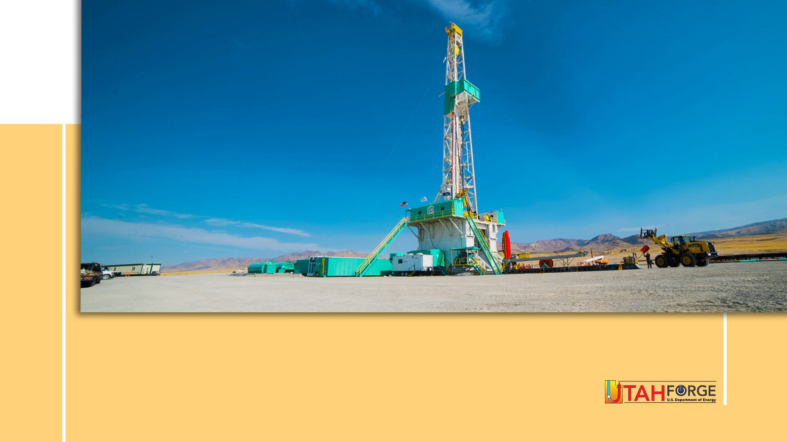
Phase 3B YR2 Annual Review
Flash Plant
Binary Plant
Photo: B. Blackett
GEOTHERMAL ENERGY – A SLEEPING GIANT
Dr. Joseph Moore (PI of the Utah FORGE Project)

Slide 2
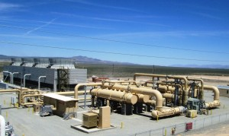
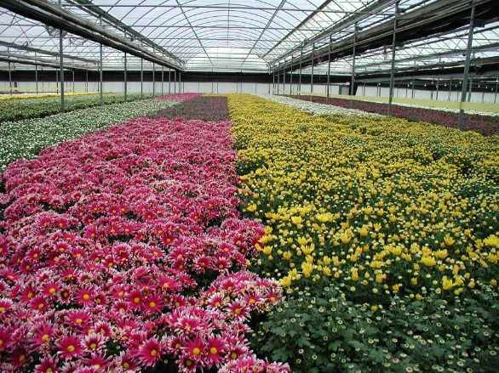
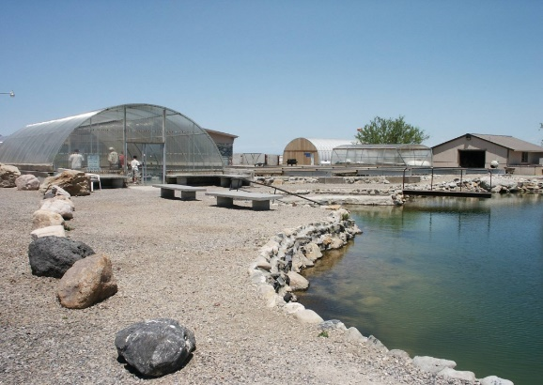
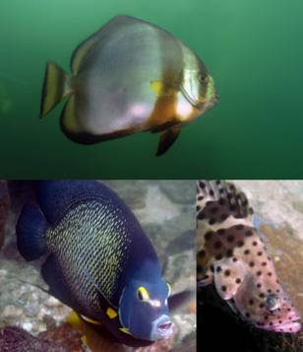
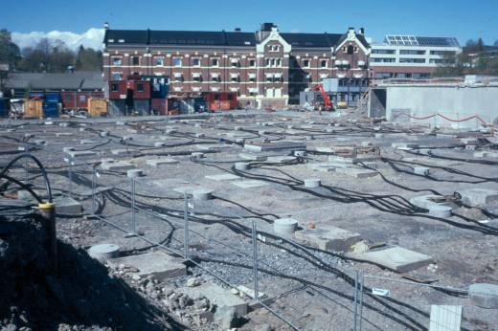
Benefits of Geothermal Energy
Electric Generation
Space Heating
Spas
Heat Pumps
Low emission
Base load power
Peaking
Renewable
Vast resource
Environmentally benign
Low costs once established
Small geographic footprint
Secure
TEMPERATURE

Slide 3
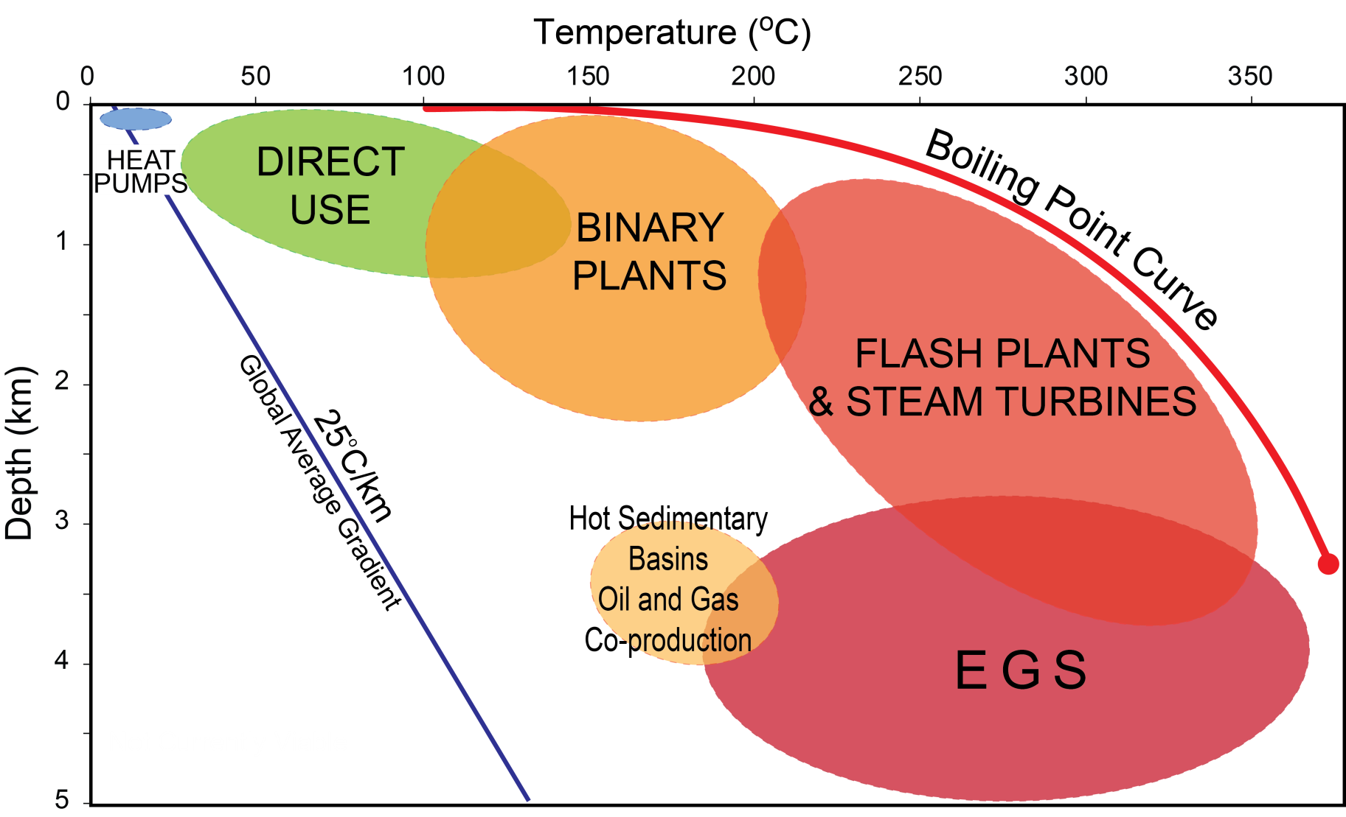
Geothermal Systems
(FORGE)
Moore and Simmons, 2013
Notes:
Geothermal systems are found over a broad range of temperatures and depths from 25 C to 350C. Temperatures are constrained by the natural geothermal gradient at the low end and the boiling point curve at the high end. Few geothermal wells are drilled deeper than 3 km because of the high cost of drilling and because permeability commonly decreases with depth, Permeability also typically decreases at temperatures greater than 350C making drilling uneconomic although drilling is currently underway in Iceland to tap supercritical fluids. Pressures within all producing geothermal systems are hydrostatic.

Slide 4
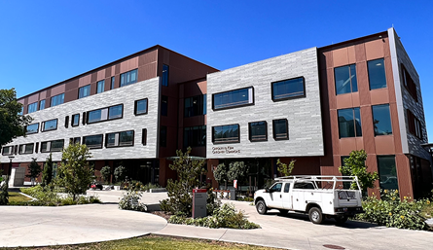
Geothermal Heat Pumps
Can be used for heating and cooling
Extract heat from ground in winter; reject heat in summer
>1,500,00 units worldwide
Growing at a rate of 25%/yr
Savings of 30-70% when heating and 20-50% when cooling
Photo J. Lund
Carolyn and Kem Gardner Building (U of U)
Save ~$62,000/year vs traditional mechanical system
Save 1,440,000 gallons of potable water per year
Eliminate > 4 tonnes CO₂/year released into the air
170 wells to depth of 350 ft
Notes:
Heat pumps use the lowest temperature geothermal energy and can be used for heating and cooling. This is the fastest growing use of geothermal energy, growing at 25% per year. We can use heat pumps to transfer heat from buildings to the ground in the summer and extract the heat in the winter. The two figures show applications of ground source heat pumps, at the top is a hotel in Switzerland, at bottom left is a building on the University of Utah Campus.

Slide 5
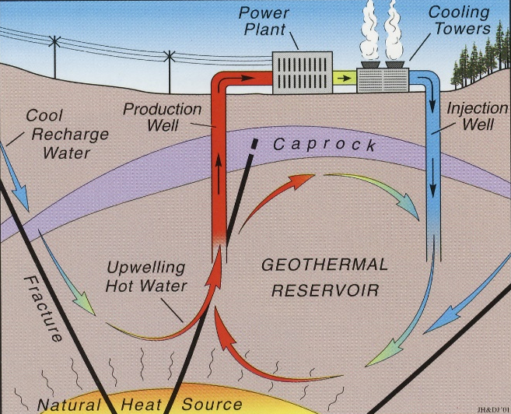
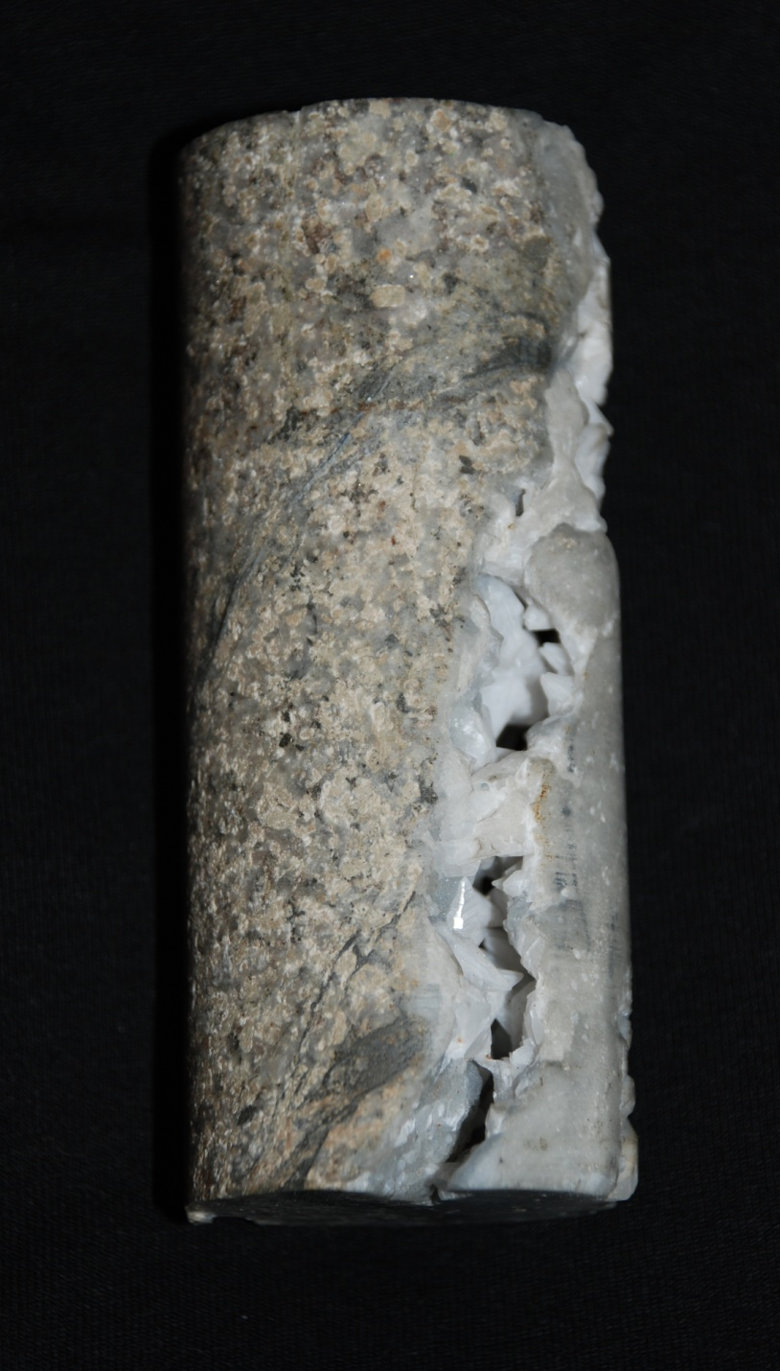
Conventional Geothermal Systems
  A heat source
  Water to transport the heat
  Permeable fractures for the water to move through
2 3/4”
Notes:
Conventional geothermal systems can be thought of as convection cells with a heat source, water to transport the heat, and a volume of fractured rock that forms the reservoir. Cold dense groundwater enters the system along faults, is heated at depth by an intrusion or the natural geothermal gradient, and then rises toward the surface because of its increased buoyancy.

Slide 6
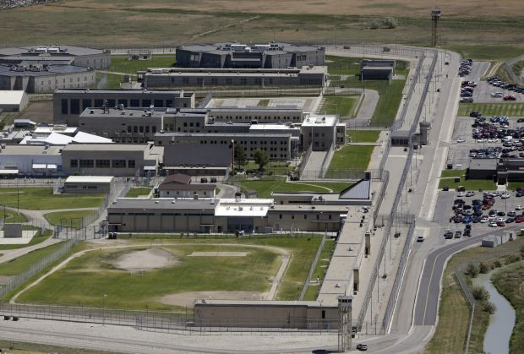
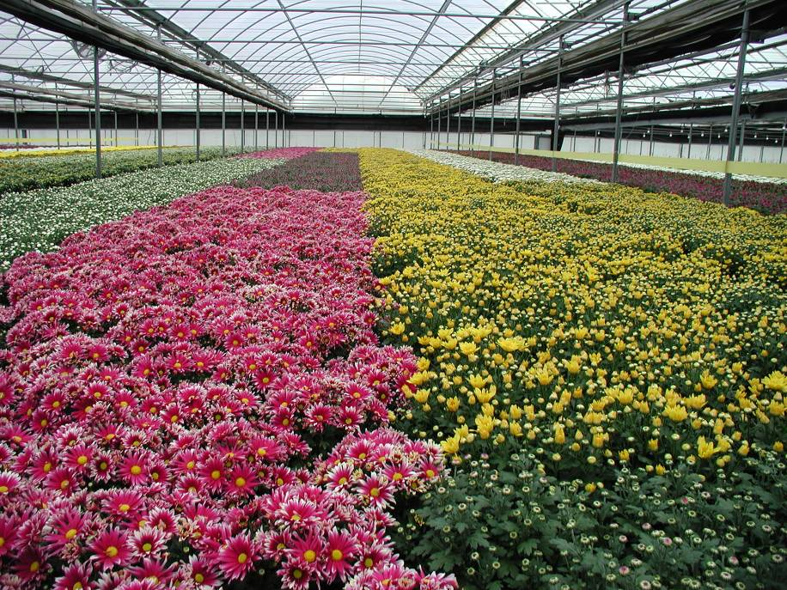
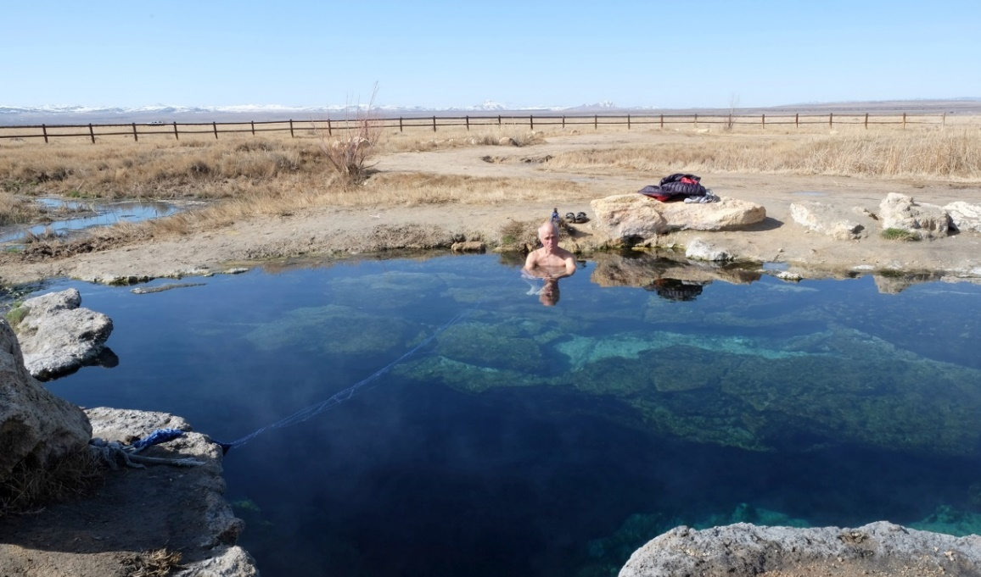
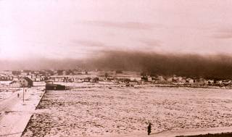
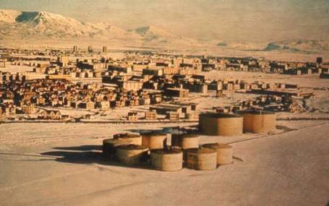
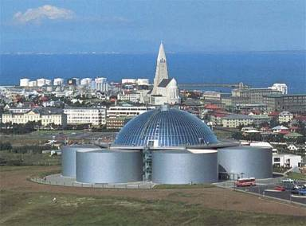
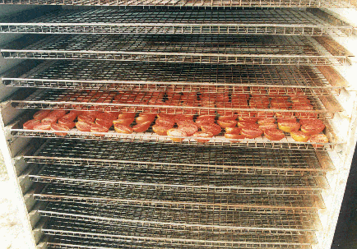
Direct Uses of Hot Water
Spas
Space heating and cooling
Agriculture (greenhouse heating)
  Aquaculture (tilapia, trout, prawns, alligators)
  Industrial processes (vegetable drying, paper production)
  Used in more than 85 countries
Heating 330,000 sq ft (Utah State Prison)
Photos: NREL
24 acres of greenhouses (Milgro – Newcastle, Utah)
Photos J. Lund
Vegetable drying (Guatemala)
1930s
1980s
Today
Notes:
At temperatures up to 150 C, the water and steam can used for a broad range of applications including spas agriculture, aquaculture and space heating. The photo in the lower left shows chrysanthemums being grown in a geothermally heated greenhouse. The prison in the upper right uses geothermal water to heat more than 330,000 sq ft. On the lower left is a picture of a small vegetable drying facility in Guatemala that employs several dozen people.

Slide 7
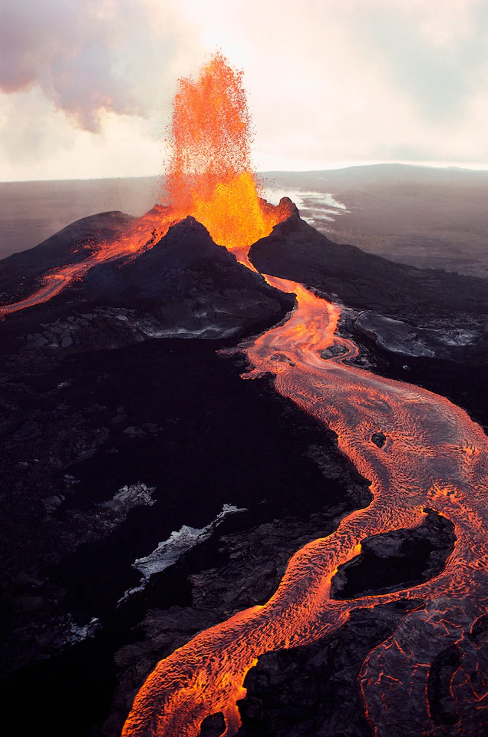
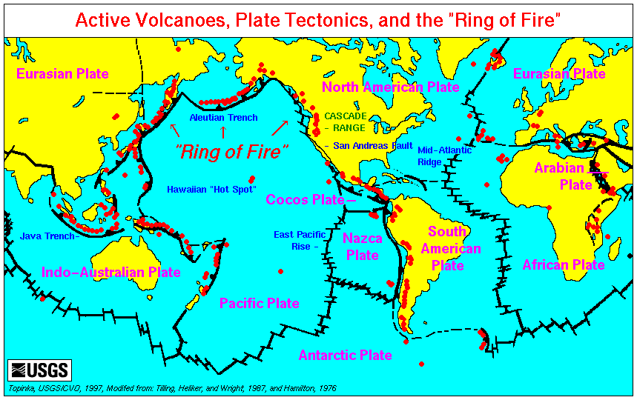
“Conventional” Geothermal Systems
  Conventional geothermal systems are commonly found in volcanic areas where the Earth’s tectonic plates meet. They are also found in areas where the crust is expanding.

Slide 8
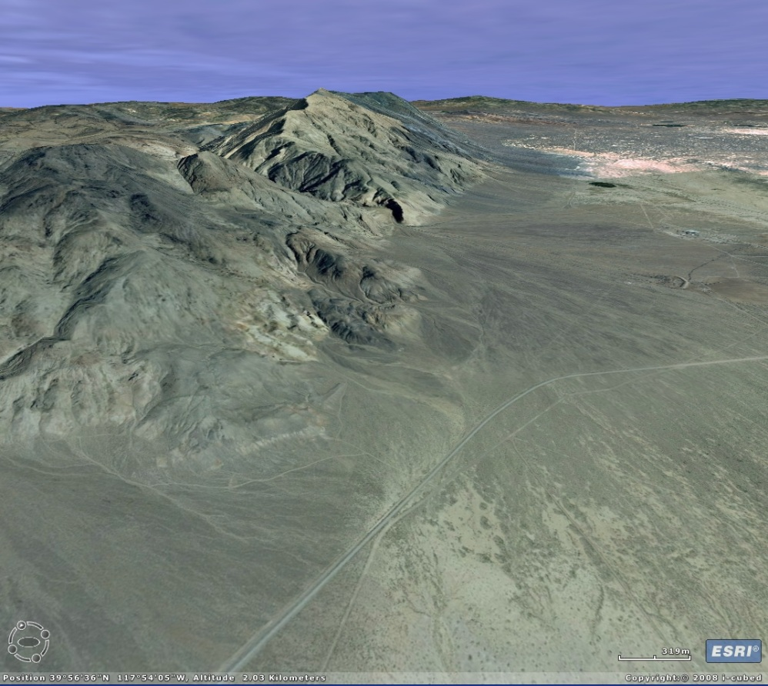
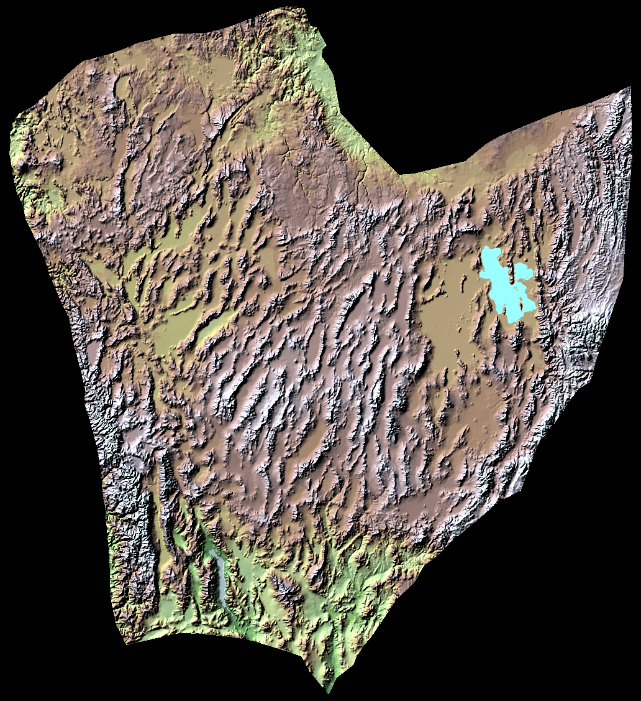
Extensional Tectonic, Fault Controlled Resources
Notes:
Areas of active faulting and rifting also tend to host geothermal systems, In the western US there are many systems localized along the basin faults that bound the range fronts in Nevada and the surrounding states.

Slide 9
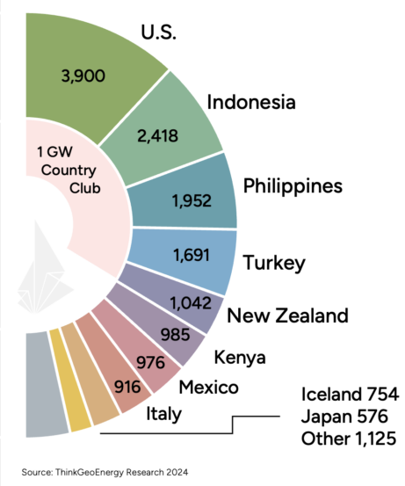
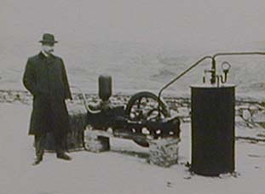
Worldwide Geothermal Electric Production
Electricity produced in 26 countries
Total capacity is ~16,000 MWe)
Production from individual fields from a few MWe to ~850 MWe
1904
Larderello, Italy:
first geothermal power plant developed by Prince Ginori Conti
5 light bulbs from 10 kWe dynamo
Photo J. Lund
Notes:
Hot water at temperatures greater than 150 C are generally used for electricity generation. The first time geothermal energy was used for electric generation was in 1904 in Italy when Prince Conti lit 5 light bulbs. Since then, there has been a slow but steady increase in geothermal development worldwide, with the exception of the period during world war 2, when plants in Italy were shut down.

Slide 10
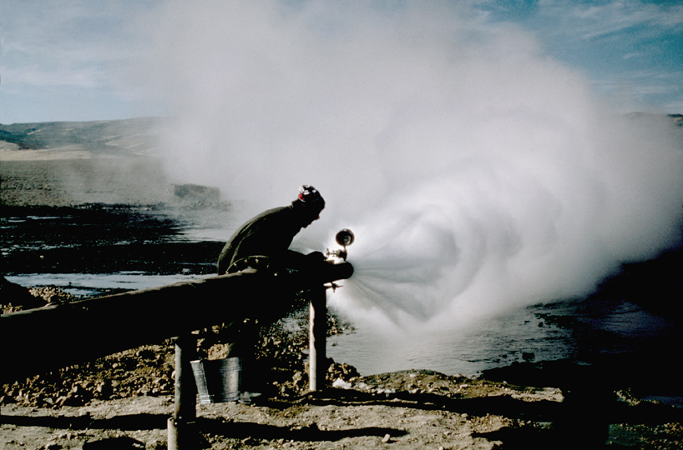
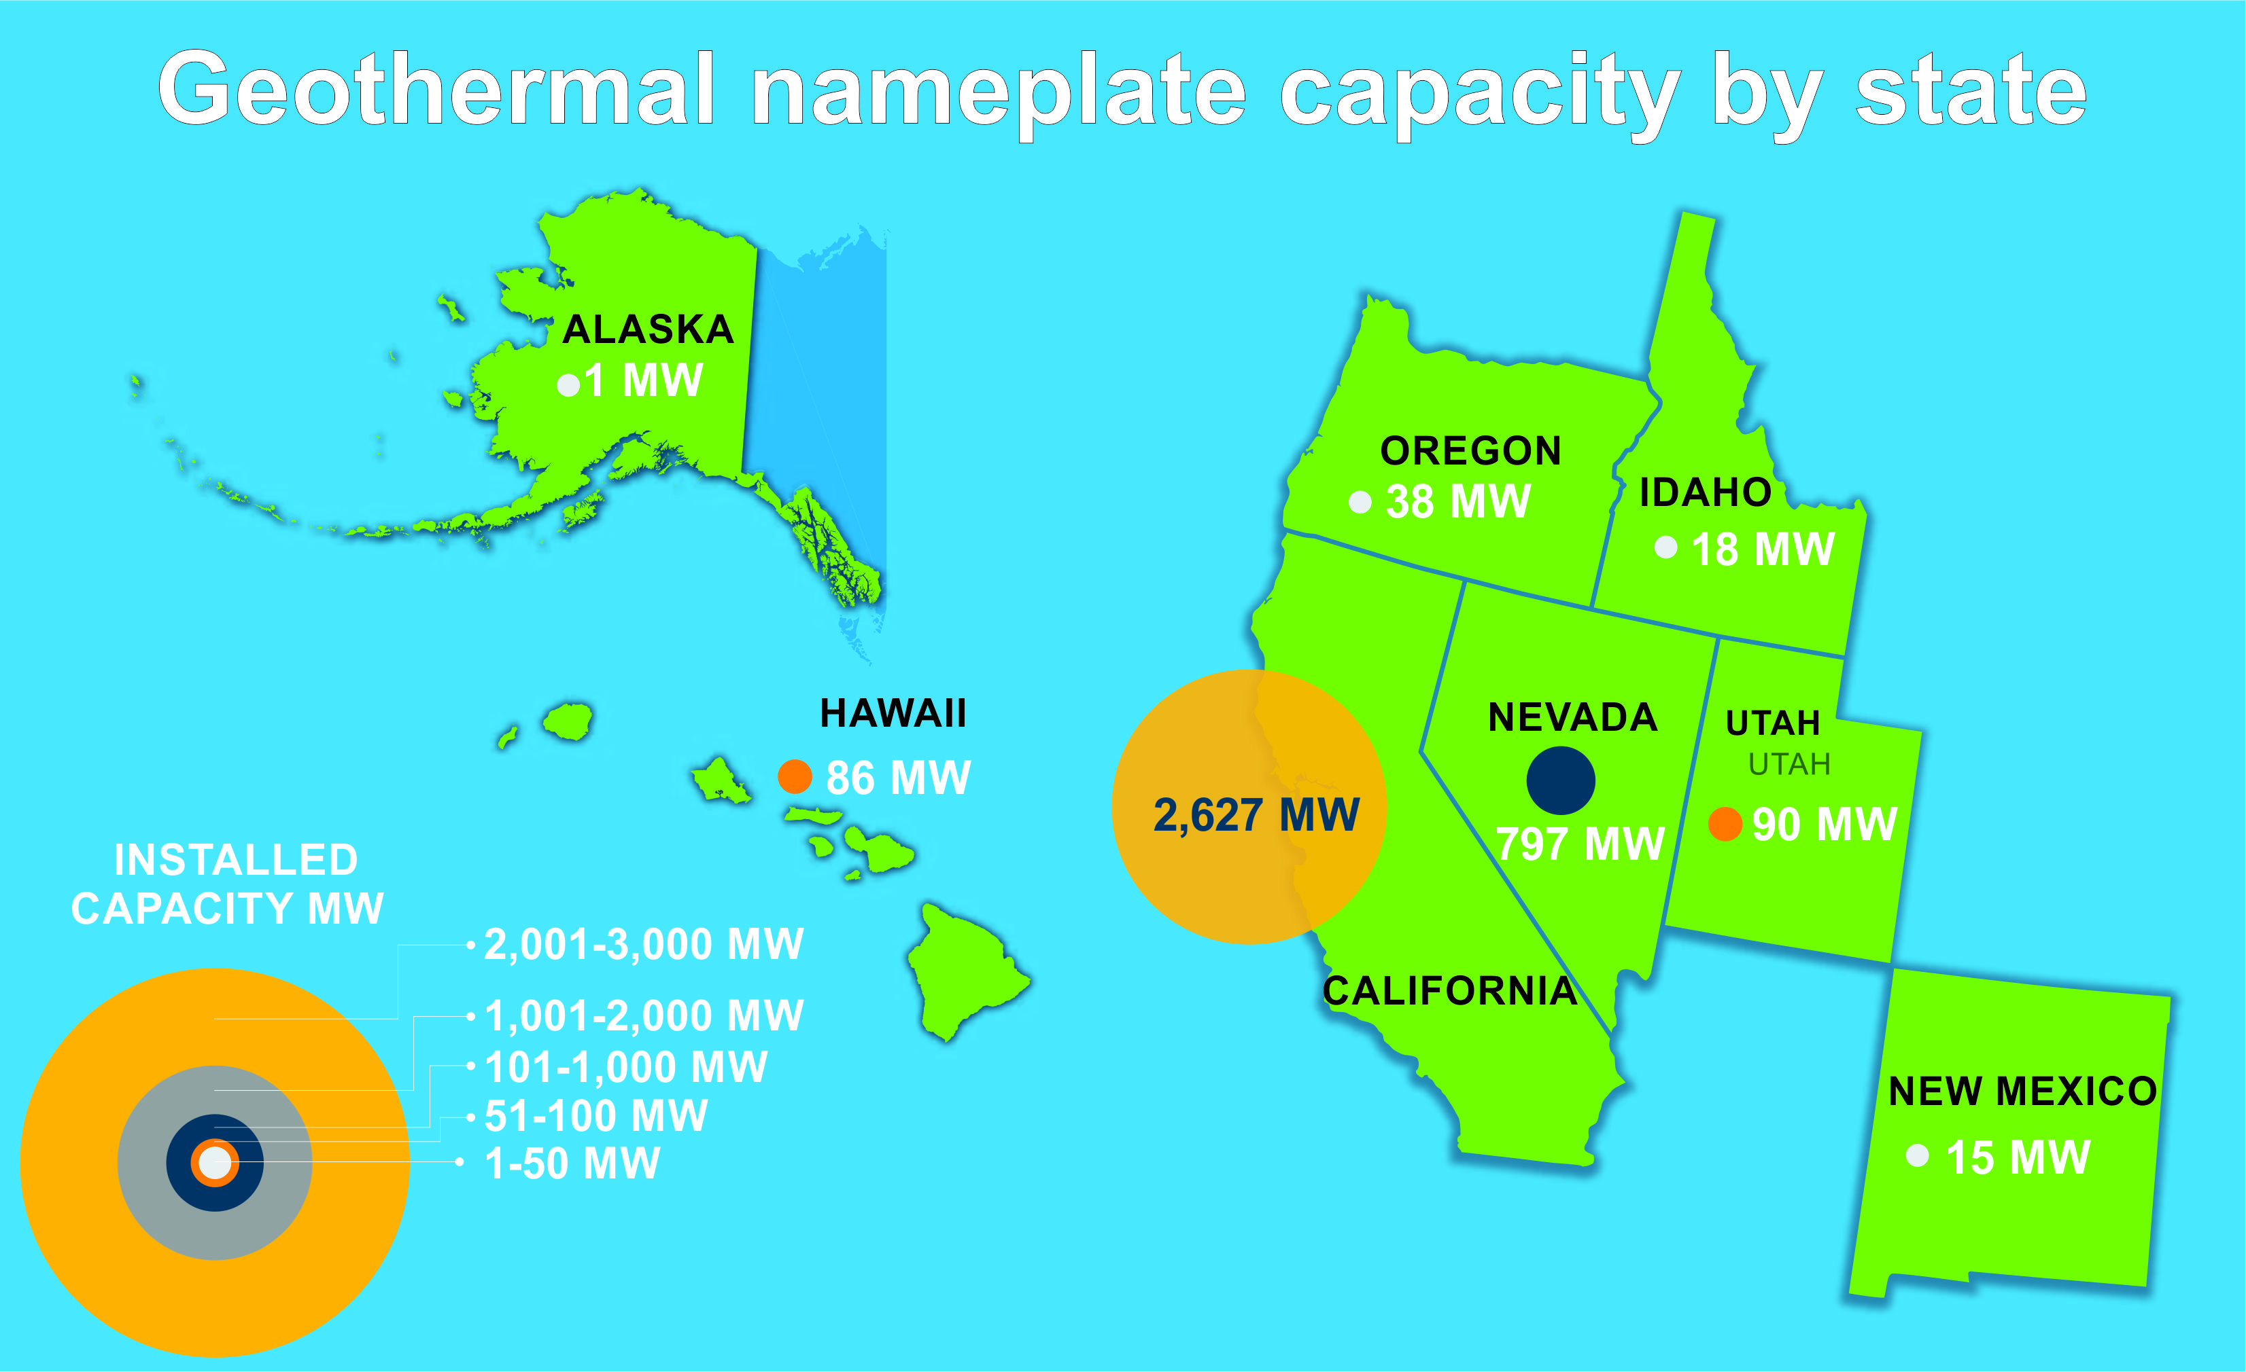
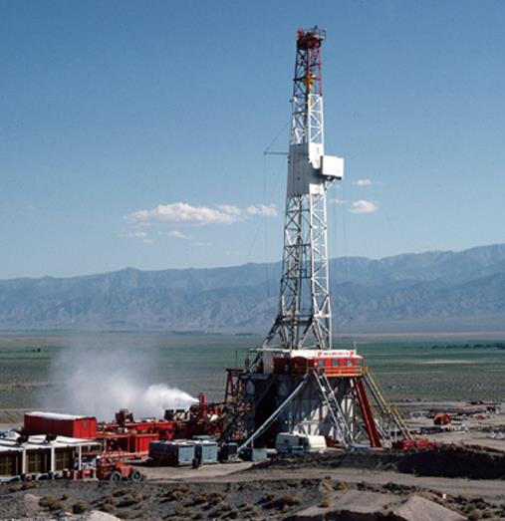
US Geothermal Electric Production
Cyrq Energy
Notes:
Once the project is considered viable, reservoir testing can be conducted. At this stage environmental impact requirements should be completed and infrastructure development initiated.

Slide 11
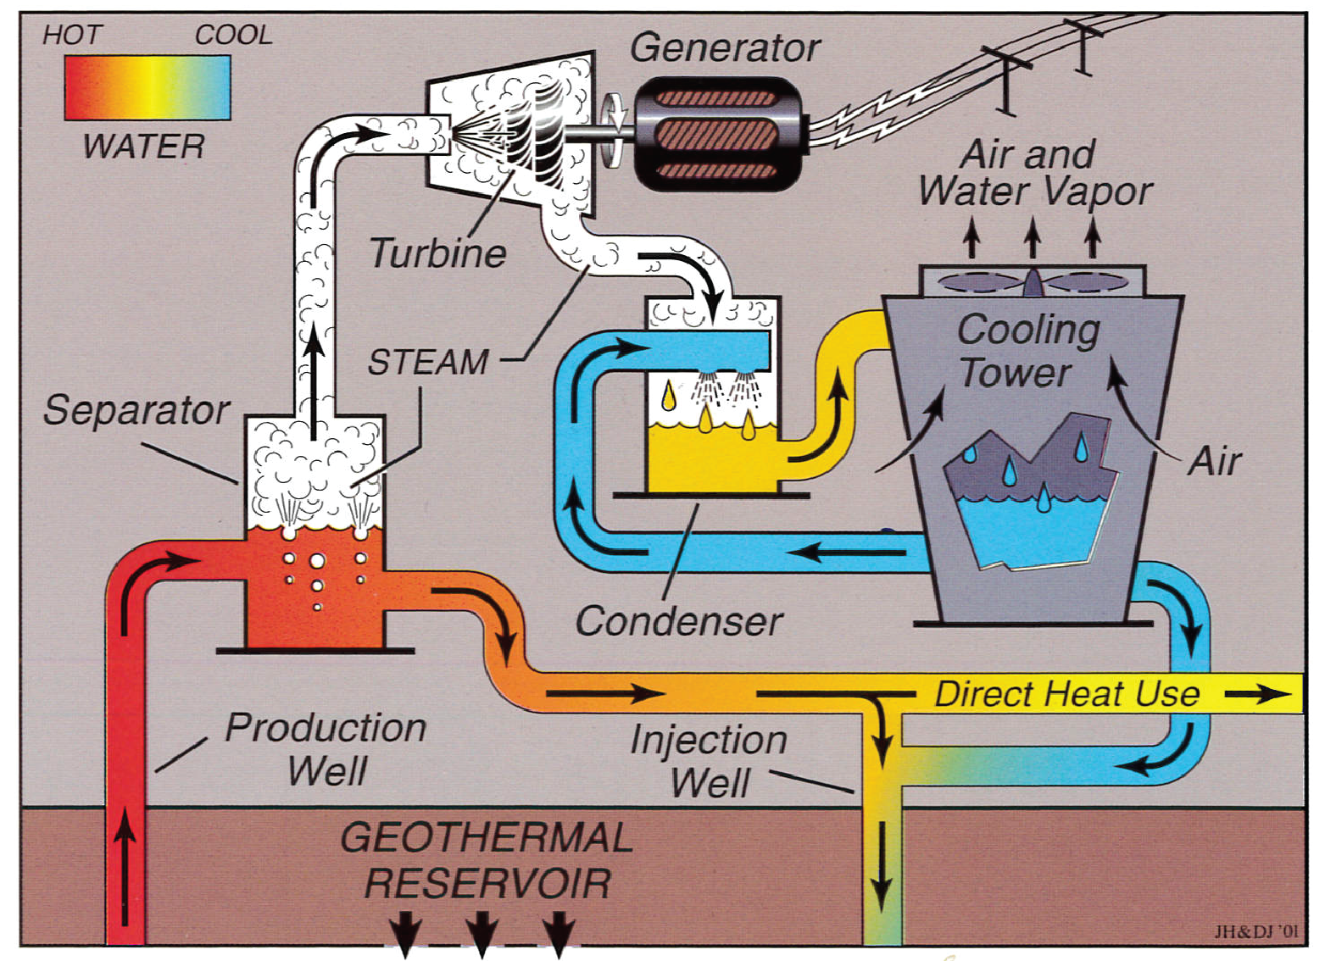
Geothermal Power Plants
Steam Plant
Binary Plant
Notes:
These two pictures show how geothermal plants operate. The concept is the same for gas, coal and nuclear plants, although the water they use can be heated to greater temperatures. The left figure shows a steam plant. Here, hot water from a production well is allowed to boil in a separator. The steam is piped to the inlet of a turbine and then condensed at the outlet. The condensing steam creates a vacuum that continually pulls steam through the turbine. The water used to condense the steam is pumped to a cooling tower where it is cooled by evaporation and then pumped back into the condenser.
The binary plant is the most common typ of geothermal plant in the US. Rather than using steam, an organic fluid is used to spin the turbine. Otherwise, the concept is identical to the steam plant. Binary plants are preferred for lower temperature waters, in the range of 300 -400 F.

Slide 12
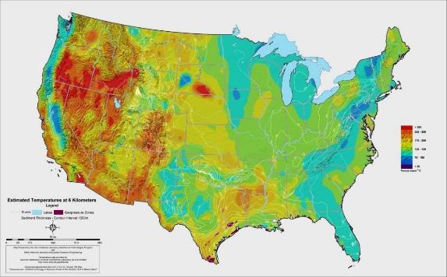
Moving Geothermal Forward
The heat beneath our feet is inexhaustible
  The US current production of 3900 MWe is a very small percent of the available energy in the earth’s crust. Earth Shot 4 set a goal of
  60,000 MWe by 2050
  Reduce cost of Enhanced Geothermal Systems by 90% to $45 per MW hour
  Requires the creation of geothermal reservoirs where none exist naturally.
  Tapping even 2% of the energy between 2 to 6 miles, would provide more than 2000 times the yearly US energy needs (Tester and others, 2006).
T = 300 F
Temperatures at ~4 miles
Data from SMU; from Tester and others (2006)
Notes:
Producing geothermal systems in the US account for a very small percentage of the US energy production. These systems are characterized by a heat source, fractures for water to circulate through the rocks and water to extract the heat and carry it to the surface. Temperatures suitable for electric generation, 300 F can be found across the country at depths between 2 and 4 miles while lower temperatures suitable for direct uses such as space heating can be found at shallower depths. However, in most places the rocks lack the permeability for water to naturally extract the heat. Jeff Tester and his colleagues showed that extracting even 2% of this heat would provide more than 2000 times the US yearly energy needs.

Slide 13
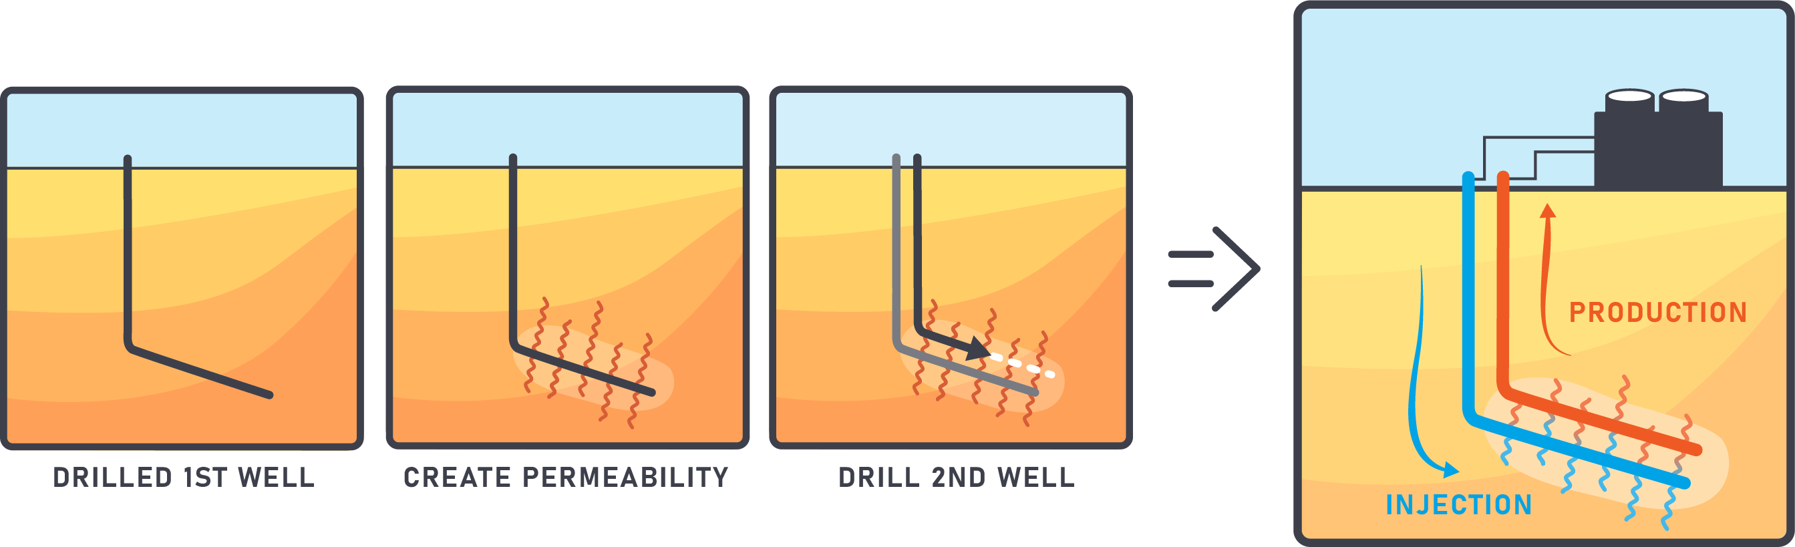

Engineering the Geothermal Reservoir
Notes:
Several different ideas have been proposed to extract heat from the earth. In the FORGE project, we will create fractures between two wells, one for injection of water into the hot rock and the second, shallower for production. The injection well was completed in January 2021. Several zones were stimulated and the locations of small seismic events were determined. These events tell us where the fractures formed. The production was steered into the seismic cloud where it was connected to the injection well by the fracture network. Once the two wells are connected, circulation tests between them will be conducted to measure heat extraction. The hot water can be used to generate electricity or for direct uses before being reinjected and produced again.

Slide 14
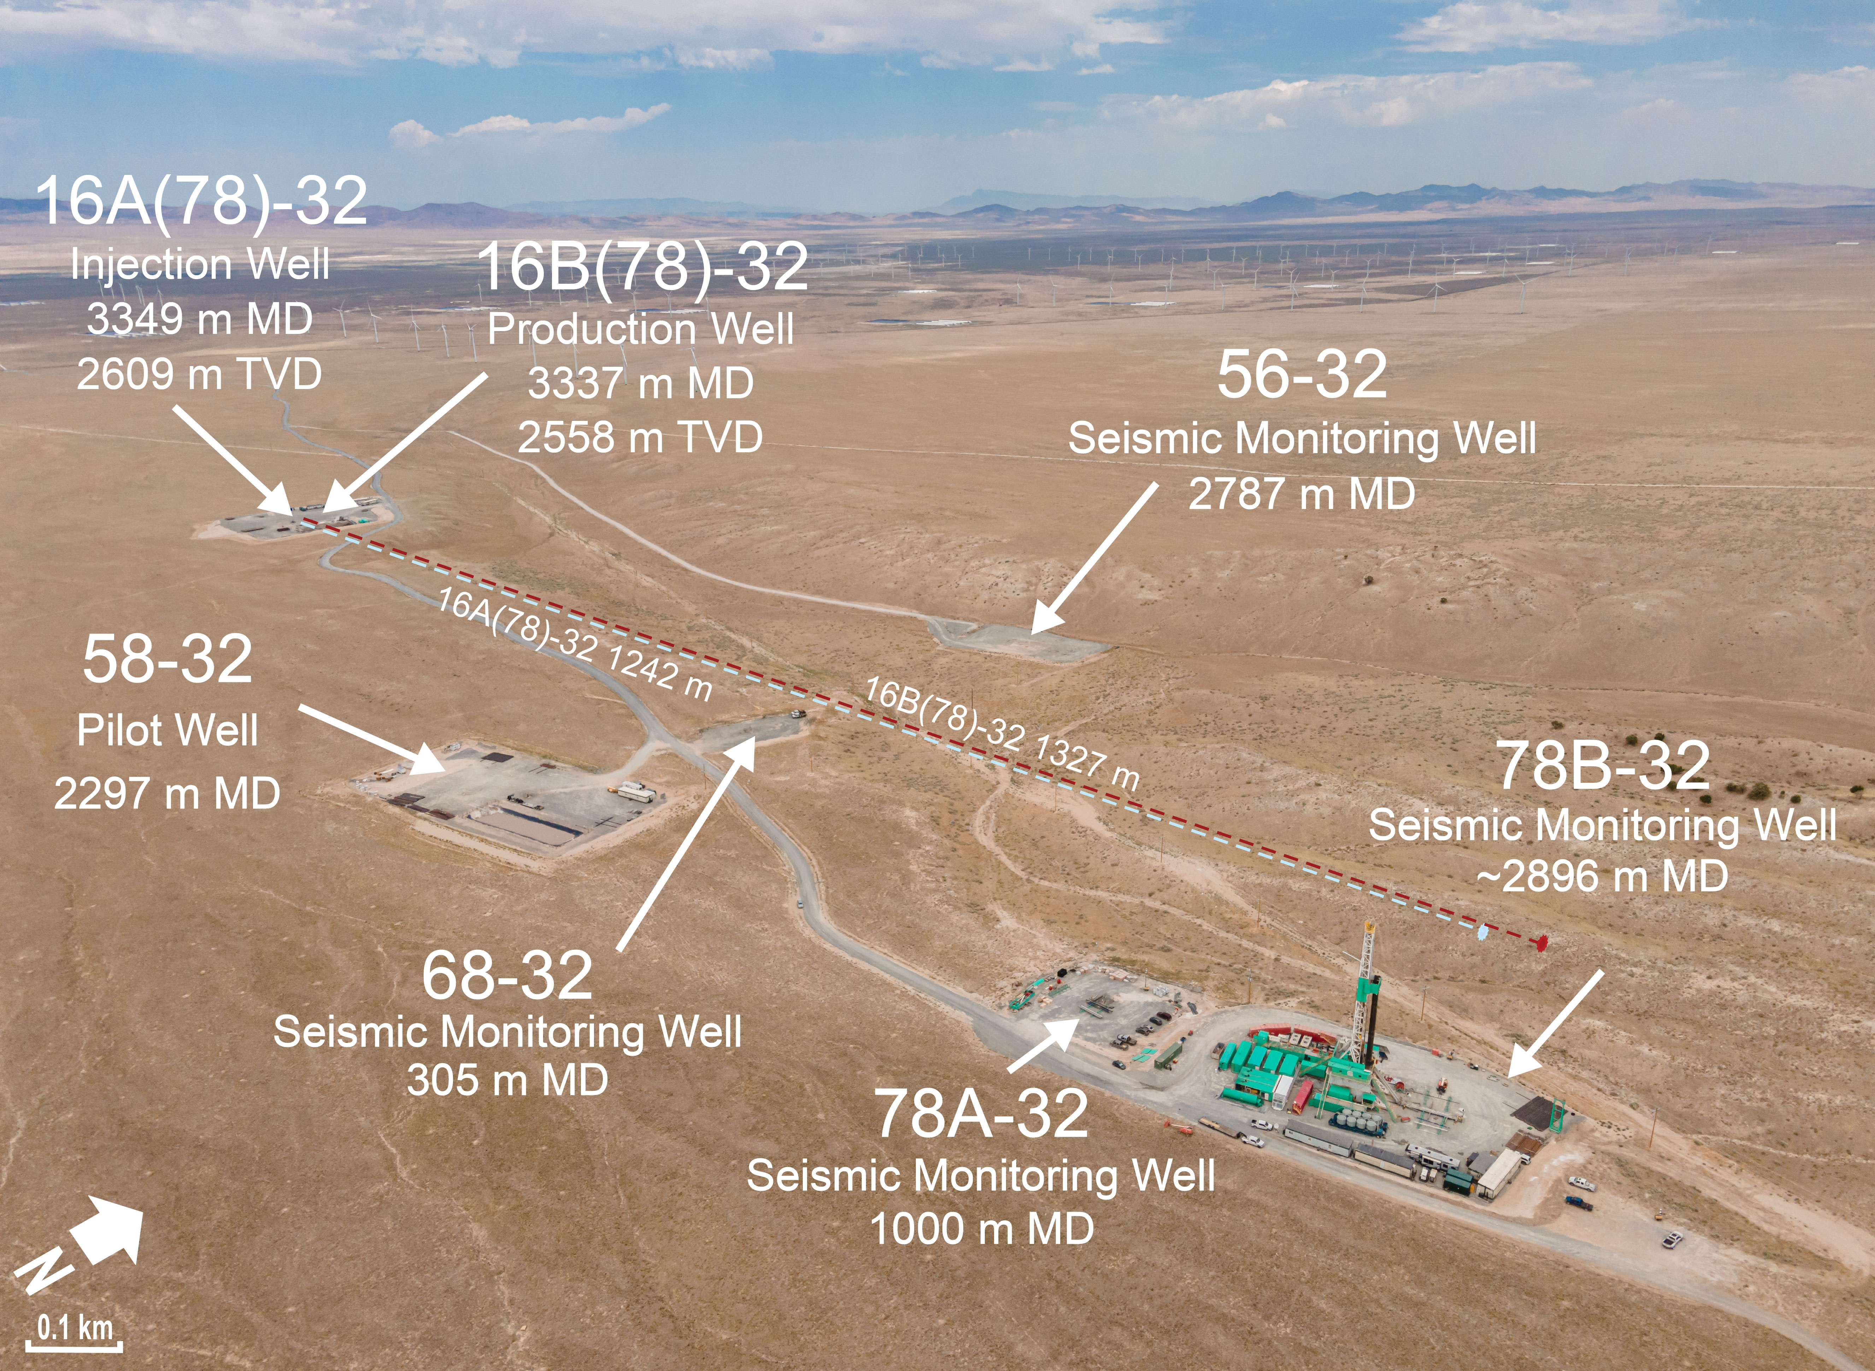
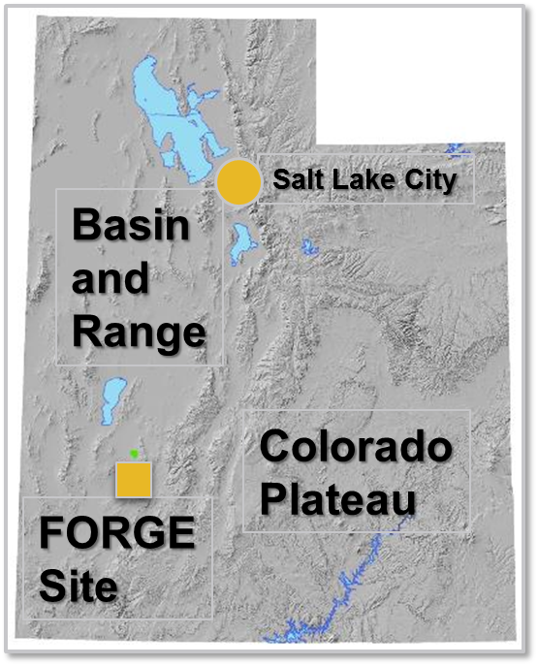
What is Utah FORGE ?

Slide 15
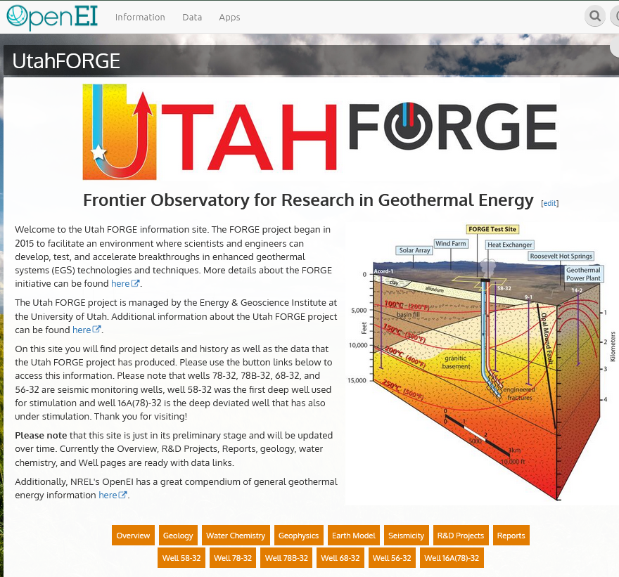
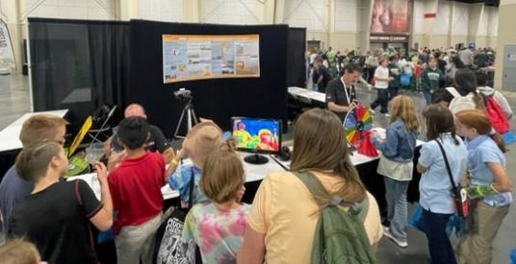
The Impact of Utah FORGE
World’s only field laboratory designed for testing tools/technologies.
Technologies developed at Utah FORGE have increased drilling rates by 50% and significantly reduced project costs.
Provides economic benefits to rural economically depressed communities by using local services.
Educates the public, regulators and elected officials through its website, social media platforms, YouTube channel, classroom lectures and presentations, K-12 contests, STEM activities and participation at local events.
All data collected is publicly available without cost.
Notes:
Utah FORGE has already had significant impact. We have established a unique field laboratory for creating EGS reservoirs. Significant advances in drilling, stimulation and monitoring technologies have been achieved although many challenges remain. All of the data that has been collected is free and publicly available on the Geothermal Data Repository or through links on our Wiki pages as well as on our web site. In April 2023 we will drill the production well. The goal of this well is to demonstrate connectivity with the injection well. Another deep well will be drilled in 2025 to evaluate long term heat extraction from the reservoir. At least two additional wells will be drilled for tool testing. Circulation testing and high resolution seismic and geophysical monitoring will continue throughout the project life, which will extend through 2030.

Slide 16
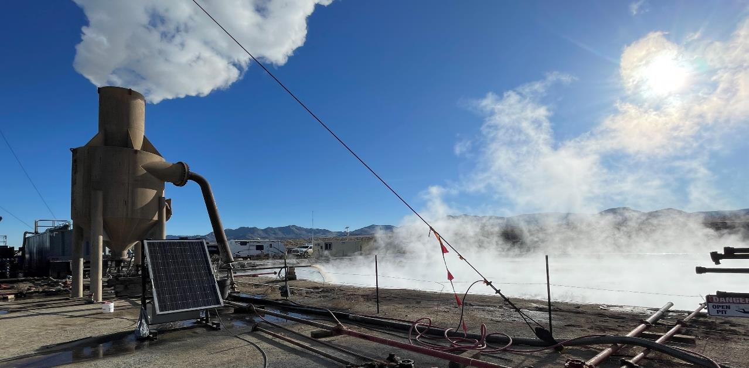






Questions?
Funding provided by the US Department of Energy with additional support from Utah Trust Lands Administration,
Beaver County, the Governor’s Office of Energy Development, and Smithfield Foods
SUBSCRIBE

